Slide 1
Three-Year Data from the MIMICS-2 Study
Thomas Zeller Bad Krozingen, Germany
On behalf of:
Timothy M Sullivan Minneapolis, MN, USA
Masato Nakamura Tokyo, Japan
and all MIMICS 2 investigators

Slide 2
Faculty Disclosure
Thomas Zeller, MD
For the 12 months preceding this presentation, I disclose the following types of financial relationships:
Honoraria received from: Abbott Vascular, Veryan, Biotronik, Boston Scientific Corp., Cook Medical, Gore & Associates, Medtronic, Philips-Spectranetics, Shockwave, BIBA Medical
Consulted for: Boston Scientific Corp., CSI, Gore & Associates, Medtronic, Veryan, Intact Vascular, Shockwave, Bayer, Vesper Medical
Research, clinical trial, or drug study funds received from (institution): Bard Peripheral Vascular, Veryan, Biotronik, Cook Medical, Gore & Associates, Medtronic, Philips, Terumo, TriReme, Shockwave, Med Alliance, Intact Vascular, B. Braun; CSI, Boston Scientific, University of Jena
Common stock: QT Medical

Slide 3
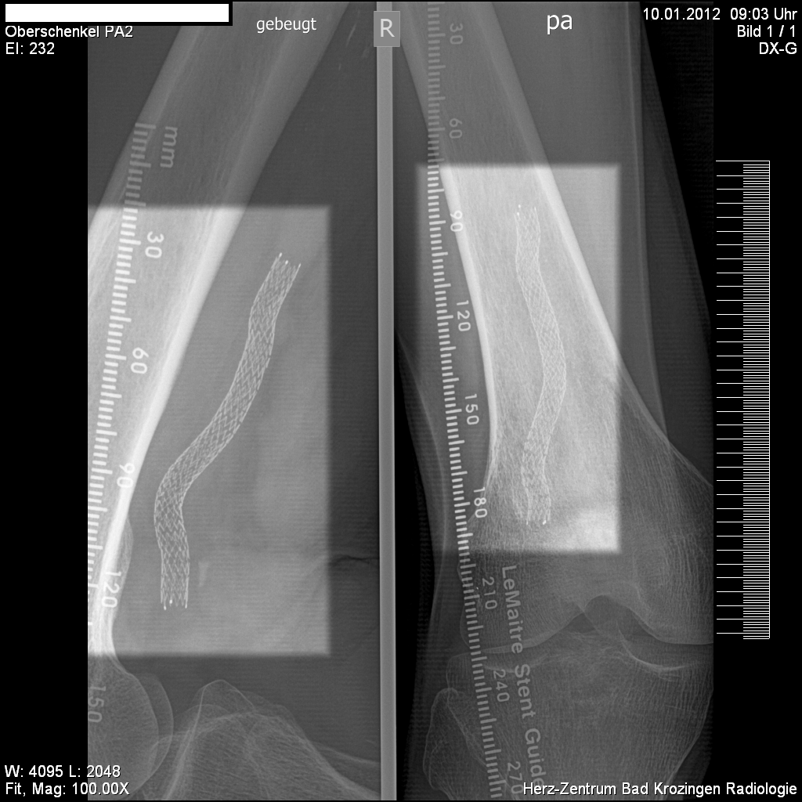
BioMimics 3D®: The Swirling Flow® Stent
Helical centerline
Simple, accurate placement using standard delivery system
Imparts non-planar curvature to stented femoropopliteal segment¹
Improved biomechanical performance compared to straight stents¹
The BioMimics 3D Vascular Stent System has FDA, PMDA and CE Mark approval. Not available for sale in Japan
CAUTION: Federal law restricts this device to sale by or on the order of a physician..
1. Data on file at Veryan Medical
BioMimics 3D and Swirling Flow are Registered Trademarks of Veryan Medical Limited PAM 241 Issue 00

Slide 4
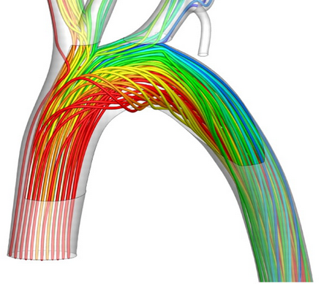
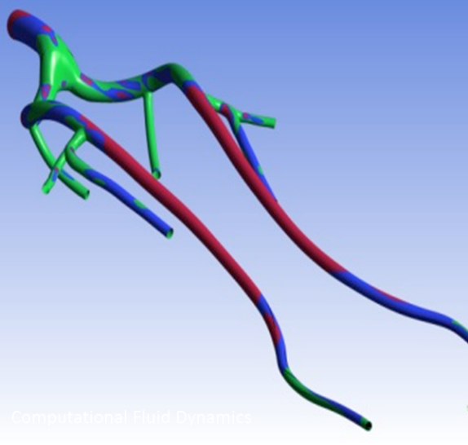
BioMimics 3D’s helical centreline promotes swirling flow: it’s natural
Wall Shear Stress (Pascal)
7.0
Protective
1.5
Suboptimal
1.
0.5
Pathogenic
1
Non-planar vascular curvature promotes swirling blood flow
Wall shear on endothelial cells naturally protects against atherosclerosis and restenosis
Swirling flow provides an antiproliferative effect without the need for a drug
Swirling flow shown to reduce restenosis in a pre clinical model and in a randomised controlled trial against a straight stent control²
Malek et al JAMA 1999
Zeller et al Circulation 2016

Slide 5
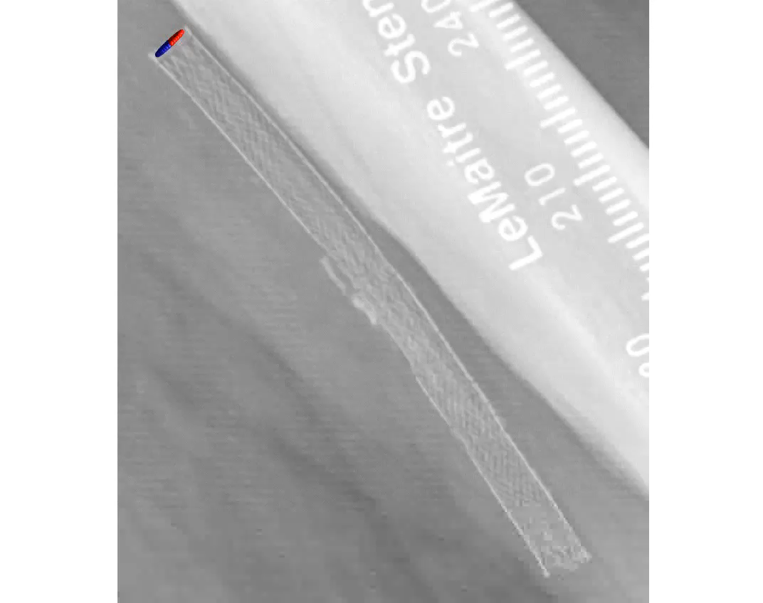
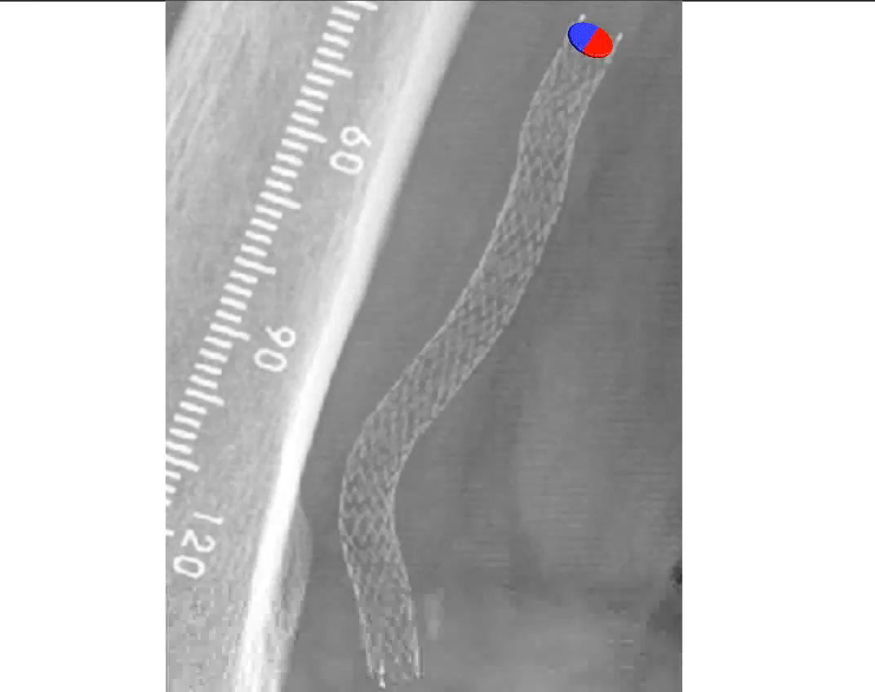
Swirling Flow in Stented Segment
Computational fluid dynamic modelling of actual X-ray and flow data from Mimics RCT Study for LifeStent (left) and BioMimics 3D Stent (right)
Data on file at Veryan Medical

Slide 6
MIMICS Randomised Controlled Trial
8 Investigational Sites Corelab (DUS; angiography; Xray)
FIM Lead-in | N=10 BioMimics 3D
Prospective Randomisation | BioMimics 3D N=50 | Straight nitinol stent N=26
24-Month Primary Patency (p=0.05) | 72% | 55%
Freedom from CDTLR 12-24 months (p=0.03) | 91% | 76%
Freedom from CDTLR
Landmark Analysis²
Provided the first clinical proof supporting the durable outcome benefit arising from the BioMimics 3D Swirling Flow stent compared to a straight nitinol stent^{1, 2}
1. Zeller T et al; Circ Cardiovasc Interv. 2016
2. Sullivan TM et al; Int J Vasc Med. 2018

Slide 7
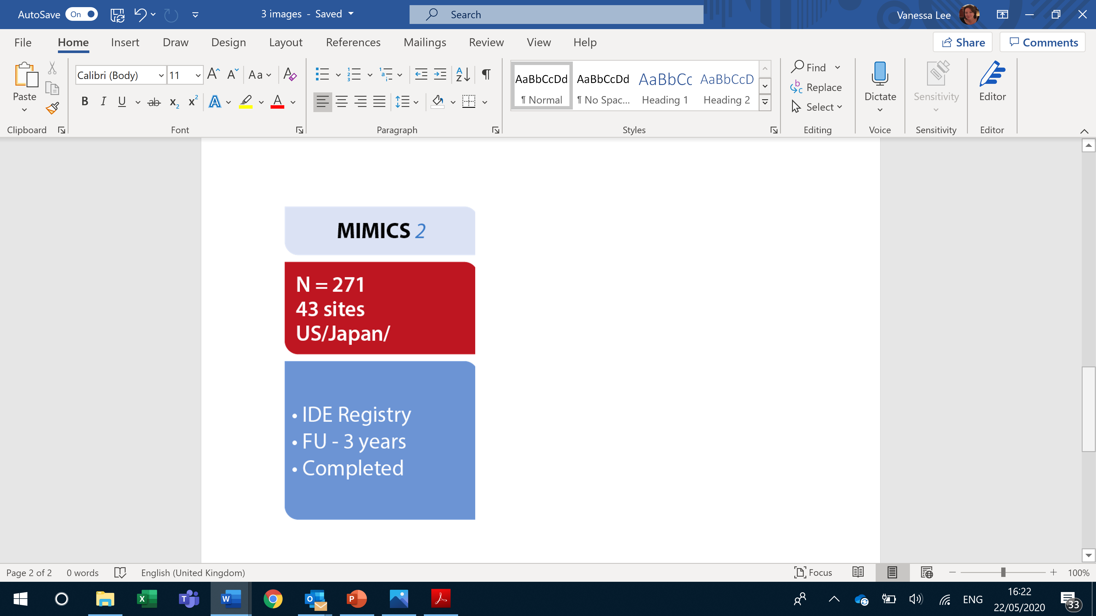
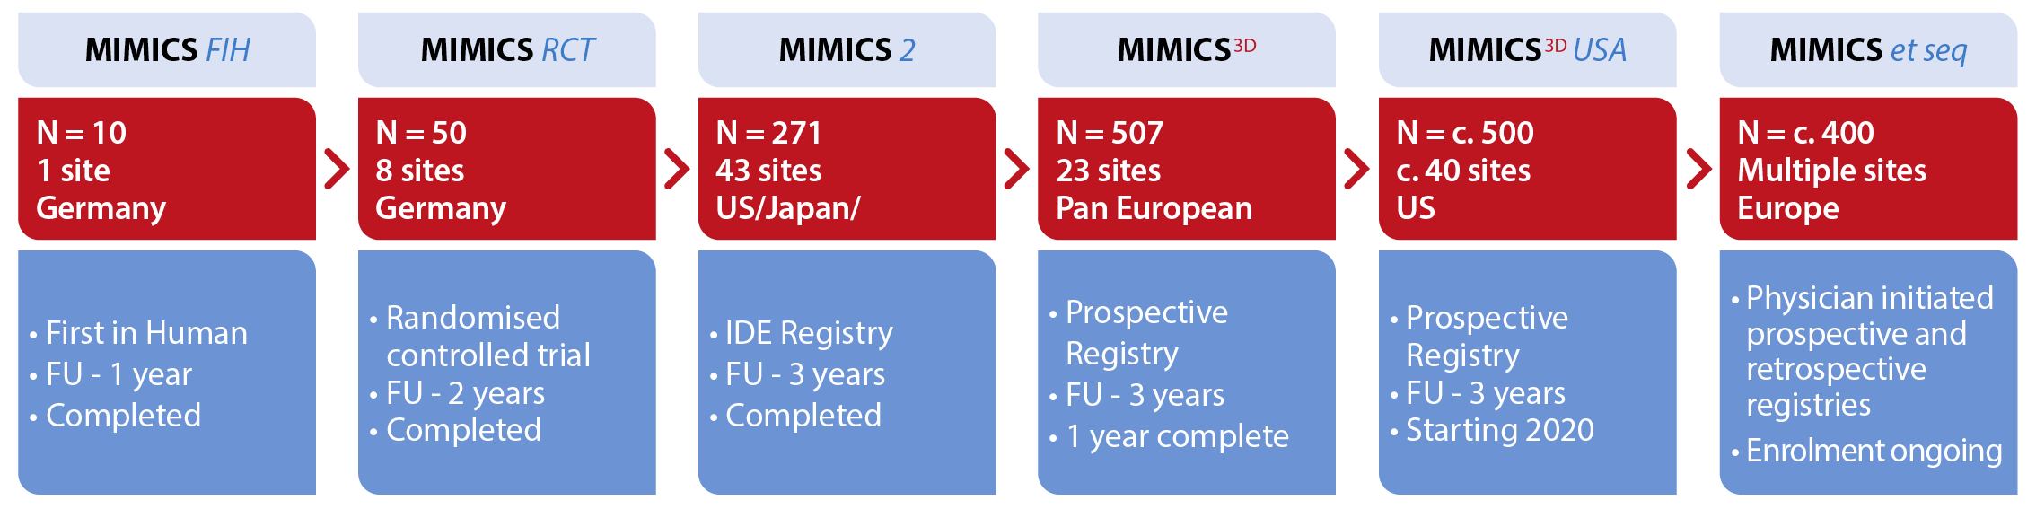
MIMICS Clinical Programme
Germany
Germany
1750+ patients

Slide 8
Evaluation of Safety and Effectiveness of the BioMimics 3D Stent System in the Femoropopliteal Arteries of Patients with Symptomatic Peripheral Arterial Disease
MIMICS 2
Primary Endpoints
  Safety: composite of death, major amputation or CDTLR through 30 days
  Effectiveness: primary patency at 12-months
Follow-up: 3 years
43 investigational sites enrolled 271 subjects
  US: 31 sites N = 162
  Germany: 6 sites N = 78
  Japan: 6 sites N = 31
Study Principal Investigators
  Timothy M. Sullivan, MD Minneapolis, MN, USA
  Thomas Zeller, MD Bad Krozingen, Germany
  Masato Nakamura, MD Tokyo, Japan
Independent Core labs:
ultrasound; angiography; X-ray
Independent Clinical Event Committee
adjudication
Data on file at Veryan Medical
ClinicalTrials.gov Identifier: NCT02400905

Slide 9
MIMICS 2
Baseline Patient Demographics
 |  | N= 271 Subjects
Age | Mean years ± SD (N) | 68.4 ± 9.5 (271/271)
Gender | Male / Female | 180 (66.4%) / 91 (33.6%)
Risk Factors | Diabetes Mellitus | 45.4% (123/271)
 | Hypertension | 90.0% (244/271)
 | Hypercholesterolemia | 81.9% (222/271)
 | Smoker Current / Former | 80.8% (219/271)
Coronary Revascularization | Previous Percutaneous or Surgical | 43.2% (117/271)
Previous Peripheral Intervention | None in target vessel | 98.2% (266/271)
Rutherford Category | 1 | 0% (0/271)
 | 2 | 26.9% (73/271)
 | 3 | 67.5% (183/271)
 | 4 | 5.2% (14/271)
 | 5 | 0.4% (1/271)
Ankle Brachial Index | Mean ± SD (N) | 0.70 ± 0.20 (257/271)
Data on file at Veryan Medical

Slide 10
MIMICS 2
Baseline Angiography and QVA
Core Laboratory Data |  | N= 271 Subjects
Reference Vessel Diameter (mm) | Mean ± SD | 5.2 ± 0.9 (269/271)
Lesion Type¹ | De novo | 100% (271/271)
Lesion Location in Femoropopliteal Artery | Prox | 11.5% (31/270)
 | Mid | 48.1% (130/270)
 | Distal | 40.4% (109/270)
Diameter Stenosis (%) | Mean ± SD | 77.8 ± 18.3 (269/271)
Lesion Length (mm) | Mean ± SD | 81.2 ± 38.4 (269/271)
Total Occlusion (%) |  | 30.0 (81/270)
Calcification (%) | None - Mild | 54.1 (146/270)
 | Moderate - Severe | 45.9 (124/270)
Run-off (%) - 1 or more patent tibial artery (<50% stenosis) |  | 98.8 (237/240)
¹ Investigator-reported
Data on file at Veryan Medical

Slide 11
MIMICS 2
Index Procedure Data
 |  | N= 271 Subjects
BioMimics 3D Stents placed¹ | # Stents / N | 305 / 271
 | # Subjects with 1 stent | 87.5% (237/271)
 | # Subjects with 2 stents | 12.5% (34/271)
Stented Segment Length² | Mean ± SD (mm) | 112.3 ± 36.3 (269/271)
Diameter Stenosis² | Pre-stent % ± SD | 77.8 ± 18.3 (269/271)
 | Post-stent % ± SD | 12.6 ± 7.5 (269/271)
Dissections² | No Dissection | 97.8% (263/269)
 | Type A-C | 2.2% (6/269)
 | Type D-F | 0% (0/269)
Device Success |  | 100% (271/271)
Technical Success |  | 100% (269/269)
¹ Investigator-reported
² CoreLab-reported
Technical Success: Core Lab determined ≤50% residual diameter stenosis (in-stent) at end of index procedure
Device Success: Successful delivery of System; placement of stent and retrieval of System
Data on file at Veryan Medical

Slide 12
MIMICS 2
Primary Endpoint: Safety
Composite of CEC-adjudicated Major Adverse Events through 30 days, including death, any major amputation performed on the target limb, or Clinically-Driven Target Lesion Revascularisation
 | Performance Goal | Rate (n/N) [95% CI]
Freedom from MAE through 30 days | >88% | 99.6% (268/269) [97.7%, 100%]
Primary safety endpoint |  | Achieved
Data on file at Veryan Medical

Slide 13
MIMICS 2
Primary Endpoint: Effectiveness
Primary stent patency rate at 12 months.
 | Performance Goal | Rate (n/N) [95% CI]
Primary stent patency | >66% | 73.1% (182/249) [67.3%, 78.2%]
Primary effectiveness endpoint |  | Achieved
Patency was defined as no significant reduction in luminal diameter (< 50% diameter stenosis) since the index procedure.
Loss of patency was determined by an independent core laboratory when the peak systolic velocity ratio (PSVR) exceeds 2.0, or where angiography revealed > 50% diameter stenosis, or where the subject had a CDTLR.
Data on file at Veryan Medical

Slide 14
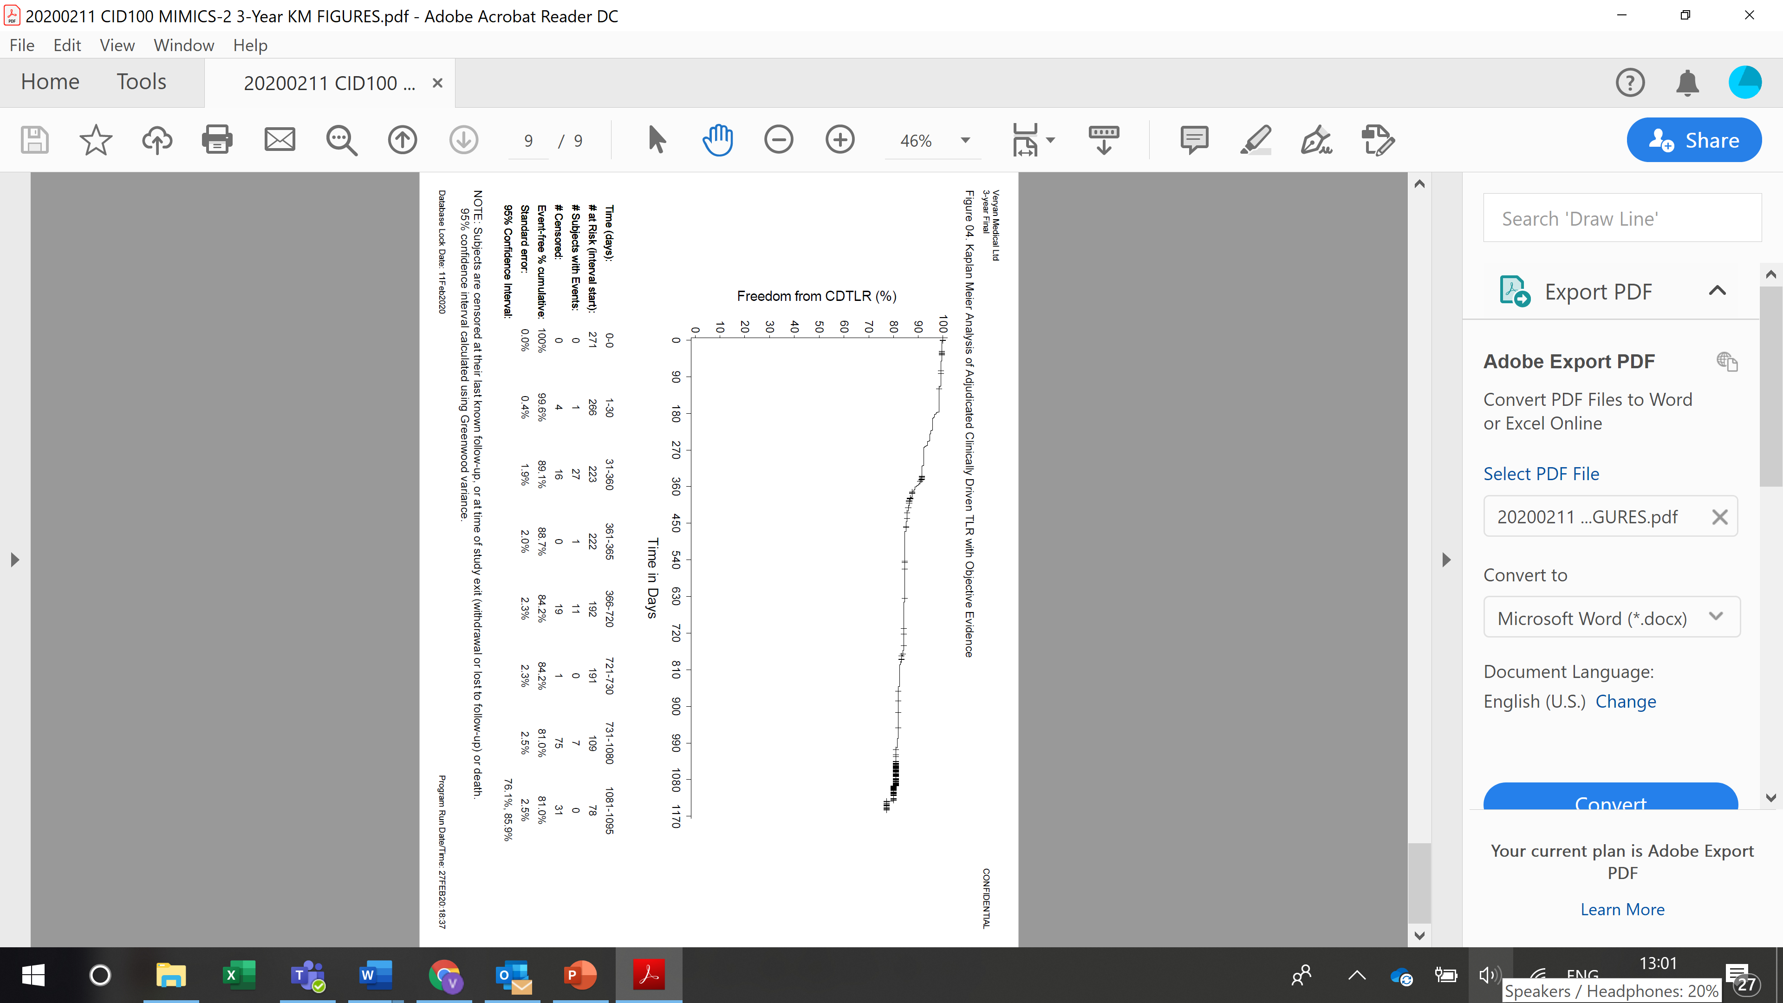
2 Kaplan Meier survival estimates of
Freedom from Clinically-Driven TLR at 3 Years = 81%
MIMICS 2
1-year = 89%
2-year = 84%
3-year = 81%
Data on file at Veryan Medical
*Core Lab adjudicated, clinically-driven TLR with objective evidence
Subjects are censored at their last known follow-up, or at time of study exit (withdrawal or lost to follow-up) or death

Slide 15
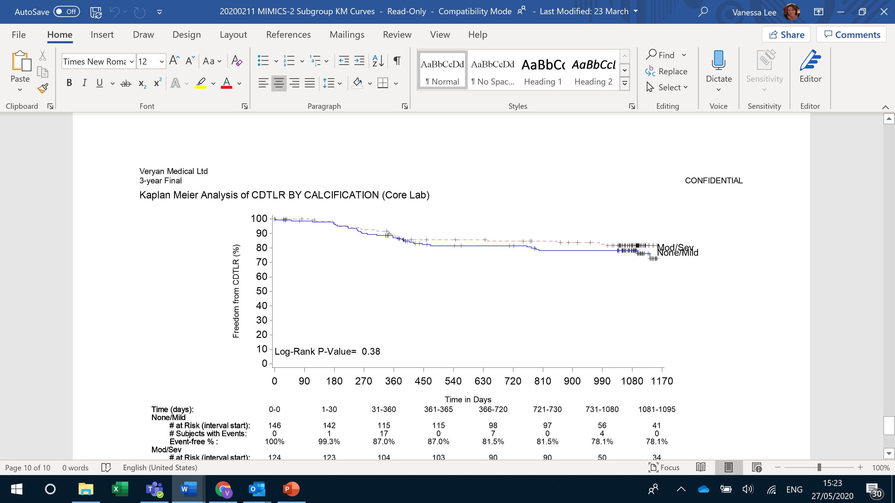
Kaplan Meier survival estimates of
Freedom from Clinically-Driven TLR at 3 Years
Lesion Calcification
MIMICS 2
Calcification % at baseline | None - Mild | 54.1 (146/270)
 | Moderate - Severe | 45.9 (124/270)
------- None / Mild
Mod / Severe
None/Mild = 78%
Mod/Severe = 82%
No statistically significant difference between both groups
Data on file at Veryan Medical
CEC adjudicated, clinically-driven TLR with objective evidence
Subjects are censored at their last known follow-up, or at time of study exit (withdrawal or lost to follow-up) or death

Slide 16
Kaplan Meier survival estimates of Freedom from Clinically-Driven TLR at 3 Years
CTO vs. Stenosis
MIMICS 2
Total Occlusion % at baseline | 30.0 (81/270)
---- Total Occlusions
No Total Occlusions
CTO = 76%
Stenosis = 82%
No statistically significant difference between both groups
Data on file at Veryan Medical
CEC adjudicated, clinically-driven TLR with objective evidence
Subjects are censored at their last known follow-up, or at time of study exit (withdrawal or lost to follow-up) or death

Slide 17
Kaplan Meier survival estimates of
Freedom from Clinically-Driven TLR at 3 Years
Tercile of Lesion Length
MIMICS-2
Lesion Length (mm) | Mean ± SD | 81.2 ± 38.4 (269/271)
Tercile 1 <65mm
------ Tercile 2 –100mm
Tercile 3 >100mm
Tercile 1 = 82%
Tercile 2 = 81%
Tercile 3 = 77%
No statistically significant difference between groups
Data on file at Veryan Medical
CEC adjudicated, clinically-driven TLR with objective evidence
Subjects are censored at their last known follow-up, or at time of study exit (withdrawal or lost to follow-up) or death

Slide 18
CDTLR study comparisons where 3-year data have been presented
BioMimics 3D BioMimics 3D Supera LifeStent Zilver PTX Eluvia IN.PACT Admiral
Comparable outcomes to DCB, DES and Supera despite more challenging lesions and without the need for lesion preparation

Slide 19
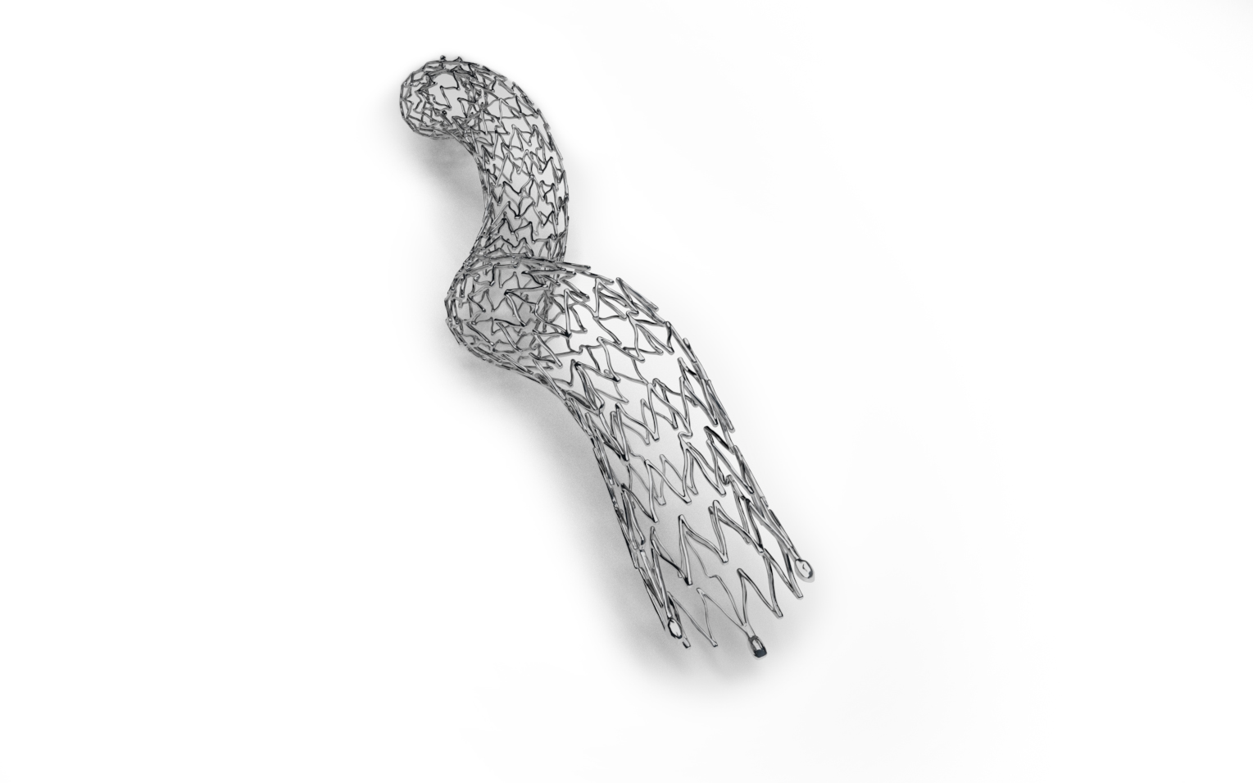
MIMICS-2 Results
BioMimics 3D
Reproducible, rigorous, high quality data from US, Japan and Europe
81% freedom from CDTLR at 3 years
Comparable outcomes to DCB, DES and Supera despite more challenging lesions and without the need for lesion preparation – providing ease-of-use simplicity and long-term benefits
0% stent fracture
Data on file at Veryan Medical
MIMICS-2 study shows continuing benefit of BioMimics 3D at 3 Years, even in challenging cases

Slide 20
Conclusion
BioMimics 3D reduces the burden of re-intervention for the patient and the health care system^{1, 2}
1 Data on file at Veryan Medical
2. Kearns BMJ 2016

