Slide 1

MIMICS-3D: 2-year Results from the BioMimics 3D Real-World Registry
Dr Michael Lichtenberg

Slide 2
Disclosure
Speaker name:
.................................................................................
I have the following potential conflicts of interest to report:
Consulting
Employment in industry
Stockholder of a healthcare company
Owner of a healthcare company
Other(s)
I do not have any potential conflict of interest

Slide 3
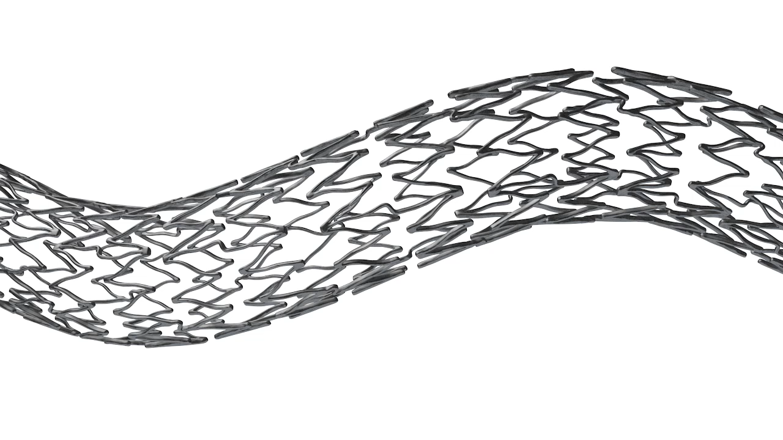
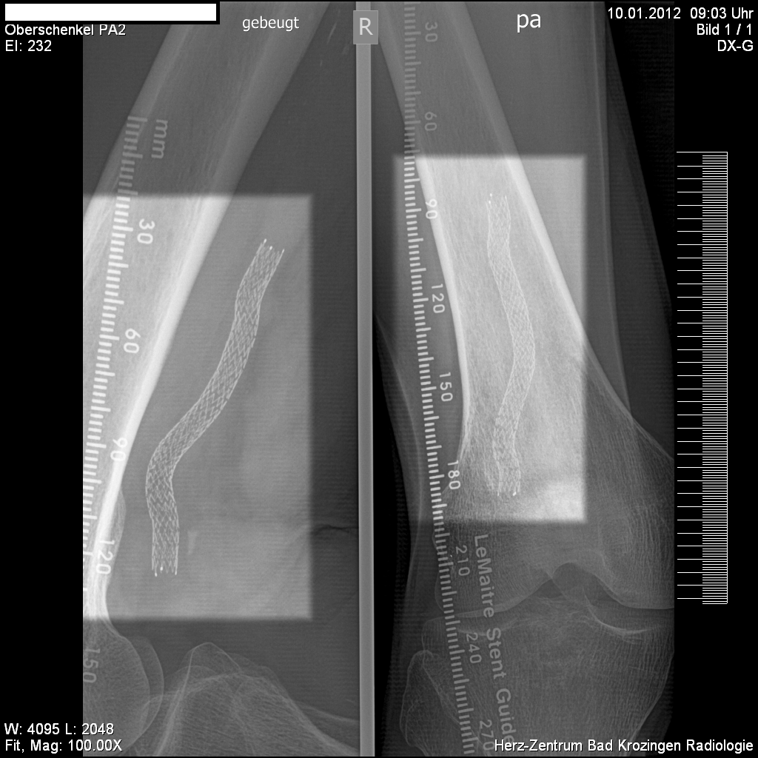
BioMimics 3D®: The Swirling Flow® Stent
Helical centreline
Simple, accurate placement using standard delivery system
Imparts non-planar curvature to stented femoropopliteal segment¹
Improved biomechanical performance compared to straight stents¹
BioMimics 3D and Swirling Flow are Registered Trademarks of Veryan Medical Limited
The BioMimics 3D Vascular Stent System has FDA, PMDA and CE Mark approval. Not available for sale in Japan
CAUTION: Federal law restricts this device to sale by or on the order of a physician.
1. Data on file at Veryan Medical
PAM 273 version 1.0

Slide 4
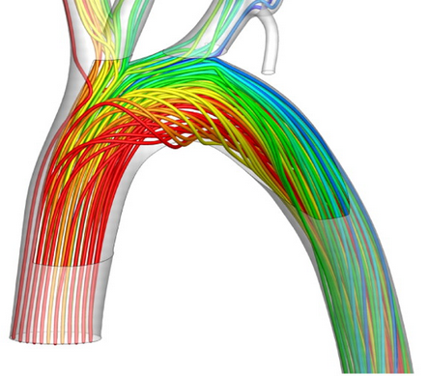
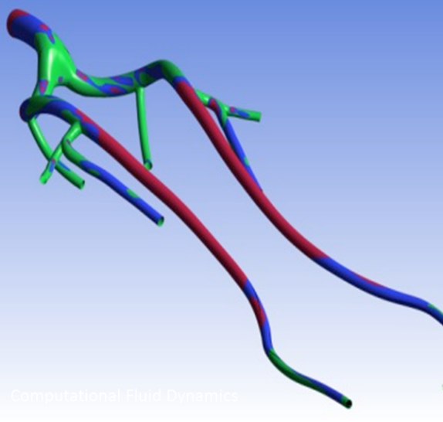
BioMimics 3D: Helical Centreline Promotes Swirling Flow
Wall Shear Stress (Pascal)
7.0
Protective
1.5
Suboptimal
1.
0.5
Pathogenic
(1)
Swirling flow increases wall shear stress (WSS) on endothelial cells
WSS naturally protects against atherosclerosis and intimal thickening ⁽²⁾
Increased WSS has been shown ⁽³⁾ to provide an antiproliferative effect after stenting, without the need for a drug
Malek AM et al, JAMA 1999;252:2035–2042
Caro CG, Arterioscler Thromb Vasc Biol 2009, 29:158-161
Caro CG et al, J R Soc Interface 10: 20130578

Slide 5
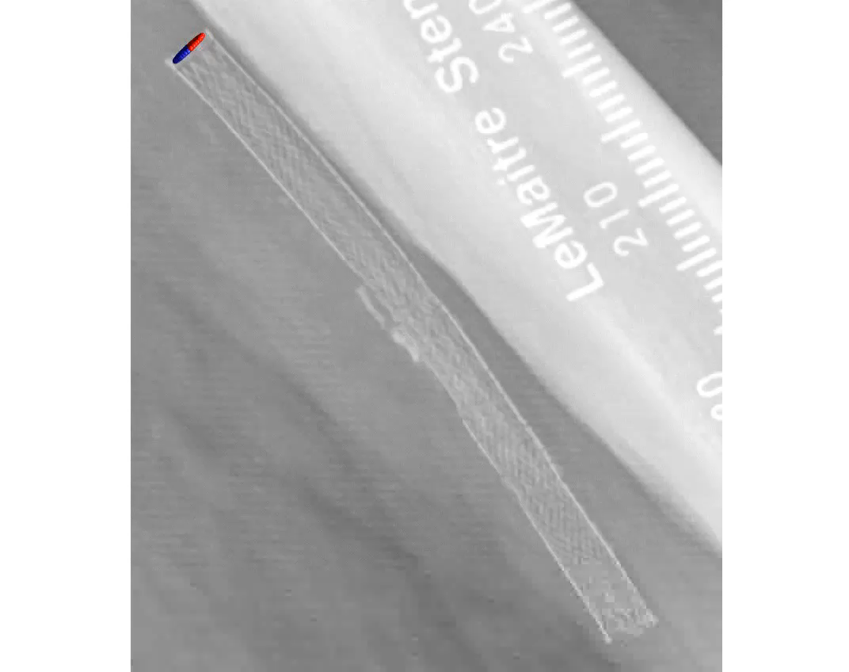
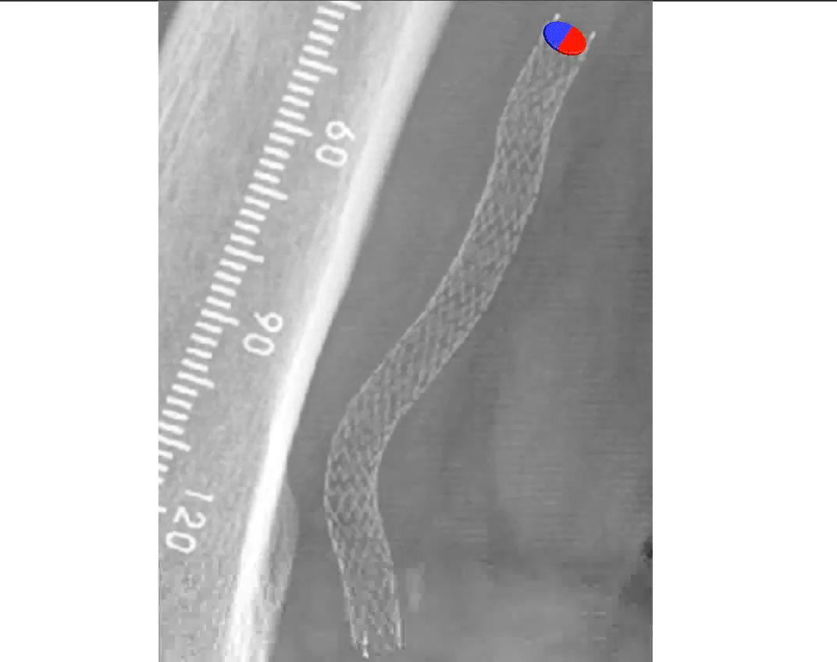
In Vivo CFD Modelling of Swirling Flow in the Stented Segment
Straight stent BioMimics 3D Stent
Data on file at Veryan Medical

Slide 6
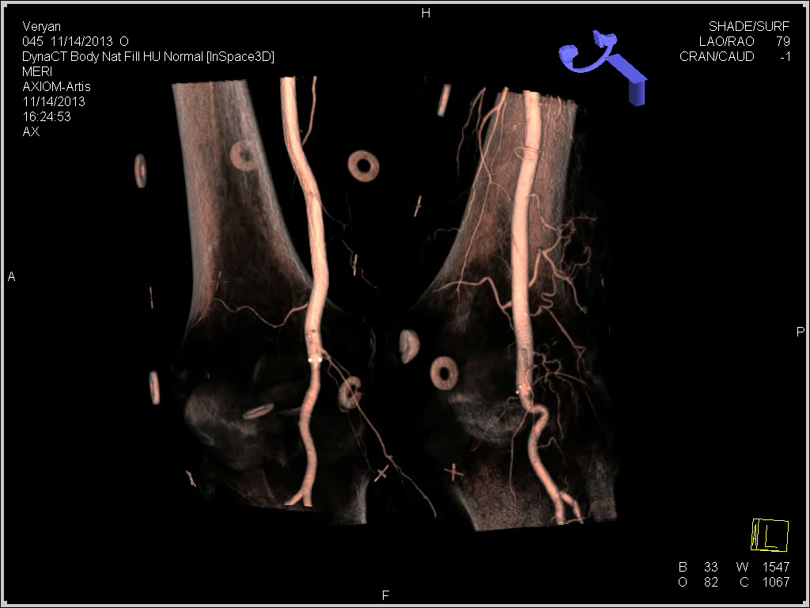
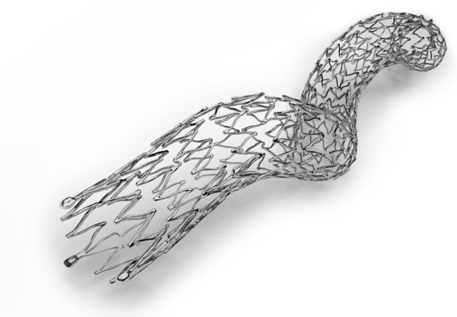
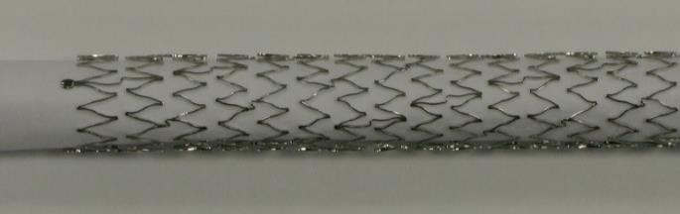
Improving the Biomechanics
Bent knee cadaver study
BioMimics 3D Stent
Straight stent
Data on file at Veryan Medical

Slide 7
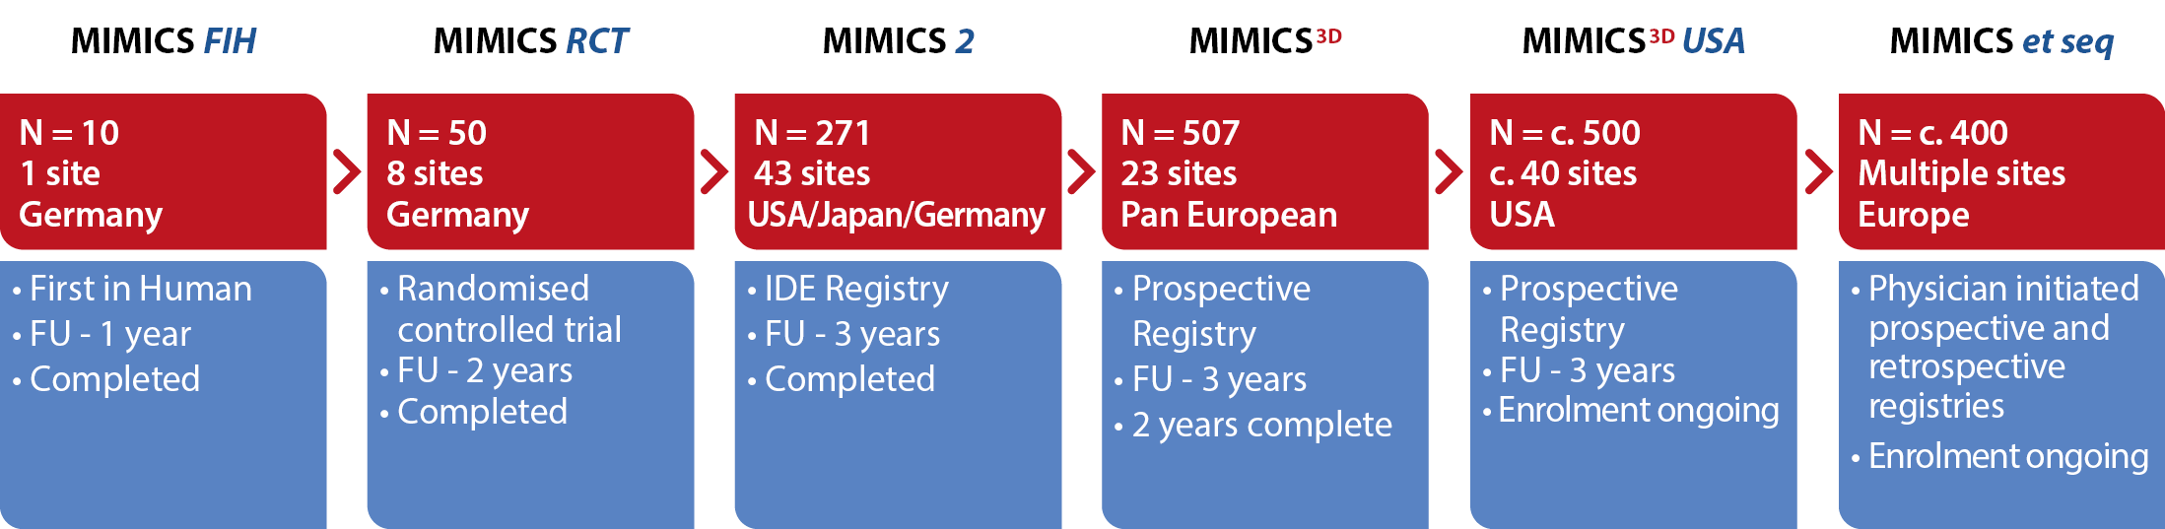
MIMICS Clinical Programme
1750+ patients
Data on file at Veryan Medical

Slide 8
MIMICS Randomised Controlled Trial
PI: Thomas Zeller 86 patients 8 Investigational sites Independent corelab (DUS; angiography; Xray) 2-year follow up COMPLETE
FIM Lead-in | N=10 BioMimics 3D
Prospective Randomization | BioMimics 3D N=50 | Straight nitinol stent N=26
24-Month Primary Patency (p=0.05) | 72% | 55%
Freedom from CDTLR 12-24 months (p=0.03) | 91% | 76%
Freedom from CDTLR
Landmark Analysis²
Provided the first clinical proof supporting the durable outcome benefit arising from the BioMimics 3D stent compared to a straight nitinol stent^{1, 2}
1. Zeller T et al; Circ Cardiovasc Interv. 2016
2. Sullivan TM et al; Int J Vasc Med. 2018

Slide 9
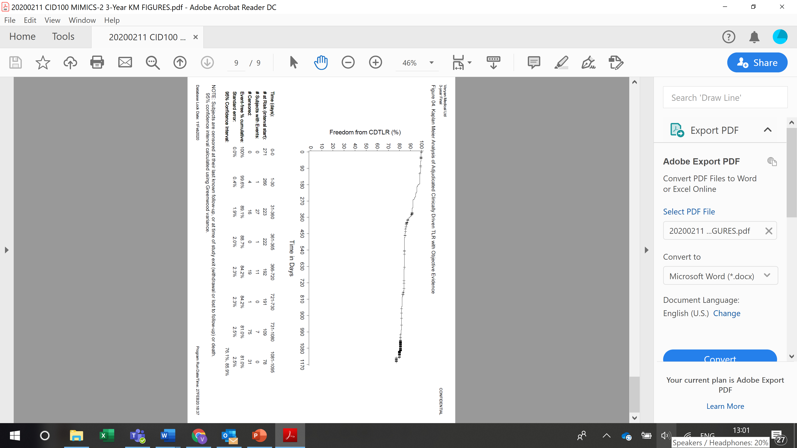
MIMICS-2 IDE Study
PIs: Timothy Sullivan (US), Thomas Zeller (Europe), Masato Nakamura (Japan) 43 Investigational sites 271 patients Independent core lab (DUS; angiography; Xray) Independent Clinical Event Committee (adjudication) 3-year follow up COMPLETE
12-Month Primary Patency | 73.1%
36-Month KM Freedom from CDTLR * | 81%
Kaplan Meier survival estimates of Freedom from Clinically-Driven TLR at 3 Years
1-year = 89%
2-year = 84%
3-year = 81%
*Core Lab adjudicated, clinically-driven TLR with objective evidence
Subjects are censored at their last known follow-up, or at time of study exit (withdrawal or lost to follow-up) or death
1. Zeller T et al; Circ Cardiovasc Interv. 2016
2. Sullivan TM et al; Int J Vasc Med. 2018

Slide 10
MIMICS-3D Registry
MIMICS^{3D}
A Prospective, Multicentre Observational Study to Evaluate BioMimics 3D Stent in PAD in the Real World
PIs: Michael Lichtenberg 43 Investigational sites 507 patients Independent Clinical Event Committee (adjudication) 3-year follow up (2-years COMPLETE)
Technical Success (procedure) | 99%
Procedural Success | 98%
Primary Endpoint – 30-Day Safety | 99% (447/452) Freedom from MAE
Primary Endpoint - 12-month Effectiveness | 91% (367/405) Freedom from CDTLR
1. Data on file at Veryan Medical

Slide 11
Baseline Patient Demographics
MIMICS^{3D}
 |  | Enrolled Population N=507
Age | Mean years ± SD (N) | 70.1 ± 10
Gender | % Male | 65.5% (332/507)
Risk Factors | Diabetes Mellitus | 36.9% (187/507)
 | Smoker Current | 37.7% (191/507)
Rutherford Category | 0 | 0.4% (2/504)
 | 1 | 1.2% (6/504)
 | 2 | 17.1% (86/504)
 | 3 | 57.3% (289/504)
 | 4 | 7.5% (38/504)
 | 5 | 14.3% (72/504)
 | 6 | 2.2% (11/504)
Ankle Brachial Index | Mean ± SD (N) | 0.6 ± 0.3 (417)
CLI present in 24% of enrolled subjects
Data on file at Veryan Medical

Slide 12
MIMICS^{3D}
Baseline Lesion Characteristics
 |  | Enrolled Population N=507 subjects (518 lesions)
Reference Vessel Diameter (mm) | Mean ± SD | 5.3 ± 0.6
Stent Location (%) | Mid to Distal SFA | 85.9% (445/518)
 | Prox. Pop | 29% (150/518)
Diameter Stenosis (%) | Mean ± SD | 94.6 ± 8 (518)
Occlusions | Total | 56.8% (294/518)
Lesion Length (mm) | Mean ± SD | 127 ± 92.4
Calcification (%) | Grade 0 | 17.6% (91/518)
 | Grade 1 | 29.3% (152/518)
 | Grade 2 | 24.1% (125/518)
 | Grade 3 | 14.7% (76/518)
 | Grade 4 | 13.9% (72/518)
38% of lesions had moderate to severe calcification
Data on file at Veryan Medical
Notes:
Added #TL but otherwise all data is per lesion
Use prox location for lesion, “other includes quite a few ostial SFA, one confirmed iliac (!) and some other stuff under query
Used proximal RVD
Removed total occlusion as don’t have direct equivalent to this core lab assessment. 210/379 report max stenosis 100%
Calcification
Grade 0 -70 18.6%
Grade 1 - 120 31.8%
Grade 2 - 88 23.3%
Grade 3 - 49 13.0%
Grade 4 - 50 13.3%
Total - 377 100.0%

Slide 13
Baseline Procedural Data
MIMICS^{3D}
 |  | Enrolled Population N=507
BioMimics 3D Stents | # stents/lesions | 674/518
 | 1 stent | 76.4% (396/518)
 | 2 stents | 18.3% (95/518)
 | 3 stents | 3.9% (20/518)
 | 4 stents | 1.4% (7/518)
Stented Segment Length | Mean ± SD (mm) | 130.8 ± 79.2
Diameter Stenosis | Pre-stent % ± SD | 94.6% ± 8
 | Post-stent % ± SD | 6.2 ± 8.8
Other Target Lesion Treatments | Drug coated balloon | 50.0% (259/518)
 | Atherectomy | 7.5% (39/518)
Technical Success |  | 99% (501/506)
50% of the lesions were treated with BioMimics 3D and Drug Coated Balloon
Data on file at Veryan Medical

Slide 14
Longer, more complex lesions
MIMICS^{3D}
Mean ± SD (mm) | MIMICS-RCT | MIMICS-2 | MIMICS-3D
Lesion Length | 66 ± 29 | 81 ± 38 | 127 ± 92
Stented Segment Length | 99 ± 30 | 112 ± 36 | 131 ± 79
Sicker patients, longer and more complex lesions
BioMimics 3D stent use 50:50 primary or bail-out to DCB
Highly relevant population for a contemporary registry
Data on file at Veryan Medical

Slide 15
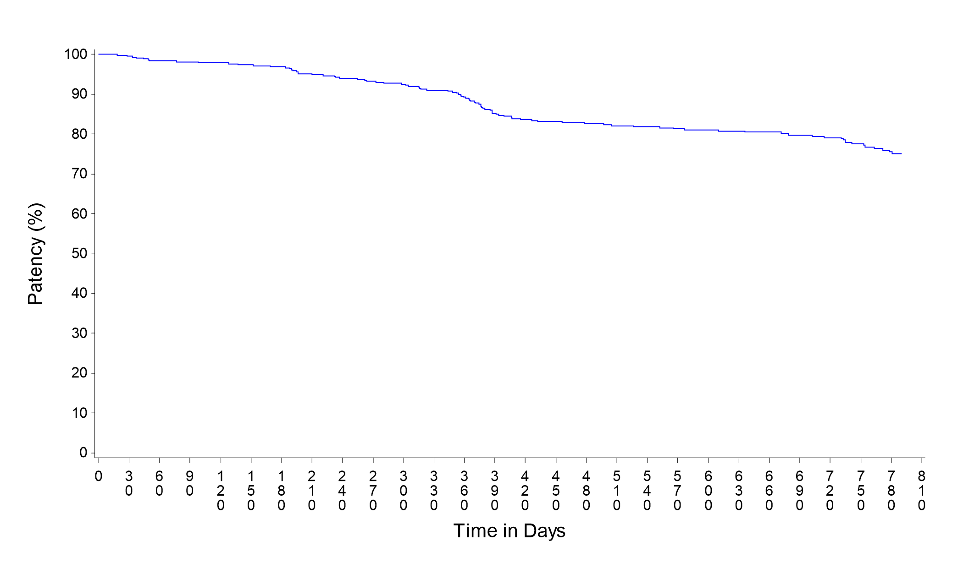
Freedom from Loss of Primary Stent Patency
MIMICS^{3D}
1-year = 88%
2-year = 76%
Per protocol analysis
Subjects are considered patent only up to the first indication of loss of patency. Subjects are censored at their last known follow-up (regardless of patency assessment).'
'Patency is defined as the composite of (1) freedom from more than 50% restenosis within the stented segment as observed by DUS or Angiography and
(2) freedom from clinically-driven target lesion revascularisation (TLR)'
Days Since Index Procedure | 0 | 30 | 365 | 395 | 730 | 790
KM Estimate (95% CI) PSVR>2.0 | 100.0% (100.0%,100.0%) | 99.8% (99.3%,100.0%) | 87.7% (84.5%,90.9%) | 83.1% (79.4%,86.8%) | 76.2% (72.0%,80.4%) | 71.2% (66.5%,75.9%)
Number Failed | 0 | 1 | 50 | 68 | 94 | 108
Number Remaining at Risk | 463 | 438 | 349 | 324 | 249 | 163
Data on file at Veryan Medical

Slide 16
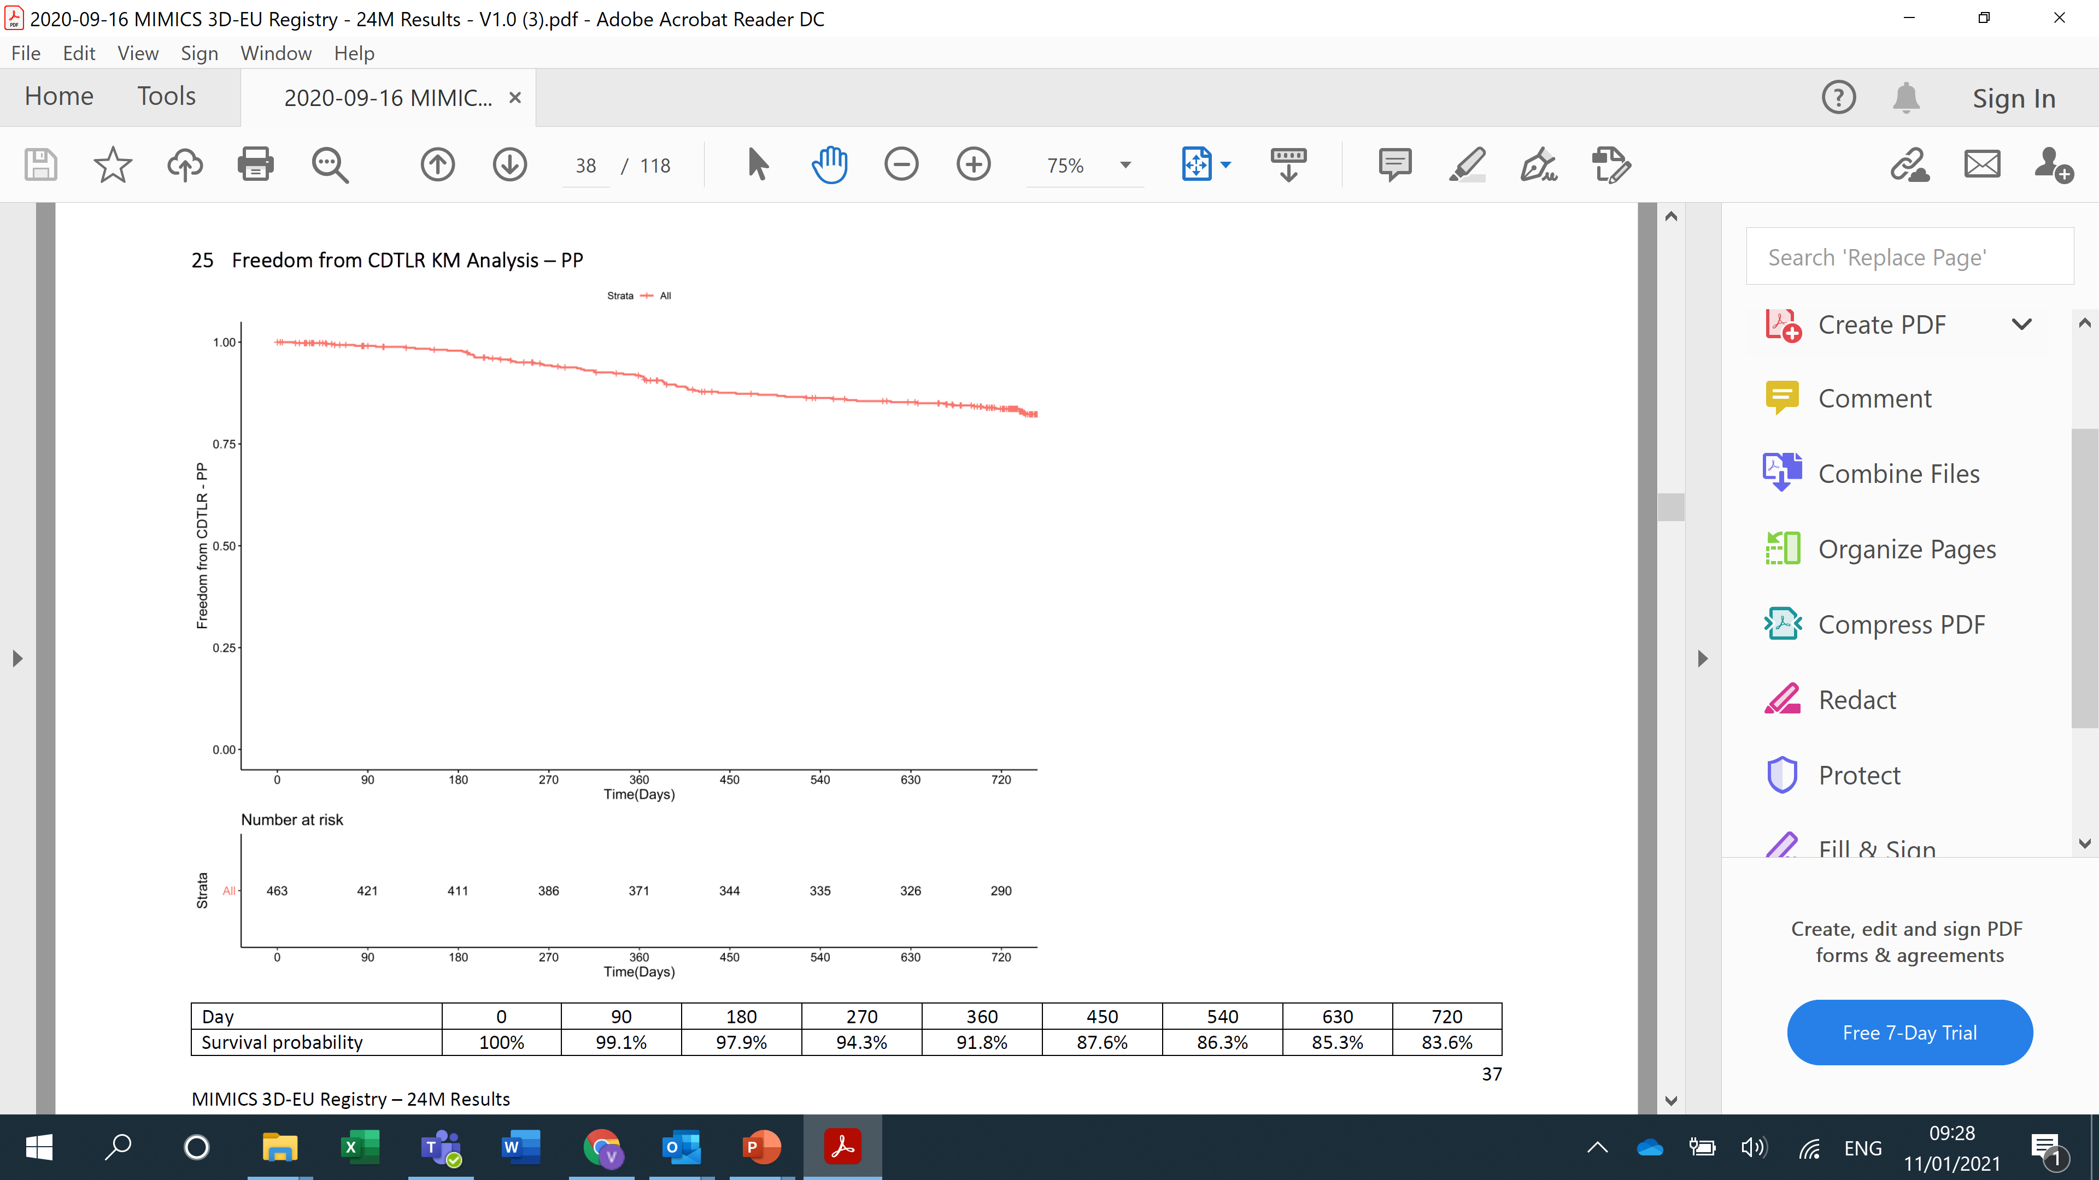
Freedom from clinically-driven target lesion revascularisation (CDTLR)
MIMICS^{3D}
1-year = 92%
2-years = 84%
Subjects are censored at their last known follow-up or death
Day | 0 | 90 | 180 | 270 | 360 | 450 | 540 | 630 | 720
Number at risk | 463 | 421 | 411 | 386 | 371 | 344 | 335 | 326 | 290
Survival probability | 100% | 99.1% | 97.9% | 94.3% | 91.8% | 87.6% | 86.3% | 85.3% | 83.6%
Data on file at Veryan Medical

Slide 17
Freedom from CDTLR at 2 years: DCB vs no-DCB
MIMICS^{3D}
No statistical difference between the DCB and no-DCB cohorts
The addition of paclitaxel by use of a DCB adds no benefit to clinical outcome in this study.
P= 0.22
 | 0 | 90 | 180 | 270 | 360 | 450 | 540 | 630 | 720
Survival probability – DCB = NO | 100% | 99.5% | 98.6% | 94.7% | 91.3% | 89.3% | 87.7% | 87.2% | 85.5%
Survival probability – DCB + YES | 100% | 98.6% | 97.2% | 93.8% | 92.3% | 85.8% | 84.8% | 83.3% | 81.7%
Number at risk
DCB = NO | 238 | 211 | 206 | 195 | 185 | 173 | 167 | 162 | 141
DCB = YES | 225 | 210 | 205 | 191 | 186 | 171 | 168 | 164 | 149
TIME (DAYS) | 0 | 90 | 180 | 270 | 360 | 450 | 540 | 630 | 720
Data on file at Veryan Medical

Slide 18
Industry Study Comparisons-Freedom from CDTLR
I--------------BioMimics 3D-------------I Supera Zilver PTX Eluvia
Comparable outcomes to DES and Supera despite more challenging lesions and without the need for lesion preparation
Data on file at Veryan Medical

Slide 19
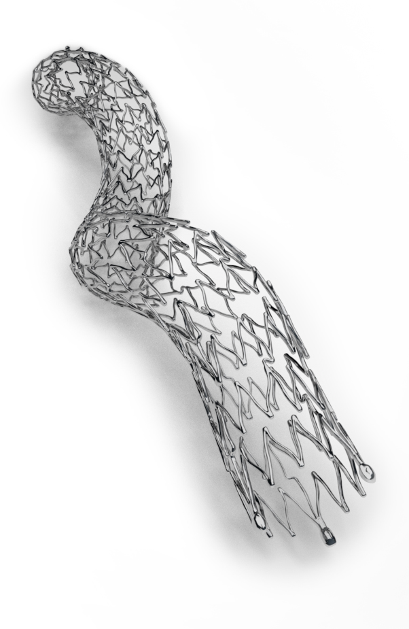
Conclusions
More challenging population than typically enrolled in registry
studies:
  24% CLI
  longer, more complex lesions
  50% with DCB
KM freedom from loss of primary stent patency at 2 years = 76%*
KM freedom from CDTLR at 2 years = 84%
No statistical difference in CDTLR between DCB and no-DCB
cohorts. The addition of paclitaxel adds no benefit to clinical outcome
Comparable outcomes to DES and Supera despite more
challenging lesions and without the need for lesion preparation
Data support the therapeutic value of swirling flow
3-year follow-up continues
* PSVR >2.0
1. Data on file at Veryan Medical
2. Kearns BMJ 2016
The BioMimics 3D Vascular Stent System reduces the burden of re-intervention for the patient and the health care system^{1,2}

