Slide 1
Three-year results from the MIMICS-3D EU study
Clinical Outcomes for the BioMimics 3D Stent in a Real-World Population
Michael Lichtenberg MD
Klinikum Hochsauerland
Arnsberg, Germany

Slide 2
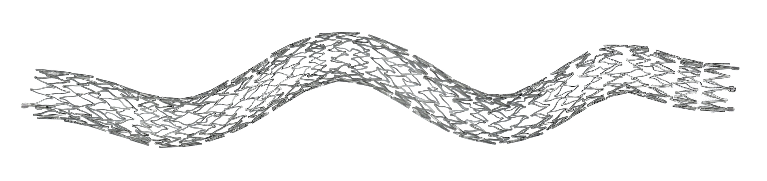
BioMimics 3D®: The Swirling Flow® Stent
Imparts non-planar curvature to stented femoropopliteal segment which generates swirling flow providing an antiproliferative effect without the need for a drug^{1, 2}
Improved biomechanical performance compared to straight stents¹
Helical centerline
Simple, accurate placement using standard delivery system
The BioMimics 3D Vascular Stent System has FDA, PMDA and CE Mark approval.
CAUTION: Federal law restricts this device to sale by or on the order of a physician PAM 302 Version 1.0
PAM 278 version 1.0
Data on file at Veryan Medical
Caro et al., 2013

Slide 3
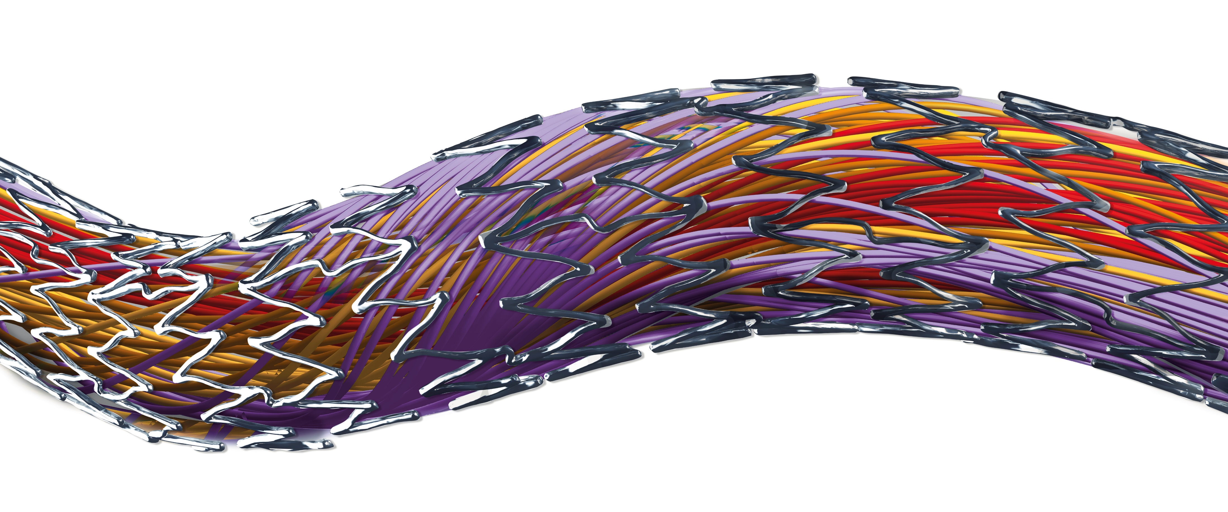
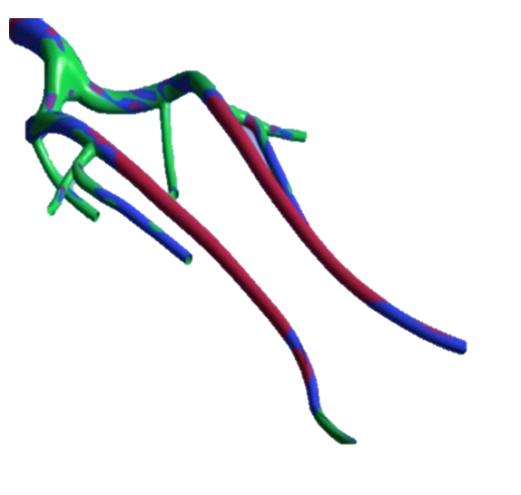
Atheroprotective & anti-restenotic effects of elevated wall shear stress
Non-planar vascular curvature promotes swirling blood flow³
Swirling flow increases wall shear stress on endothelial cells⁴
Elevated wall shear stress has been shown to reduce intimal hyperplasia¹
Wall Shear Stress in Femoropopliteal Segment
PROTECTIVE
SUBOPTIMAL
PATHOGENIC
³

Slide 4
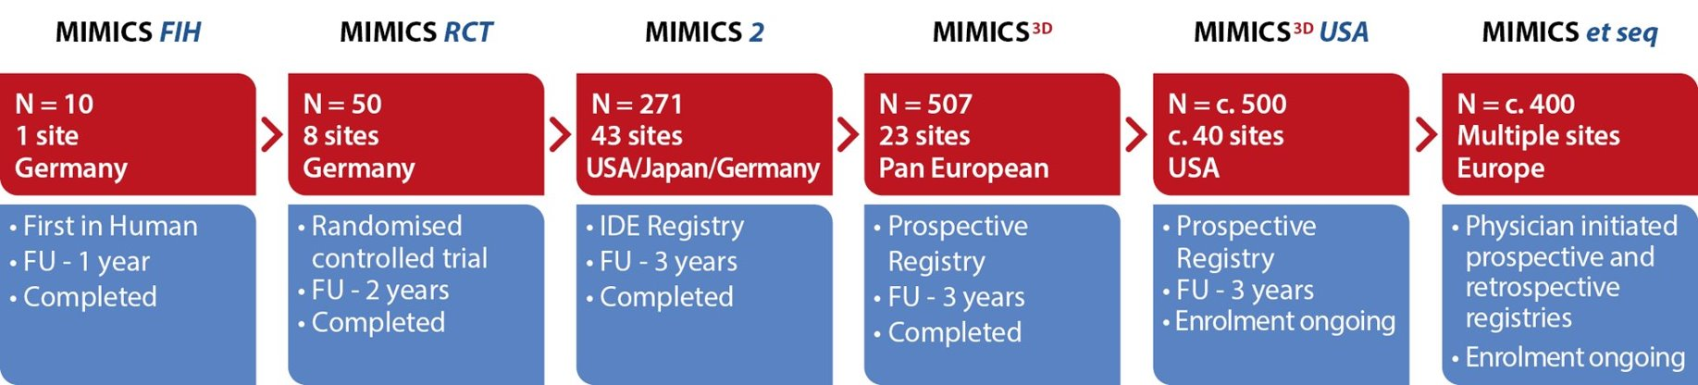

MIMICS Clinical Program
1750+ patients
⁵
Data on file at Veryan Medical

Slide 5
MIMICS Randomised Controlled Trial
PI: Thomas Zeller 86 patients 8 Investigational sites Independent corelab (DUS; angiography; Xray) 2-year follow up: STUDY COMPLETE
FIM Lead-in | N=10 BioMimics 3D
Prospective Randomization | BioMimics 3D N=50 | Straight nitinol stent N=26
24-Month Primary Patency (p=0.05) | 72% | 55%
Freedom from CDTLR 12-24 months (p=0.03) | 91% | 76%
Stent fracture | 0% | 0%
Freedom from CDTLR
Landmark Analysis²
^{6, 7}
Provided the first clinical proof supporting the durable outcome benefit arising from the BioMimics 3D stent compared to a straight nitinol stent^{1, 2}

Slide 6
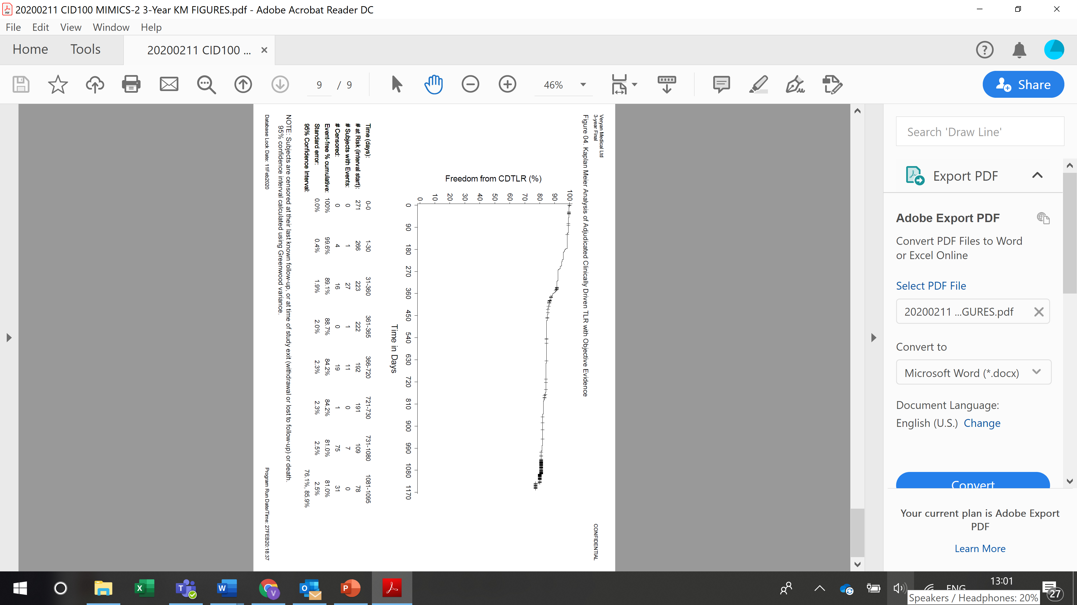
MIMICS-2 IDE Study
PIs: Timothy Sullivan (US), Thomas Zeller (Europe), Masato Nakamura (Japan) 43 Investigational sites 271 patients Independent core lab (DUS; angiography; Xray) Independent Clinical Event Committee (adjudication) 3-year follow up COMPLETE
12-Month KM Freedom from loss of Primary Patency | 83%
36-Month KM Freedom from CDTLR * | 81%
Stent fracture | 0%
Kaplan Meier survival estimates of Freedom from Clinically-Driven TLR at 3 Years
1-year = 89%
2-year = 84%
3-year = 81%
*Core Lab adjudicated, clinically-driven TLR with objective evidence
Subjects are censored at their last known follow-up, or at time of study exit (withdrawal or lost to follow-up) or death
^{8.}
The MIMICS-2 study validated the outcomes of the randomised study by providing clinical proof in a larger, more challenging cohort¹

Slide 7

Baseline Patient Demographics
 |  | Enrolled Population N=507
Age | Mean years ± SD (N) | 70.1 ± 10
Gender | % Male | 66% (332/507)
Risk Factors | Diabetes Mellitus | 37% (187/507)
 | Smoker Current | 38% (191/507)
Rutherford Category | 0 | 0.4% (2/504)
 | 1 | 1% (6/504)
 | 2 | 17% (86/504)
 | 3 | 57% (289/504)
 | 4 | 8% (38/504)
 | 5 | 14% (72/504)
 | 6 | 2% (11/504)
Ankle Brachial Index | Mean ± SD (N) | 0.6 ± 0.3 (417)
CLTI present in 24% of enrolled subjects
⁹
Data on file at Veryan Medical

Slide 8
Baseline Lesion Characteristics
 |  | Enrolled Population N=507 subjects (518 lesions)
Reference Vessel Diameter (mm) | Mean ± SD | 5.5 ± 0.7
Diameter Stenosis (%) | Mean ± SD | 95 ± 8 (518)
Occlusions | Total | 57% (294/518)
Lesion Length (mm) | Mean ± SD | 126 ± 91
Calcification (%) | Grade 0 | 18% (91/516)
 | Grade 1 | 30% (152/516)
 | Grade 2 | 24% (125/516)
 | Grade 3 | 15% (76/516)
 | Grade 4 | 14% (72/516)
Longer, more complex lesions than previously studied
38% of lesions had moderate to severe calcification
⁹
Data on file at Veryan Medical
Notes:
Added #TL but otherwise all data is per lesion
Use prox location for lesion, “other includes quite a few ostial SFA, one confirmed iliac (!) and some other stuff under query
Used proximal RVD
Removed total occlusion as don’t have direct equivalent to this core lab assessment. 210/379 report max stenosis 100%
Calcification
Grade 0 -70 18.6%
Grade 1 - 120 31.8%
Grade 2 - 88 23.3%
Grade 3 - 49 13.0%
Grade 4 - 50 13.3%
Total - 377 100.0%

Slide 9
Baseline Procedural Data
 |  | Enrolled Population N=507
BioMimics 3D Stents | # stents/lesions | 676/518
 | 1 stent | 76% (395/518)
 | 2 stents | 19% (96/518)
 | 3 stents | 4% (19/518)
 | 4 stents | 2% (8/518)
Stented Segment Length | Mean ± SD (mm) | 131 ± 80.1
Diameter Stenosis | Pre-stent % ± SD | 95% ± 8.0
 | Post-stent % ± SD | 6%± 8.7
Other Target Lesion Treatments | Drug coated balloon | 50.0% (259/518)
 | Atherectomy | 8% (39/518)
50% of the lesions were treated with BioMimics 3D and Drug Coated Balloon
⁹
Data on file at Veryan Medical

Slide 10
European Registry: 3-year Results
Technical Success (procedure) | 99% (501/506)*
Procedural Success | 97%
Primary Endpoint: 30-day safety | 98.6% (486/493) Freedom from MAE
Primary Endpoint: 12-month effectiveness | 89.1% (399/448) Freedom from CDTLR
36-Month KM Freedom from loss of Primary Patency** | 71%
36-Month KM Freedom from CDTLR | 78%
Stent fracture (site reported) | 0.6% (4/676)
Stent fracture (confirmed by investigation) | 0.4% (3/676)
Kaplan Meier survival estimates of Freedom from Clinically-Driven TLR at 3 Years
1 year
90%
2 years
82%
3 years
78%
*1 patient did not have a final diameter stenosis recorded
**ITT population. PSVR >2.4
⁹

Slide 11
European Registry: Comparison of CDTLR results with and without DCB
 |  | BioMimics 3D with DCB | BioMimics 3D without DCB | Log rank P- value
KM Freedom from CDTLR | 1 Year | 91.4% | 88.7%
 | 2 Year | 81.5% | 83.1%
 | 3 Year | 76.4% | 79.6% | 0.4789
No statistical difference in CDTLR between DCB and no-DCB cohorts
The addition of paclitaxel added no benefit to clinical outcome in this study
⁹
Data on file at Veryan Medical

Slide 12
MIMICS Clinical Program
Enrolling progressively longer and more complex lesions
 | MIMICS-RCT | MIMICS-2 | MIMICS-3D
Lesion Length Mean ± SD (mm) | 66 ± 29 | 81 ± 38 | 126 ± 91
Stented Segment Length Mean ± SD (mm) | 99 ± 30 | 112 ± 36 | 131 ± 80
CTO | 44% | 30% | 57%
Mod/Severe Ca++ | 52% | 46% | 38%
CLI | 6% | 6% | 24%
Core lab reported data for MIMICS and MIMICS-2, site-reported for MIMICS-3D
⁹
Data on file at Veryan Medical

Slide 13
Indicative Study Comparisons-Freedom from CDTLR
I----------------BioMimics 3D-----------I Supera Zilver PTX Eluvia Eluvia Zilver PTX
BioMimics 3D has comparable outcomes to DES and Supera despite enrolling progressively longer lesions in the MIMICS Clinical program
Data on file at Veryan Medical
¹⁰

Slide 14
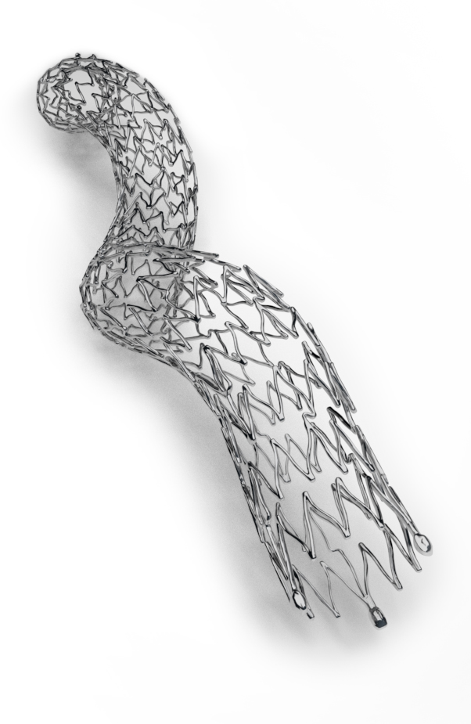
Conclusions
More challenging population than typically enrolled in registry studies:
  24% CLTI
  longer, more complex lesions
KM freedom from loss of primary stent patency at 3 years = 71%
KM freedom from CDTLR at 3 years = 78%
No statistical difference in CDTLR between DCB and no-DCB cohorts
  The addition of paclitaxel added no benefit to clinical outcome in this study
Comparable outcomes to DES and Supera despite more challenging lesions and without the need for extensive lesion preparation
MIMICS Clinical Program investigations into the performance of the BioMimics 3D Vascular Stent System support the hypothesis that imparting non-planar curvature to the femoropopliteal artery to promote swirling blood flow and increase wall shear stress, results in clinical outcomes that are comparable to those of drug-coated and drug-eluting devices
⁹
1. Data on file at Veryan Medical

