Slide 1

Three-Year Results For The BioMimics 3D Swirling Flow Stent Show Why It Is The Most Cost-Effective Stent For Patients with Long, Complex SFA Lesions
Michael Lichtenberg MD
Klinikum Hochsauerland, Arnsberg, Germany
PAM 345 Version 1.0

Slide 2
Disclosures
Disclosures

Slide 3
Study Background
Peripheral arterial disease (PAD) is a growing burden to global healthcare systems¹
  Recent report shows the prevalence of PAD in the US has nearly doubled between 1995 and 2020
  Increasing from 11.3M to 21.0M within the study period
Majority of PAD intervention is due to disease within the femoropopliteal segment²
  Challenging vessel to treat due to location and anatomical complexity
  Limited clinical study data beyond 1 year detailing outcomes for endovascular treatment of complex (TASC C/D) femoropopliteal lesions
  Disease complexity drives significant increase in costs within the first two years of treatment (R2-3: $11,416, R4-5: $24,846, R6:$25,720)
Vascular Disease Management 2023;20(4):E67-E73
Journal of Medical Economics 2021, VOL. 24, NO. 1, 570–580
Notes:
As we know, the management of PAD is a significant problem globally. Recent studies show the incidence of PAD in the US has nearly doubled in a 15 year window
The femoropopliteal segment remains one of the most challenging segments to treat, due to the dynamic nature of the artery and the complexity of disease
Unfortunately, there are little data available for complex lesions beyond a year, but we know that these complex lesions drive a significant increase in costs

Slide 4
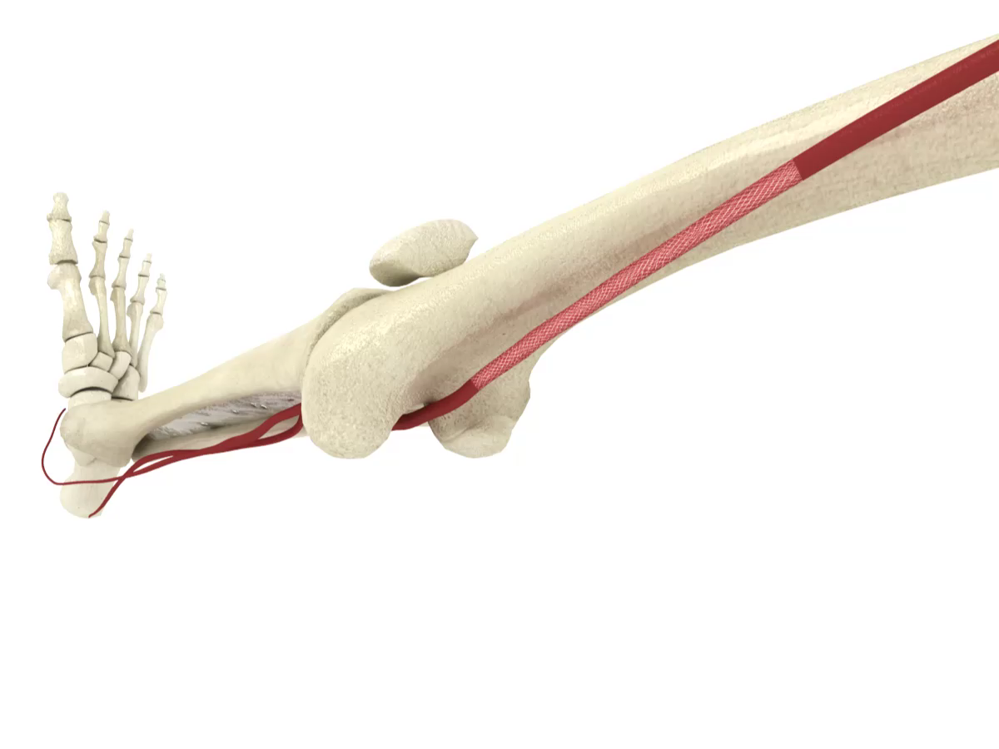
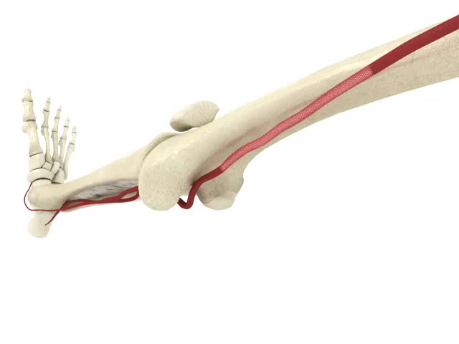
The Role of Scaffolds in Complex Disease
  The need for adjunctive stenting remains high in complex lesions, reported in up to 68%¹ of cases in a recent meta-analysis
  However, traditional straight stent platforms have not shown durable results in complex lesions
    Primary patency rates reported as low as 41% at 3 years¹
  DES offer some promise, but very limited data in complex lesions
  BioMimics 3D incorporates a unique, helical centerline design that may address some of the challenges other platforms face, in a cost-effective manner
Traditional Straight Stent Designs
BioMimics 3D – Helical Centerline
1. S. Giannopoulos et al.Cardiovascular Revascularization Medicine 22 (2021) 52–65
Notes:
Traditional BMS lack durability in their results for complex lesions, whereas DES offers some promise but there is very limited data. BioMimics 3D incorporates a unique, helical centerline design that may address some of the challenges other platforms face, and in a cost-effective manner

Slide 5
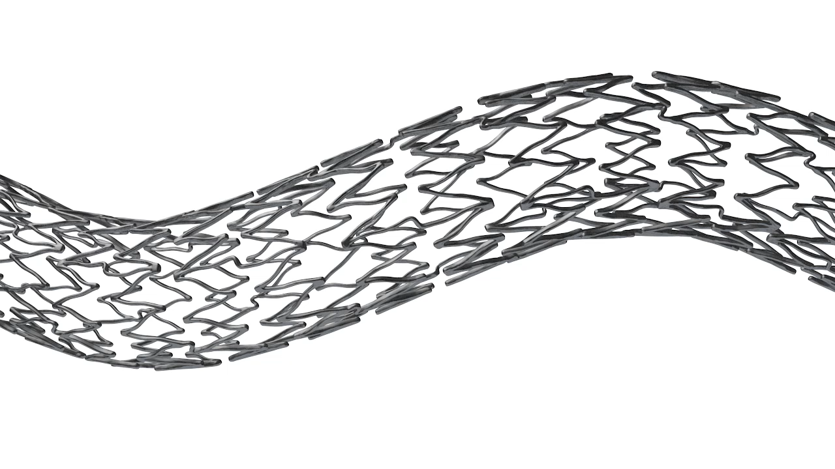
BioMimics 3D
The BioMimics 3D Vascular Stent System has FDA, PMDA and CE Mark approval.
CAUTION: Federal law restricts this device to sale by or on the order of a physician
PAM 345 Version 1.0
Notes:
The main design differentiator for BioMimics is the 3D helical centreline of the stent which after implantation is imposed onto the artery, improving biomechanical compatibility and inducing laminar swirling flow

Slide 6
Study Methodology
Study Intent: To determine how the different stent platforms and design modalities impact on patient outcomes and how those outcomes impact on the cost of intervention for long complex lesions
PAD patient
First intervention
CD-TLR
Second intervention
Markov decision model using long-term
data published from independent studies
Primary outcomes for long SFA lesions, over 15cm
  (freedom from) CD-TLR
  Major amputation
  Death
Analysis conducted over lifetime time horizon
Major amputation
Death
Notes:
Our intent was to use the current published literature to objectively compare the long-term outcomes for patients treated with the different stent platforms and stent designs. And from there, assess how these outcomes impacted the interventional costs for long complex lesions, which can be double that of shorter, simpler lesions.
Caveat- We only modelled one reintervention (assumed to be POBA), despite possibility of there being multiple interentions over a patient’s lifetime. This is due to lack of data on what patients receive in subsequent treatments and their outcomes after those subsequent treatments.

Slide 7
Lesions characteristics and studies utilized
BioMimics 3D data derived from long lesion cohort (>15 cm) of MIMICS 3D observational trial¹
BMS results pooled from systematic literature search: 8 trials reporting outcomes for primary BMS procedures in long lesions (>15 cm) OR TASC II C & D lesions of SFA / fempop artery²⁻⁹
Zilver PTX data derived from ZILVERPASS study¹⁰
Lesion Characteristics | BioMimics 3D | BMS | Zilver PTX
Patient number (N) | 127 | 649 | 113
Mean lesion length (mm) | 254.0 | 224.9 | 241.7
Average patient age (years) | 70.3 | 70.5 | 69.6
Diabetes mellitus (%) | 38.3 | 39.4 | 27.4
No significant differences between patient cohorts
1. M Piorkowski et al (2023), 2. FK Enzmann et al (2019), 3. M Kluckner et al (2022), 4. N Zamani et al (2021), 5. J Lammer et al (2014), 6. JM Davaine et al (2012), 7. GF Veraldi et al (2018), 8. MY Yin et al (2013), 9. DT Baril et al (2010), 10. MJ Bosier et al (2023)
Notes:
We conducted a systematic review of the literature for SFA trials that 1. treated lesions >15cm or TASC II C & D, 2. reported out for the 3 primary endpoints (CD-TLR, MA, mortality) at yearly increments (min. 12 months) and 3. enrolled more than 40 patients in the primary stenting cohort.
When we compared the patient characteristics from the studies used, they were all very similar with no significant differences between them.
One study was excluded for including a high proportion of infrapopliteal artery lesions and having significantly poorer patient outcomes than average.
Eluvia was not included due to a lack of long-term data in long lesions. IMPERIAL does not report all data points necessary for analysis.

Slide 8
Model Inputs - Outcomes
BioMimics 3D
BMS
Zilver PTX
Year 1
Clinically-driven TLR | 19.3% | 24.9% | 19.2%
Major amputation | 2.6% | 1.7% | 2.1%
Death | 7.7% | 7.6% | 6.4%
CD-TLR and rates of major amputation were main points of difference between cohorts
Year 2
Clinically-driven TLR | 26.2% | 31.6% | 26.8%
Major amputation | 2.8% | 5.9% | 3.5%
Death | 14.2% | 10.9% | 13.1%
Year 3
Clinically-driven TLR | 31.6% | 38.4% | 34.0%
Major amputation | 3.2% | 13.7% | 3.5%
Death | 17.7% | 16.2% | 18.0%
1. M Piorkowski et al (2023), 2. FK Enzmann et al (2019), 3. M Kluckner et al (2022), 4. N Zamani et al (2021), 5. J Lammer et al (2014), 6. JM Davaine et al (2012), 7. GF Veraldi et al (2018), 8. MY Yin et al (2013), 9. DT Baril et al (2010), 10. MJ Bosier et al (2023)
Notes:
In comparing the patient outcomes, Biomimics 3D and Zilver PTX consistently performed better than BMS in terms of both CD-TLR and rates of major amputation.

Slide 9
Model Inputs – Hospital Costs
 | CMS procedural cost
PTA + stent placement | $11,452.69
BMS average list price | $814.00
BioMimics-3D list price | $1,239.00
Zilver PTX list price | $1,744.05
PTA only (reintervention) | $7,043.06
Major lower limb amputation | $36,429.05
Calendar year 2021 most recent data available
Procedure costs based on CMS average
Reimbursement based on CPT / HCPCS and MS-DRG codes
Cost of individual stents based on hospital list prices and may vary between institutions
Did not account for physician payments or additional follow up for patients following completed procedures
Discount rates (per annum) | Per annum
Treatment costs | 3.5%
QALY | 3.5%
Source: Public use files, data.CMS.gov; accessed October 2023
Notes:
To calculate the index procedure costs, we retrieved CMS reimbursement data from 2021 and the average list prices for each stent or stent type.
Costs are taken from public use files published by CMS. The most recent data available was for 2021.

Slide 10
BioMimics 3D could have considerable cost and QoL improvements when treating patients with long SFA lesions
Per patient averages (lifetime time horizon)
 | Average treatment cost | Total QALYs | Cost effectiveness ratio
BioMimics 3D | $17,613 | 6.9 | $2,541
BMS | $24,449 | 5.5 | $4,461
Zilver PTX | $19,010 | 6.1 | $3,122
- $6,835
+ 1.4
- $1,396
+ 0.8
BioMimics 3D demonstrates significant cost effectiveness when compared to both BMS and Zilver PTX in the treatment of complex SFA lesions from 3 years
Data on file at Veryan Medical
Notes:
In our model, BioMimics 3D demonstrates significant cost effectiveness when compared to both BMS and Zilver PTX in the treatment of complex SFA lesions.
The per patient saving over a lifetime time horizon for BioMimics over BMS is $6,835 with an improvement of 1.4 QALYs
The per patient saving over a lifetime time horizon for BioMimics over Zilver PTX is $1,396 with an improvement of 0.8 QALYs

Slide 11
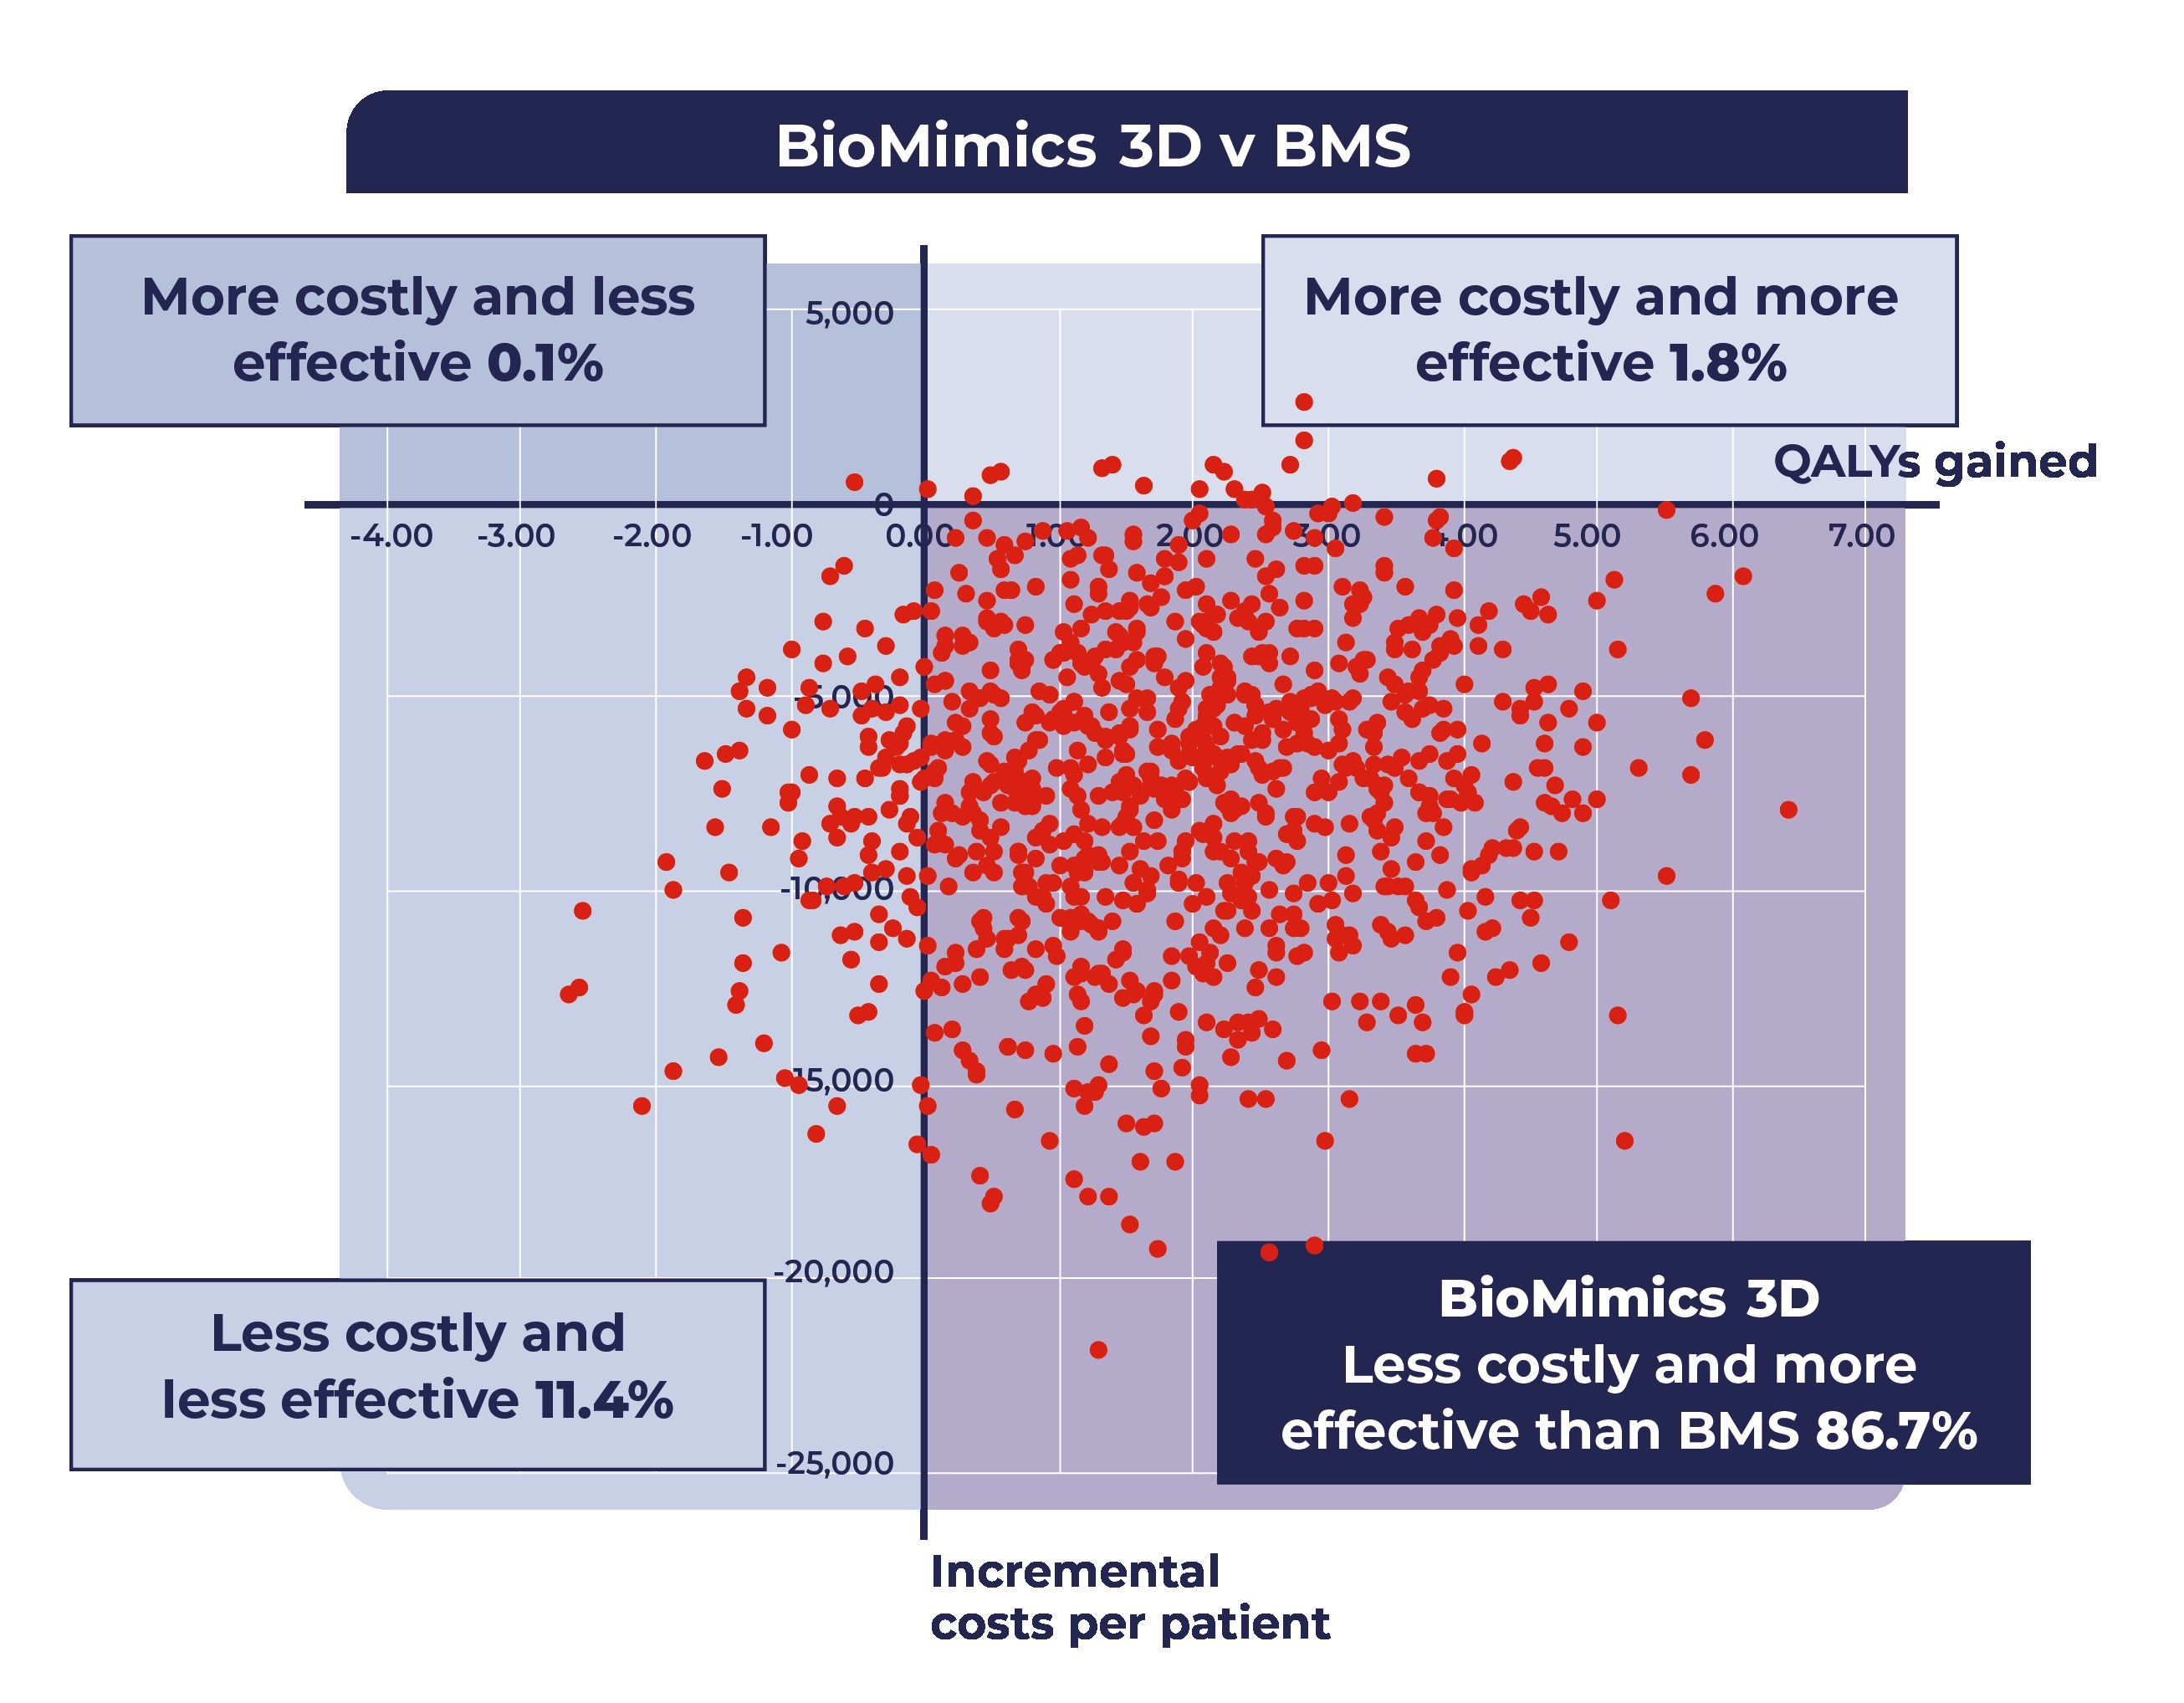
Probabilitistic Sensitivity Analysis - BioMimics 3D v. BMS
Notes:
When taking these inputs and outcomes into consideration, you can see in this sensitivity analysis that BioMimics3D proves to be more effective clinically and less costly in nearly 87% of cases when compared to BMS

Slide 12
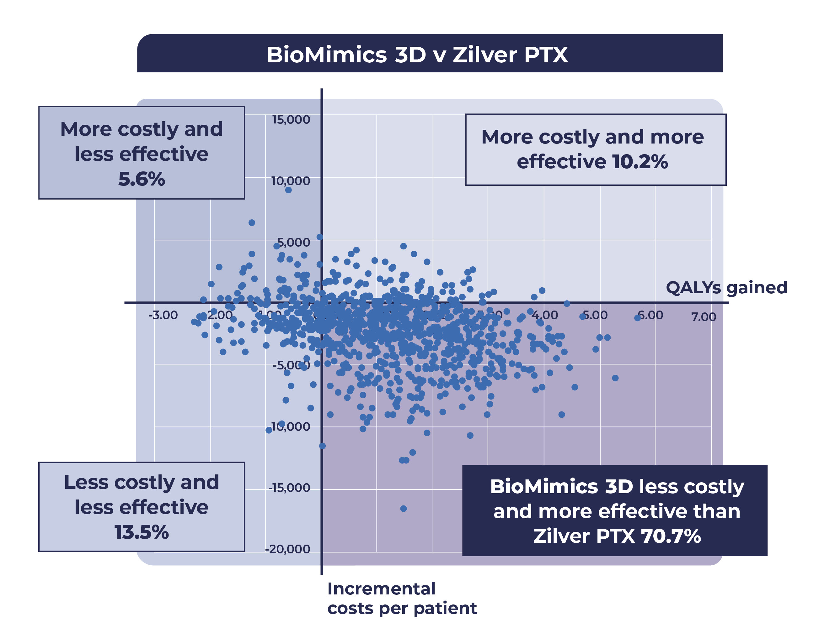
Probabilitistic Sensitivity Analysis - BioMimics 3D v. Zilver PTX
Notes:
Similarly, BioMimics shows more effective and cost efficient outcomes in more than 70% of cases when compared to Zilver PTX

Slide 13
Summary
Study limitations:
    Procedure costs were calculated for CMS reimbursement to hospitals only
    Patient follow-up costs were not included in analysis
    Some modern stents were not included (Supera and Eluvia) due to the absence of long-term data in complex lesions
Systematic literature review indicated improved outcomes for patients treated with BioMimics 3D and Zilver PTX compared to conventional BMS
Model demonstrates the dominance of BioMimics 3D over conventional BMS and Zilver PTX for the treatment of long SFA lesions, with considerable cost savings per patient
More analysis is needed to assess the economic benefits of modern endovascular technologies compared to current standard of care

