Slide 1
Compelling 36-Month Outcomes for the
BioMimics 3D Stent in TASC-D Lesions
A Subgroup Analysis of the MIMICS-3D EU Registry
Robert E Beasley
Palm Vascular Centers
Miami Beach, FL

Slide 2
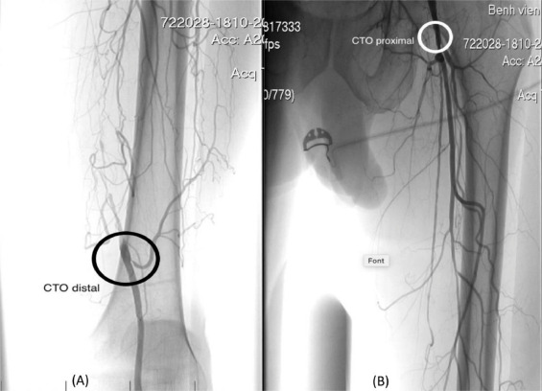
TASC D Lesions in Clinical Practice
In clinical practice, treatment of long, complex femoropopliteal lesions is commonplace
There are numerous interventional and surgical options, but no consensus and little data to support a particular approach
Unfortunately, most device trials exclude patients with complex lesions, especially those > 20 cm¹
²
Phillips JA, et al . JEVT. 2018;25(3):295-301.
Nguyen Viet Lam et al, Radiology Case Reports 2020, Volume 15 Issue 11, 2116-2119

Slide 3
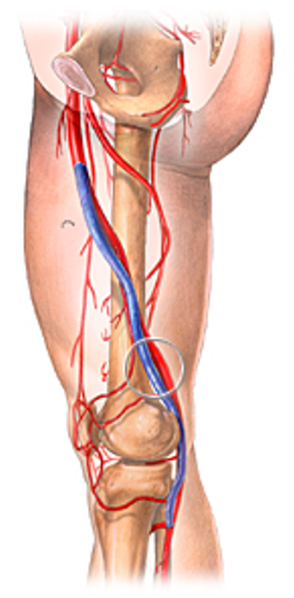
Surgical Bypass – The Gold Standard
Trans-Atlantic Inter-Society Consensus II recommendations suggest bypass for the treatment of TASC D lesions
Potential for improved mid-term patency compared to endovascular approach
  72% vs 62% at 1 year¹
Significantly higher 30-day morbidity (37%) noted in
surgical bypass²
  8.2% infection rate noted in meta analysis of surgical
  fem pop outcomes
Patient preference for endovascular treatment
George A. Antoniou et al, JVS,Volume 57, Issue 1,2013
Shah, T, et al. J CRIT LIMB ISCHEM 2022;2(4):E122-E130

Slide 4
Endovascular First Approach
Leave nothing behind:
  Numerous endovascular strategies available to avoid traditional scaffolds due to concerns over long term outcomes
  However, the need for adjunctive stenting remains high in TASC D lesions, reported in up to 68%¹ of cases in a recent meta-analysis
Outcomes with scaffolds:
  Primary patency rates reported as low as 64% at 1 year and 41% at 3 years in TASC D lesions¹
  DES offer some promise, but very limited data in TASC D to date (73% primary patency at 1 year)
New therapies such as percutaneous transmural arterial bypass (PTAB) may offer promise, but there is limited follow-up data available
S. Giannopoulos et al.Cardiovascular Revascularization Medicine 22 (2021) 52–65

Slide 5
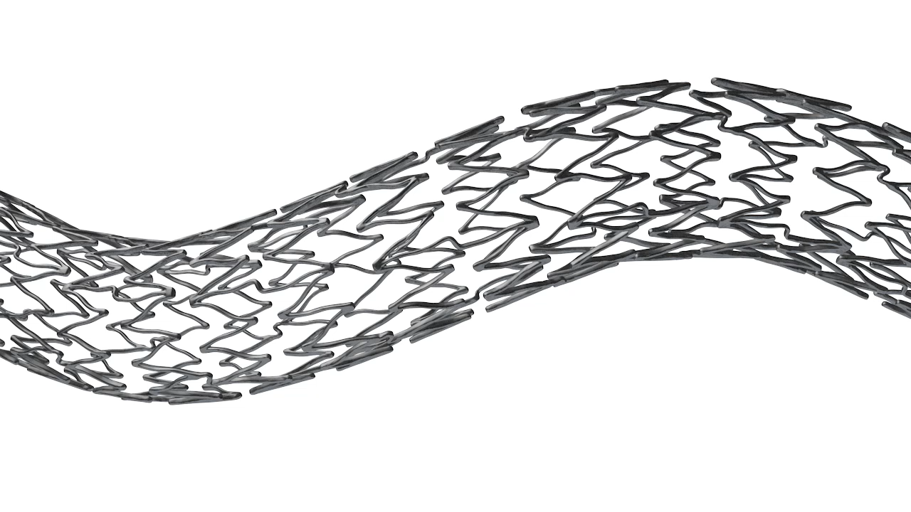
BioMimics 3D
Designed Specifically for the Femoropopliteal Segment
The BioMimics 3D Vascular Stent System has FDA, PMDA and CE Mark approval.
CAUTION: Federal law restricts this device to sale by or on the order of a physician
PAM 344 Version 1.0

Slide 6
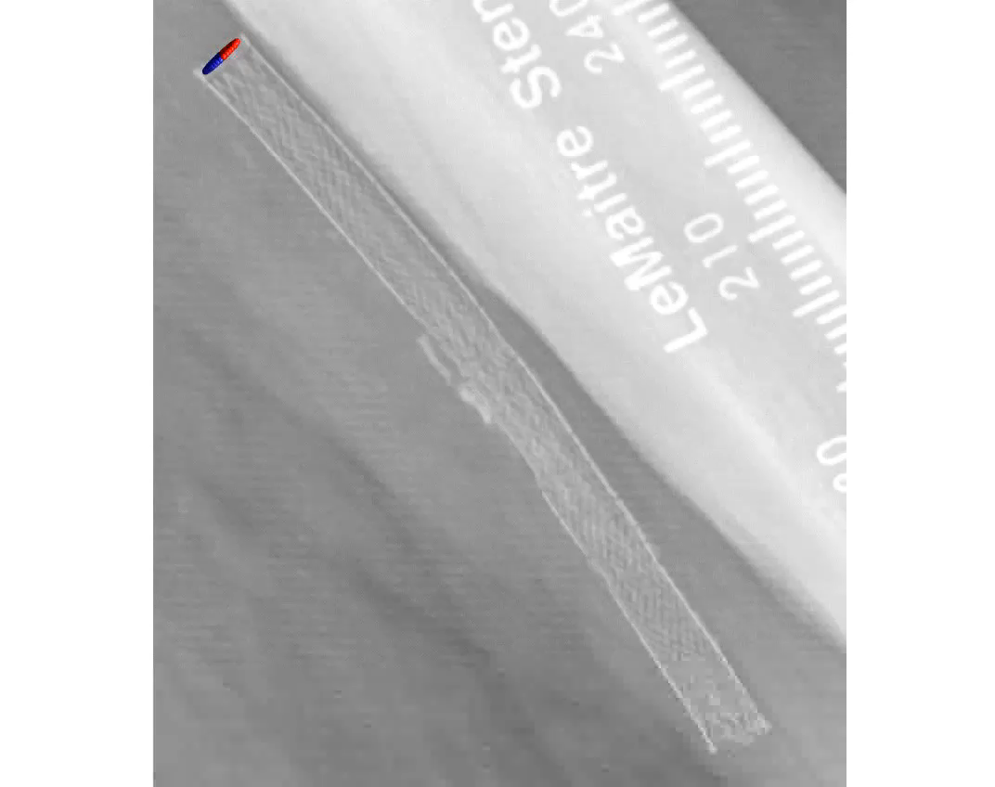
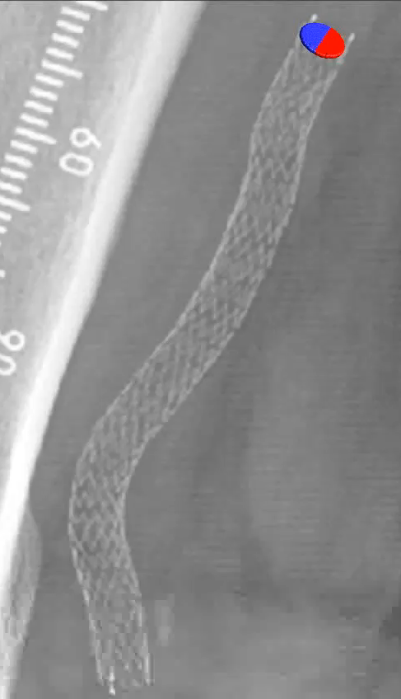
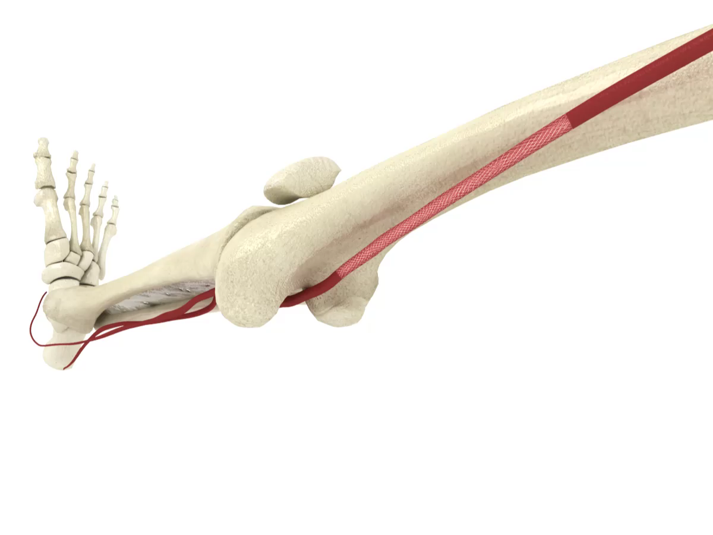
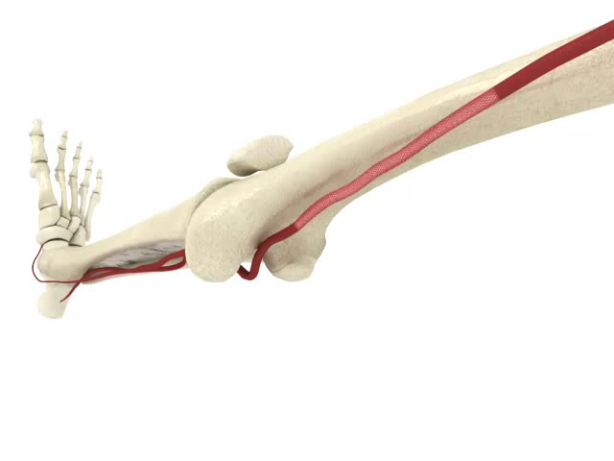
BioMimics 3D
Designed Specifically for the
Femoropopliteal Segment
Straight stent BioMimics 3D stent
Straight laminar flow
Swirling laminar flow
BioMimetic Design¹
Elevated Wall Shear Stress²
  Mimics natural movement of the femoropopliteal segment
  Aids in reducing localized trauma
  Helps reduce risk of stent fracture in dynamic artery
  Reduces restenosis by reducing thrombus formation and inflammation
  Reduces Smooth Muscle Cell proliferation
  Reduces neointimal hyperplasia
Data on file at Veryan Medical
Murphy EA, Cardiovascular Engineering and Technology 2012

Slide 7
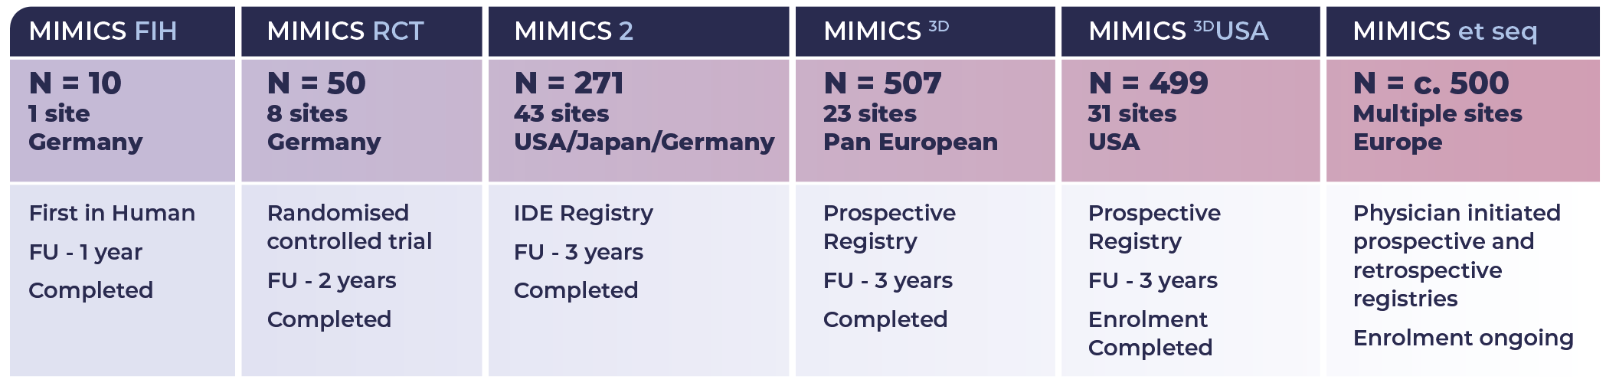

Mimics Clinical Program
1750+ patients

Slide 8
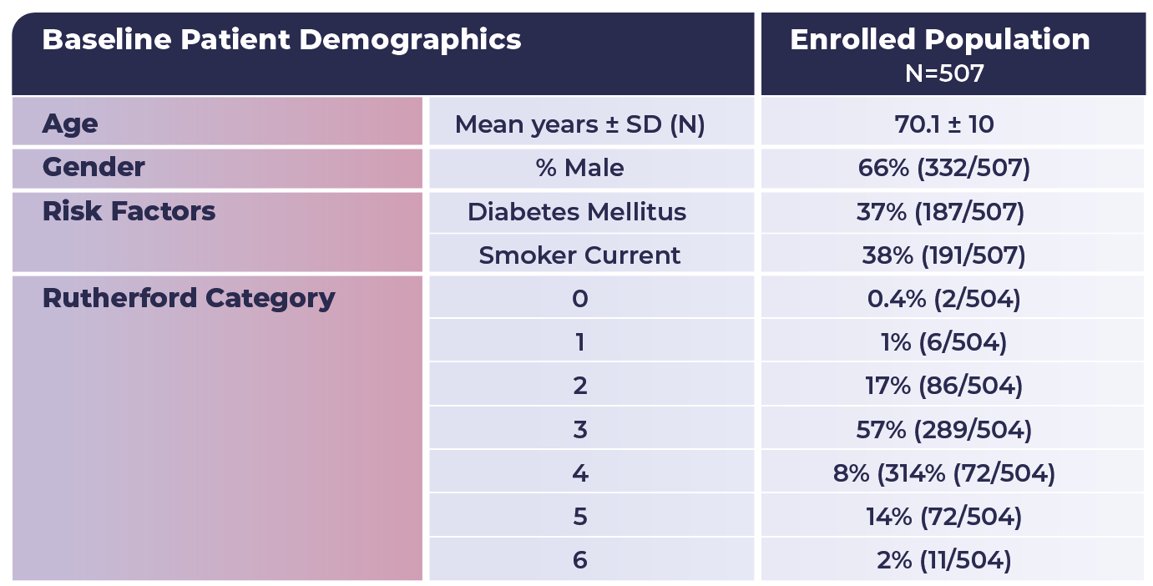
Mimics-3D Registry
A prospective, multicentre observational study to evaluate BioMimics 3D stent in PAD in the real world
PI: Michael Lichtenberg
23 Investigational sites
507 patients
Independent Clinical Event Committee (adjudication)
3-year follow up
CLTI present in 24%
of enrolled subjects
Data on file at Veryan Medical

Slide 9
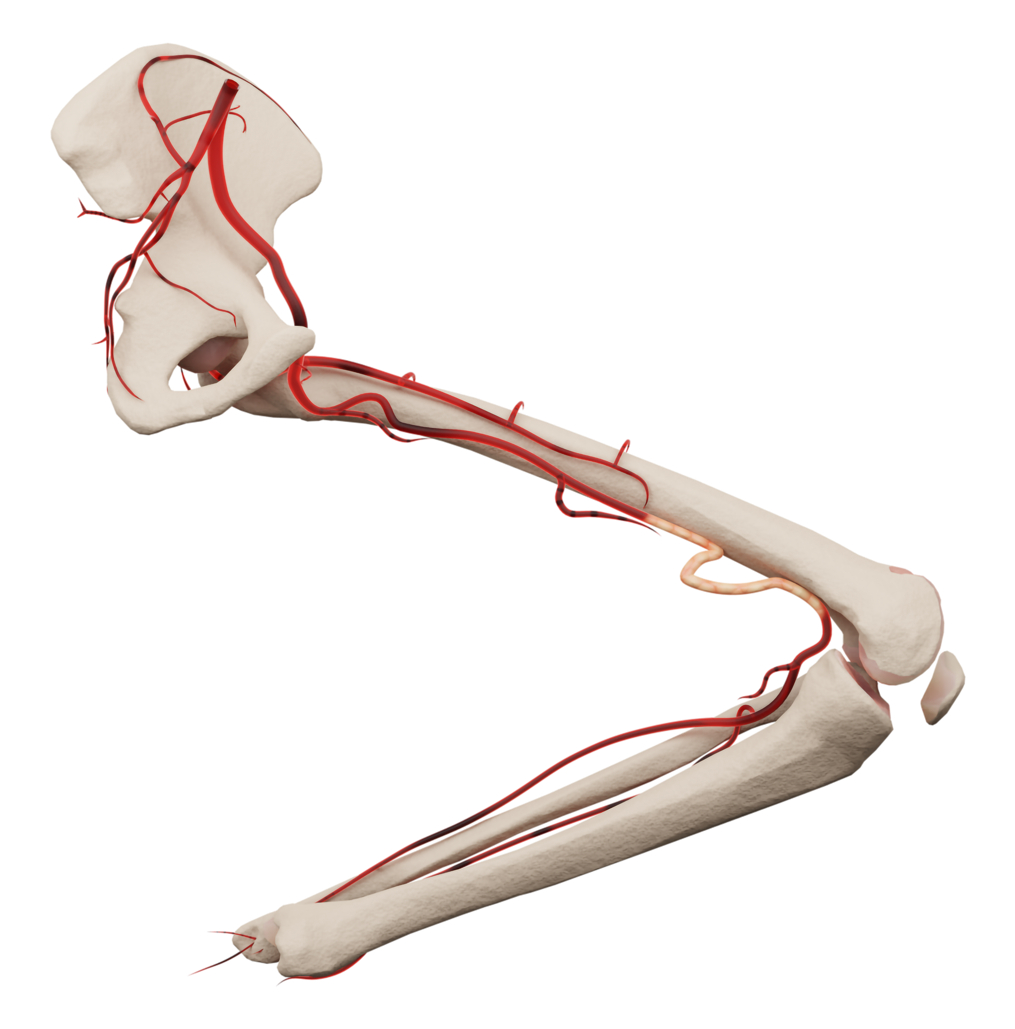
Subgroup analysis of outcomes in TASC D Lesions
As part of the 3-year follow up, a separate analysis was conducted to determine:
  Overall prevalence of TASC D lesions
  Impact on primary patency
  Impact on freedom from clinically-driven TLR
  Freedom from stent fracture
Data on file at Veryan Medical
Notes:
Goal: Given the prevalence of distal lesions, wanted to do a subgroup analysis to determine if there was a difference in 3 year outcomes with patients treated is the distal segment compared to those treated in the proximal segment.

Slide 10
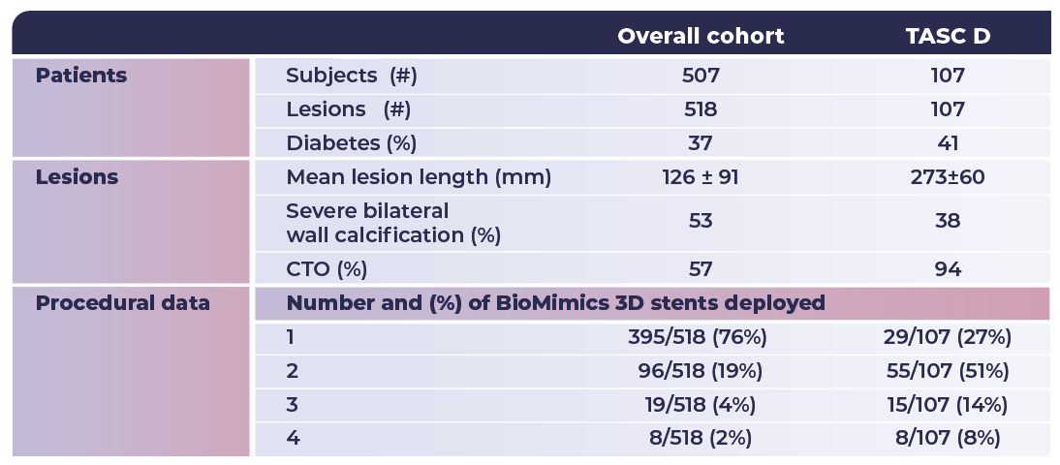
Mimics-3D Registry

Slide 11
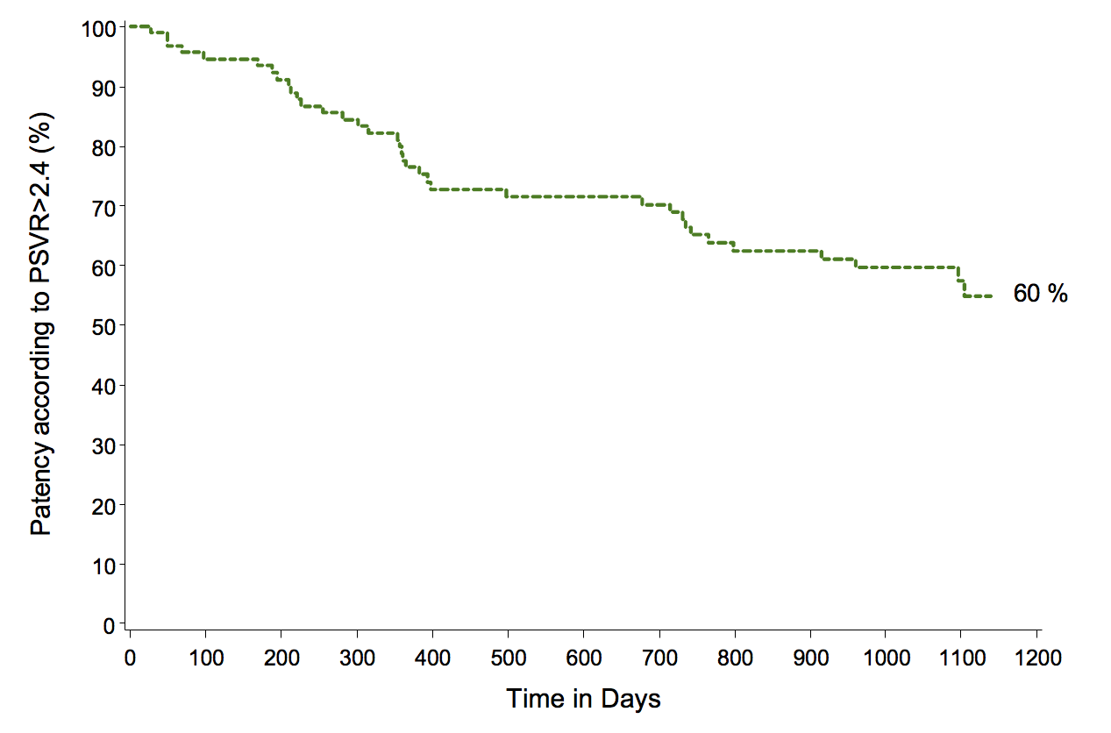
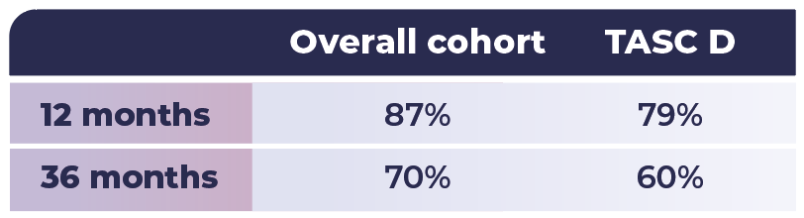
Results
KM Estimate of Freedom from Loss of Primary Patency
*
1
* ITT population. PSVR >2.4
As expected, the highly complex TASC D lesion population shows lower primary patency compared to the overall cohort but is well above the 41% at 3-years reported in the literature²
Data on file at Veryan Medical
S. Giannopoulos et al.Cardiovascular Revascularization Medicine 22 (2021) 52–65

Slide 12
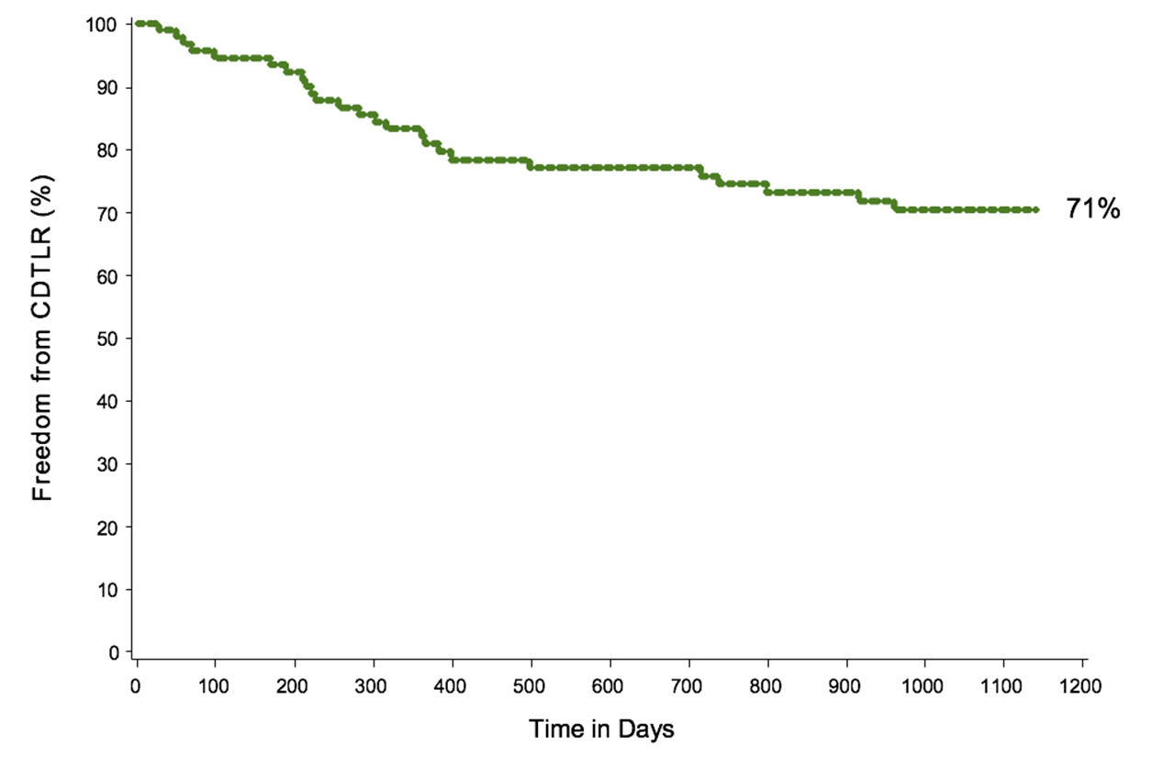
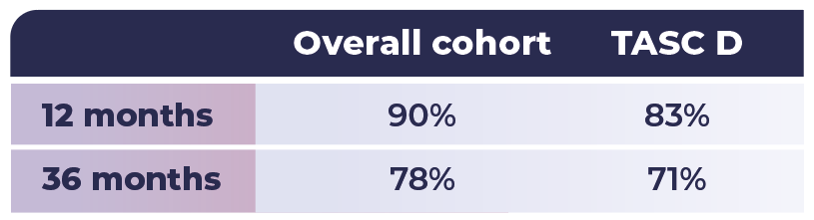
Results
KM Estimate of Freedom from Clinically-Driven TLR
1
As expected, the highly complex TASC D lesion population shows lower freedom from CD-TLR compared to the overall cohort but the 71% observed in the MIMICS study are comparable to the 2-year data (68%) reported in the literature²
Data on file at Veryan Medical
S. Giannopoulos et al.Cardiovascular Revascularization Medicine 22 (2021) 52–65

Slide 13
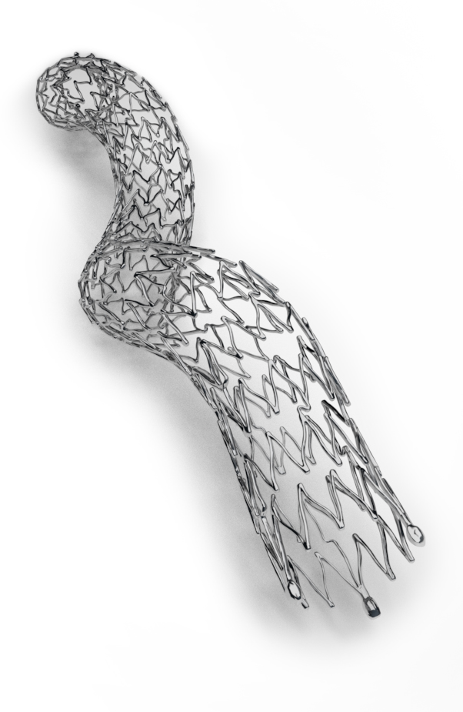
Conclusions
BioMimics 3D is a unique, helical stent platform that has demonstrated
excellent results and durability in several trials
Subgroup analysis performed to determine outcomes in patients with
TASC D femoropopliteal lesions treated with BioMimics3D shows:
  21% of pts with TASC D lesions
  Average lesion length of 273mm, 94% presenting with CTO
Durable 3-year outcomes with BioMimics3D platform in extremely complex lesions
  3-year KM freedom from loss of primary patency: 60%
  3-year KM freedom from CDTLR: 71%
  3-year stent fracture rate: 1.9% (2/107). (Overall cohort: 0.4% (3/676))
In 3 separate subgroup analyses, BioMimics 3D continues to demonstrate durable outcomes regardless of lesion location, morphology or length
through 3 years of follow up
Data on file at Veryan Medical
Data on file at Veryan Medical

