Slide 1
BioMimics3D
Clinical Program
Overview

Slide 2
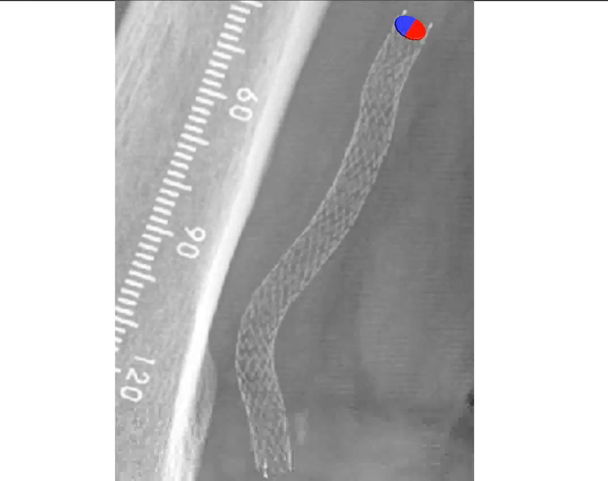
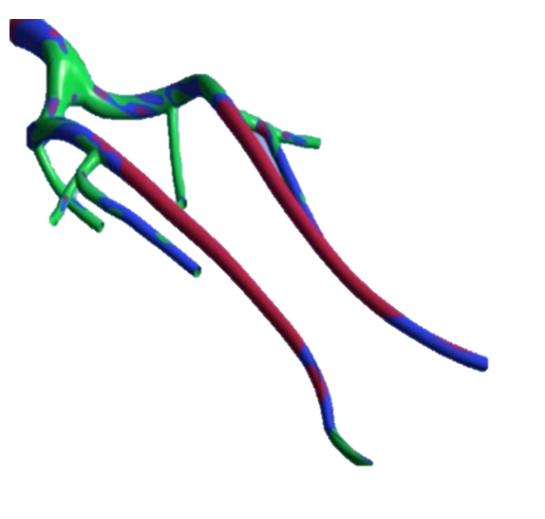
Atheroprotective & anti-restenotic effects of elevated wall shear stress
Non-planar vascular curvature promotes swirling blood flow¹
Swirling flow increases wall shear stress on endothelial cells²
Elevated wall shear stress has been shown to reduce intimal hyperplasia³
Wall Shear Stress in Femoropopliteal Segment
PROTECTIVE
SUBOPTIMAL
PATHOGENIC
Malek AM et al, JAMA 1999;252:2035–2042​
2. Caro CG, Arterioscler Thromb Vasc Biol 2009, 29:158-161​
3. Caro CG et al, J R Soc Interface 10: 20130578 ​

Slide 3
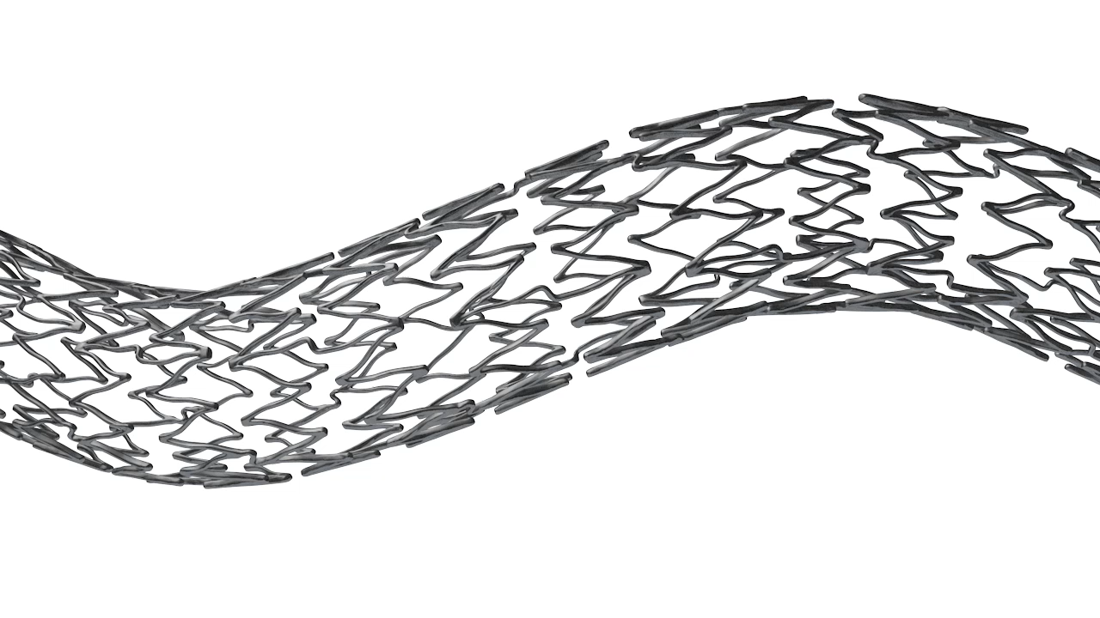
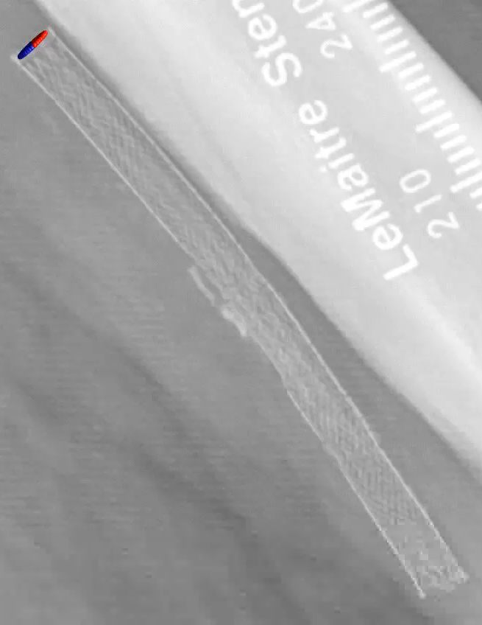
BioMimics 3D®: The Swirling Flow® Stent
Helical centreline
Simple, accurate placement using standard delivery system
Imparts non-planar curvature¹
Generates swirling flow to provide an antiproliferative effect without the need for a drug^{1, 2}
Improved biomechanical performance compared to straight stents¹
Data on file at Veryan Medical
Caro et al., 2013
The BioMimics 3D Vascular Stent System has FDA, PMDA and CE Mark approval.
CAUTION: Federal law restricts this device to sale by or on the order of a physician
PAM 293 Version 3.0.
Data on file at Veryan Medical
Caro CG et al, JR Soc. Interface 10: 20130578 2013

Slide 4
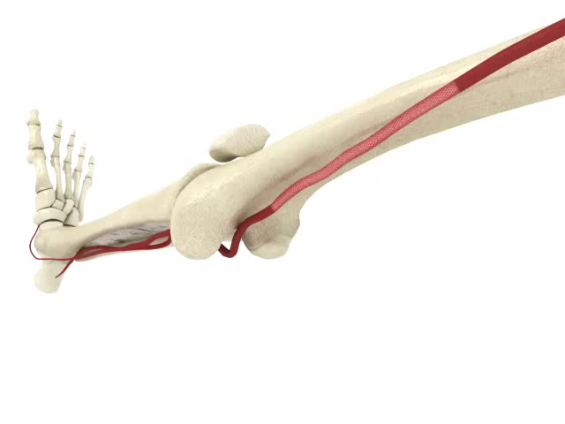
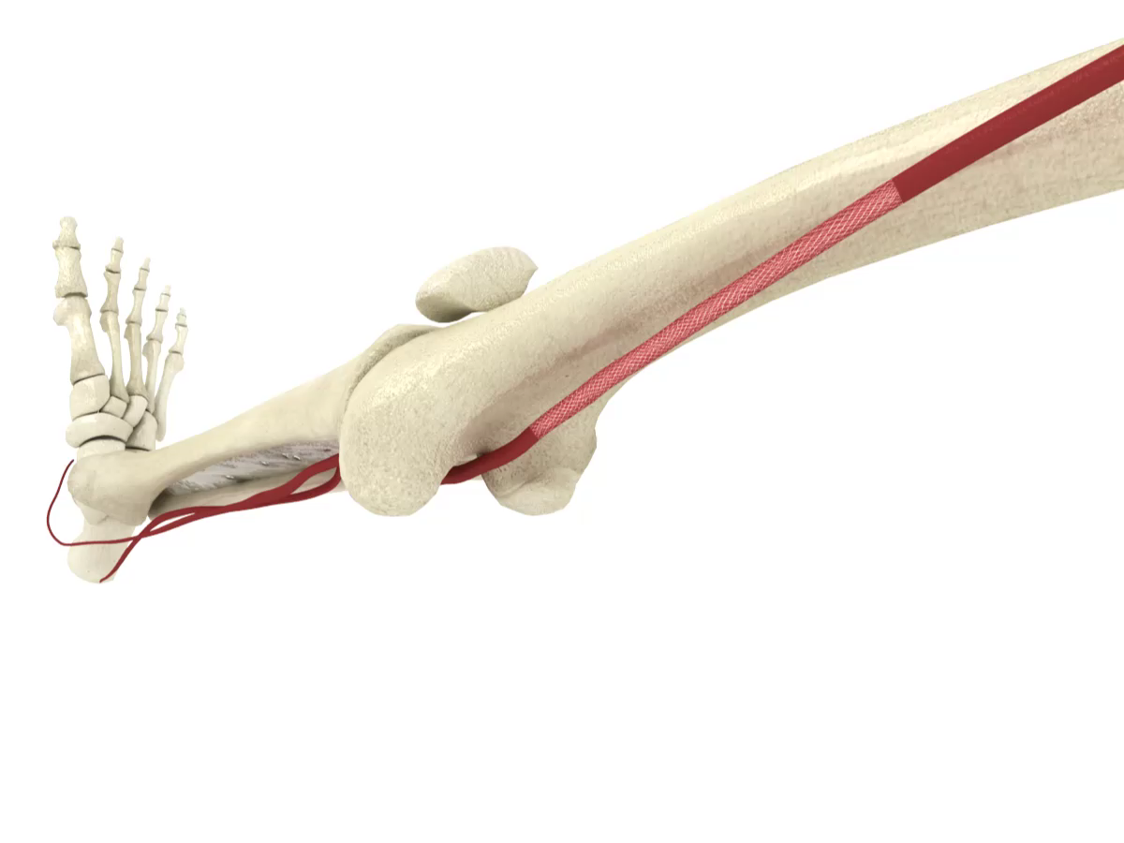
Improving the Biomechanics
BioMimics 3D
3D helical geometry of the BioMimics 3D stent is designed to adapt to the morphological changes and reduce the risk of vessel buckling / kinking during knee flexion/extension
Straight Stents
Straight laser-cut stents do not allow the physiological compensation required when the knee bends and the femoropopliteal artery shortens
Data on file at Veryan Medical

Slide 5
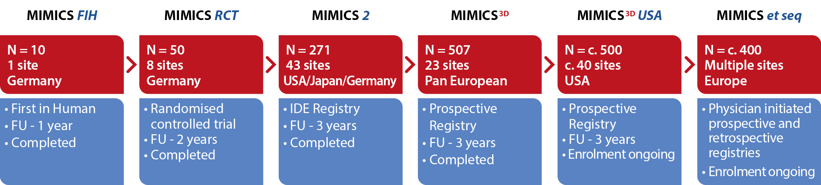
BioMimics 3D Clinical Program
Germany
1750+ patients
Data on file at Veryan Medical

Slide 6
MIMICS RCT
A randomized study comparing safety and effectiveness of the BioMimics 3D Vascular Stent System to a straight stent control
2-Year Results

Slide 7
MIMICS RCT STUDY: DESIGN
LEAD-IN PHASE I N=10
RANDOMISED PHASE II N=76
8 INVESTIGATIONAL SITES
Universitäts-Herzzentrum Freiburg - Bad Krozingen
MVZ, Hamburg
ZMIT, Berlin
CardioVascular Center, Frankfurt
Park-Krankenhaus, Leipzig
Königin Elisabeth Herzberge, Berlin
Klinikum Rosenheim, Rosenheim
St. Franziskus-Hospital, Münster
BIOMIMICS 3D N=50
CONTROL STENT N=26
(24/26 BARD LIFESTENT™)
DEATH(1) WITHDRAWN CONSENT(3) LOST TO FOLLOW-UP(2)
12-MONTH ASSESSMENTS N=44/44
LOST TO FOLLOW-UP(1) MISSED 12-MONTH VISIT(2)
12-MONTH ASSESSMENTS N=23/25
WITHDRAWN CONSENT(1) NO RE-CONSENT TO
24-MONTH PROTOCOL(2)
24-MONTH ASSESSMENTS N=41/41
DEATH(1) WITHDRAWN CONSENT(1)
LOST TO FOLLOW-UP(1)
24-MONTH ASSESSMENTS N=22/22
Data on file at Veryan Medical

Slide 8
MIMICS RCT STUDY: DEMOGRAPHICS
 |  | BioMimics 3D (N=50) | Control Stent (N-26) | P value
Age | Mean ± SD (N) | 68 ± 10.4 | 67 ± 8.9 | 0.66
Gender | Male | 66% | 65% | 1.00
Risk Factors | Diabetes Type 2 | 26% | 42% | 0.16
 | Insulin-dependent | 14% | 19% | 1.00
 | Hypertension | 88% | 85% | 0.73
 | Smoking Current | 42% | 50% | 0.63
Medical History | Carotid artery disease | 10% | 8% | 1.00
 | Iliac disease | 18% | 15% | 1.00
Previous Interventions | Previous PTA | 16% | 12% | 0.74
 | Previous Stent | 2% | 8% | 0.27
Rutherford Category | 1 | 6% (3/50) | 4% (1/26) | 1.00
 | 2 | 14% (7/50) | 4% (1/26) | 0.74
 | 3 | 74% (37/50) | 88% (23/26) | 0.27
 | 4 | 6% (3/50) | 4% (1/26) | 1.00
Ankle Brachial Index | Mean ± SD (N) | 0.60 ± 0.23 (N=45) | 0.59 ± 0.17 | 0.83
Data on file at Veryan Medical

Slide 9
MIMICS RCT STUDY: LESION CHARACTERISTICS
 |  | BioMimics 3D (N=50) | Control Stent (N-26) | P value
Lesion Location | SFA | 92% | 77% | 0.08
 | SFA/Popliteal | 6% | 12% | 0.41
 | Popliteal | 2% | 12% | 0.11
TASC II | A | 42% | 42% | 1.00
 | B | 56% | 58% | 1.00
 | C | 2% | 0% | 1.00
Lesion Length | mm | 66 ± 29 | 63 ± 28 | 0.66
Stent Length | mm | 99 ± 30 | 88 ± 22 | 0.08
Occlusion | Total | 44% | 46% | 1.00
Calcification | Moderate to Severe | 52% | 58% | 0.81
Data on file at Veryan Medical

Slide 10
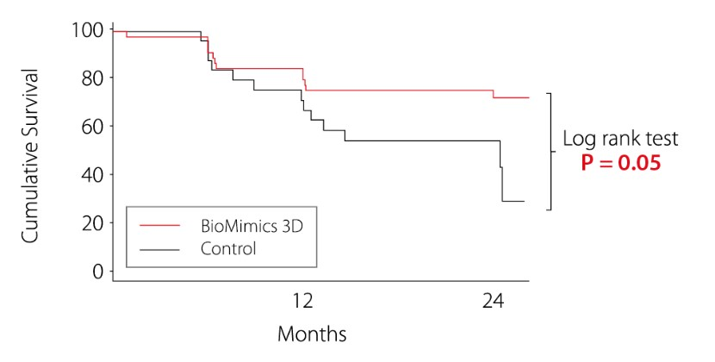
MIMICS RCT STUDY: PRIMARY PATENCY
Kaplan Meier Survival Estimate from
Loss of Patency
Defined as PSVR >2.0, or where angiography reveals >50% diameter stenosis; or adjudicated clinically-driven TLR
Data on file at Veryan Medical

Slide 11
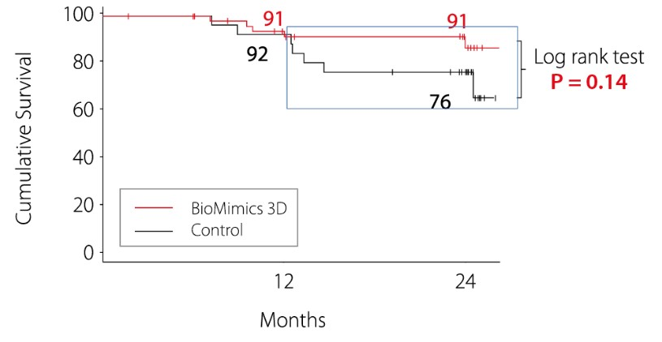
MIMICS RCT STUDY: CLINICALLY-DRIVEN TARGET LESION REVASCULARIZATION
Kaplan Meier Estimate of Survival from clinically-driven TLR determined through Independent Event Adjudication
Data on file at Veryan Medical

Slide 12
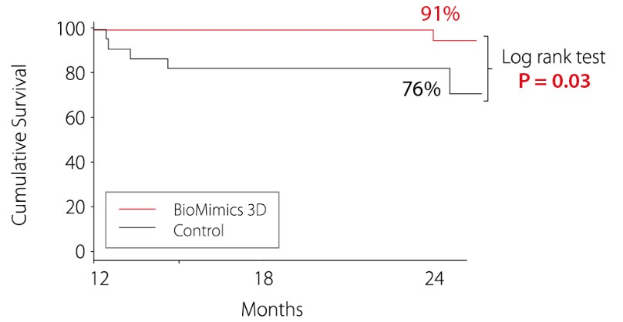
MIMICS RCT STUDY: LONG TERM TLR BENEFIT
12-Month Landmark Analysis
Kaplan Meier Estimate of Survival from clinically-driven TLR determined through Independent Event Adjudication
Data on file at Veryan Medical

Slide 13
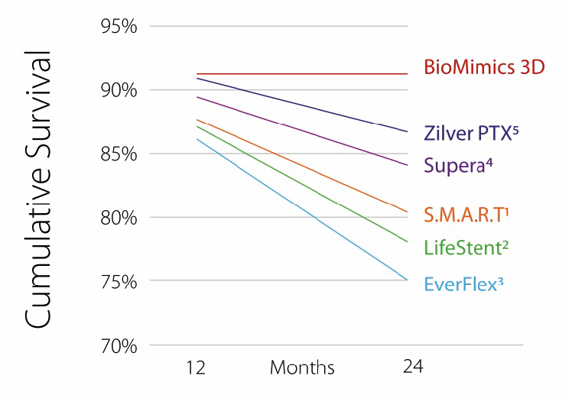
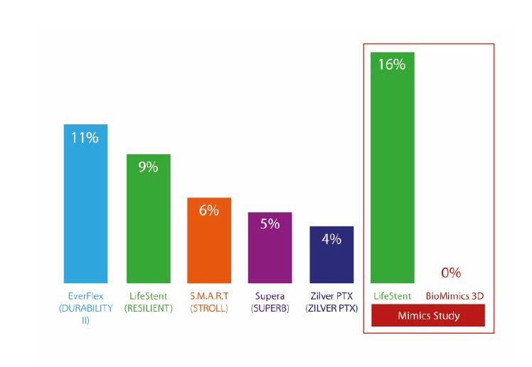
TLR: Contemporary Comparisons
Freedom from CDTLR (KM Survival Estimates)
Change in CDTLR from 12 to 24 months
6
1. 2. 3. 4. 5. 6.
1. Covidien EverFlex Stent: DURABILITY II Study, K Rocha-Singh, VIVA 2013
2. Bard LifeStent; RESILIENT Study, J. Mustapha, LINC 2012
3. Cordis SMART Stent; STROLL Study, 1-year: G. Ansel, LINC 2013; 2-year:; W. Gray ISET 2013
4. Abbott Supera Stent: SUPERB Study, K. Rosenfield, LINC 2014
. Cook Zilver PTX Stent: ZILVER PTX Study, M Dake, LINC 2012
. Zeller T et al; Circ Cardiovasc Interv. 2016;9:e002930. DOI: 10.1161

Slide 14
MIMICS RCT STUDY: CONCLUSIONS
MIMICS-RCT Provided the first clinical proof supporting the durable outcome benefit arising from the BioMimics 3D stent compared to a straight nitinol stent
Freedom from loss of Primary Patency at 2 years
  72% for BioMimics 3D vs 55% for straight control stents (P=0.05).
Freedom from CDTLR
  91% for BioMimics 3D maintained out to 2 years.
Core lab X-ray imaging review confirmed 0% stent fractures at 2 years.
Improvement in Rutherford Category
  88% of patients treated with BioMimics 3D experienced an improvement of one or more Rutherford category at 2 years vs baseline.
Data on file at Veryan Medical

Slide 15
MIMICS 2
Prospective, Multi-Center International IDE Study
Presentation of 3-year Data

Slide 16
MIMICS 2 A multi-center international IDE study
Evaluation of Safety and Effectiveness of the BioMimics 3D Stent System in the Femoropopliteal Arteries of Patients with Symptomatic Peripheral Arterial Disease
Primary Endpoints
Safety: composite of death, major amputation or CDTLR through 30 days
Effectiveness: primary patency at 12-months
Follow-up: 3 years
43 investigational sites enrolled 271 subjects
US: 31 sites N = 162
Germany 6 sites N = 78
Japan: 6 sites N = 31
Study Principal Investigators
Timothy M. Sullivan, MD Minneapolis, MN, USA
Thomas Zeller, MD Bad Krozingen, Germany
Masato Nakamura, MD Tokyo, Japan
Core laboratories: ultrasound; angiography; X-ray Clinical Event Committee (CEC) adjudication
Data on file at Veryan Medical

Slide 17
MIMICS 2 A multi-center international IDE study
Baseline Patient Demographics
 |  | N= 271 Subjects
Age | Mean years ± SD (N) | 68.4 ± 9.5 (271/271)
Gender | Male / Female | 180 (66.4%) / 91 (33.6%)
Risk Factors | Diabetes Mellitus | 45.4% (123/271)
 | Hypertension | 90.0% (244/271)
 | Hypercholesterolemia | 81.9% (222/271)
 | Smoker Current / Former | 80.8% (219/271)
Coronary Revascularization | Previous Percutaneous or Surgical | 43.2% (117/271)
Previous Peripheral Intervention | None in target vessel | 98.2% (266/271)
Rutherford Category | 1 | 0% (0/271)
 | 2 | 26.9% (73/271)
 | 3 | 67.5% (183/271)
 | 4 | 5.2% (14/271)
 | 5 | 0.4% (1/271)
Ankle Brachial Index | Mean ± SD (N) | 0.70 ± 0.20 (257/271)
Data on file at Veryan Medical

Slide 18
MIMICS 2 A multi-center international IDE study
Baseline Angiography and QVA
Core Laboratory Data |  | N= 271 Subjects
Reference Vessel Diameter (mm) | Mean years ± SD | 5.2 ± 0.9 (269/271)
Lesion Type¹ | De novo | 100% (271/271)
Lesion Location in Femoropopliteal Artery | Prox Mid Distal | 11.5% (31/270) 48.1% (130/270) 40.4% (109/270)
Diameter Stenosis (%) | Mean ± SD | 77.8 ± 18.3 (269/271)
Lesion Length (mm) | Mean ± SD | 81.2 ± 38.4 (269/271)
Total Occlusion (%) |  | 30.0 (81/270)
Calcification (%) | None - Mild Moderate - Severe | 54.1 (146/270) 45.9 (124/270)
Run-off (%) - 1 or more patent tibial artery (<50% stenosis) |  | 98.8 (237/240)
1 Investigator-reported
Data on file at Veryan Medical

Slide 19
MIMICS 2 A multi-center international IDE study
Index Procedure Data
 |  | N= 271 Subjects
BioMimics 3D Stents placed¹ | # Stents / N | 305 / 271
 | # Subjects with 1 stent | 87.5% (237/271)
 | # Subjects with 2 stents | 12.5% (34/271)
Stented Segment Length² | Mean ± SD (mm) | 112.3 ± 36.3 (269/271)
Diameter Stenosis² (%) | Pre-stent % ± SD | 77.8 ± 18.3 (269/271)
 | Post-stent % ± SD | 12.6 ± 7.5 (269/271)
Dissections² | No Dissection | 97.8% (263/269)
 | Type A-C | 2.2% (6/269)
 | Type D-F | 0% (0/269)
Device Success¹ |  | 100% (271/271)
Technical Success² |  | 100% (269/269)
. Investigator-reported
. Core Lab
Device Success: Successful delivery of System; placement of stent and retrieval of System
Technical Success: Core Lab determined ≤50% residual diameter stenosis (in-stent) at end of index procedure
Data on file at Veryan Medical

Slide 20
MIMICS 2 A multi-center international IDE study
Rigorous, high quality data shows continuing benefit at 3 years
Overview of 3-Year Results from MIMICS-2
Primary Safety Endpoint* | 30 days | 99.6%
Stent fracture/Core Lab review | Maintained out to 3 years | 0%
KM freedom from loss primary patency | 12 months | 83%
KM freedom from CDTLR** | 12 months | 89%
 | 2 years | 84%
 | 3 years | 81%
* Major Adverse Events comprising death, major amputation on index limb or CDTLR through Day 30.
** Core Lab adjudicated, clinically-driven TLR with objective evidence. Subjects are censored at their last known follow-up, or at time of study exit (withdrawal or lost to follow-up) or death.
Data on file at Veryan Medical

Slide 21
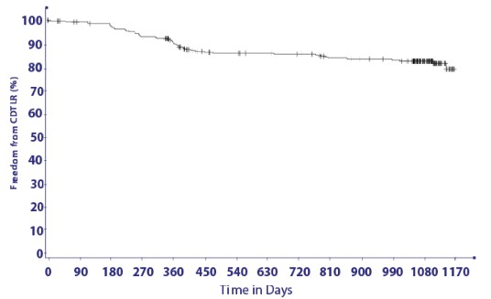
MIMICS 2 A multi-center international IDE study
Kaplan-Meier Survival Analysis
3-year Freedom from CDTLR*:
81%
Time (days): | 0-0 | 1-30 | 31-360 | 361-365 | 366-720 | 721-730 | 731-1080 | 1081-1095
# at Risk (interval start): | 271 | 266 | 223 | 222 | 192 | 191 | 109 | 78
# Subjects with Events: | 0 | 1 | 27 | 1 | 11 | 0 | 7 | 0
# Censored: | 0 | 4 | 16 | 0 | 19 | 1 | 75 | 31
Event-free % cummulative: | 100% | 99.6% | 89.1% | 88.7% | 84.2% | 84.2% | 81.0% | 81.0%
Standard error: | 0.0% | 0.4% | 1.9% | 2.0% | 2.3% | 2.3% | 2.5% | 2.5%
* Core Lab adjudicated, clinically-driven TLR with objective evidence
Subjects are censored at their last known follow-up, or at time of study exit (withdrawal or lost to follow-up) or death
Data on file at Veryan Medical

Slide 22
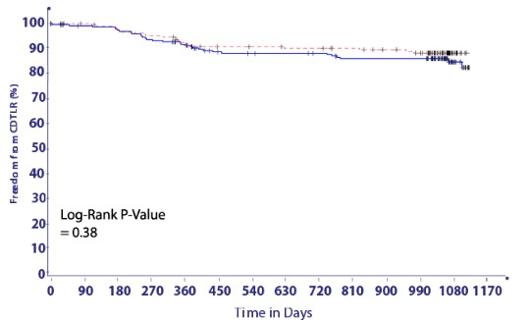
MIMICS 2 A multi-center international IDE study
Kaplan-Meier Survival Analysis
Lesion Calcification
No statistical difference in need for reintervention, even in heavily calcified lesions
---- Mod/Severe = 82%
None/Mild = 78%
Time (days): | 0-0 | 1-30 | 31-360 | 361-365 | 366-720 | 721-730 | 731-1080 | 1081-1095
None/Mild
# at Risk (interval start): | 146 | 142 | 115 | 115 | 98 | 97 | 56 | 41
# Subjects with Events: | 0 | 1 | 17 | 0 | 7 | 0 | 4 | 0
Event-free % : | 100% | 99.3% | 87.0% | 87.0% | 81.5% | 81.5% | 78.1% | 78.1%
Mod/Severe # at Risk (interval start): | 124 | 123 | 104 | 103 | 90 | 90 | 50 | 34
# Subjects with Events: | 0 | 0 | 13 | 1 | 4 | 0 | 3 | 0
Event-free % : | 100% | 100% | 89.1% | 88.2% | 84.7% | 84.7% | 81.7% | 81.7%
Subjects are censored at their last DUS follow-up, or at time of study exit (withdrawal or lost to follow-up) or death.
Subjects who are PATENT at DUS follow-up are censored at the end of the follow-up window.
Data on file at Veryan Medical

Slide 23
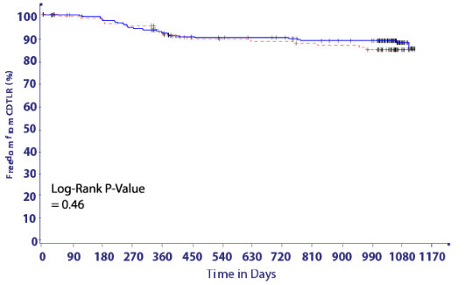
MIMICS 2 A multi-center International IDE Study
Kaplan-Meier Survival Analysis
CTO vs Stenosis
No statistical difference in need for reintervention, even in complex lesions
Stenosis = 82%
---- CTO = 76%
Time (days): | 0-0 | 1-30 | 31-360 | 361-365 | 366-720 | 721-730 | 731-1080 | 1081-1095
No Total Occlusions # at Risk (interval start): | 189 | 185 | 153 | 153 | 131 | 130 | 73 | 56
# Subjects with Events: | 0 | 1 | 21 | 0 | 7 | 0 | 3 | 0
Event-free % : | 100% | 99.5% | 87.8% | 87.8% | 83.7% | 83.7% | 81.7% | 81.7%
Total Occlusion # at Risk (interval start): | 81 | 80 | 66 | 65 | 57 | 57 | 33 | 19
# Subjects with Events: | 0 | 0 | 9 | 1 | 4 | 0 | 4 | 0
Event-free % : | 100% | 100% | 88.2% | 86.9% | 81.3% | 81.3% | 75.5% | 75.5%
Subjects are censored at their last DUS follow-up, or at time of study exit (withdrawal or lost to follow-up) or death. Subjects who are PATENT at DUS follow-up are censored at the end of the follow-up window.
Data on file at Veryan Medical

Slide 24
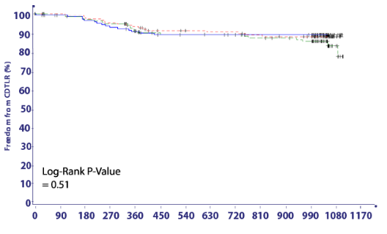
MIMICS 2 A multi-center International IDE Study
Kaplan-Meier Survival Analysis
Tercile of Lesion Length
No statistical difference in need for re-intervention, even in long lesions
Tercile 1 (<65mm) = 82%
---- Tercile 2 (>65mm - <100mm) = 81%
---- Tercile 3 (>100mm) = 77%
Time (days): | 0-0 | 1-30 | 31-360 | 361-365 | 366-720 | 721-730 | 731-1080 | 1081-1095
Tercile 1
# at Risk (interval start): | 90 | 87 | 72 | 71 | 63 | 62 | 34 | 24
# Subjects with Events: | 0 | 1 | 11 | 1 | 2 | 0 | 0 | 0
Event-free % : | 100% | 98.9% | 85.9% | 84.7% | 82.2% | 82.2% | 82.2% | 82.2%
Tercile 2
# at Risk (interval start): | 95 | 94 | 80 | 80 | 68 | 68 | 43 | 31
# Subjects with Events: | 0 | 0 | 9 | 0 | 5 | 0 | 3 | 0
Event-free % : | 100% | 100% | 90.2% | 90.2% | 84.4% | 84.4% | 80.6% | 80.6%
Tercile 3
# at Risk (interval start): | 86 | 85 | 68 | 68 | 58 | 58 | 30 | 21
# Subjects with Events: | 0 | 0 | 10 | 0 | 4 | 0 | 4 | 0
Event-free % : | 100% | 100% | 87.6% | 87.6% | 82.3% | 82.3% | 76.5% | 76.5%
Subjects are censored at their last DUS follow-up, or at time of study exit (withdrawal or lost to follow-up) or death.
Subjects who are PATENT at DUS follow-up are censored at the end of the follow-up window.
Data on file at Veryan Medical

Slide 25
MIMICS 2 CONCLUSIONS
MIMICS-2 shows continuing benefit of the BioMimics 3D Vascular Stent System at 3 Years, even in challenging cases:
Reproducible, rigorous, high quality data from US, Japan and Europe.
KM freedom from loss of primary patency - 83% at 1 year
KM freedom from CDTLR - 81% at 3 years.
Comparable outcomes to DES/DCB despite more challenging lesions and without the need for lesion preparation.
Core Lab X-ray imaging review confirmed 0% stent fracture at 3 years.
Providing ease-of use simplicity and long-term benefits
Data on file at Veryan Medical

Slide 26
MIMICS^{3D} European Registry
A prospective observational registry evaluating BioMimics 3D in a real-world clinical population
Presentation of 3-year Data
Data on file at Veryan Medical

Slide 27
MIMICS^{3D} European Registry
A prospective observational registry evaluating the BioMimics 3D helical stent in a real-world clinical population with dedicated subgroup analysis of device performance as a complementary treatment in procedures involving drug-coated balloons.
Primary Endpoints
Safety: Composite of major adverse events (MAE), death, major amputation performed or CDTLR through 30 days
Effectiveness: Freedom from clinically-driven target lesion revascularization through 12 months
Enrolment completed June 2018 - N=507 Clinical Sites – 23 Pan-European
Follow Up – 3 Years
Principal Investigator: Michael Lichtenberg MD , Arnsberg, Germany
Data on file at Veryan Medical

Slide 28
MIMICS^{3D} European Registry
Baseline Patient Demographics
 |  | ​ Enrolled Population​ N=507​
Age | Mean years ± SD (N) | 70.1 ± 10​
Gender | % Male | 66% (332/507)​
Risk Factors | Diabetes Mellitus Smoker Current | 37% (187/507)​ 38% (191/507)
Rutherford Category | 0 | 0.4% (2/504)​
 | 1 | 1% (6/504)​
 | 2 | 17% (86/504)​
 | 3 | 57% (289/504)​
 | 4 | 8% (38/504)​
 | 5 | 14% (72/504)​
 | 6 | 2% (11/504)​
Ankle Brachial Index | Mean ± SD (N) | 0.6 ± 0.3 (417)​
24% of subjects enrolled in MIMICS-3D have Critical Limb Threatening Ischemia
Data on file at Veryan Medical
Data on file at Veryan Medical

Slide 29
MIMICS^{3D} European Registry
Baseline Lesion Characteristics
 |  | Enrolled Population N=507 subjects (518 lesions)
Reference Vessel Diameter (mm) | Mean ± SD | 5.5 ± 0.7
Stent Location (%) | Mid ± Distal SFA | 86% (444/518)
 | Prox. Pop | 30% (154/518)
Diameter Stenosis (%) | Mean ± SD | 95 ± 8 (518)
Occlusions | Total | 57% (294/518)
Lesion Length (mm) | Mean ± SD | 126 ± 91
Calcification % | None / mild | 47% (243/516)
 | Moderate / severe | 53% (273/516)
Longer, more complex lesions than previously studied
53% of lesions had moderate to severe calcification
Data on file at Veryan Medical
Notes:
Added #TL but otherwise all data is per lesion
Use prox location for lesion, “other includes quite a few ostial SFA, one confirmed iliac (!) and some other stuff under query
Used proximal RVD
Removed total occlusion as don’t have direct equivalent to this core lab assessment. 210/379 report max stenosis 100%
Calcification
Grade 0 -70 18.6%
Grade 1 - 120 31.8%
Grade 2 - 88 23.3%
Grade 3 - 49 13.0%
Grade 4 - 50 13.3%
Total - 377 100.0%

Slide 30
Baseline Procedural Data
MIMICS^{3D} European Registry
Baseline Procedural Data
 |  | Enrolled Population N=507
BioMimics 3D Stents | # stents/lesions | 676/518
 | 1 stent | 76% (395/518)
 | 2 stents | 19% (96/518)
 | 3 stents | 4% (19/518)
 | 4 stents | 2% (8/518)
Stented Segment Length | Mean ± SD (mm) | 131 ± 80.1
Diameter Stenosis | Pre-stent % ± SD | 95% ± 8.0
 | Post-stent % ± SD | 6%± 8.7
Other Target Lesion Treatments | Drug coated balloon | 50.0% (260/518)
 | Atherectomy | 8% (39/518)
More than 1 stent used in 25% of lesions
Data on file at Veryan Medical

Slide 31
MIMICS Clinical Program
Enrolling progressively longer and more complex lesions
Mean ± SD (mm) | MIMICS-RCT | MIMICS-2 | MIMICS-3D
Lesion Length | 66 ± 29 | 81 ± 38 | 126 ± 91
Stented Segment Length | 99 ± 30 | 112 ± 36 | 131 ± 80
CTO | 44% | 30% | 57%
Mod/Severe Ca++ | 52% | 46% | 53%
CLTI | 6% | 6% | 24%
Core lab reported data for MIMICS and MIMICS-2, site-reported for MIMICS-3D
Sub group analyses conducted on the impact of CTO/calcium on CDTLR and patency
Data on file at Veryan Medical

Slide 32
MIMICS^{3D} European Registry: 3-Year Results
Technical Success (procedure) | 99% (501/506)*
Procedural Success | 97%
Primary Endpoint: 30-day safety | 99% (486/493) Freedom from MAE
Primary Endpoint: 12-month effectiveness | 89% (399/448) Freedom from CDTLR
36-Month KM Freedom from loss of Primary Patency** | 71%
36-Month KM Freedom from CDTLR | 78%
Stent fracture (site reported) | 0.6% (4/676)
Stent fracture (confirmed by investigation) | 0.4% (3/676)
Kaplan Meier survival estimates of Freedom from Clinically-Driven TLR at 3 Years
1 year
90%
2 years
82%
3 years
78%
*1 patient did not have a final diameter stenosis recorded
**ITT population. PSVR >2.4
Data on file at Veryan Medical

Slide 33
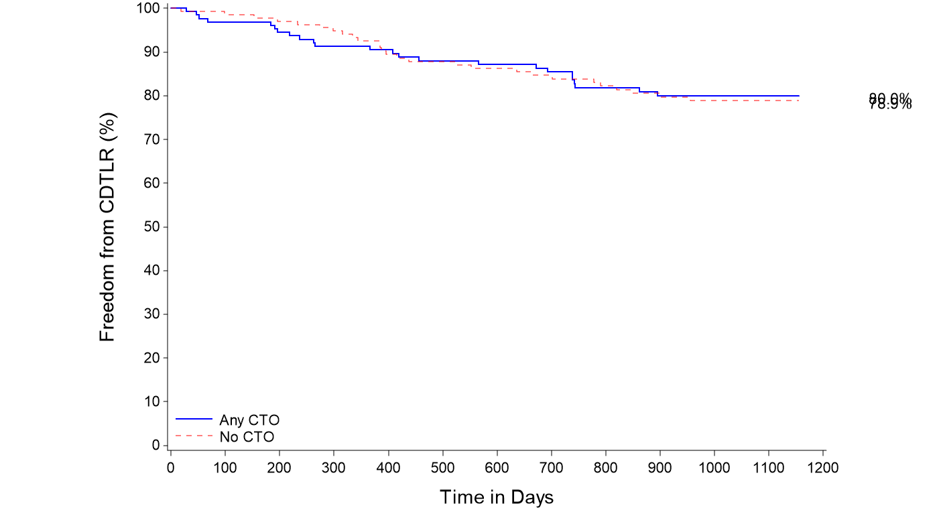
MIMICS-3D Subgroup Propensity Matched Analysis: CTO
KM Freedom from CDTLR comparison
% incidence in MIMICS-3D
CTOs | 57%
80%
79%
Freedom from CDTLR at 3 years
80% in Any CTO cohort
79% in No CTO cohort
No statistical significance between the 2 cohorts
P value = 0.890
Any CTO
-------- No CTO
Data on file at Veryan Medical
Notes:
Propensity matching conducted to reduce the bias due to confounding variables present in the 2 different cohorts.

Slide 34
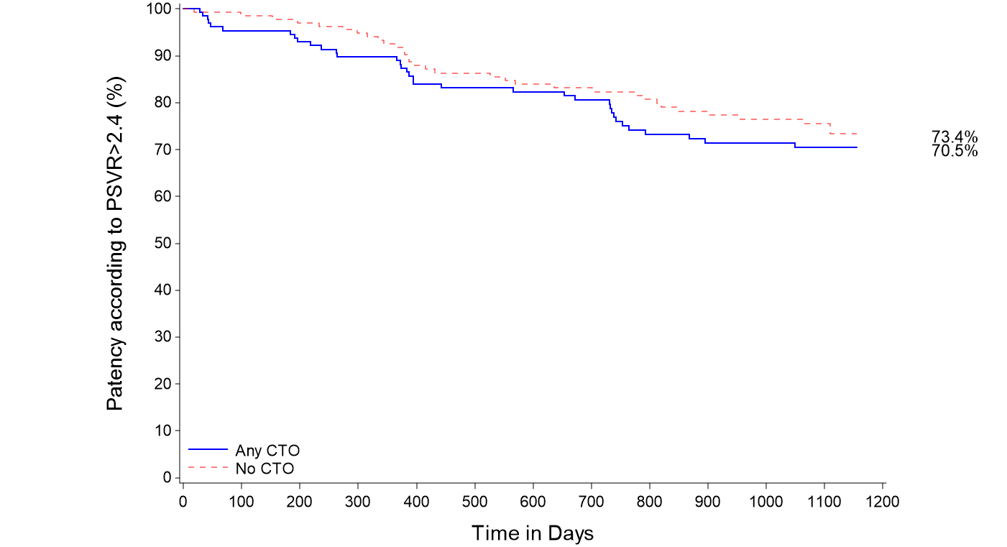
MIMICS-3D Subgroup Propensity Matched Analysis: CTO
KM freedom from loss of primary patency comparison
% incidence in MIMICS-3D
CTOs | 57%
Freedom from loss of primary patency at 3 years
76% in No CTO cohort
71% in Any CTO cohort
No statistical significance between the 2 cohorts
76%
71%
P value = 0.388
Any CTO
-------- No CTO
ITT population. PSVR >2.4
Data on file at Veryan Medical
Notes:
Propensity matching conducted to reduce the bias due to confounding variables present in the 2 different cohorts.

Slide 35
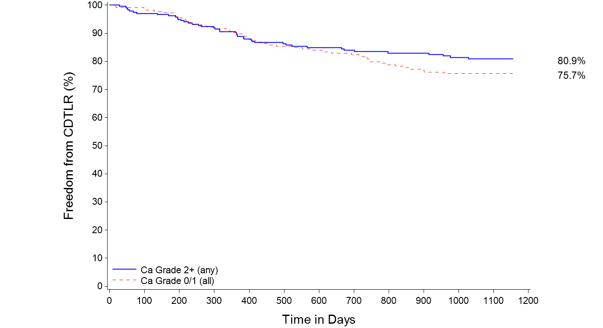
MIMICS-3D Subgroup Analysis : Calcium
KM Freedom from CDTLR comparison
% incidence in MIMICS-3D
Moderate to severe calcification | 53%
Severe, bilateral wall calcium | 28%
81%
76%
P value = 0.256
Freedom from CDTLR at 3 years
81% in moderate/severe cohort
76% in none/mild cohort
No statistical significance between the 2 cohorts
Mod/severe
-------- None/mild
Data on file at Veryan Medical
Notes:
Propensity matching not conducted as potential confounding variables were not present in the 2 different cohorts.

Slide 36
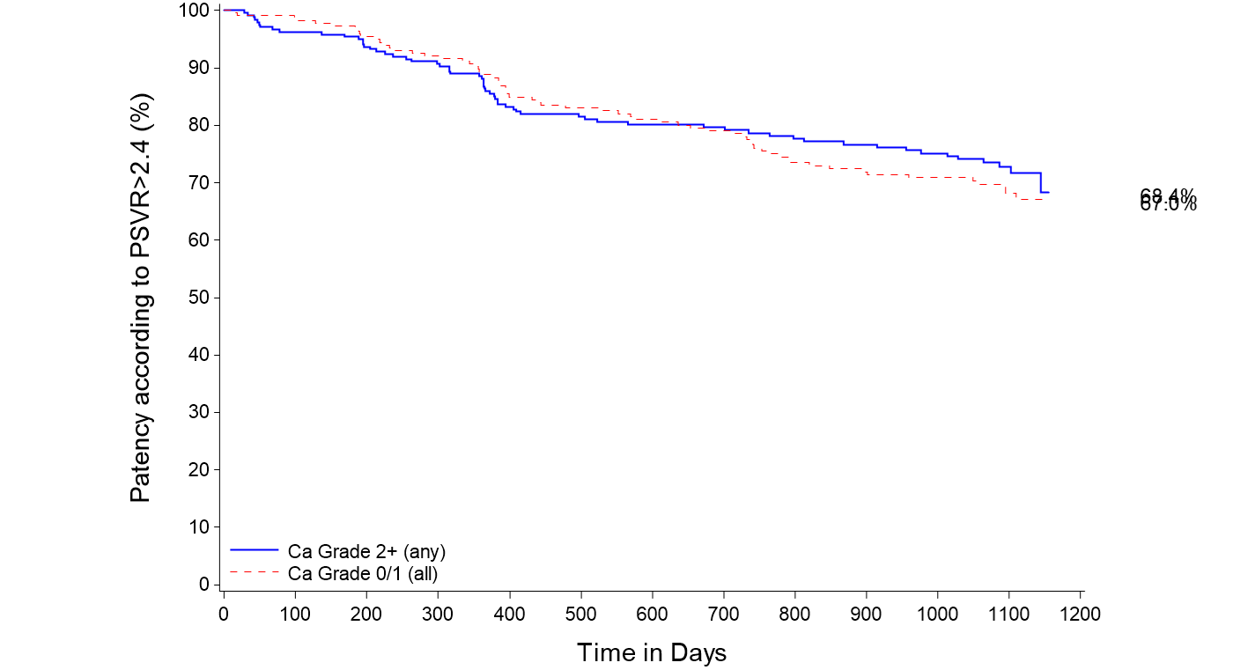
MIMICS-3D Subgroup Analysis : Calcium
KM freedom from loss of primary patency comparison
% incidence in MIMICS-3D
Moderate to severe calcification | 53%
Severe, bilateral wall calcium | 28%
74%
70%
P value = 0.544
Freedom from loss of primary patency at 3 years
74% in moderate/severe cohort
70% in none/mild cohort
No statistical significance between the 2 cohorts
Mod/severe
-------- None/mild
ITT population. PSVR >2.4
Data on file at Veryan Medical
Notes:
Propensity matching not conducted as potential confounding variables were not present in the 2 different cohorts.

Slide 37
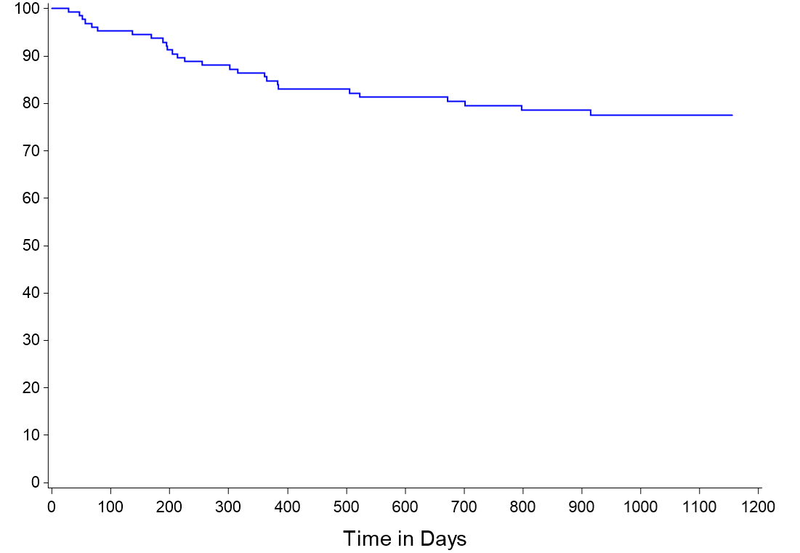
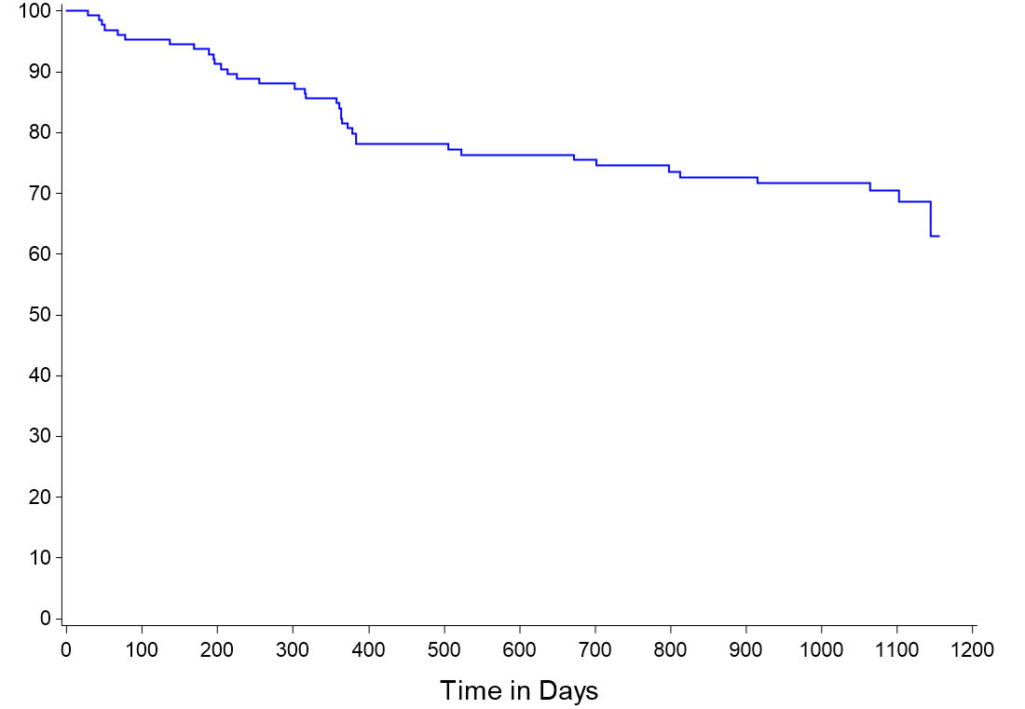
3-Year Outcomes in Severe Calcium Cohort
Freedom from CDTLR
Freedom from loss of Primary Patency
78% in severe calcification
71% in severe calcification
PSVR >2.4
28% of lesions had severe/bilateral wall calcification
59% of severely calcified lesions were CTOs
144mm +/-94 avg lesion length in severely calcified cohort
Data on file at Veryan Medical

Slide 38
Indicative Study Comparisons-Freedom from CDTLR
I-------------------BioMimics 3D------------------I Supera Eluvia Zilver PTX
BioMimics 3D has comparable outcomes to DES and Supera despite enrolling progressively longer lesions in the MIMICS Clinical program
Data on file at Veryan Medical
¹⁰

Slide 39
Post-hoc Subgroup Analysis of the MIMICS-3D European Registry
Three groups:
Moderate Lesions (L): length <140mm (N=342)
Long lesions (LL): length between 140mm to ≤ 190mm (N=46)
Very long lesions (VLL): length >190mm (N=119).
Data on file at Veryan Medical

Slide 40
Baseline Patient Demographics
 |  | Moderate Lesions <140mm (N=342) | Long lesions 140mm to ≤ 190mm (N=46) | Very long lesions >190mm (N=119)
Age | Mean years ± SD | 70.1 ± 9.9 | 70.4 ± 9.6 | 69.8 ± 10.3
Gender | % Male | 66% (227/342) | 57% (26/46) | 66% (79/119)
Risk Factors | Diabetes Mellitus | 37% (125/342) | 33% (15/46) | 40% (47/119)
 | Smoker Current | 36% (124/342) | 37% (17/46) | 42% (50/119)
Rutherford Category | Mean ± SD (n) | 3.2 ± 1.1 (339) | 3.2 ± 0.9 (46) | 3.3 ± 0.9 (119)
Ankle Brachial Index | Mean ± SD (N) | 0.62 ± 0.27 (270) | 0.61 ± 0.23 (42) | 0.54 ± 0.22 (105)
CLTI present in 24% of enrolled subjects
Data on file at Veryan Medical

Slide 41
Baseline Lesion Characteristics
 |  | Moderate Lesions <140mm (N=342) | Long lesions 140mm to ≤ 190mm (N=46) | Very long lesions >190mm (N=119)
Reference Vessel Diameter (mm) | Mean ± SD | 5.4 ± 0.7 | 5.5 ± 0.7 | 5.5 ± 0.7
Diameter Stenosis (%) | Mean ± SD | 93.0 ± 8.7 | 94 ± 8.0 | 99 ± 2.4
Occlusions | Total | 45% | 58% | 92%
Lesion Length (mm) | Mean ± SD | 72.2 ± 29.4 | 160.2 ± 22.6 | 269 ± 61
Calcification | Severe bilateral wall calcification | 26% | 25% | 38%
Data on file at Veryan Medical

Slide 42
3-Year Results
 | Moderate Lesions <140mm | Long lesions 140mm to ≤ 190mm | Very long lesions >190mm
Acute technical success | 99% (339/341) | 100% (46/46) | 98% (116/119)
Primary Effectiveness Endpoint – 12-month KM Freedom from CDTLR | 93% | 85% | 82%
KM freedom from Major Amputation at 3 years | 99% | 98% | 98%
Fracture rate* at 3 years | 0.5% | 0% | 0.8%
*Investigator reported
Data on file at Veryan Medical

Slide 43
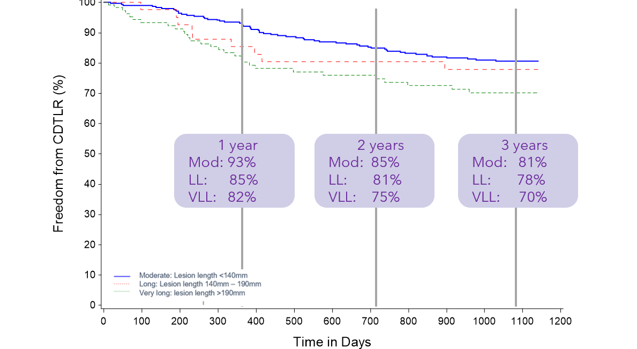
3-Year Kaplan-Meier Freedom from CDTLR
Lesion Length | CDTLR
<140mm | 81%
140mm–190mm | 78%
>190mm | 70%
No significant difference between moderate and long lesion groups
As expected, there is an observable difference between the moderate and very long lesion groups however, the CDTLR and durability of the very long lesion group is impressive given the lesion length and morphology
Data on file at Veryan Medical

Slide 44
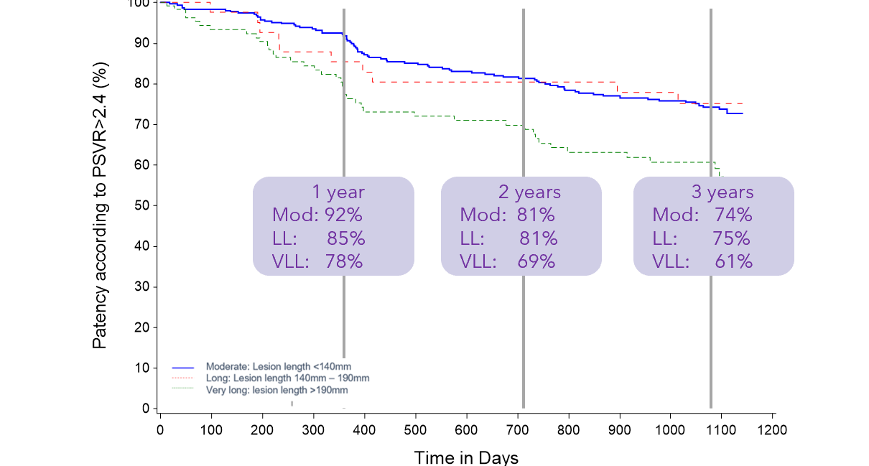
3-Year Kaplan-Meier Estimate of Primary Patency
Lesion Length | PSVR 2.4
<140mm | 74%
140mm–190mm | 75%
>190mm | 61%
75.2%
No significant difference between moderate and long lesion groups
As expected, there is an observable difference between the moderate and very long lesion groups however, the patency and durability of the very long lesion group is impressive given the lesion length and morphology
Data on file at Veryan Medical

Slide 45
Industry Study Comparisons-Freedom from CDTLR
I-----------BioMimics 3D------------I Viabahn Supera Eluvia Zilver PTX
Data on file at Veryan Medical
Data on file at Veryan Medical

Slide 46
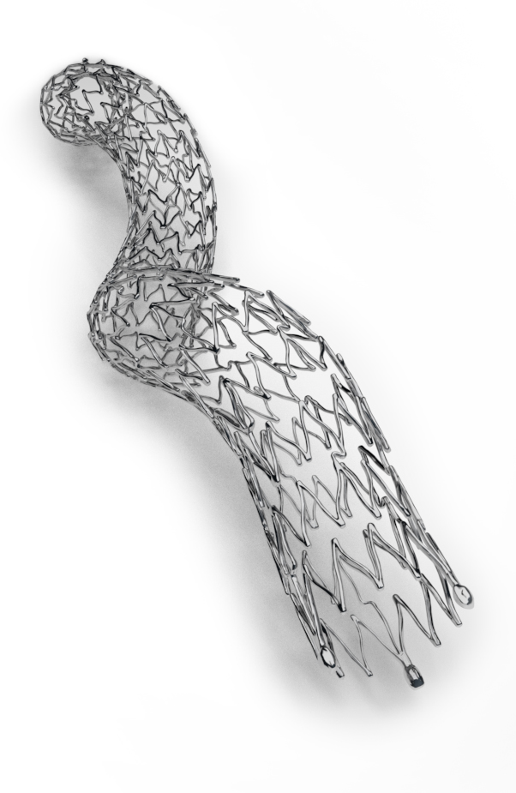
Conclusions
More challenging population than typically enrolled in registry studies, including longer, more complex lesions:
  24% CLTI
  53% moderate to severe calcification
  57% CTO
71% KM freedom from loss of primary stent patency at 3 years
78% KM freedom from CDTLR at 3 years
Presence of moderate/severe calcification and/or CTO had no impact on patency or CDTLR
Comparable outcomes to DES and Supera despite more challenging lesions and without the need for extensive lesion preparation
Data on file at Veryan Medical

