Slide 1
Full Name, MD, Other Credentials
MIMICS-3D 3-year results: Compelling clinical outcomes with BioMimics 3D in complex patients and lesions
Title
Academic Affiliation (if any)
City, State, Country
Title
Academic Affiliation (if any)
City, State, Country

Slide 2
Disclosures
Consultant:
Speaker’s Bureau:
Major Stockholder:
Other Support:

Slide 3
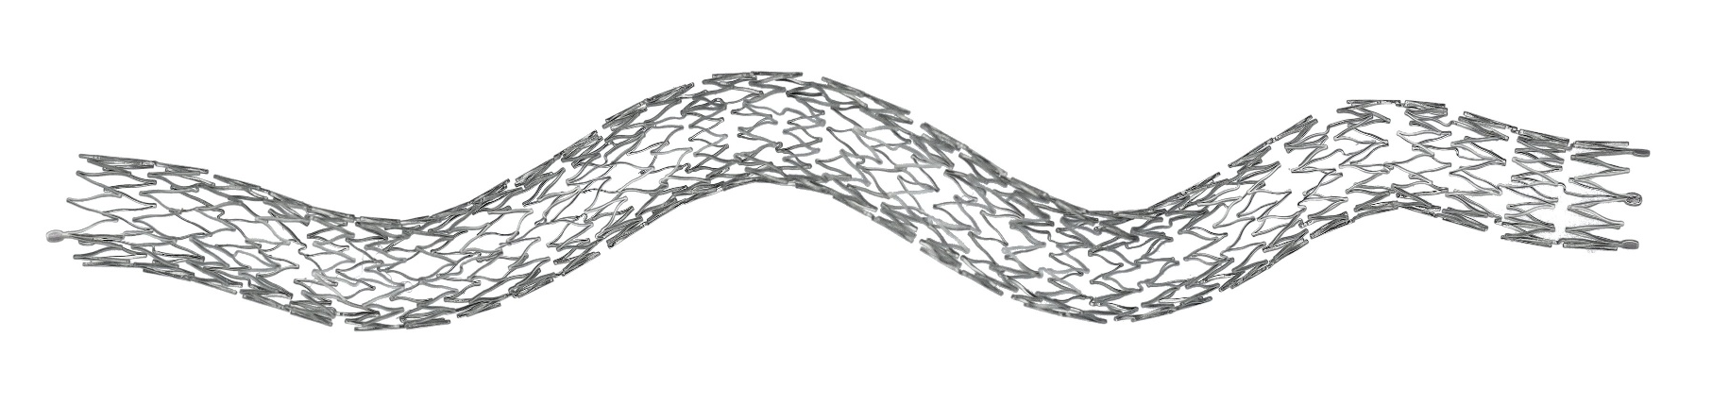
BioMimics 3D®
Imparts non-planar curvature to stented femoropopliteal segment which generates swirling flow to raise wall shear stress, providing an antiproliferative effect without the need for a drug^{1, 2}
Improved biomechanical performance compared to straight stents¹
Helical centreline
Simple, accurate placement using standard delivery system
PAM 313 version 1.0
Data on file at Veryan Medical
Caro et al., 2013
The BioMimics 3D Vascular Stent System has FDA, PMDA and CE Mark approval.
CAUTION: Federal law restricts this device to sale by or on the order of a physician

Slide 4
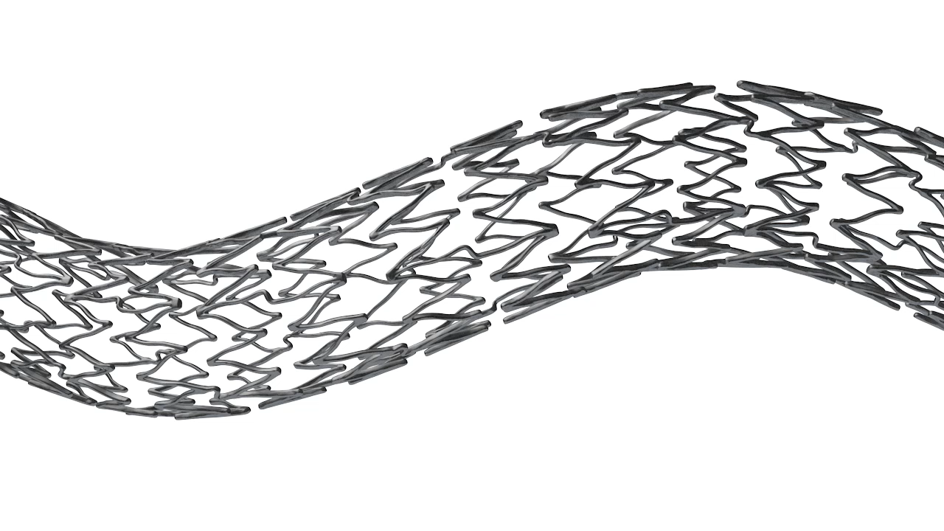
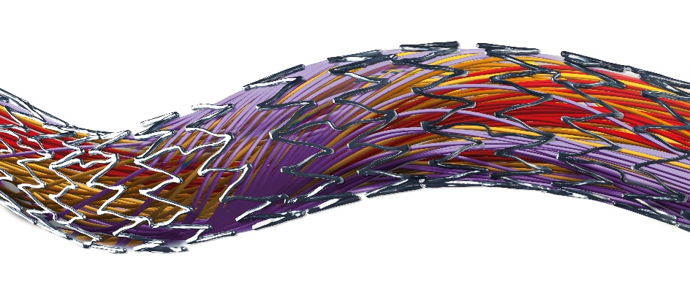
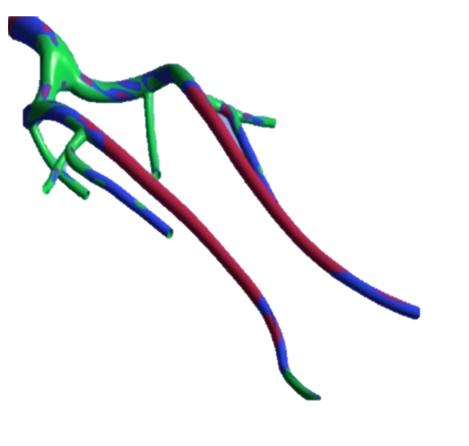
Atheroprotective & anti-restenotic effects of elevated wall shear stress
Non-planar vascular curvature promotes swirling blood flow¹
Swirling flow increases wall shear stress on endothelial cells²
Elevated wall shear stress has been shown to reduce intimal hyperplasia³
Wall Shear Stress in Femoropopliteal Segment
PROTECTIVE
SUBOPTIMAL
PATHOGENIC
³
1.Malek AM et al, JAMA 1999;252:2035–2042 2. Caro CG, Arterioscler Thromb Vasc Biol 2009, 29:158-161 3. Caro CG et al, J R Soc Interface 10: 20130578

Slide 5
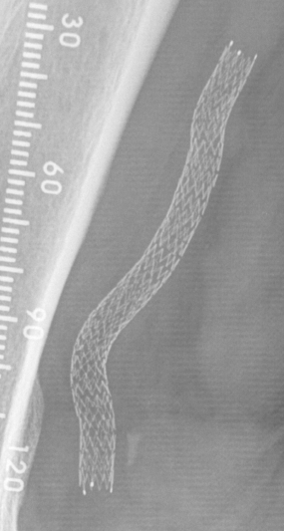
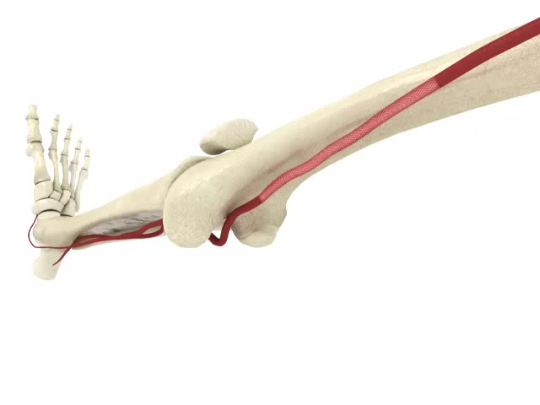
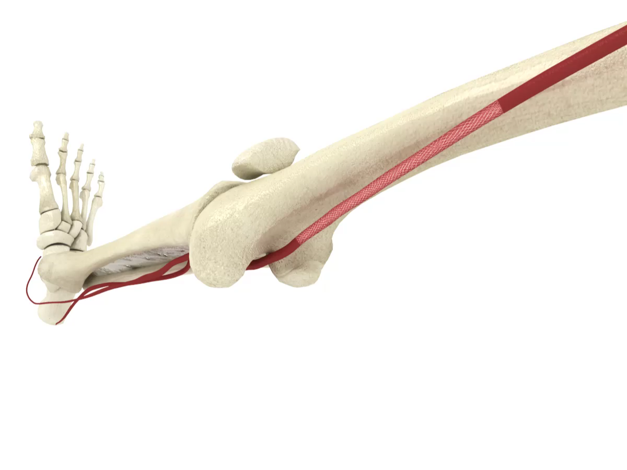
BioMimics 3D: Improving the Biomechanics
BioMimics 3D
3D helical geometry of the BioMimics 3D stent is designed to adapt to the morphological changes and reduce the risk of buckling / kinking during knee flexion/extension
Straight Stents
Straight laser-cut stents do not allow the physiological compensation required when the knee bends and the femoropopliteal artery shortens
Data on file at Veryan Medical
Data on file at Veryan Medical
Notes:
Additionally, the helical geometry of the BioMimics 3D stent is more biomechanically compatible with the femoropopliteal arteries than are straight stents. It is designed to adapt to the morphological changes experienced when the knee or hip is flexed and extended. Straight stents by contrast are unable to shorten with the artery as it shortens

Slide 6
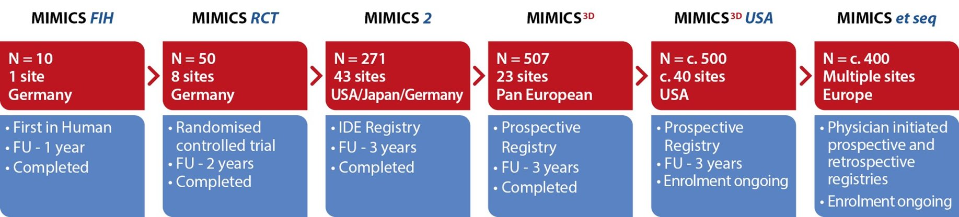

MIMICS Clinical Programme
1750+ patients
Data on file at Veryan Medical

Slide 7
MIMICS-3D Registry
A Prospective, Multicentre Observational Study to Evaluate BioMimics 3D Stent in PAD in the Real World
PI: Michael Lichtenberg 23 Investigational sites 507 patients Independent Clinical Event Committee (adjudication) 3-year follow up
Technical Success (procedure) | 99%
Procedural Success | 97%
Primary Endpoint – 30-Day Safety | 99% (486/493) Freedom from MAE
Primary Endpoint - 12-month Effectiveness | 89% (399/448) Freedom from CDTLR
Data on file at Veryan Medical

Slide 8
Baseline Patient Demographics
 |  | Enrolled Population N=507
Age | Mean years ± SD (N) | 70.1 ± 10
Gender | % Male | 66% (332/507)
Risk Factors | Diabetes Mellitus | 37% (187/507)
 | Smoker Current | 38% (191/507)
Rutherford Category | 0 | 0.4% (2/504)
 | 1 | 1% (6/504)
 | 2 | 17% (86/504)
 | 3 | 57% (289/504)
 | 4 | 8% (38/504)
 | 5 | 14% (72/504)
 | 6 | 2% (11/504)
Ankle Brachial Index | Mean ± SD (N) | 0.6 ± 0.3 (417)
CLTI present in 24% of enrolled subjects
Data on file at Veryan Medical

Slide 9
Baseline Lesion Characteristics
 |  | Enrolled Population N=507 subjects (518 lesions)
Reference Vessel Diameter (mm) | Mean ± SD | 5.5 ± 0.7
Stent Location (%) | Mid ± Distal SFA | 86% (444/518)
 | Prox. Pop | 30% (154/518)
Diameter Stenosis (%) | Mean ± SD | 95 ± 8 (518)
Occlusions | Total | 57% (294/518)
Lesion Length (mm) | Mean ± SD | 126 ± 91
Calcification % | None / mild | 47% (243/516)
 | Moderate / severe | 53% (273/516)
Longer, more complex lesions than previously studied
53% of lesions had moderate to severe calcification
Data on file at Veryan Medical
Notes:
Added #TL but otherwise all data is per lesion
Use prox location for lesion, “other includes quite a few ostial SFA, one confirmed iliac (!) and some other stuff under query
Used proximal RVD
Removed total occlusion as don’t have direct equivalent to this core lab assessment. 210/379 report max stenosis 100%
Calcification
Grade 0 -70 18.6%
Grade 1 - 120 31.8%
Grade 2 - 88 23.3%
Grade 3 - 49 13.0%
Grade 4 - 50 13.3%
Total - 377 100.0%

Slide 10
Baseline Procedural Data
 |  | Enrolled Population N=507
BioMimics 3D Stents | # stents/lesions | 676/518
 | 1 stent | 76% (395/518)
 | 2 stents | 19% (96/518)
 | 3 stents | 4% (19/518)
 | 4 stents | 2% (8/518)
Stented Segment Length | Mean ± SD (mm) | 131 ± 80.1
Diameter Stenosis | Pre-stent % ± SD | 95% ± 8.0
 | Post-stent % ± SD | 6%± 8.7
Other Target Lesion Treatments | Drug coated balloon | 50.0% (260/518)
 | Atherectomy | 8% (39/518)
More than 1 stent used in 25% of lesions
Data on file at Veryan Medical

Slide 11
MIMICS^{3D} European Registry: 3-Year Results
Technical Success (procedure) | 99% (501/506)*
Procedural Success | 97%
Primary Endpoint: 30-day safety | 99% (486/493) Freedom from MAE
Primary Endpoint: 12-month effectiveness | 89% (399/448) Freedom from CDTLR
36-Month KM Freedom from loss of Primary Patency** | 71%
36-Month KM Freedom from CDTLR | 78%
Stent fracture (site reported) | 0.6% (4/676)
Stent fracture (confirmed by investigation) | 0.4% (3/676)
Kaplan Meier survival estimates of Freedom from Clinically-Driven TLR at 3 Years
1 year
90%
2 years
82%
3 years
78%
*1 patient did not have a final diameter stenosis recorded
**ITT population. PSVR >2.4
Data on file at Veryan Medical

Slide 12
MIMICS Clinical Program
Enrolling progressively longer and more complex lesions
Mean ± SD (mm) | MIMICS-RCT | MIMICS-2 | MIMICS-3D
Lesion Length | 66 ± 29 | 81 ± 38 | 126 ± 91
Stented Segment Length | 99 ± 30 | 112 ± 36 | 131 ± 80
CTO | 44% | 30% | 57%
Mod/Severe Ca++ | 52% | 46% | 53%
CLTI | 6% | 6% | 24%
Core lab reported data for MIMICS and MIMICS-2, site-reported for MIMICS-3D
Sub group analyses conducted on the impact of CTO/calcium on CDTLR and patency
Data on file at Veryan Medical

Slide 13
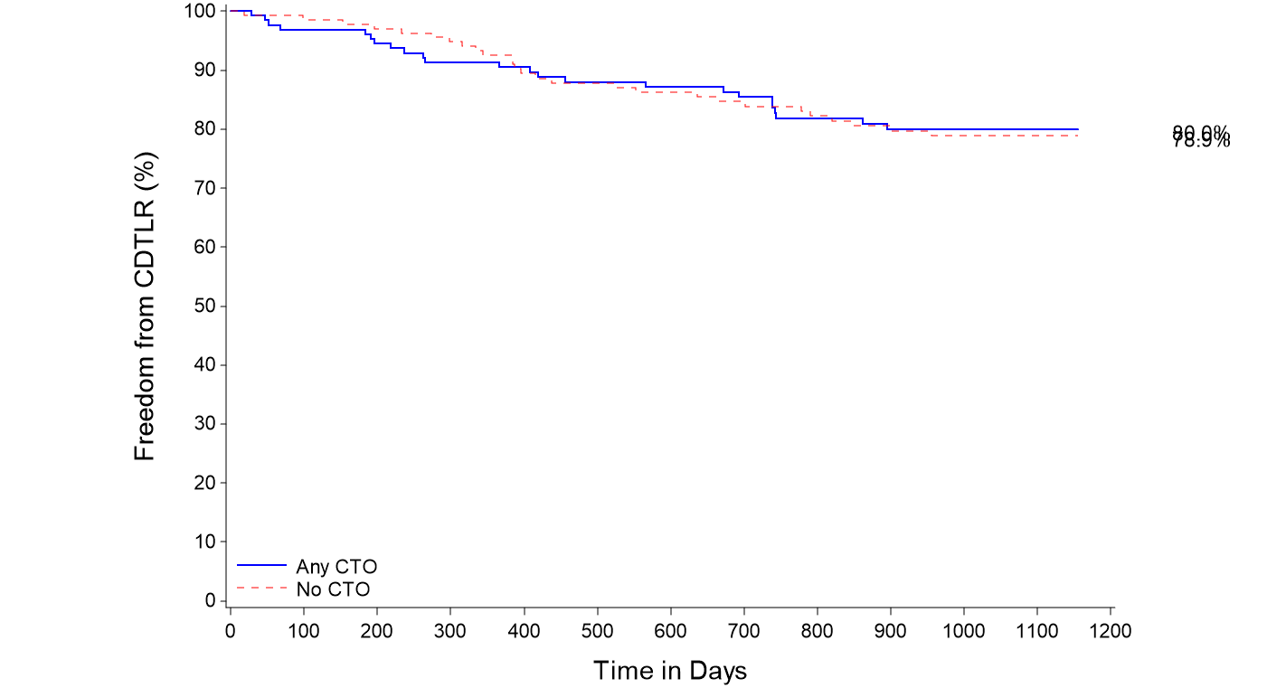
MIMICS-3D Subgroup Propensity Matched Analysis: CTO
KM Freedom from CDTLR comparison
% incidence in MIMICS-3D
CTOs | 57%
80%
79%
Freedom from CDTLR at 3 years
80% in Any CTO cohort
79% in No CTO cohort
No statistical significance between the 2 cohorts
P value = 0.890
Any CTO
-------- No CTO
Data on file at Veryan Medical
Notes:
Propensity matching conducted to reduce the bias due to confounding variables present in the 2 different cohorts.

Slide 14
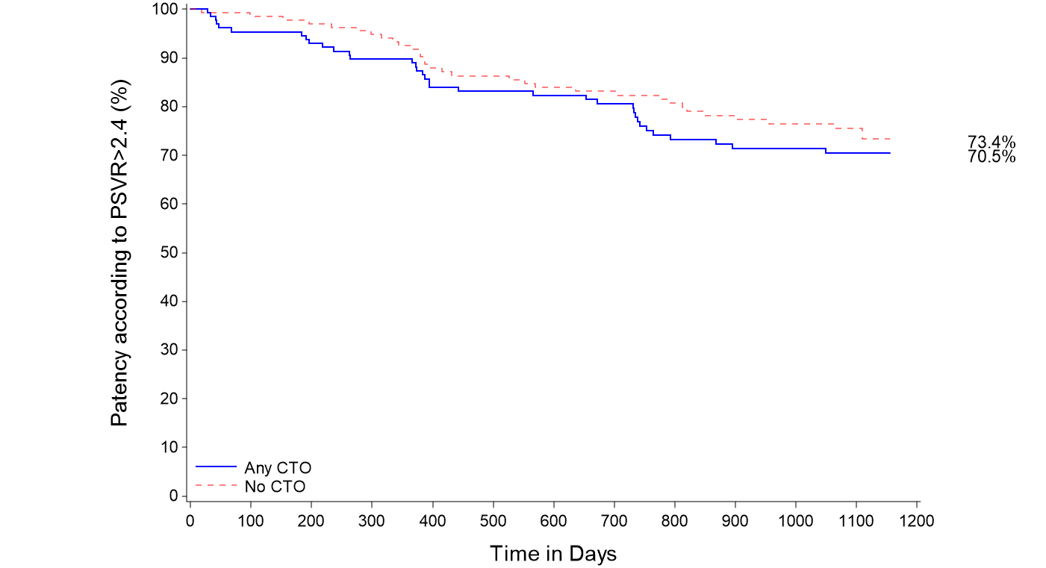
MIMICS-3D Subgroup Propensity Matched Analysis: CTO
KM freedom from loss of primary patency comparison
% incidence in MIMICS-3D
CTOs | 57%
Freedom from loss of primary patency at 3 years
76% in No CTO cohort
71% in Any CTO cohort
No statistical significance between the 2 cohorts
76%
71%
P value = 0.388
Any CTO
-------- No CTO
ITT population. PSVR >2.4
Data on file at Veryan Medical
Notes:
Propensity matching conducted to reduce the bias due to confounding variables present in the 2 different cohorts.

Slide 15
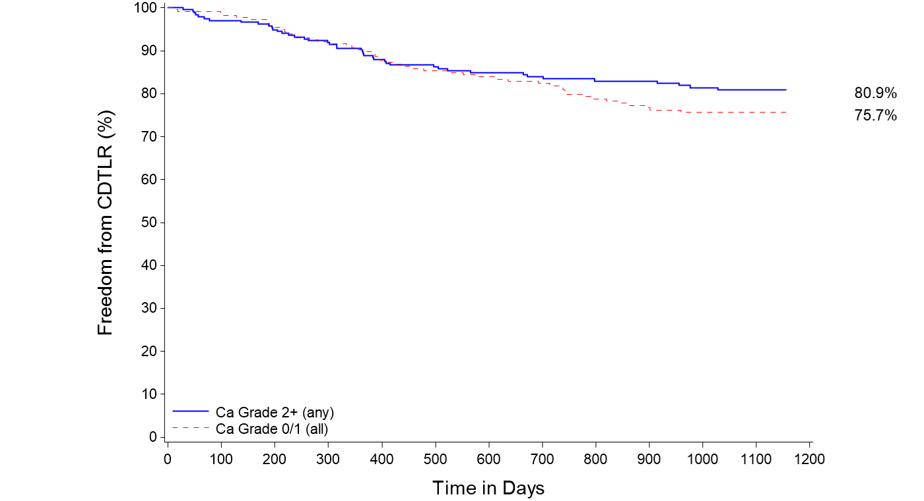
MIMICS-3D Subgroup Analysis : Calcium
KM Freedom from CDTLR comparison
% incidence in MIMICS-3D
Moderate to severe calcification | 53%
Severe, bilateral wall calcium | 28%
81%
76%
P value = 0.256
Freedom from CDTLR at 3 years
81% in moderate/severe cohort
76% in none/mild cohort
No statistical significance between the 2 cohorts
Mod/severe
-------- None/mild
Data on file at Veryan Medical
Notes:
Propensity matching not conducted as potential confounding variables were not present in the 2 different cohorts.

Slide 16
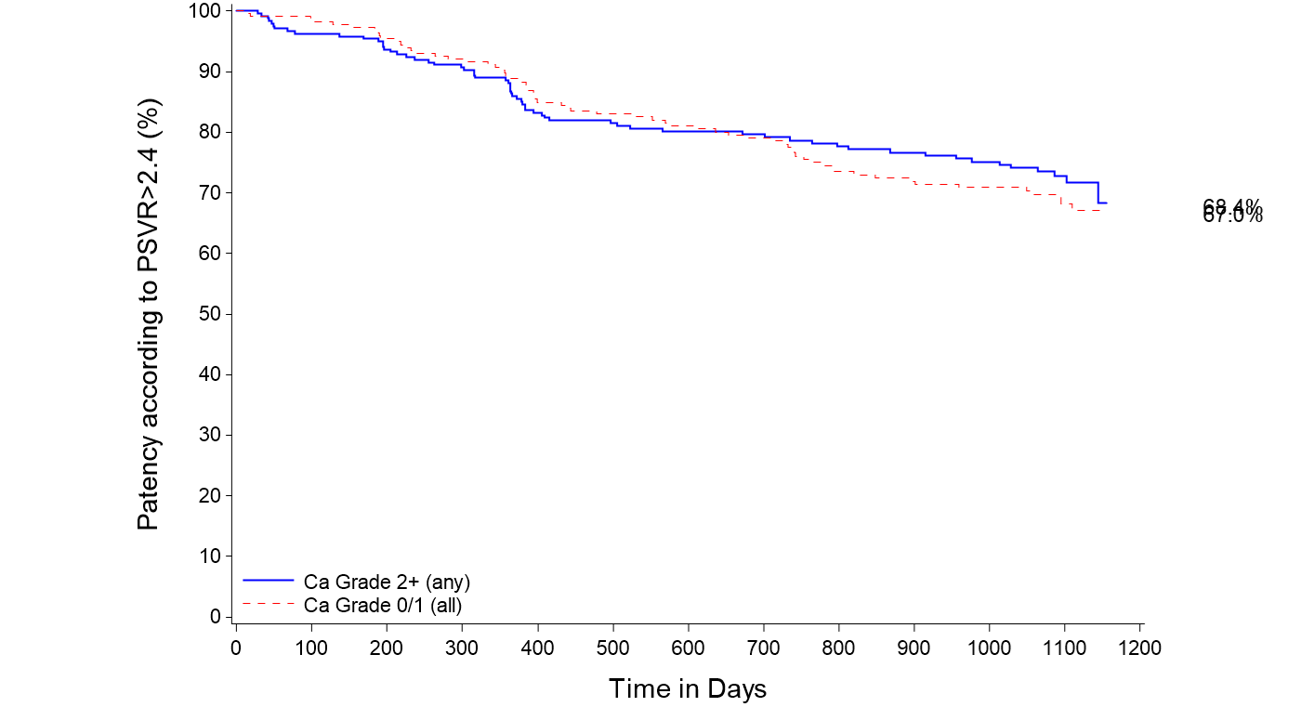
MIMICS-3D Subgroup Analysis : Calcium
KM freedom from loss of primary patency comparison
% incidence in MIMICS-3D
Moderate to severe calcification | 53%
Severe, bilateral wall calcium | 28%
74%
70%
P value = 0.544
Freedom from loss of primary patency at 3 years
74% in moderate/severe cohort
70% in none/mild cohort
No statistical significance between the 2 cohorts
Mod/severe
-------- None/mild
ITT population. PSVR >2.4
Data on file at Veryan Medical
Notes:
Propensity matching not conducted as potential confounding variables were not present in the 2 different cohorts.

Slide 17
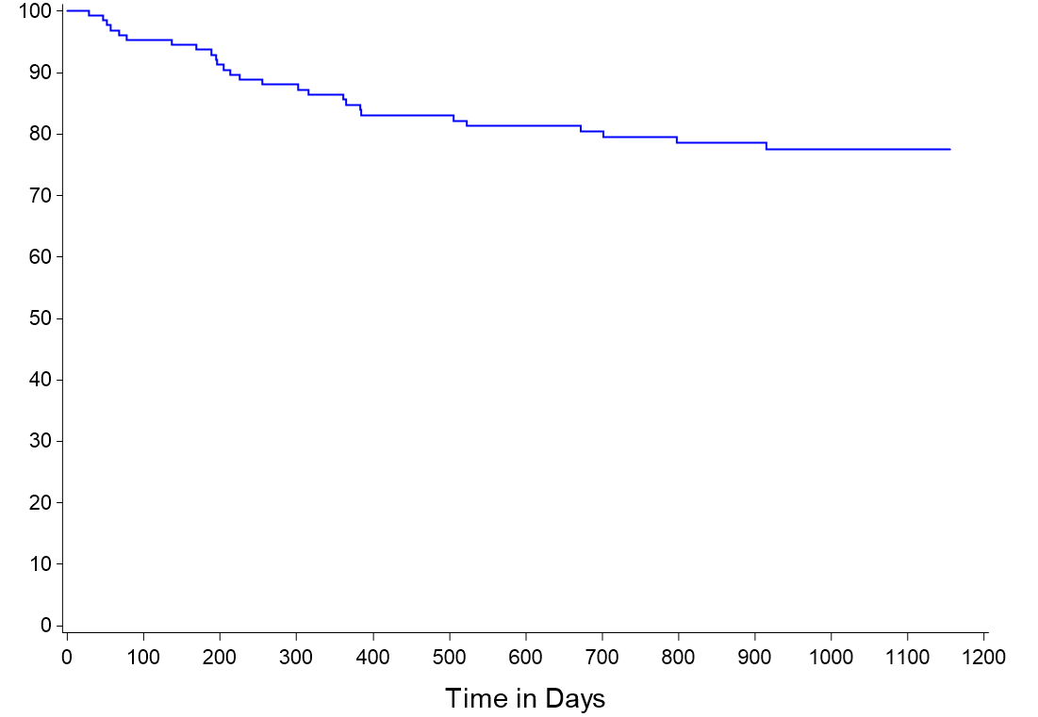
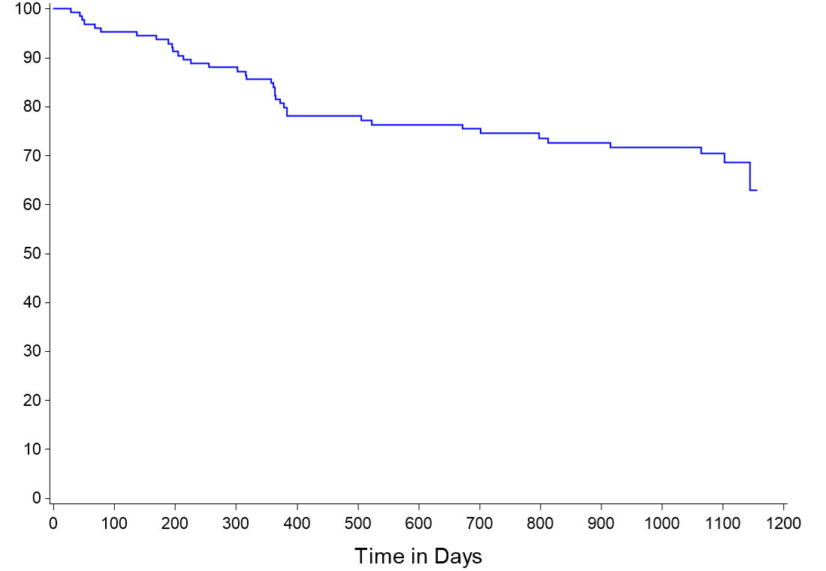
3-Year Outcomes in Severe Calcium Cohort
Freedom from CDTLR
Freedom from loss of Primary Patency
78% in severe calcification
71% in severe calcification
PSVR >2.4
28% of lesions had severe/bilateral wall calcification
59% of severely calcified lesions were CTOs
144mm +/-94 avg lesion length in severely calcified cohort
Data on file at Veryan Medical

Slide 18
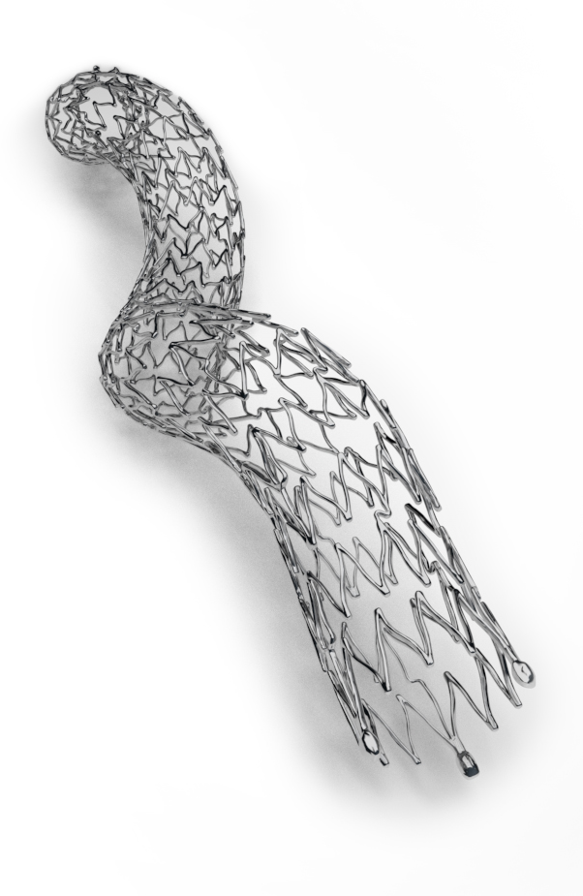
Conclusions
More challenging population than typically enrolled in registry studies, including longer, more complex lesions:
  24% CLTI
  53% moderate to severe calcification
  57% CTO
71% KM freedom from loss of primary stent patency at 3 years
78% KM freedom from CDTLR at 3 years
Presence of moderate/severe calcification and/or CTO had no impact on patency or CDTLR
Comparable outcomes to DES and Supera despite more challenging lesions and without the need for extensive lesion preparation
Data on file at Veryan Medical

