Slide 1
BioMimics 3D in complex lesions:
3-year outcomes of the MIMICS-3D European registry
Prof Christos Rammos (DE)
University of Duisburg-Essen

Slide 2
Disclosures
Speaker name: Christos Rammos MD
I do not have any potential conflicts of interest

Slide 3
Persistent challenges in real-world fempop lesions
The DCB pivotal trials showed improved performance over simple angioplasty but in a well-defined set of lesions ¹⁻⁵
The Global DCB Registries have an average provisional stent rate of 28–36%, driven by lesion length and CTOs.¹⁻⁵
In IN.PACT Global the rate is 53% for lesions >25cm^{1,2}
DES trials show high fracture rates and concern over aneurysmal degeneration⁶
Tepe G. 12-Month Results from the IN.PACT SFA Randomized Trial. Circulation. 2014
Laird JRl. 24-Month Results of IN.PACT SFA. J Am Coll Cardiol. 2015;66:2329-2338.
Scheinert D. Twelve-month results from the BIOLUX P-I randomized trial. J Endovasc Ther. 2015;22:14-21.
Schroeder H. Two-year results from the ILLUMENATE first-in-human study. Catheter Cardiovasc Interv. 2015;86:278-286.
Rosenfield K, Jaff MR, White CJ et al. Trial of a Paclitaxel-Coated Balloon for Femoropopliteal Artery Disease. N Engl J Med. 2015;373:145-153
Bisdas T et al, JACC VOL. 11. NO.10 201
Notes:
While the DCB pivotal trials showed improved performance over simple angioplasty we know that this was achieved in a well-defined set of lesions and that the global DCB registries show that the real world patient population is more complex.
These registries demonstrate an average provisional stent rate of 28 to 35.5% driven by lesion length and CTOs.
In IN.PACT Global, the provisional stent rate for lesions longer than 25cm was 53%

Slide 4
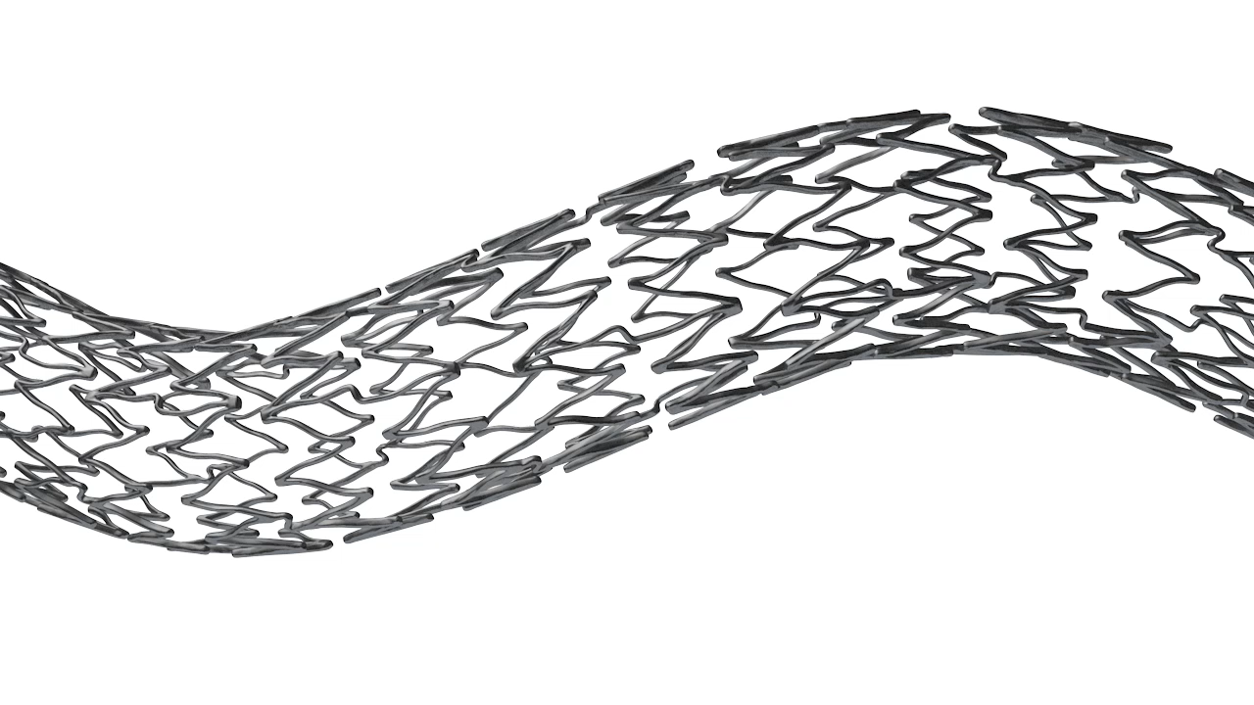
BioMimics 3D
Designed specifically for the Femoropopliteal Segment
The BioMimics 3D Vascular Stent System has FDA, PMDA and CE Mark approval.
CAUTION: Federal law restricts this device to sale by or on the order of a physician
PAM 331 version 1.0
Notes:
The straight stent challenges of the femoropopliteal region are the reasons why BioMimics 3D was designed with a helical centerline which permits the stent to shorten with the artery and provide the ultimate biomechanical compatibility.

Slide 5
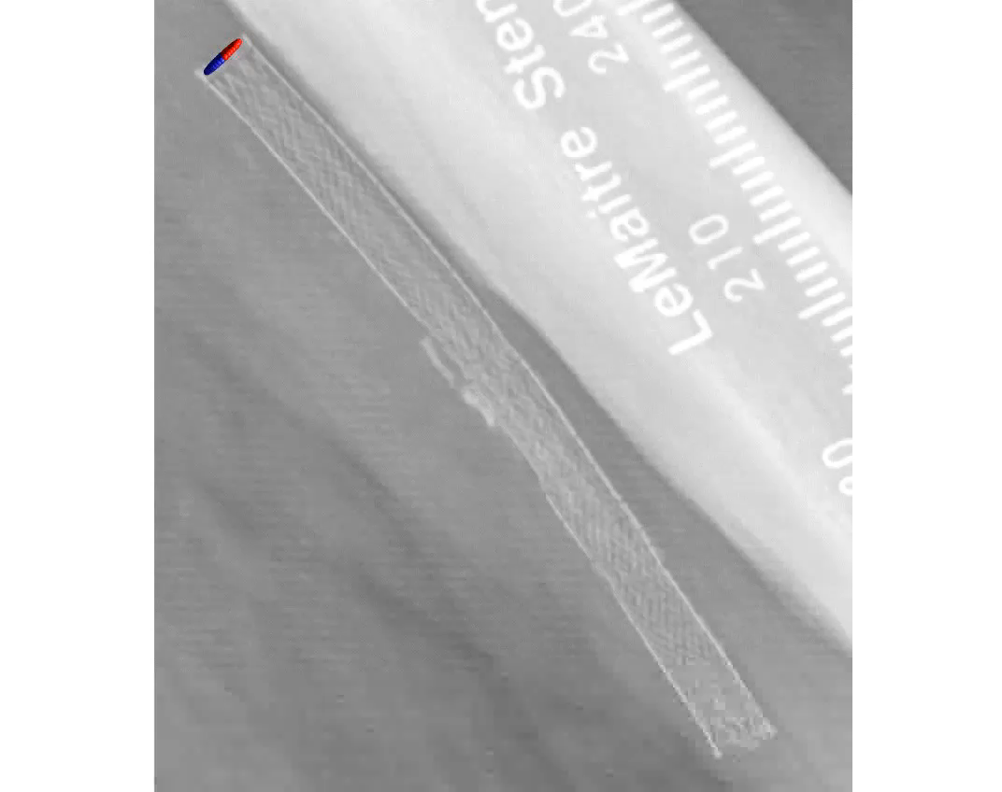
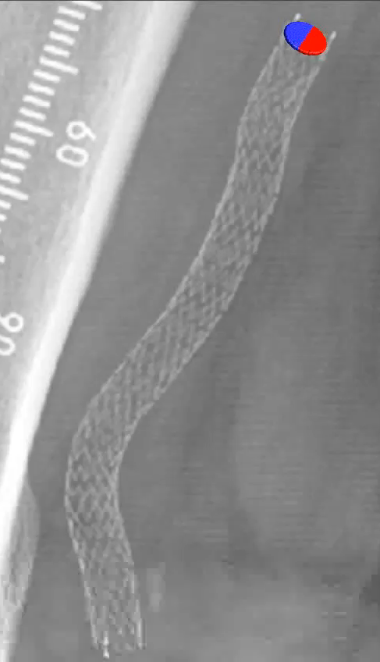
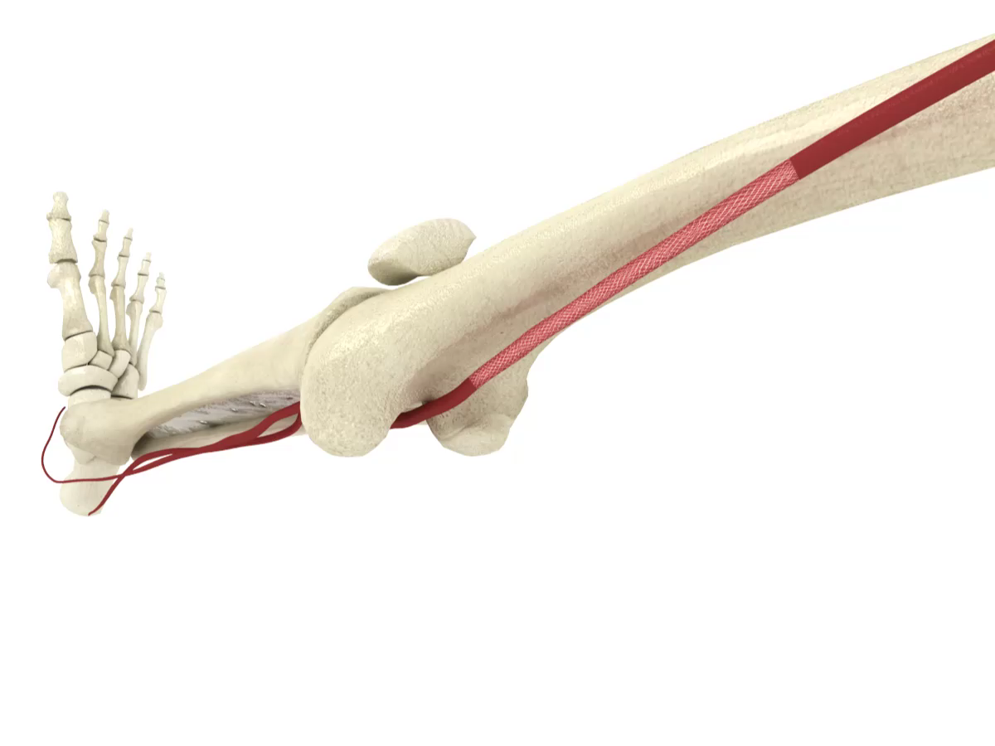
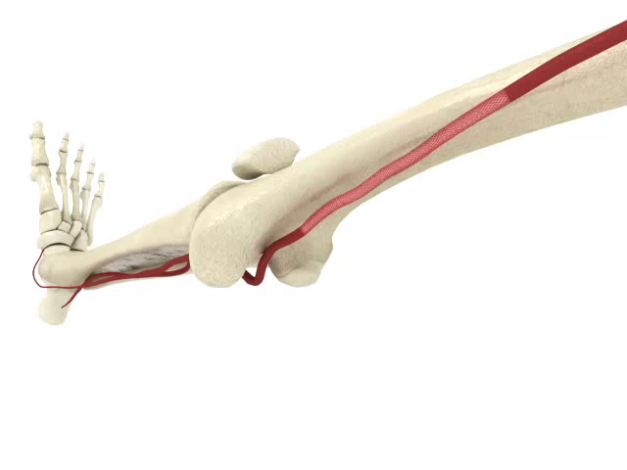
BioMimics 3D
Designed specifically for the Femoropopliteal Segment
Swirling flow elevates wall shear stress¹
  Reduces restenosis by reducing thrombus formation and inflammation
  Reduces Smooth Muscle Cell proliferation
  Reduces neointimal hyperplasia
Biomechanical Compatibility²
  Mimics natural movement of the femoropopliteal segment
  Aids in reducing localised trauma
  Helps reduce risk of stent fracture in dynamic artery
Murphy EA, Cardiovascular Engineering and Technology 2012
Data on file at Veryan Medical
Notes:
The top right video illustrates BioMimics 3D shortening with the artery as the knee is flexed. This mimics the natural movement of the artery which helps to reduce localized trauma and reduce the risk of stent fracture
But in addition, the helical centreline generates a natural laminar swirling flow which elevates wall shear stress and reduces restenosis by reducing thrombus formation and inflammation. The images on the bottom left show straight flow in a straight stent and swirling flow in a BioMimics 3D stent on the right,

Slide 6
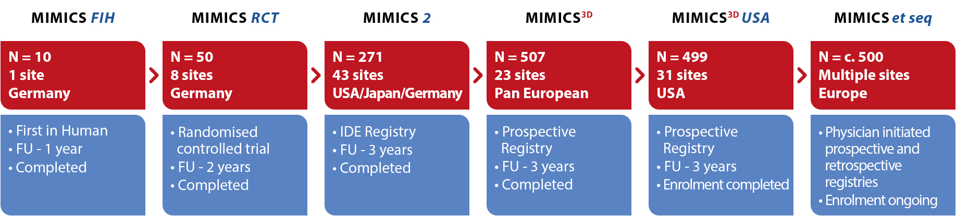

MIMICS Clinical Programme
1750+ patients
Data on file at Veryan Medical
Notes:
The company has invested in a compelling clinical programme to evaluate the performance of BioMimics 3D. Once all studies are enrolled, there will be more than 1750 patients being studied.
In this presentation we will review the 3-year results for the MIMICS-3d European registry, and will look specifically at a subgroup analysis of long and very long lesions.
MIMICS-3D enrolled 507 patients in 23 sites across Europe and is a prospective registry with 3 years follow up.

Slide 7
MIMICS-3D Registry
A Prospective, Multicentre Observational Study to Evaluate BioMimics 3D Stent in PAD in the Real World
Baseline Patient Demographics |  | Enrolled Population N=507
Age | Mean years ± SD (N) | 70.1 ± 10
Gender | % Male | 66% (332/507)
Risk Factors | Diabetes Mellitus | 37% (187/507)
 | Smoker Current | 38% (191/507)
Rutherford Category | 0 | 0.4% (2/504)
 | 1 | 1% (6/504)
 | 2 | 17% (86/504)
 | 3 | 57% (289/504)
 | 4 | 8% (38/504)
 | 5 | 14% (72/504)
 | 6 | 2% (11/504)
Ankle Brachial Index | Mean ± SD (N) | 0.6 ± 0.3 (417)
PI: Michael Lichtenberg 23 Investigational sites 507 patients Independent Clinical Event Committee (adjudication) 3-year follow up
CLTI present in 24% of enrolled subjects
Data on file at Veryan Medical

Slide 8
Baseline Lesion Characteristics
 |  | Enrolled Population N=507 subjects (518 lesions)
Reference Vessel Diameter (mm) | Mean ± SD | 5.5 ± 0.7
Stent Location (%) | Mid ± Distal SFA | 86% (444/518)
 | Prox. Pop | 30% (154/518)
Diameter Stenosis (%) | Mean ± SD | 95 ± 8 (518)
Occlusions | Total | 57% (294/518)
Lesion Length (mm) | Mean ± SD | 126 ± 91
Calcification % | None / mild | 47% (243/516)
 | Moderate / severe | 53% (273/516)
Longer, more complex lesions than previously studied
53% of lesions had moderate to severe calcification
Data on file at Veryan Medical
Notes:
Added #TL but otherwise all data is per lesion
Use prox location for lesion, “other includes quite a few ostial SFA, one confirmed iliac (!) and some other stuff under query
Used proximal RVD
Removed total occlusion as don’t have direct equivalent to this core lab assessment. 210/379 report max stenosis 100%
Calcification
Grade 0 -70 18.6%
Grade 1 - 120 31.8%
Grade 2 - 88 23.3%
Grade 3 - 49 13.0%
Grade 4 - 50 13.3%
Total - 377 100.0%

Slide 9
Baseline Procedural Data
 |  | Enrolled Population N=507
BioMimics 3D Stents | # stents/lesions | 676/518
 | 1 stent | 76% (395/518)
 | 2 stents | 19% (96/518)
 | 3 stents | 4% (19/518)
 | 4 stents | 2% (8/518)
Stented Segment Length | Mean ± SD (mm) | 131 ± 80.1
Diameter Stenosis | Pre-stent % ± SD | 95% ± 8.0
 | Post-stent % ± SD | 6%± 8.7
Other Target Lesion Treatments | Drug coated balloon | 50.0% (260/518)
 | Atherectomy | 8% (39/518)
More than 1 stent used in 25% of lesions
Data on file at Veryan Medical

Slide 10
MIMICS^{3D} European Registry: 3-Year Results
Kaplan Meier survival estimate of Freedom from Clinically-Driven TLR at 3 Years
36-Month KM Freedom from CDTLR | 78%
36-Month KM Freedom from loss of Primary Patency** | 71%
Stent fracture (confirmed by investigation) | 0.4% (3/676)
1 year
90%
2 years
82%
3 years
78%
*1 patient did not have a final diameter stenosis recorded
**ITT population. PSVR >2.4
Data on file at Veryan Medical

Slide 11
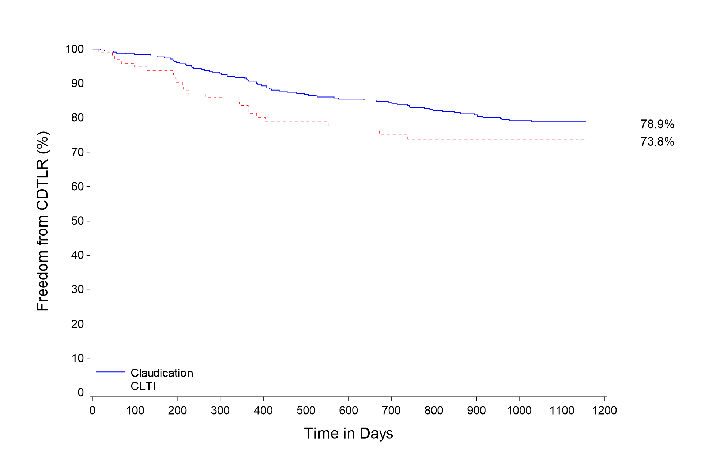
MIMICS-3D Subgroup Propensity Matched Analysis: CLTI v IC
KM Freedom from CDTLR comparison
% incidence in MIMICS-3D
CLTI | 24%
79%
74%
Freedom from CDTLR at 3 years
79% in Claudication cohort
74% in CLTI cohort
No statistical significance between the 2 cohorts
P value = 0.1470
Claudication
-------- CLTI
Data on file at Veryan Medical
Notes:
Propensity matching conducted to reduce the bias due to confounding variables present in the 2 different cohorts.

Slide 12
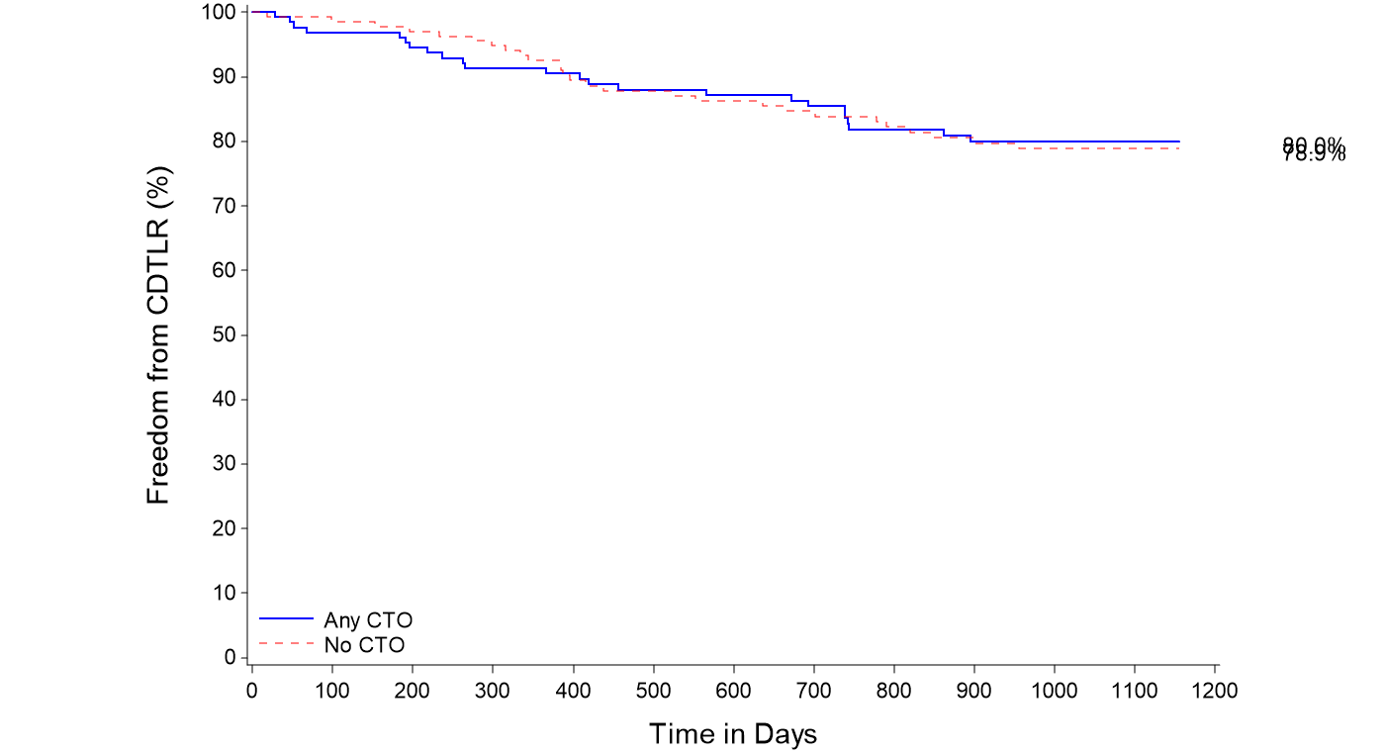
MIMICS-3D Subgroup Propensity Matched Analysis: CTO
KM Freedom from CDTLR comparison
% incidence in MIMICS-3D
CTOs | 57%
80%
79%
Freedom from CDTLR at 3 years
80% in Any CTO cohort
79% in No CTO cohort
No statistical significance between the 2 cohorts
P value = 0.890
Any CTO
-------- No CTO
Data on file at Veryan Medical
Notes:
Propensity matching conducted to reduce the bias due to confounding variables present in the 2 different cohorts.

Slide 13
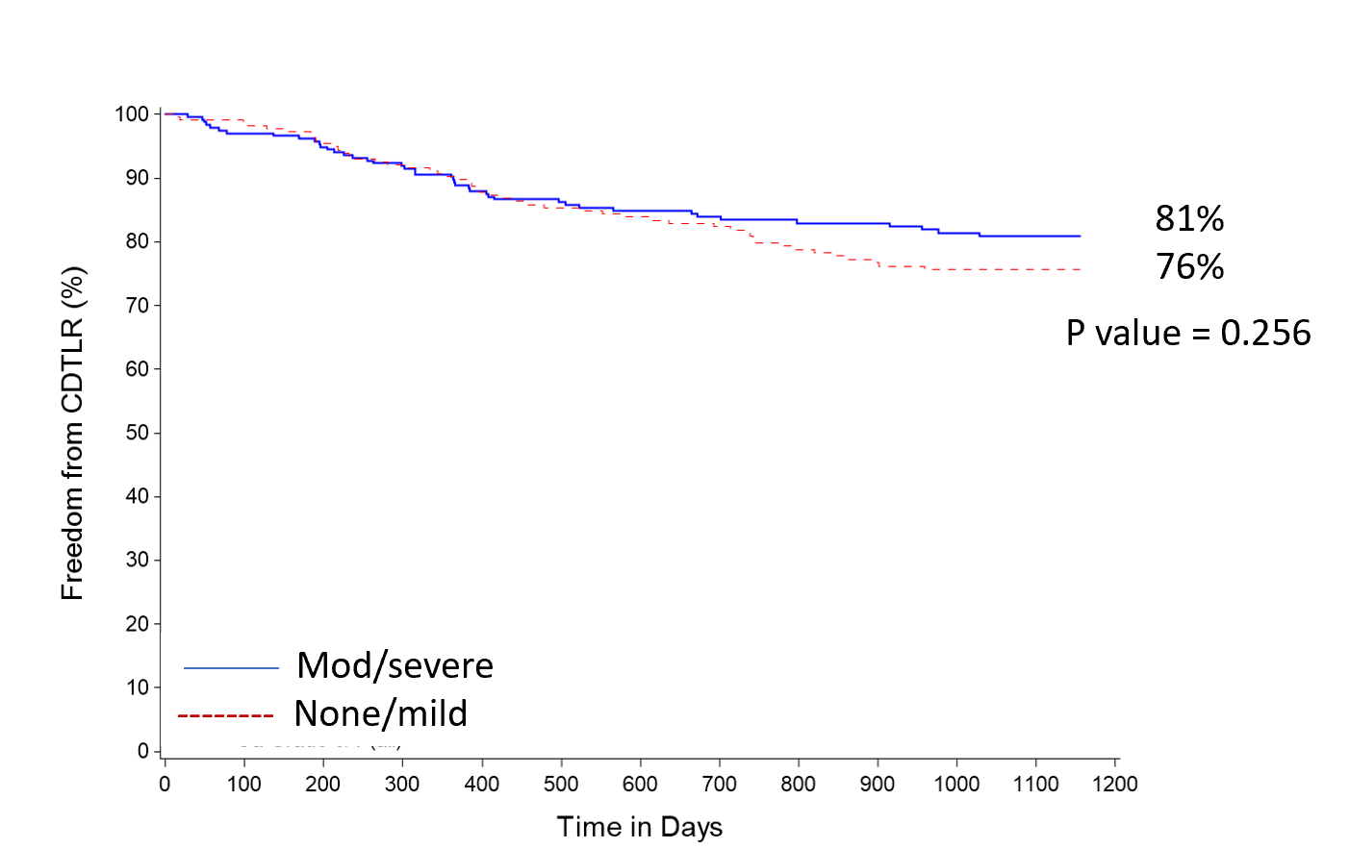
MIMICS-3D Subgroup Analysis : Calcium
KM Freedom from CDTLR comparison
% incidence in MIMICS-3D
Moderate to severe calcification | 53%
Freedom from CDTLR at 3 years
81% in moderate/severe cohort
76% in none/mild cohort
No statistical significance between the 2 cohorts
Data on file at Veryan Medical
Notes:
Propensity matching not conducted as potential confounding variables were not present in the 2 different cohorts.

Slide 14
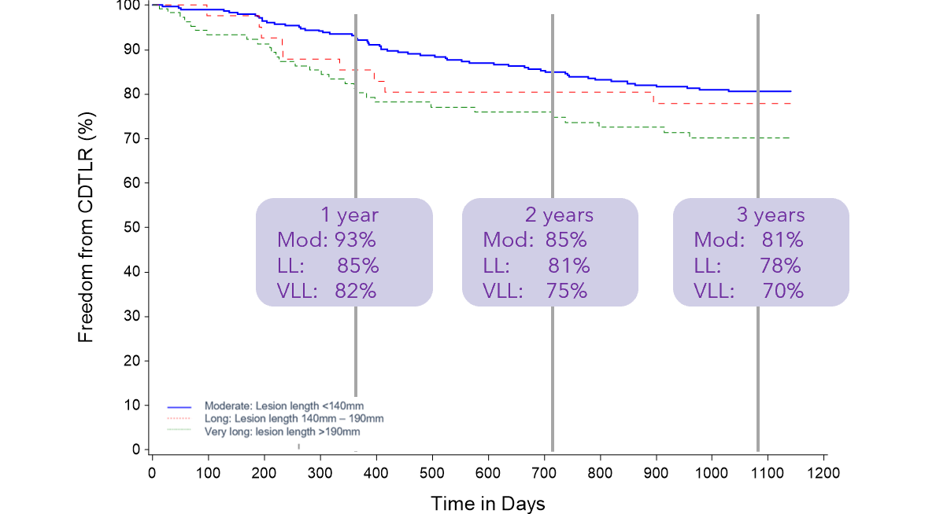
MIMICS-3D Subgroup Analysis: Long / very long lesions
KM freedom from CDTLR
Lesion Length | CDTLR
Moderate (<140mm) | 81%
Long (140mm– 190mm) | 78%
Very Long (>190mm) | 70%
1 year
Mod: 93%
LL: 85%
VLL: 82%
2 years
Mod: 85%
LL: 81%
VLL: 75%
3 years
Mod: 81%
LL: 78%
VLL: 70%
No significant difference between moderate and long lesion groups
As expected, there is an observable difference between the moderate and very long lesion groups however, the CDTLR and durability of the very long lesion group is impressive given the lesion length and morphology
Data on file at Veryan Medical
Notes:
At 3 years there is no significant difference between the moderate and long lesion groups
As expected, there is an observable difference between the moderate and very long lesion groups however, the CDTLR and durability of the very long lesion group is impressive given the lesion length and morphology

Slide 15
Industry Study Comparisons-
Freedom from CDTLR
Industry Study Comparisons-
Freedom from CDTLR
I----------------BioMimics 3D-----------I Supera Zilver PTX Eluvia Eluvia Zilver PTX
Data on file at Veryan Medical

Slide 16
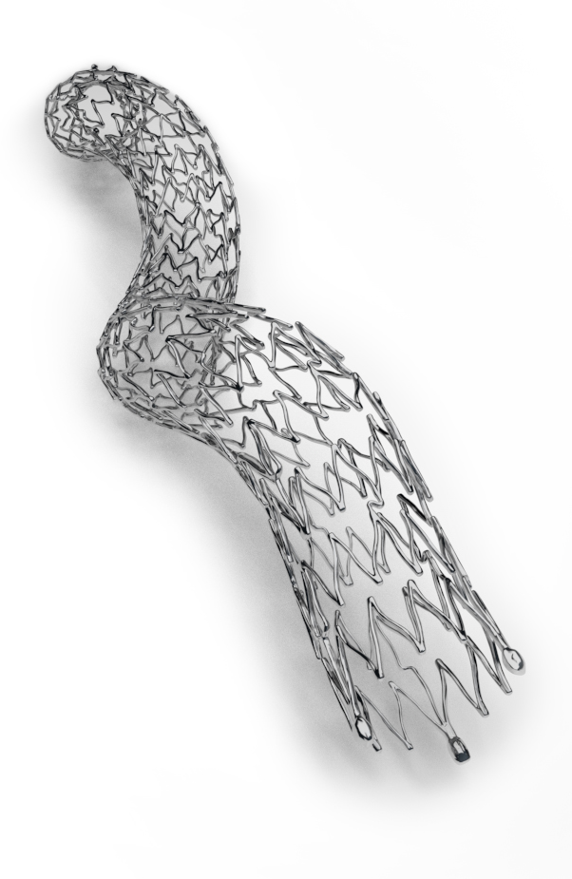
Conclusions
Longer follow up (3 years) than reported in other long lesion studies
More challenging population than typically enrolled in registry studies, including longer, more complex lesions:
  9% long lesions (140mm to ≤ 190mm)
  24% very long lesions >190mm
  24% CLTI
  53% moderate to severe calcification
  57% CTO
Excellent 3-year results including those for complex patients and complex lesions
Very low fracture rate at 3 years: 0% in long lesions and 0.8% in very long lesions
Comparable outcomes to DES and Supera despite more challenging, longer lesions
Data on file at Veryan Medical

Slide 17
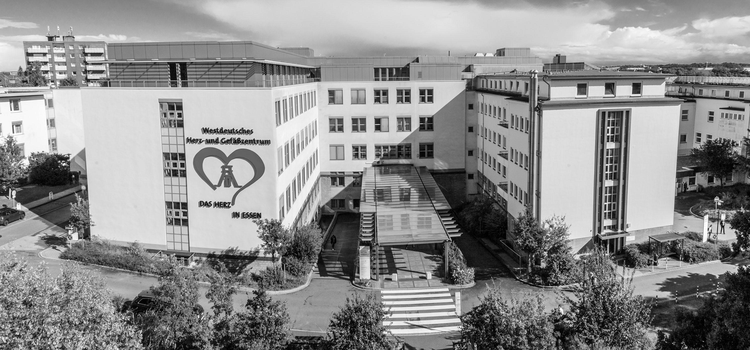
THANK YOU FOR YOUR ATTENTION!
Prof Dr. med. Christos Rammos
christos.rammos@uk-essen.de

