Slide 1
SFA Stent Review
Current Landscape & Pipeline
PAM 349 Version 1.0

Slide 2
Topline Overview
 | BioMimics 3D (Veryan) |  |  |  | Supera (Abbott) | Everflex (Medtronic) | LifeStent (Bard) | Pulsar-18 (Biotronik) | Zilver PTX (Cook Medical) | Eluvia (Boston Scientific)
Pivotal trial (N) | Mimics RCT |  | MIMICS-2 (N = 271) | MIMICS-3D (N = 507) | SUPERB (N = 325) | DURABILITY II (N = 287) | RESILIENT (N = 134) | BIOFLEX-PEACE (N = 148) | ZILVER PTX (N = 236) | MAJESTIC (N = 57)
 | BM3D N = 50 | Straight Control N = 26
Mean lesion length (mm) | 65.8 | 63.3 | 81.2 | 127 | 78.1 | 89.1 | 70.0 | 116 | 66.4 | 70.8
Patency definition (PSVR) | < 2.0 |  | < 2.0 | < 2.4 | < 2.0 | < 2.0 | ≤ 2.5 | < 2.5 | < 2.0 | < 2.5
Primary patency rate | 80% (12m); 72% (24m) | 71% (12m); 55% (24m) | 83.1% (12m); 70.2% (24m) | 87.7% (12m); 78.6% (24m); 70.2% (36m) | 78.9% (12m) | 77.9% (12m); 66.% (24m); 60.0% (36m) | 81.5% (12m) | 86.2% (12m) | 84.4% (12m); 76.3% (24m); 71.5% (36m) | 96.4% (12m); 83.5% (24m)
Freedom from CD-TLR (12 months) | 91% (12m); 91% (24m) | 92% (12m); 76% (24m) | 88.0% (12m); 83.0% (24m); 81% (36m)* | 90.6% (12m); 82.8% (24m); 78% (36m) | 88.9% (12m) | 86.0% (12m); 75.3% (24m); 69.7% (36m) | 87.3% (12m); 77.8% (24m); 75.5% (36m) | 97.1% (12m) | 91.6% (12m); 86.0% (24m); 83.6% (36m) | 96.4% (12m); 92.8% (24m); 85.3% (36m)
MAE / MALE (30 days) | - |  | 0.4% | 1.2% | 1.2% | 0% (30d); 17.2% (12m) | 14.2% (12m); 24.8% (36m) | - | - | 4%
Reference | DOI: 10.1161/CIRCINTERVENTIONS.115.002930 NB: control stent used was majority LifeStent (24/26) |  | doi: 10.1177/1526602820980419 * T Zeller, CX2020 | https://doi.org/10.1024/0301-1526/a000980 doi: 10.3390/jcdd10030126 | Doi: 10.1161/CIRCINTERVENTIONS.113.000937 | https://doi.org/10.1002/ccd.25895 | https://doi.org/10.1583/11-3627.1 | https://www.biotronik.com/en-gb/healthcare-professionals/clinical-trials/peace | https://doi.org/10.1161/CIRCULATIONAHA.115.016900 | DOI: 10.1007/s00270-017-1771-5
Data on file at Veryan Medical

Slide 3

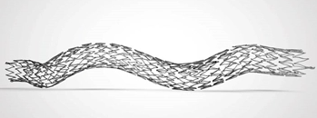
BioMimics 3D (Veryan Medical)
Design | Bare metal, nitinol
USP | 3D helical structure promotes swirling flow of arterial blood, increasing long-term primary patency
Pivotal trial | Mimics RCT (NCT02163863) PCD: July 2014 https://doi.org/10.1161/CIRCINTERVENTIONS.115.002930
CE Mark | November 2012
FDA Approval | June 2018
Notes
BioMimics 3D Stent Clinical Investigation: The Mimics Study (Mimics RCT)
Objective: To evaluate the safety and performance of the BioMimics 3D Stent System in the treatment of symptomatic SFA/proximal popliteal disease.
R
BioMimics 3D
N = 50
LifeStent
N = 26
Primary Endpoints:
Freedom from major adverse events (30 days)
Freedom from clinically driven TLR (6 moths)
Inclusion:
Rutherford 1-4 (mild claudication to ischemic rest pain), with an occlusion or de novo and/or restenotic SFA/PPA lesion
Single target lesion located at least 1 cm distal to the take-off of the profunda femoris artery and at least 3 cm proximal to the highest point of the cortical margin of the femur
Target lesion length is 4.0 cm - 10.0 cm.
Adequate distal run-off to the ankle in the target limb (defined as having at least one patent calf vessel <50% stenosed
The BioMimics 3D Vascular Stent System has FDA, PMDA and CE Mark approval.
CAUTION: Federal law restricts this device to sale by or on the order of a physician
Source: T Zeller et al. (2016)

Slide 4
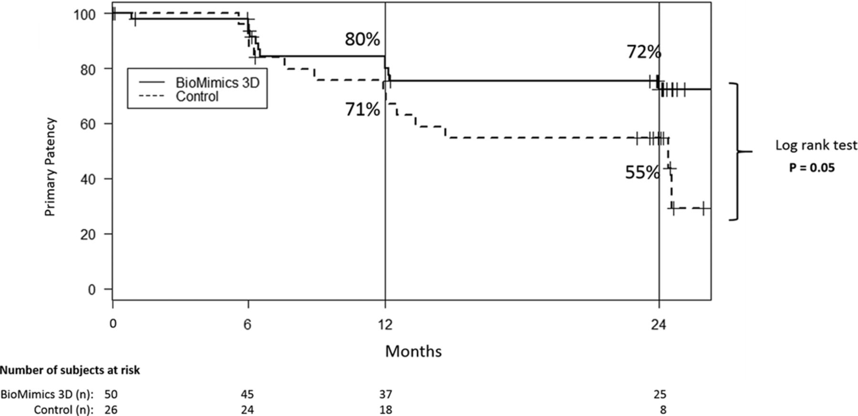
MIMICS-RCT trial results
Two-year results:
Primary Patency - 72% for BioMimics 3D vs 55% for straight control stents (P=0.05)
Freedom from CDLTR - 91% for BioMimics 3D maintained.
0% stent fractures.
Secondary evaluations:
Substantial improvement in Rutherford Category after stent implantation. At 1 and 2 years, the proportion of patients that had improved by at least 1 Rutherford category after the helical stent was 86% (38/44) and 88% (36/41), respectively
  straight stent was 82% (18/22) and 86% (19/22), respectively
Mimics RCT was powered to detect superiority to the VIVA OPG at 30 days and superiority in CDTLR at 6 months rather than differences in primary patency or CDTLR to 24 months.
Given the compelling data compared to a straight stent control, further investigation was warranted and lead to initiation of the MIMICS-2 clinical trial and MIMICS-3D registry trial.
Source: T Zeller et al. (2016)

Slide 5
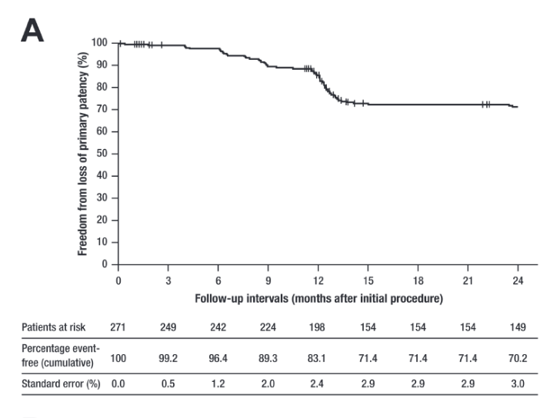
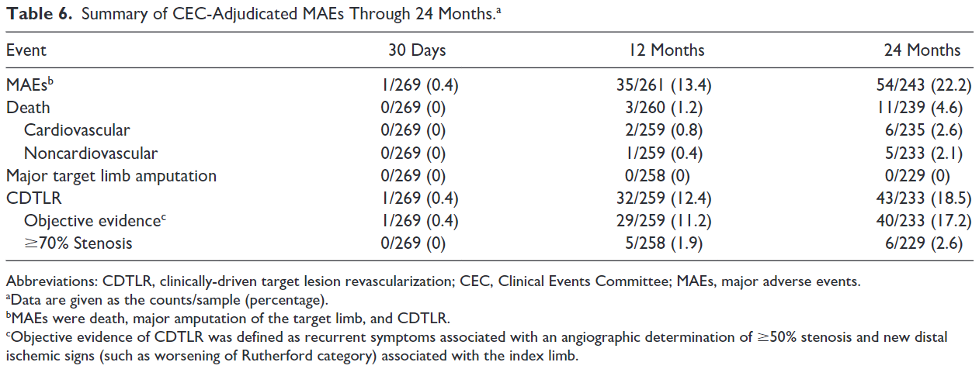
MIMICS-2 trial overview and results
NCT02400905: Evaluation of Safety and Effectiveness of the BioMimics 3D Stent System (MIMICS-2)
Despite the longer lesion length in patients treated for the MIMICS-2 trial (compared to MIMICS RCT), improvement in primary patency and freedom from CDTLR were maintained, without negatively impacting patient safety.
83.1% rate of freedom from loss of primary patency at 12 months for BioMimics 3D is similar to that reported in other trials of bare metal stents in the femoropopliteal segment:
  The 24-month freedom from CDTLR estimate of 83.0% for BioMimics 3D is comparable to the rates reported for drug-eluting devices
Objective: To demonstrate that the BioMimics 3D Stent System meets the performance goals defined by VIVA Physicians, Inc. for the safety and effectiveness of Nitinol stents used in the treatment of symptomatic disease of the femoropopliteal artery. It is a prospective, single-arm, multicenter clinical trial.
Prospective, single-arm, multicentre study
N = 271
Primary Endpoints:
Primary safety endpoint: Freedom from major adverse events (MAE) at 30 days
Primary effectiveness endpoint: Primary stent patency rate at 12 months.
Inclusion:
Symptomatic PAD requiring intervention to relieve de novo obstruction or occlusion of the femoropopliteal artery.
Rutherford clinical category 2, 3 or 4.
Single or multiple target lesions measure ≥40 mm to ≤140 mm in overall length.
Patent popliteal artery (no stenosis ≥50%) distal to the treated segment.
At least one patent infrapopliteal vessel (<50% stenosis) with run-off to the ankle.
Source: T Sullivan et al. (2020)
Notes:
https://pubmed.ncbi.nlm.nih.gov/33331207/

Slide 6
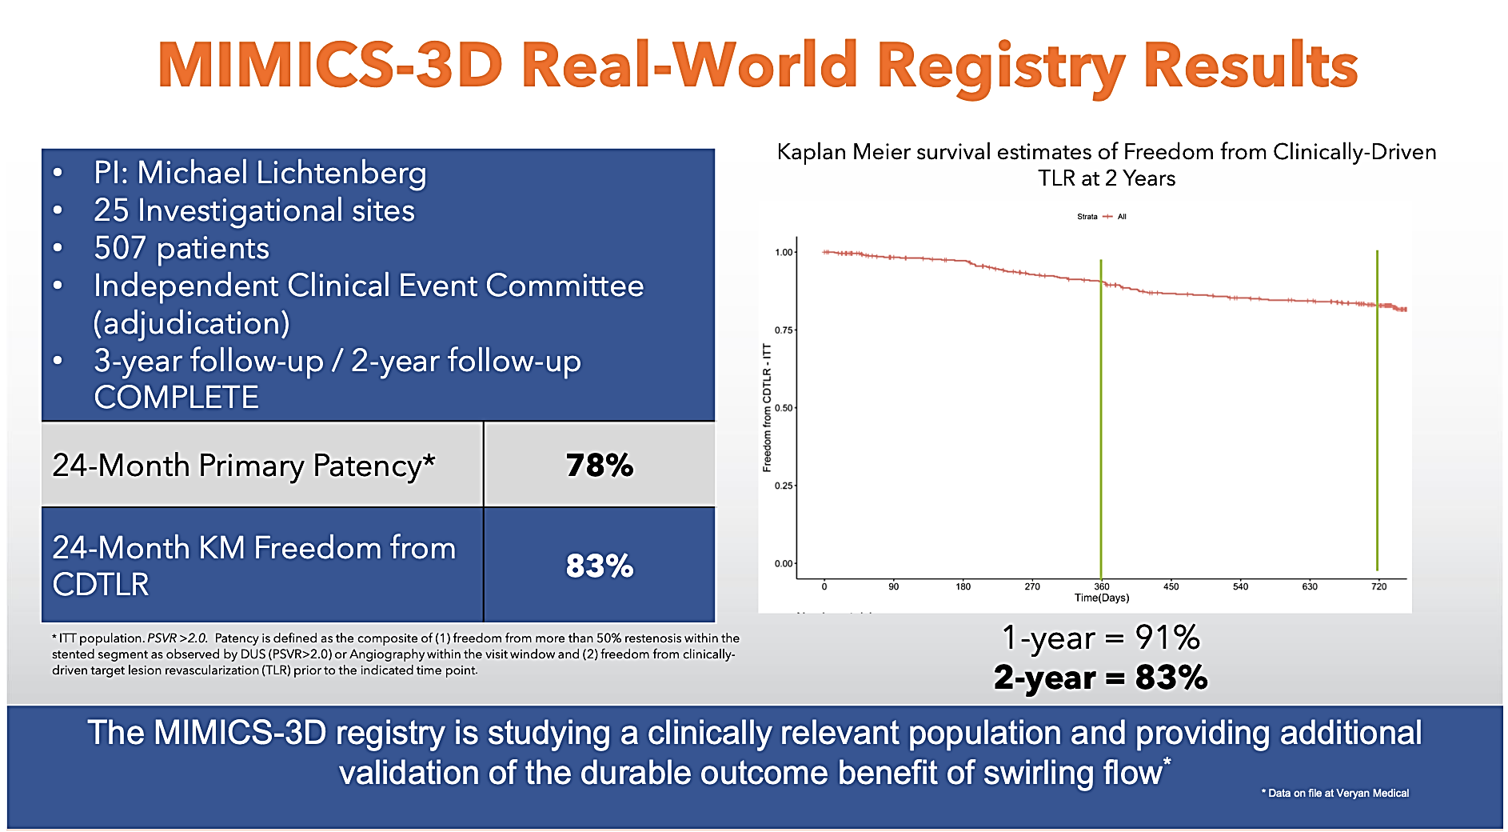
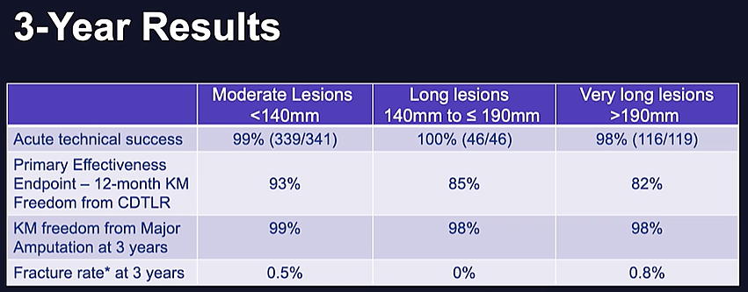
MIMICS-3D trial overview and results
NCT02900924: Observational Study to Evaluate the BioMimics 3D Stent System: MIMICS-3D
Objective: To evaluate safety, effectiveness and device performance within a real-world clinical population of patients undergoing femoropopliteal intervention.
Observational, single-arm, multicentre study
N = 507
Primary Endpoints:
Freedom from major adverse events (MAE) at 30 days
Freedom from clinically-driven target lesion revascularization (CDTLR) at 12 months
Inclusion:
Patient has documented symptomatic peripheral arterial disease scheduled for treatment with the BioMimics 3D stent in accordance with the approved CE Mark indication and Instructions for Use (IFU)
The prospective, observational MIMICS-3D Registry study included patients with CLTI and longer, more challenging lesions in a real-world setting to confirm that real world patients suffering from symptomatic disease of the femoropopliteal segment can be safely and effectively treated with the BioMimics 3D
The published 2-year MIMICS-3D data show a KM estimate of freedom from loss of primary patency at 12 and 24 months of 87.7% and 78.6% respectively.
In the 3-year MIMICS-3D EU data (presented at ISET 2022), the KM estimate of freedom from CD-TLR at 1, 2, and 3 years in the ITT population was 90%, 82%, and 78%, respectively. The KM estimate of freedom from loss of primary stent patency (PSVR > 2.4) through 3 years was 71%.
Source: M Lichtenberg et al. (2021)
Notes:
https://doi.org/10.1024/0301-1526/a000980

Slide 7
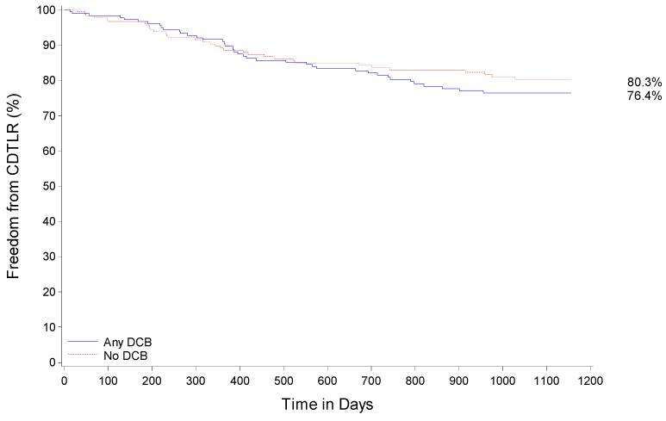
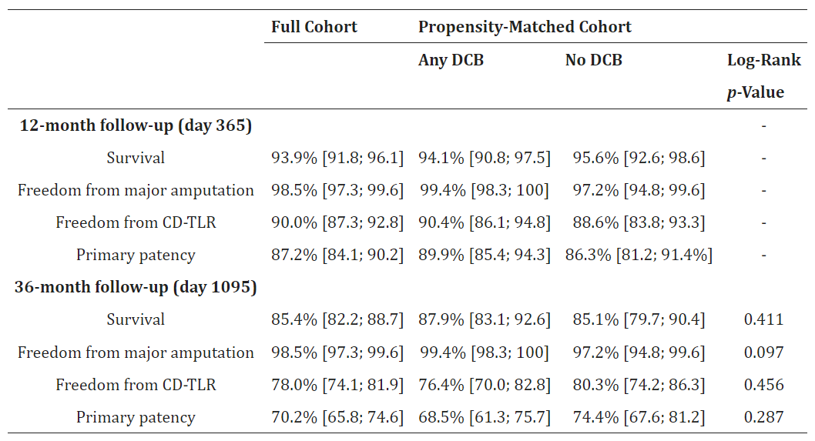
MIMICS-3D 3-year results
A propensity-matched analysis of the MIMICS-3D registry data was published March 2023 to determine the effect of BioMimics 3D + DCB use v. BioMimics 3D + POBA on patient outcomes.
The 3-year outcomes of the full cohort and propensity matched cohorts were consistent with the results of MIMICS-2 and demonstrated the durability of patient outcomes.
Notably, there was no significant difference in outcomes between the propensity-matched cohorts, suggesting that the use of DCBs had minimal effect on patient outcomes when used in combination with BM3D.
Full cohort, N = 507
Propensity matched:
  Any DCB, N = 195
  No DCB, N = 195
Source: M Piorkowski et al. (2023)
Notes:
BioMimics 3D Stent in Femoropopliteal Lesions: 3-Year Outcomes with Propensity Matching for Drug-Coated Balloons - PMC (nih.gov)

Slide 8
Bare nitinol stents

Slide 9


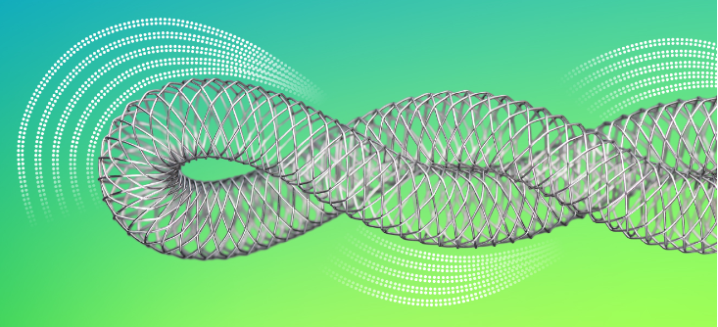
Supera (Abbott)
Design | Bare metal, nitinol
USP | Unique interwoven wire technology High resistance to compression Low chronic outward force High flexibility and fracture resistance
Pivotal trial | SUPERB (NCT00933270) PCD: May 2014 https://doi.org/10.1161/CIRCINTERVENTIONS.113.000937
CE Mark | May 2008
FDA Approval | March 2014
Notes | Labelling includes warning on sizing: Careful attention should be paid when sizing and deploying the stent to prevent stent elongation. In the SUPERB clinical study, stent elongation was associated with a decrease in patency at 12 months. The stent design and high flexibility results in considerable variability to deployed length.
Comparison of the SUpera® PERipheral System in the Superficial Femoral Artery (SUPERB)
Objective: To demonstrate the safety and effectiveness of the SUPERA® Nitinol Stent System in treating subjects with obstructive SFA disease, compared to performance goals based on clinical trials of percutaneous transvenous angioplasty alone
Single-arm, multi-centre
N = 325
Primary Endpoints:
Safety: Freedom From Death, Target Lesion Revascularization (TLR), or Any Amputation of the Index Limb to 30 (±7) Days.
Efficacy: SFA Patency at 12 Months, and TLR.
Inclusion:
Lifestyle limiting claudication or rest pain (Rutherford-Becker scale 2-4) with a resting ankle-brachial index (ABI) less than or equal to 0.9.
A single superficial femoral artery lesion > 60% stenosis or total occlusion.
Stenotic lesion(s) or occluded length within the same vessel (one long or multiple serial lesions) 40 mm – 140 mm.
Distal point of lesion(s) at least 3 cm above the knee joint, defined as the distal end of the femur at the knee joint, and proximal point at least 2 cm below origin of profunda artery.
Patent infrapopliteal and popliteal artery, i.e., single vessel runoff or better with at least one of three vessels patent (less than 50% stenosis) to the ankle or foot.

Slide 10
SUPERB trial Results – 12 Month Follow-up
Event-Driven Safety, Efficacy, and Device-Performance End Points | Rate | 95% CI Using Normal Approximation | Lower Bound of 95% 1-Sided Wilson CI
Safety end points
30-Day freedom from death, TLR or any amputation of index limb | 99.2% (258/260) | 97.2%, 99.9% | 97.7%*
30-Day major adverse vascular events | 1.2% (3/260) | 0.2%, 3.3%
Stent thrombosis | 0.4% (1/260) | 0.0%, 2.1%
12-Month index limb amputations | 0.4% (1/233) | 0.0%, 2.2%
Efficacy end points
12-Month primary patency rate | 78.9% (180/228) | 73.1%, 84.1% | 74.2%*
12-Month TLR | 11.1% (26/235) | 7.4%, 15.8%
12-Month target vessel revascularization | 13.2% (31/235) | 9.1%, 18.2%
Device performance
Technical success (per segment) | 100.0% (262/262) | 98.6%, 100.0%
Device success (per patient) | 98.5% (257/261)† | 96.1%, 99.6%
12-Month stent fracture | 0.0% (0/243) | 0.0%, 1.6%
Effect of compression/elongation on Supera patency
NB: Differences in (and difficulties with) accuracy of deployment mean the structural properties of Supera, such as radial strength and COF, are inconsistent and unreliable – negatively impacting vessel patency.
Source: Garcia L et al. (2015), doi.org/10.1161/CIRCINTERVENTIONS.113.000937.

Slide 11
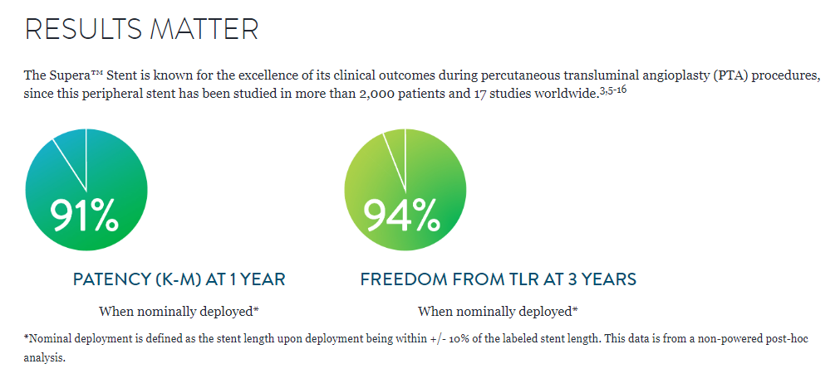
Supera overview
Marketing & Messaging - “Mimetic” stent class
The Supera stent has biomimetic properties that partially mimics the reticular structure of native collagen and elastin within vessels, emphasizing radial strength, flexibility, and kink resistance allows the stent to flex, twist, and otherwise mimic the motion of the vessel in which it is placed, allowing more even distribution of mechanical stress. Interwoven wire design gives considerable flexibility compared to other BMS on market Despite positive trial results, Abbotts’ marketing of efficacy comes with the disclaimer “When nominally deployed” due to the deployment/compacting issues and high degree of user error
On design, Larry J. Diaz-Sandoval MD commented in a 2020 commentary article for publication of the XLPAD registry results:
“Supera’s design partially replicates the endogenous reticular network of interconnected collagen and elastin fibers in healthy arterial walls and therefore dissipates the radial, axial, and torsional opposing forces that typically compromise the patency and integrity of stents delivered in this area.”
Source: Abbott Supera website, accessed December 2022; LJ Diaz-Sandoval (2020), https://doi.org/10.1177/1526602819897068

Slide 12

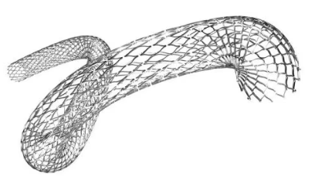
Everflex (Medtronic)
Design | Laser-cut nitinol stent
USP | Open lattice design, tantalum radiopaque markers at the proximal and distal ends, and a spiral cell connection pattern to enhance flexibility and improve fracture resistance.
Pivotal trial | DURABILITY II (NCT00530712) PCD: March 2012 DOI: 10.1002/ccd.25895
FDA Approval | March 2012
Notes | Website states: Combines benefits of durability and deployment accuracy. Treat lesions in either the SFA, proximal popliteal, subclavian, common and/or external iliac arteries or in the biliary system with confidence.
Safety and Effectiveness Study of EverFlex Stent to Treat Symptomatic Femoral-popliteal Atherosclerosis (DURABILITY II)
Objective: To compare PTA and primary stenting using a single PROTÉGÉ® EverFlex™ stent to performance goals of PTA alone in the treatment of atherosclerotic superficial femoral artery (SFA) and proximal popliteal lesions.
Single-arm, multi-centre
N = 287
Primary Endpoints:
Primary stent patency at the 1-year follow-up visit and no clinically-driven TLR within the stented segment within 1 year of the procedure
Major Adverse Events (MAE) was defined as clinically-driven Target Lesion Revascularization (TLR), amputation of treated limb, or all-cause mortality
Inclusion:
Stenotic, restenotic or occluded lesion(s) located in the native superficial femoral artery or superficial femoral and proximal popliteal arteries.
Symptomatic femoral-popliteal atherosclerosis.
Source: EverFlex Product information, last updated July 2022; Rocha-Singh K. et al (2015), https://doi.org/10.1002/ccd.25895

Slide 13
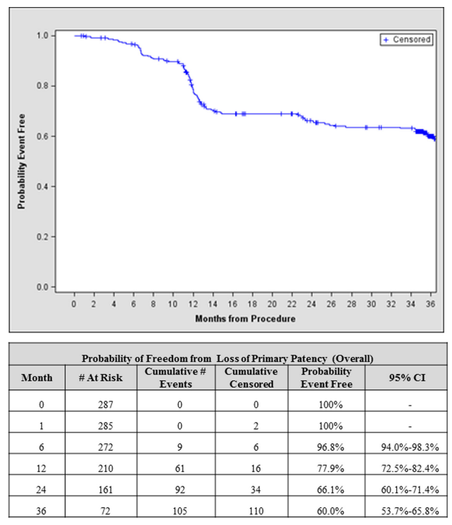
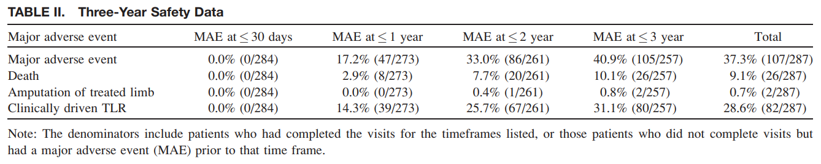
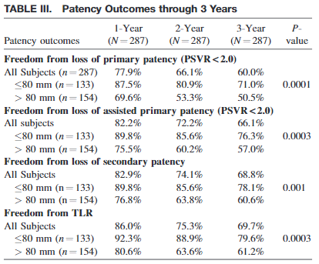
DURABILITY II trial results
1-year results of the DURABILITY II trial established the superiority of using a single, long (up to 20 cm) self-expanding EverFlex stent in reducing restenosis in patient with severe life-style limiting claudication compared to a predefined performance goal derived from patient-level historical data.
Importantly, the study confirmed a low 0.4% stent fracture rate in long stents while demonstrating noninferiority to a prespecified safety performance goal.
The long-term 3-year data presented here show sustained outcomes in adjudicated primary patency, CDTLR, and stent fracture rates and maintenance of functional improvement (ABIs and WIQ scores) with use of the EverFlex stent.
Three-year follow-up from the randomized controlled trial comparing the LifeStent nitinol stent to Percutaneous transluminal angioplasty (PTA) in the RESILIENT Trial has been previously reported, noting a freedom from clinically driven TLR rate in the stent treatment arm of 75.5% for Bard’s LifeStent.

Slide 14
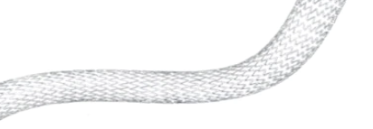


LifeStent (BD/Bard)
Design | Second-generation nitinol stent that is more flexible because of both the orientation of the stent’s inner connections and its helical design.
USP | Unique helical design, it is engineered for bending, compression, and torsion with dynamic vessel conformability
Pivotal trial | RESILIENT (NCT00673985) PCD: August 2006 DOI: https://doi.org/10.1583/11-3627.1
CE Mark | 2008/2009 (?)
FDA Approval | February 2009
Notes | The only FDA-approved stent for the SFA and full popliteal artery. With the promised improved flexibility, the RESILIENT trial reported a stent fracture rate of 3.1% at 12 months and 4.2% at 18 months.
Edwards Lifesciences Self-Expanding Stent Peripheral Vascular Disease Study (RESILIENT)
Objective: To assess the safety and effectiveness of the Edwards Lifesciences LifeStent nitinol self expandable stent device and its delivery system in the treatment of occlusive SFA disease by reducing the re-intervention rate as compared PTA alone
R
PTA only
N = 72
PTA + LifeStent
N = 134
Primary Endpoints:
Safety: Freedom from death at 30 days post-procedure.
Effectiveness: Freedom from Target Lesion Revascularization (TLR) and/or Target Vessel Revascularization (TVR) at 30 Day, 6 Month, and 12 Months post-procedure.
Inclusion:
Lifestyle-limiting claudication defined as: Rutherford Cat. 1-3.
Target lesion(s) is de-novo or restenotic and located within the native SFA and/or proximal popliteal artery
Target total length of the lesion or series of lesions is ≤ 150 mm.
Angiographic evidence of at least one vessel runoff to the foot.

Slide 15
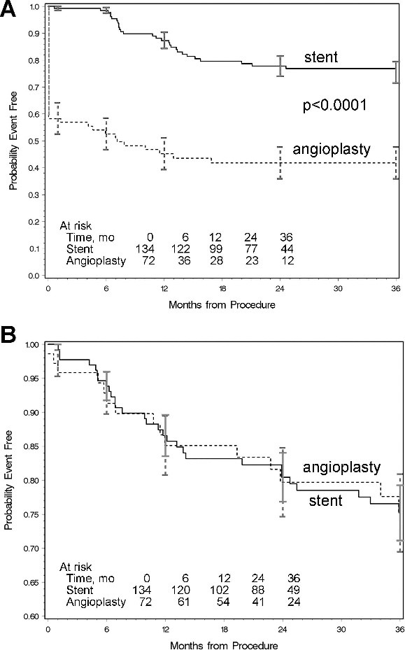
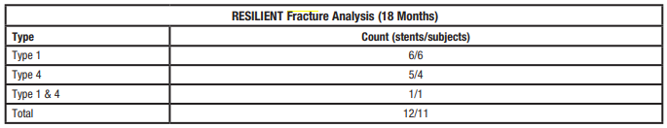
RESILIENT trial results
The probability of freedom from TLR through 3 years for the primary intention-to-treat analysis (Figure, A) demonstrated a significantly better outcome for the stent group than the angioplasty group throughout the course of the study.
In addition, there was no statistically significant difference between the composite MACE rates. Freedom from MACE at 36 months for the stent and angioplasty groups was 75.2% (Figure, B).
In the RESILIENT study, there was no difference in quality of life between the angioplasty and stent groups at 2 and 3 years following intervention.
Notably, only lesions shorter than 150 mm were enrolled and only Rutherford 1-3, selecting for less complex lesions compared to other pivotal studies.

Slide 16


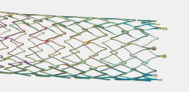
Pulsar-18 (Biotronik)
Design | Laser-cut nitinol stent, coated with amorphous silicon carbide to reduce platelet activation and aggregation
USP | Thinner struts for low chronic outward force Lower risk of restenosis Reduced vessel injury and inflammation Faster endothelialization
Pivotal trial | BIOFLEX-I (NCT01319812) PCD: September 2015 https://doi.org/10.1016/j.jvir.2016.06.008
CE Mark | 2011
FDA Approval | March 2017
Notes | Only 4F delivery system to reduce access complications. Results from BIOFLEX-1 published for Astron stent in iliac artery lesions but missing results for Pulsar in fempop. Instead Biotronik published BIOFLEX-PEACE, all-comers registry results.
IDE Study to Determine the Safety and Efficacy of the Astron and Pulsar Stents (BIOFLEX-I)
Objective: To demonstrate the safety and efficacy of BIOTRONIK's Astron and Pulsar stents. The Pulsar stent will be used for the treatment of femoro-popliteal lesions, while the Astron stent will be for treatment of the common or external iliac artery lesions
Astron
N = 161
Pulsar
N = 302
Primary and Secondary Endpoints:
Primary patency at 12 Months
Freedom From Procedure- or Stent-related Major Adverse Events at 30 days
Long-term safety - Major Adverse Event Rate at 12 months
Inclusion:
Candidate for PTA
Life-style limiting claudication or rest pain with an ABI ≤ 0.9 (resting or exercise)
Femoro-popliteal lesions must be located at least 1 cm distal to the profunda femoris artery and at least 3 cm above the knee joint (radiographic joint space)
Angiographic evidence of ≥ 70% stenosis or occlusion (operator visual assessment)
Lesion length ≤ 190 mm (if de novo or restenotic) or ≤ 100 mm (if occluded)

Slide 17
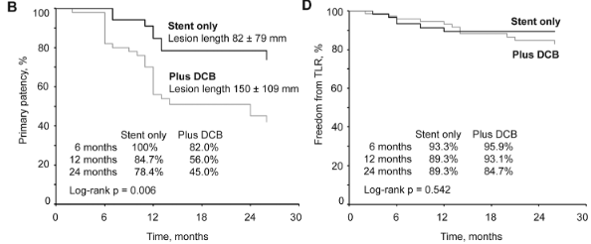
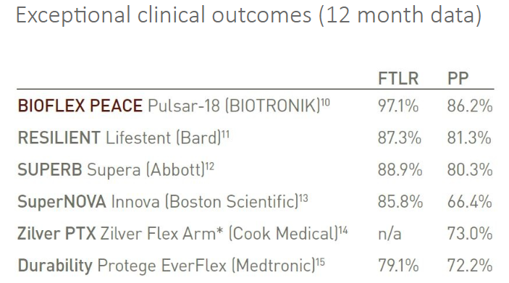
BIOFLEX-PEACE, 12 Month Patient Registry Data
Effectiveness of the Pulsar-18 self-expanding stent with optional drug-coated balloon angioplasty in the treatment of femoropopliteal lesions – the BIOFLEX PEACE All-Comers Registry
Objective: To evaluate effectiveness and safety of stenting with the Pulsar-18 SE nitinol stent and optional DCB angioplasty in femoropopliteal segment lesions and whether results obtained in clinical trials will be confirmed in a real-world setting with varying stenting strategies.
Prospective, single-arm, multicentre study
N = 160
Primary & Secondary Endpoints:
Major adverse events (MAE) at 6 months
Primary patency at 12 months.
Clinical success (defined as improvement by one or more Rutherford class), target lesion revascularisation (TLR), amputation rate.
Inclusion:
Patients with symptomatic peripheral artery disease of Rutherford category 2 to 5
70+% stenosis or occlusion of the SFA/PPA.
At least one patent infrapopliteal outflow vessel
Lesion Characteristics | ITT (n=160) | Stent only (n=60/135) | +DCB (n=75/135)
SFA lesion | 84.9% | 83.6% | 85.0%
PPA lesion | 15.1% | 16.4% | 15.0%
Lesion length (mm) | 116.3 ± 103.1 | 81.6 ± 79.3 | 150.2 ± 108.7
Over 150mm | 30.6% | 15.1% | 46.3%
Source: Pulsar-18 Product information 2018 (Accessed October 2022); Lichtenberg M. et al (2019), https://doi.org/10.1024/0301-1526/a000785
Note: TLR presented in study results refers to clinically driven TLR

Slide 18
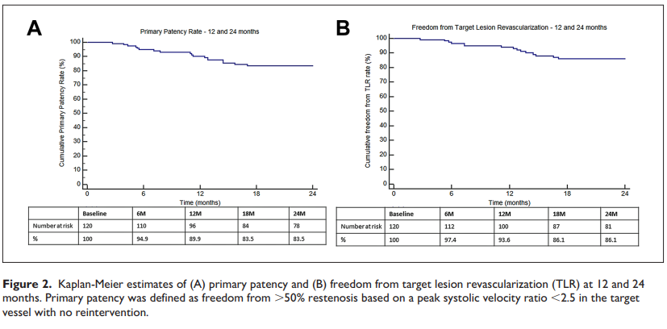
BIOLUX 4EVER Trial Overview and Results
NCT02211664: Physician-Initiated Trial Investigating the Efficacy of Endovascular Treatment of Femoropopliteal Arterial Stenotic Disease With the Biotronik Passeo-18 Lux Drug Releasing Balloon and the Biotronik Pulsar-18 Stent (Comparing With 4EVER Trial Results) (BIOLUX 4EVER)
Objective: To evaluate the short- and long-term (up to 24 months) outcome of treatment by means of dilation with the Passeo-18 Lux drug releasing balloon and by Pulsar-18 stent implantation in symptomatic (Rutherford 2-4) femoro-popliteal arterial stenotic or occlusive lesions.
Single-arm, multi-centre
N = 120
Primary & Secondary Endpoints:
Primary patency at 6-, 12- and 24-months follow-up
Technical & procedural success
Freedom from TLR at 1-, 6-, 12- and 24-months follow-up
Serious Adverse Events at up to 24-months follow-up
Inclusion:
De novo lesions located in the femoropopliteal arteries
Patients with a Rutherford classification score from 2 to 4
The target lesions are within the native SFA: distal point 3 cm above knee joint and 1 cm below the origin of the profunda femoralis
At least one-vessel-runoff to the foot
In BIOLUX 4EVER, physicians used the combination of the Passeo-18 Lux DCB and the Pulsar-18 BMS to treat superficial femoral artery lesions. The full 12-month (395 days) outcomes showed 86.9% primary patency and 91.6% freedom from TLR in 120 patients.
In Biotronik’s PR, Koen Deloose commented, “The 12-month outcomes of the BIOLUX 4EVER trial indicate the value of a combined approach that provides physicians with more options and versatility when treating SFA lesions while achieving DES-like results… there is now the freedom to determine how much support is necessary based on each vessel’s unique anatomy and lesion characteristics for a more tailored approach.”
Source: Pulsar-18 Product information 2018 (Accessed October 2022)

Slide 19
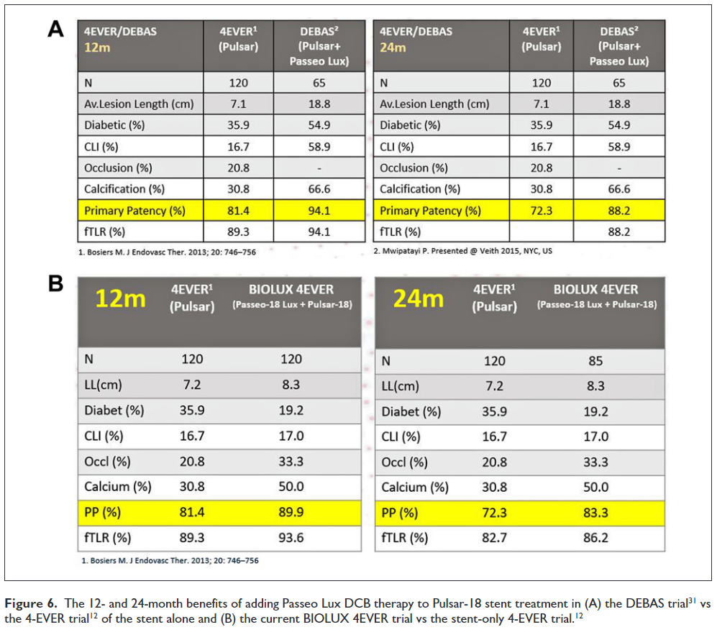
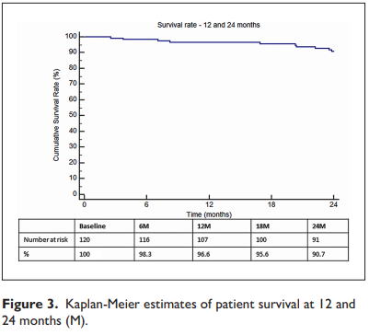
BIOLUX 4EVER Trial Results
The earlier DEBAS trial showed that direct implantation of the Pulsar-18 stent, followed by post-dilation with a DCB (e.g., Passeo-18 Lux), results in improved efficacy compared with stenting alone.
The reverse strategy of prepping the vessel first with the Passeo-18 Lux DCB followed by stenting with the Pulsar 18 stent was investigated in the BIOLUX 4EVER trial, achieving very good primary patency and TLR rates comparable to current DES therapy
Source: Pulsar-18 Product information 2018 (Accessed October 2022)

Slide 20
Drug-Eluting stents

Slide 21


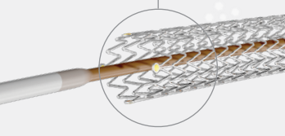
Zilver PTX (Cook Medical)
Design | Paclitaxel-coated, straight, laser cut nitinol stent.
USP | First paclitaxel-eluting nitinol stent Coating-free, short-term delivery of PTX ensures limited drug exposure and related AEs
Pivotal trial | ZILVER PTX (NCT00120406) PCD: October 2009 DOI: 10.1161/CIRCINTERVENTIONS.111.962324
CE Mark | August 2009
FDA Approval | November 2012
Notes | Long-term (5-years) follow-up for pivotal ZILVER PTX trial available, demonstrating superiority of Zilver PTX over PTA + BMS in treating SFA lesions.
NCT00120406: Evaluation of the Zilver PTX Drug-Eluting Stent in the Above-the-Knee Femoropopliteal Artery (Zilver PTX)
Objective: To compare the 12-month safety and effectiveness of a polymer-free, paclitaxel-coated DES with PTA and provisional BMS placement in patients with femoropopliteal peripheral artery disease
R
Zilver PTX
N = 236
PTA + BMS
N = 238
Primary Endpoints:
Event-free survival at 12 months
Primary patency at 12 Months
Inclusion:
De novo or restenotic lesion(s) with >50% stenosis documented angiographically and no prior stent in the target lesion.
Patient has symptoms of peripheral arterial disease classified as Rutherford Category 2 or greater.
Patient agrees to return for a clinical status assessment and duplex ultrasound at 6 months, 12 months, and at 2, 3, 4, and 5 years.

Slide 22
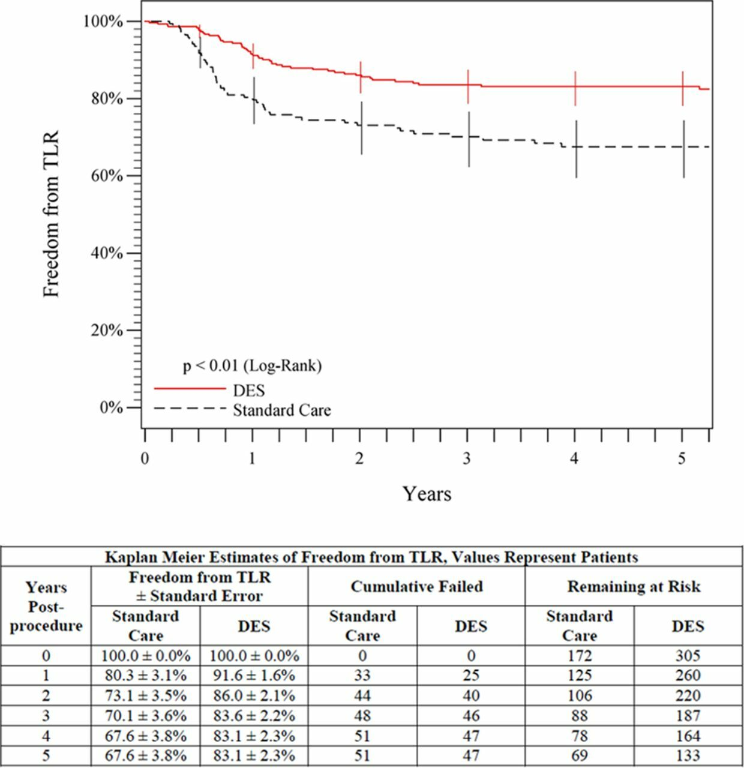
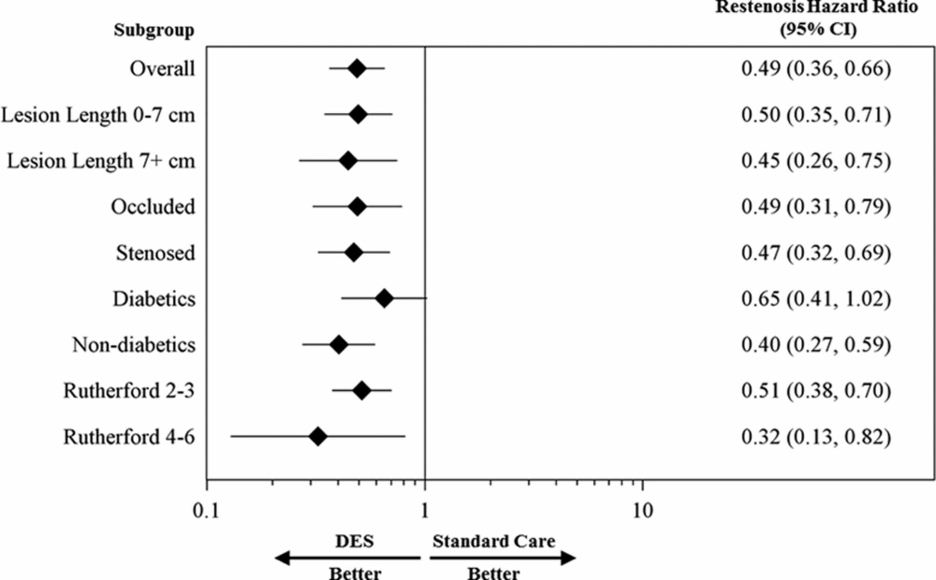
ZILVER PTX RCT, 5-year results
Original RCT was planned with 3-years’ follow-up but this was extended to 5-years in response to Katsanos’ meta-analysis claiming PTX exposure increased patient mortality.
  Topline 5-Year results initially presented at CIRSE 2019 by Michael Dake
Subgroup analysis indicated universal benefit in favour of DES
Cook Medical has made the dataset available to public, on request and with reason/intention of use included in request submission.
Source: M. Dake et al. (2016), https://doi.org/10.1161/CIRCULATIONAHA.115.016900

Slide 23


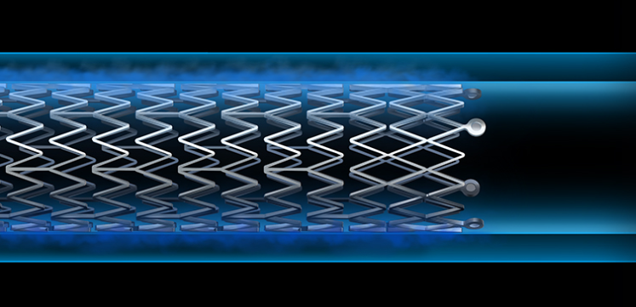
Eluvia (Boston Scientific)
Design | Paclitaxel-coated, straight, laser cut nitinol stent.
USP | Promus polymer coated for sustained drug release, limiting systemic exposure.
Pivotal trial | IMPERIAL (NCT02574481) PCD: December 2017 DOI: 10.1007/s00270-020-02693-1
CE Mark | February 2016
FDA Approval | September 2018
Notes | First head-to-head DES SFA Trial 5-year follow-up MAJESTIC (NCT01820637; N=57), a single-arm trial, also demonstrated positive 9-month patency results compared to historic BMS trial results.
ELUVIA™ Drug-eluting Stent Versus Zilver® PTX® Stent (IMPERIAL)
Objective: To evaluate the safety and effectiveness of the ELUVIA Drug-Eluting Vascular Stent System (ELUVIA Stent) for treating SFA and/or PPA lesions
R
Eluvia
N = 309
Zilver PTX
N = 156
Primary Endpoints:
Major Adverse Events (MAE) defined as all causes of death through 1 month, target limb major amputation through 12 months and/or target lesion revascularization (TLR) through 12 months
Primary patency at 12 Months
Inclusion:
Chronic, symptomatic lower limb ischemia defined as Rutherford categories 2, 3 or 4.
Stenotic, restenotic or occlusive lesion(s) located in the native SFA and/or PPA:
Degree of stenosis ≥ 70% by visual angiographic assessment
  Total lesion length (or series of lesions) 30 mm - 140 mm
  Long Lesion Substudy: Total lesion length (or series of lesions) 140 mm - 190 mm
  Target lesion located at least 3 cm above the inferior edge of the femur
Patent infrapopliteal and popliteal artery, i.e., single vessel runoff or better with at least one of three vessels patent (<50% stenosis) to the ankle or foot.

Slide 24
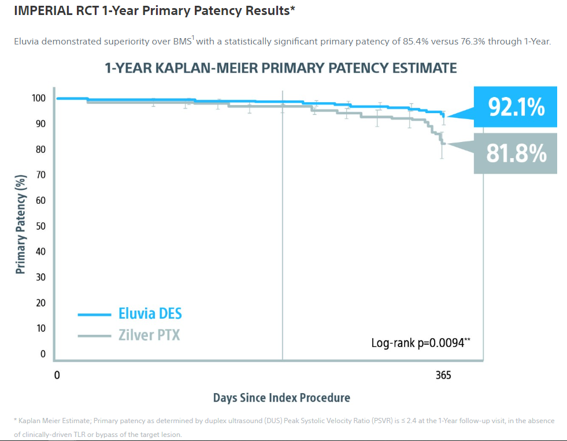
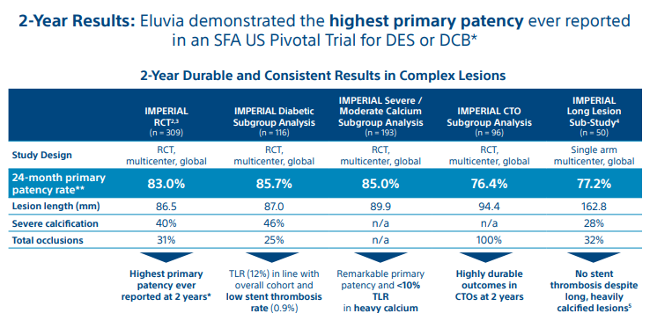
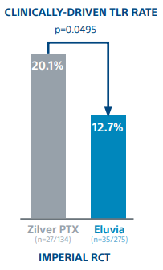
IMPERIAL trial results
24-month endpoints | Eluvia (N = 295) | Zilver PTX (N = 145) | P-value
All cause mortality | 7.1% (21) | 8.3% (12) | 0.6649
CD-TLR | 12.7% | 20.1% | 0.0495
Primary patency | 83.0% | 77.1% | 0.1008
Conclusion: Two-year follow-up suggests a sustained advantage for Eluvia for avoiding target lesion revascularization. Initial hypoechogenic halo assessment showed no difference in prevalence between the study arms, no flow within the halo, and no associated adverse events.
Source: S Müller-Hülsbeck et al. (2021), doi: 10.1007/s00270-020-02693-1
Notes:
Two-Year Efficacy and Safety Results from the IMPERIAL Randomized Study of the Eluvia Polymer-Coated Drug-Eluting Stent and the Zilver PTX Polymer-free Drug-Coated Stent - PubMed (nih.gov)

Slide 25
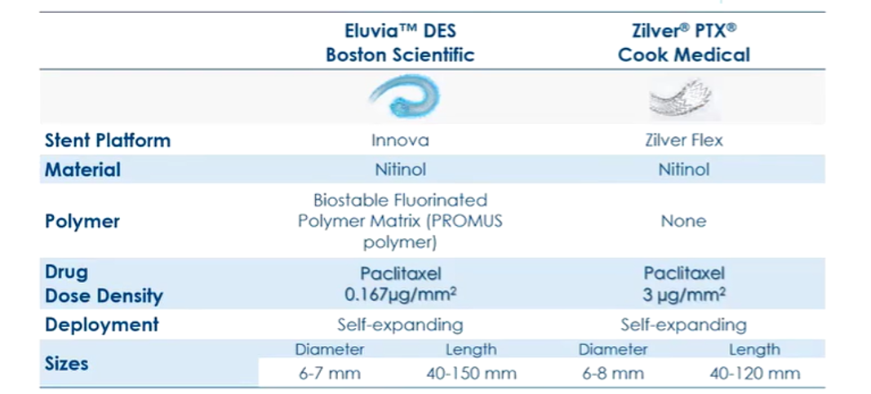
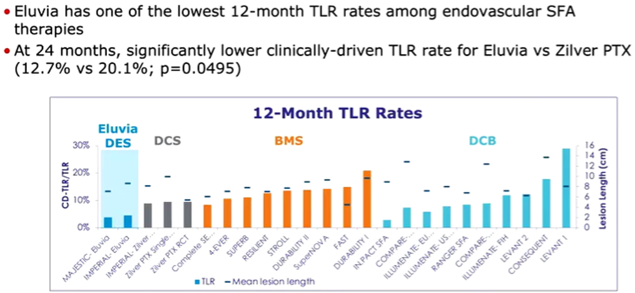
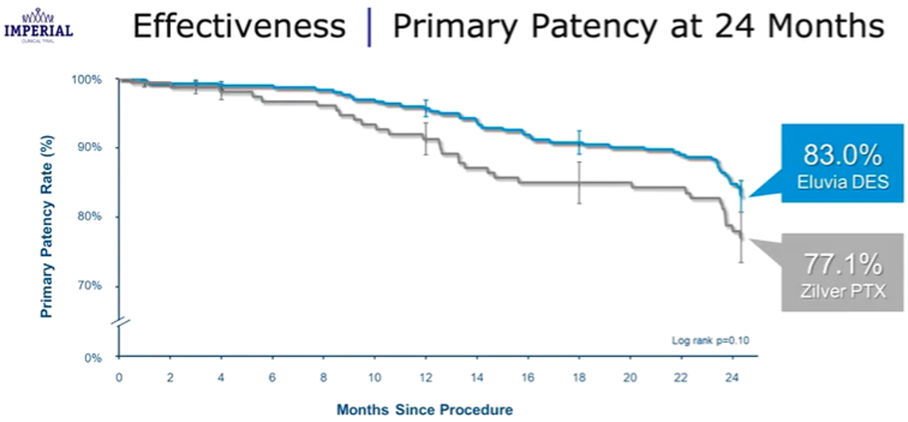
IMPERIAL trial results
Boston’s direct comparison of Eluvia with Zilver PTX in marketing materials points out the marked difference in paclitaxel dose density. While the polymer-free design of Zilver PTX allows shorter duration of paclitaxel exposure, the polymer used in Eluvia results in superior efficacy while using a far lower dose, limiting total/overall paclitaxel exposure.

Slide 26
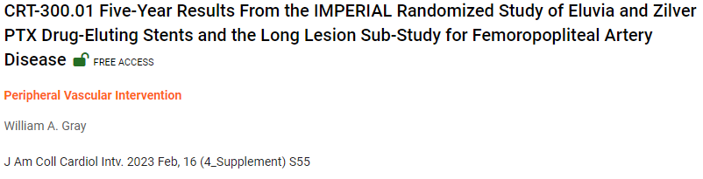
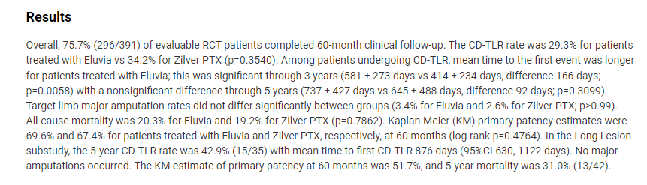
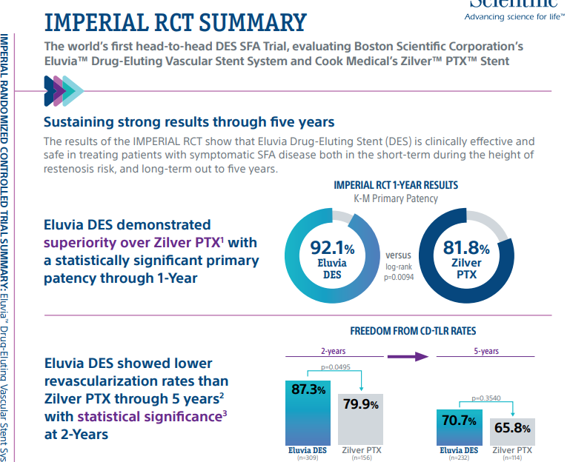



IMPERIAL trial results
5- year results were made available as an abstract at the CRT congress, February 2023 but Boston Scientific did not make any announcement or press release to acknowledge the new results.
  Overall, the 5-year data, while trending in Eluvia’s favour, was not statistically significant and showed the early advantage of Eluvia was not sustained and had narrowed considerably by 5-year follow-up. Notably, limb amputation rate and primary patency were near identical at 5-years.
  KM data plots were not included in the abstract.
They have included some mentions of the 5-year data in their updated product sheet but the data are inconsistently used, with most focus being made to highlight their earlier data (1 year).
  Only one 5-year data point is included and this is not statistically significant.
Source: WA Gray (2023), DOI: 10.1016/j.jcin.2023.01.179; Boston Scientific Imperial data sheet, accessed February 2024
Notes:
CRT-300.01 Five-Year Results From the IMPERIAL Randomized Study of Eluvia and Zilver PTX Drug-Eluting Stents and the Long Lesion Sub-Study for Femoropopliteal Artery Disease | JACC: Cardiovascular Interventions
IMPERIAL RCT Summary (bostonscientific.com)

Slide 27
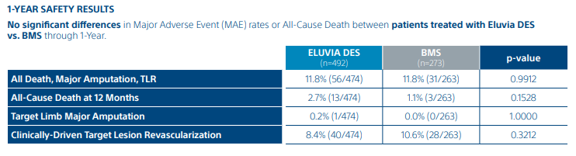
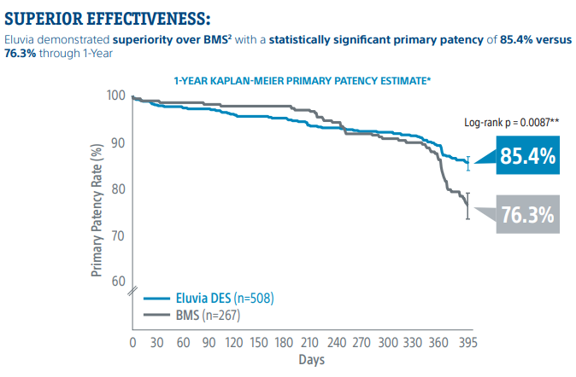
EMINENT trial overview and results
NCT02921230: Trial Comparing ELUVIA v. Bare Metal Stent in Treatment of Superficial Femoral and/or Proximal Popliteal Artery (EMINENT)
Objective: To confirm the superior effectiveness of the ELUVIA Drug-Eluting Vascular Stent System for treating SFA/PPA lesions up to 210 mm in length when compared against bare metal stents
R
Eluvia
N = 508
BMS
N = 267
Primary & Secondary Endpoints:
Primary patency at 12 Months
Walking Improvement
Change in quality of life
Cost effectiveness
Primary completion date for EMINENT was July 2021 but Boston Scientific has not made any public statement to acknowledge this.
To date, only 12-month data have been publicly released or presented at a congress, despite plans to also measure patency, MAE and TLR/TVR (plus other measures) at 24, 36, and 60 months (according to ct.gov)
Source: Boston Scientific EMINENT data sheet, accessed February 2024

Slide 28
Pipeline Stents

Slide 29

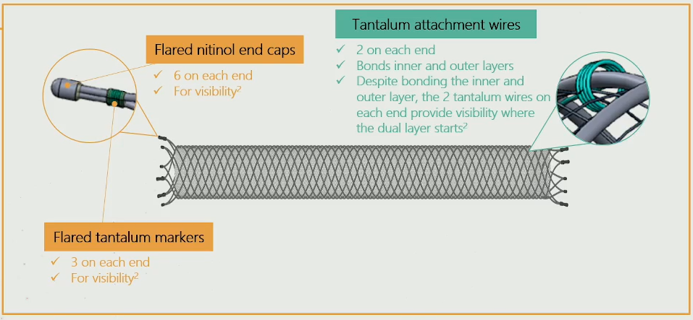
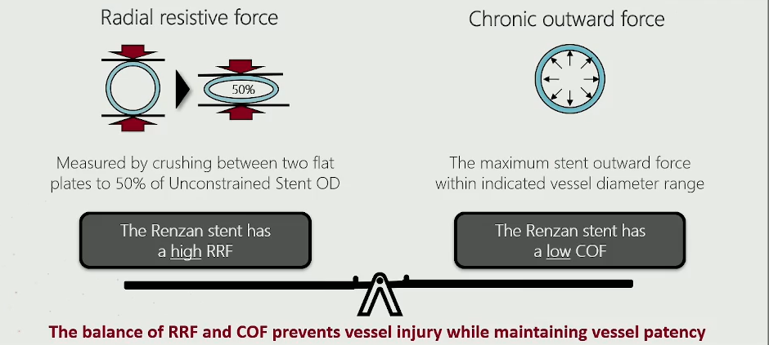
Renzan (Terumo/ID3)
Design | Bare metal, nitinol
USP | Helically interwoven wires Retrievable and redeployable to aid exact stent placement
Pivotal trial | PRIZER (NCT04546477) PCD: July 2022 Initial 30-day results presented at CIRSE 2022 (First @CIRSE session and also by sponsored symposium)
Estimated EU Approval | -
Estimated FDA Approval | -
Notes | Design was based on the Roadsaver stent (indicated for carotid artery) During CIRSE, K. Deloose made strong and multiple comparisons to Supera and renewed the classification of mimetic stents as the modern class of stent design.
Prospective Multicenter Study to Confirm the Performance of the Renzan Stent in Treatment of SFA/POP Artery Disease (PRIZER)
Objective: To confirm the safety and efficacy of the Renzan Peripheral Stent System when used for treatment of superficial femoral (SFA) and/or popliteal (POP) artery disease.
Stent visibility
Prospective, multicenter, post-market, single arm study
N = 135 (90 in Fempop + 45 pop)
Primary Endpoints:
Death/Freedom from death at 30 days and 12 months
TLR/Freedom from Target Lesion Revascularization (TLR) at 30 days and 12 months
Amputation/Freedom from any amputation of the index limb at 30 days and 12 months
Primary patency of the artery at 12 months
Inclusion:
Rutherford-Becker clinical classification category 2 to 5
A superficial femoral and/or popliteal artery lesion with > 50% stenosis or total occlusion.
Stenotic or occluded lesion(s) within the same vessel (one long or multiple serial lesions treatable with one stent) ≥ 40 mm and ≤ 140 mm in length
At least one patent native outflow artery to the foot, free from significant (≥50%) stenosis, not previously been revascularized.
Balance of forces

Slide 30
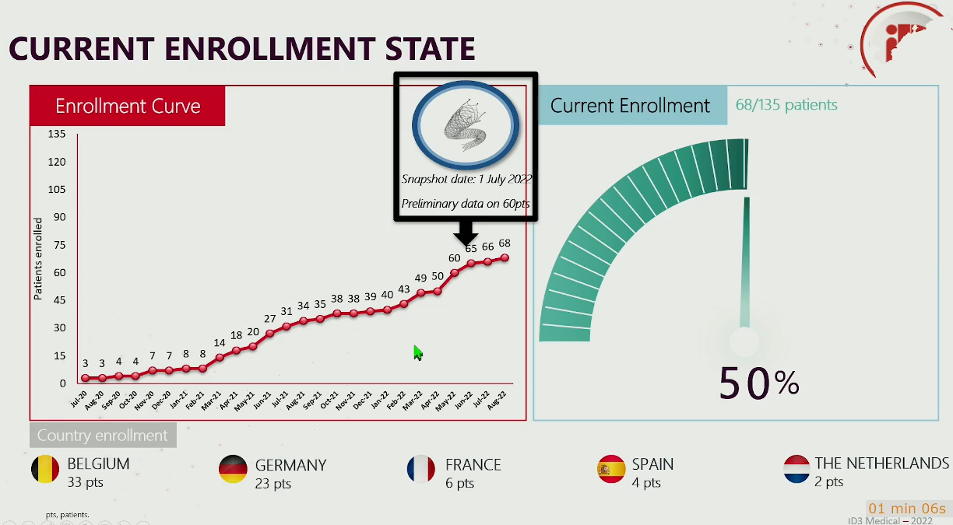
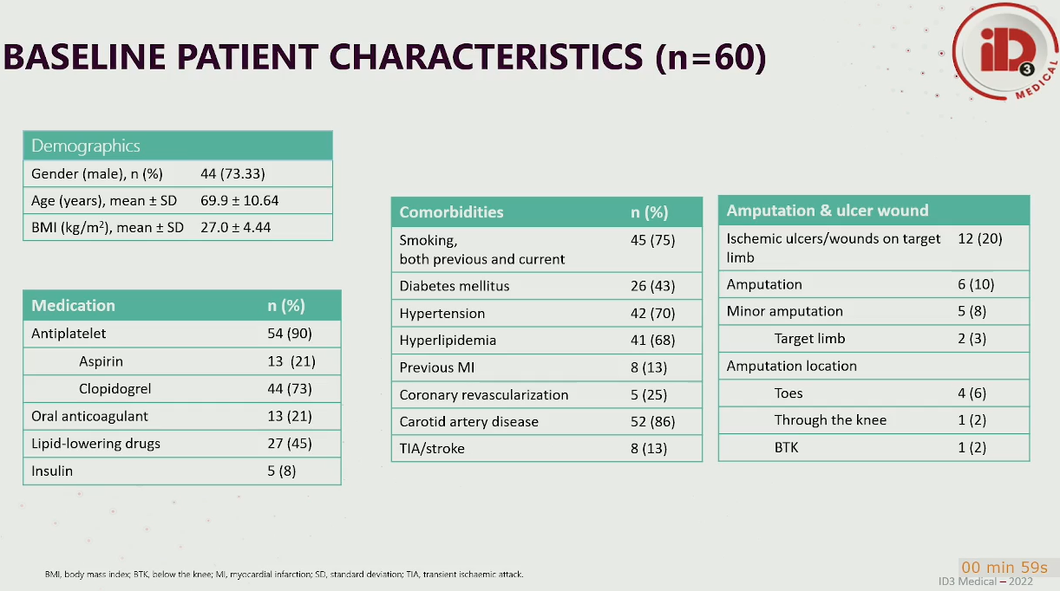
PRIZER trial results
  N = 60 (52 Fempop / 5 pop)
  Single-arm, multi-centre study
  Cumulative target lesion length = 68.4mm ± 21.44
  Freedom from TLR = 97% (TLR due to instent restenosis in 1 patient)
  Note: Only one stent is allowed for implantation in PRIZER due to flared ends and overlap of the ends is not allowed.
K Deloose; CIRSE presentation 2022

Slide 31
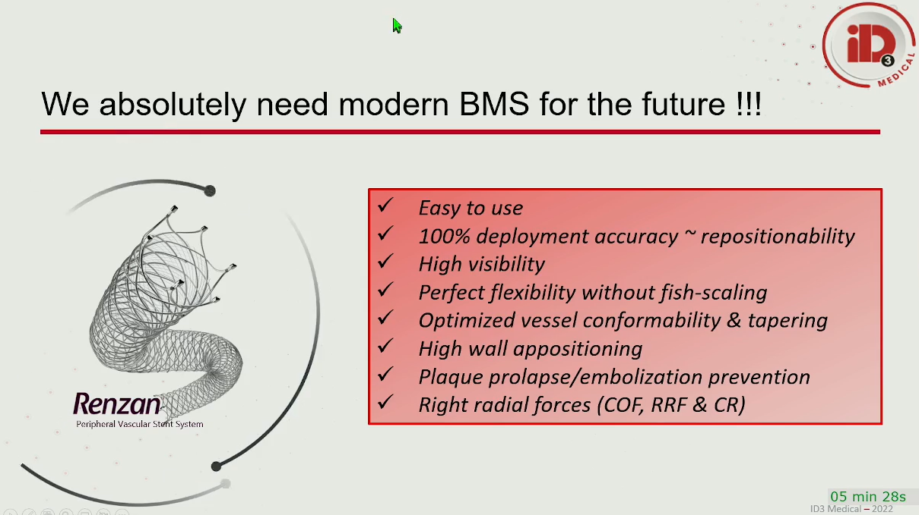
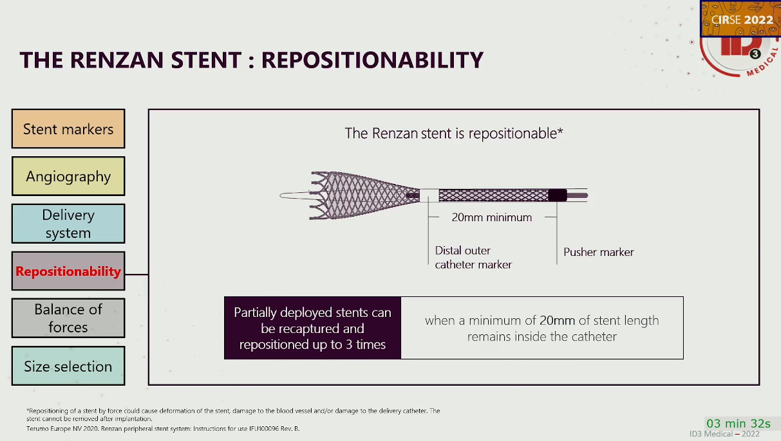
PRIZER presentation and messaging
What’s the main differentiator from Supera?
The learning curve for implantation of the Supera has been a hurdle and precise placement is very difficult. So, the goal with the Renzan stent, is to employ a system reminiscent of early BMS. To have better visibility, ease of deployment and to make precise placement predictable. You can also reposition it, up to 3 times. Allowing for precise placement. The ability to compact and elongate the Renzan stent is also claimed as an improvement compared to Supera, avoiding non-optimal deployment issues that could negatively affect patency outcomes.
K Deloose; CIRSE presentation 2022

