Slide 1
2023 Q3 Sales and Marketing Discussion
From Transformation to Acceleration

Slide 2



Critical Marketing Considerations
Messaging
Strategic Accounts
KOL/Congress Strategy
Amplifying the message
Business Transformation
Targeting to go deep vs wide
Brand Development
Air cover support for team
Creation and delivery of a message for “why” and the strategic vision for Veryan/Otsuka. It’s critical that remaining team, partner physicians ”buy in” and society relationships
Critical to identify the “right” accounts to continue to service and grow. Considerations include physician prominence, ASP/Volumes, IDN affiliations, etc.
Continue to engage your KOLs as brand ambassadors and leverage 4-5 meetings/year to launch and reinforce clinical campaigns.
With the reduced footprint, it will be more critical to leverage a select few platforms to build awareness and support commercial initiatives

Slide 3
Continue the Campaign with KOLs
Campaign approach lead to 85% increase in sales per day!
Reduce focus in US to select national meetings
  ISET, NCVH, AMP, VIVA
Each should be viewed as opportunity to either launch or reinforce clinical campaign
Best way to keep KOLs engaged through the transition and keep support within the major societies
Establish a Campaign strategy through 24 that allows smaller team time to develop and execute and sets expectations with KOLs

Slide 4
2023 BM3D US Sales and Marketing Initiatives – Proposed Cadence
Q1
Q2
Q3
Q4
BM3D Complex Lesions
BM3D Small Vessel Subgroup
TASC Comparison
EXEC ROADSHOW
BM3D Health/Econ analysis
ISET
NCVH
AMP
VIVA
MIMICS3D 3Y Pub
M3D 3Y CTO/CA+ Pub
M3D 3Y LL/SV Pub
AIR COVER-PROPOSED PROGAMS
ISET-BM3D Complex
VIVA-TASC
CX-BM3D Complex
LINC-Complex,SV
SM RVD Subgroup
HPG Pack
NCVH Complex
SM Complex Subgroup

Slide 5
Aircover Update
Congress | Dates | Topic | Presenter
ISET | 16-19 Jan 2023 | MIMICS-3D Complex lesions | R Beasley
CX | 25-27 April 2023 | MIMICS-3D 1. Complex lesions [CTO, calcium, LL] 2. Swirling flow and DCB | C Rammos M Piorkowski M Lichtenberg
NCVH | 30 May – 01 June 2023 | MIMICS-3D 1.Complex lesions [CTO, calcium, LL) | J Yoho
LINC | 06-09 June 2023 | MIMICS-3D 1. Complex lesions [CTO, calcium, LL] 2. Swirling flow and DCB | C Rammos M Piorkowski M Lichtenberg
AMP | 16-19 Aug 2023 | MIMICS-3D 1. COMPLEX lesions [RVD] | TBC
CIRSE | 09-13 Sept 2023 | MIMICS-3D COMPLEX lesions [small diameter CTO, calcium, LL] | TBC
VIVA | 30 Oct – 02 Nov 2023 | MIMICS-3D 1. TASC D Clinical Comparison | TBC
VEITH | 15-18 Nov 2023 (TBC) | MIMICS-3D 1. Health economics 2. BM3D vs BMS | TBC

Slide 6
RVD Subgroup Analysis
Q3 Clinical Campaign
7.13.23

Slide 7
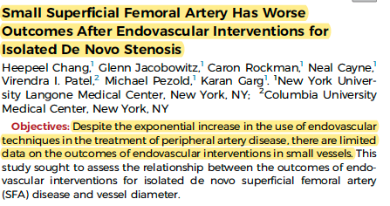
Outcomes in Small SFAs – JVS, 2020

Slide 8
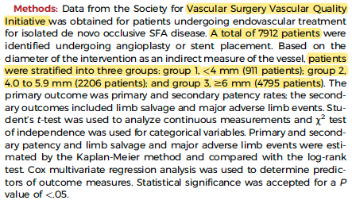
Outcomes in Small SFAs – JVS, 2020

Slide 9
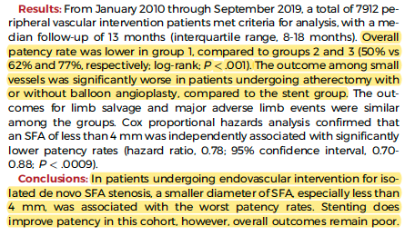
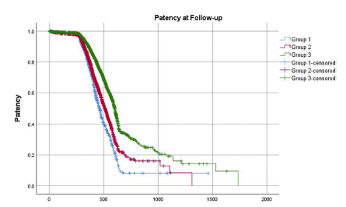
Outcomes in Small SFAs – JVS, 2020

Slide 10
A few key takeaways
Thanks Craig Walker!
VQI is a powerful data source, particularly with VS! Study well powered!
What’s the downside to VQI…..F/U
Study isn’t isolated to stents but rather all endo outcomes
However, demonstrates that all outcomes are worse below 6mm!!
Stents performed better than Ath + POBA in very small vessels…somewhat counterintuitive.
  How do we use that?
  What are the watchouts with it?

Slide 11
MIMICS^{3D}
Small vessel sub-group analysis

Slide 12
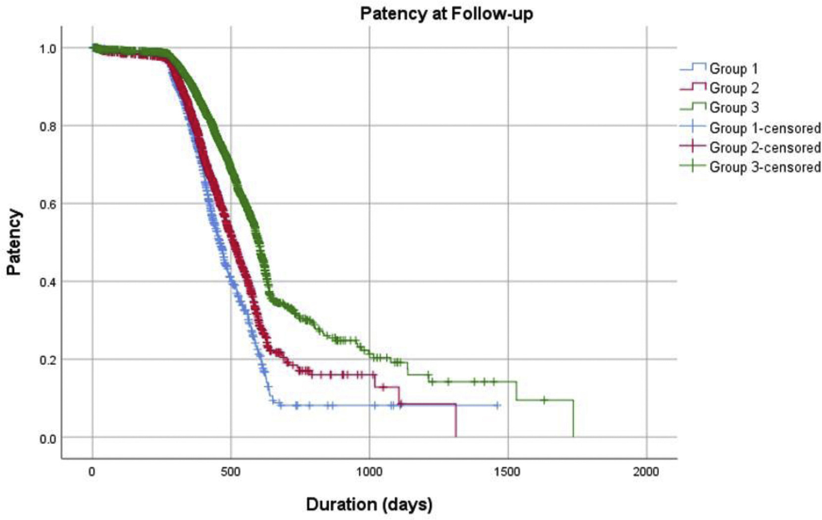
Comparing outcomes in SMALL VESSEL SFA/Pop lesions
Retrospective analysis from 7,912 interventions in the Society for Vascular Surgery: Vascular Quality Initiative (SVS VQI) database
Outcomes stratified based on diameter of vessel treated
  Group 1: <4MM
  Group 2: 4-5.9MM
  Group 3: >6MM
“Outcome among small vessels was significantly worse in patients undergoing atherectomy with or without balloon angioplasty, compared to the stent group”¹
At median follow up of 13 months, primary patency was:
  Group 1: 50%
  Group 2: 62%
  Group 3: 77%
Key Takeaways:
VQI…7912!
Atherectomy and POBA did WORSE than stent in SV group
Any vessel under 6mm associated with worse outcomes
“In patients undergoing endovascular intervention for isolated de novo SFA stenosis, a smaller diameter SFA was associated with the worst patency rates.”¹
1. Chang, H, et al. Journal of Vascular Surgery 2020 72e158-e159DOI: (10.1016/j.jvs.2020.04.274)
Notes:
Journal of Vascular Surgery
July 2020
Small Superficial Femoral Artery Has Worse
Outcomes After Endovascular Interventions for
Isolated De Novo Stenosis
Heepeel Chang,1 Glenn Jacobowitz,1 Caron Rockman,1 Neal Cayne,1
Virendra I. Patel,2 Michael Pezold,1 Karan Garg1. 1New York University
Langone Medical Center, New York, NY; 2Columbia University
Medical Center, New York, NY

Slide 13
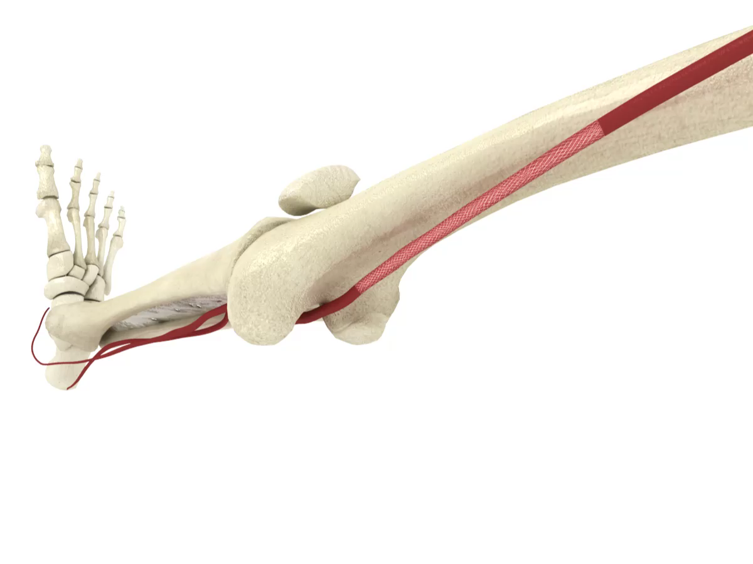
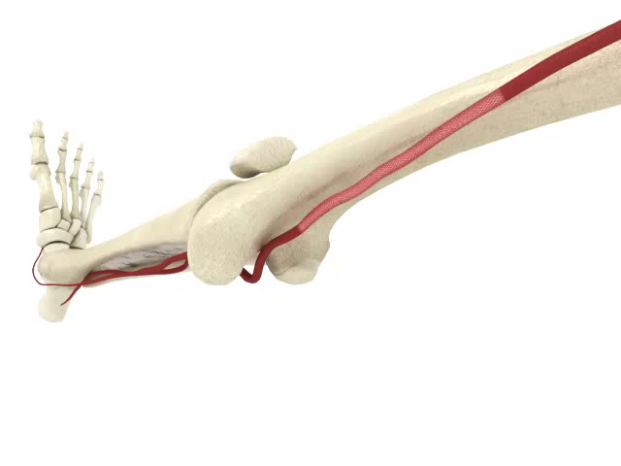
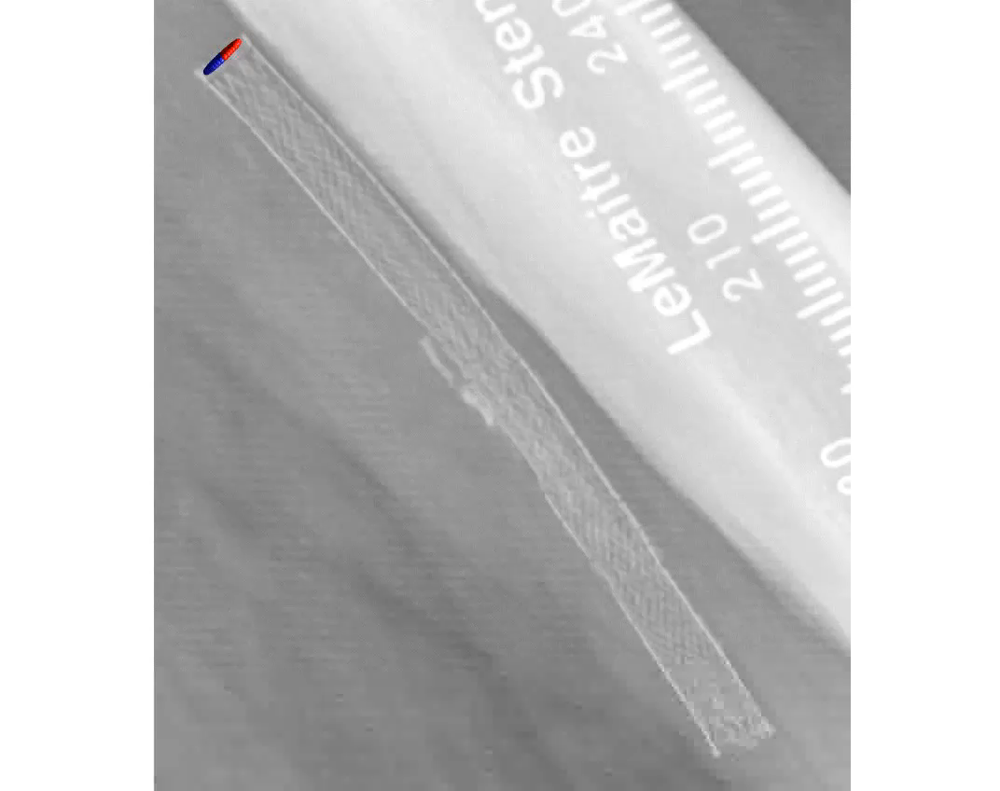
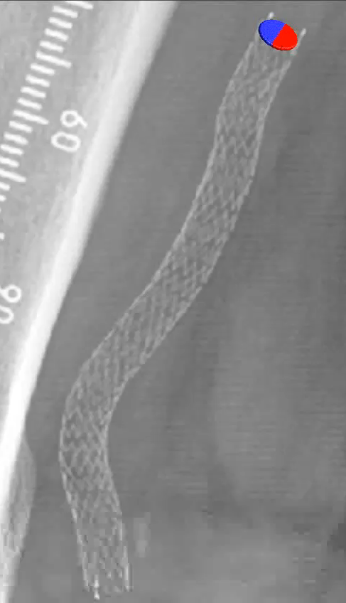
Design Intent:
Purpose-built for the Femoropopliteal Segment
Biomimetic Design¹
  Mimics natural movement of the femoropopliteal segment
  Aids in reducing localized trauma
  Helps reduce risk of stent
  fracture in dynamic artery
Straight stent
BioMimics 3D
ELEVATED WALL SHEAR STRESS²
  Reduces restenosis by reducing thrombus formation and inflammation
  Reduces Smooth Muscle Cell proliferation
  Reduces neointimal hyperplasia
Straight stent
BioMimics 3D
Data on file at Veryan Medical
Murphy EA, Cardiovascular Engineering and Technology 2012 ​
PAM 342 Version 1.0

Slide 14
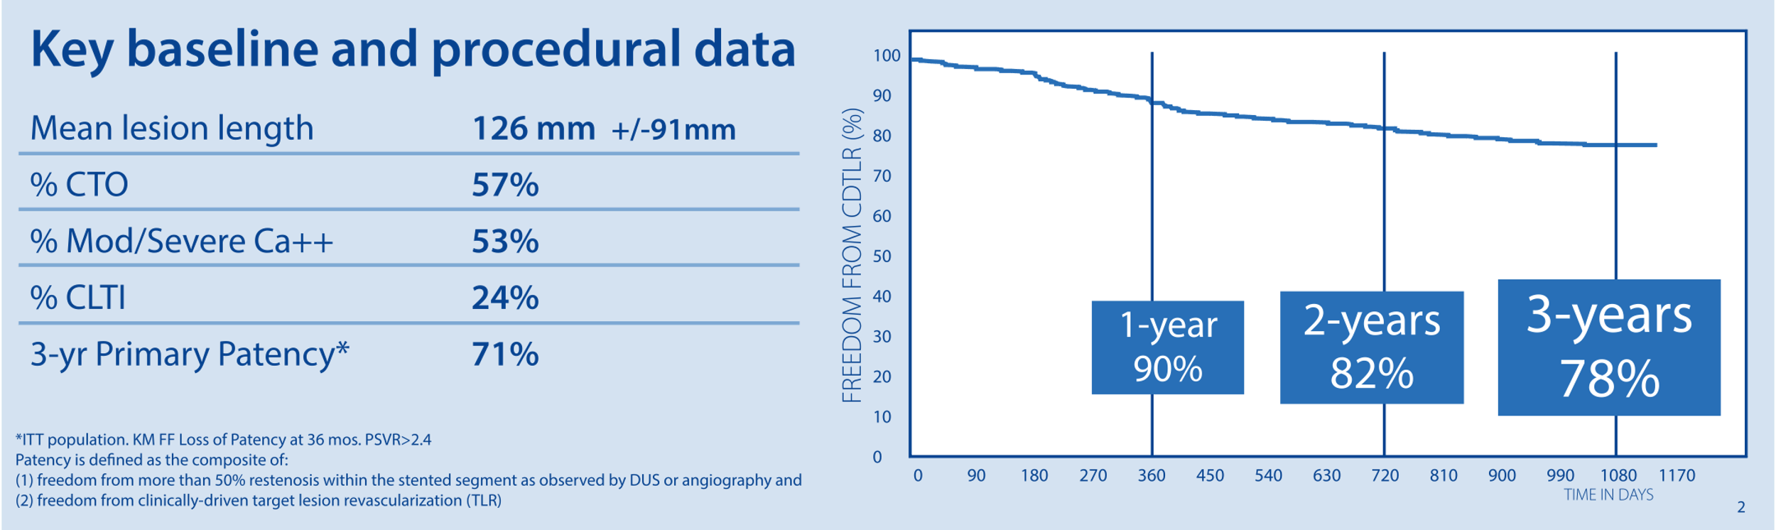
MIMICS^{3D}
MIMICS-3D data contribute real-world experience to the evolving database supporting the therapeutic value of swirling flow in the BioMimics 3D® stent.
0.4%
Fracture rate at three years (investigation confirmed)
Data on file at Veryan Medical

Slide 15

MIMICS Clinical Program
Enrolling progressively longer and more complex lesions
Mean ± SD (mm) | MIMICS-RCT | MIMICS-2 | MIMICS^{3D}
Lesion Length | 66 ± 29 | 81 ± 38 | 126 ± 91
Stented Segment Length | 99 ± 30 | 112 ± 36 | 131 ± 80
CTO | 44% | 30% | 57%
Mod/Severe Ca++ | 52% | 46% | 53%
CLTI | 6% | 6% | 24%
Key Takeaways:
Reinforcing increased complexity with each subsequent study
Core lab reported data for MIMICS and MIMICS-2, site-reported for MIMICS-3D
Data on file at Veryan Medical

Slide 16
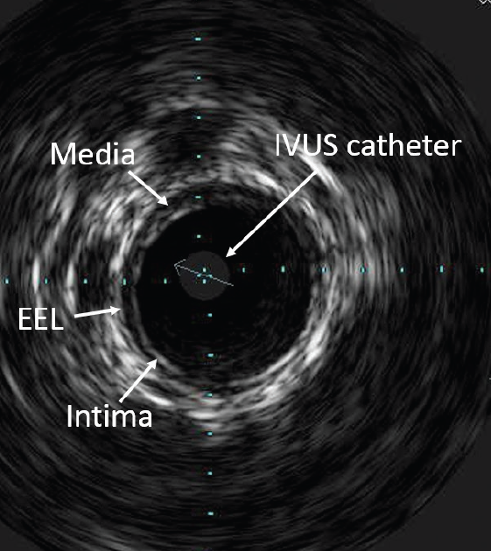
Design Intent – Subgroup Analysis
Key Takeaways:
IVUS image, but sizing left to physician discretion!
Post Hoc analysis to determine if vessel diameter influenced key endpoints, like what was observed above
As part of the 3-year follow up, a separate analysis was conducted to determine:
Differential outcomes based on vessel diameter
  Measurement modality at physician’s discretion
Propensity matched analysis across 390 pts
    Primary patency
    Freedom from clinically-driven TLR
    Freedom from stent fracture

Slide 17
Lesion Characteristics
Key Takeaways:
Analyzed RVD > and <5.5. Note Mean RVD! 6mm in large group, 5mm in small group
Note % occlusions (sig difference) and LL, comparable.
Nearly 40% had small RVD
Table 3 Baseline Lesion Characteristics - ITT
 |  | RVD</=5.5mm | RVD>5.5mm | P-value
Number of Subjects | N | 195 | 195
Number of Lesions | N | 202 | 198
Max Reference Vessel Diameter (mm) | Mean±SD (n) | 5.0 ± 0.4 (202) | 6.1 ± 0.3 (198) | <.0001
 | [min,max] | [4.0, 6.0] | [5.8, 7.0]
Proximal Vessel Diameter (mm) | Mean±SD (n) | 5.0 ± 0.4 (201) | 6.1 ± 0.3 (197) | <.0001
 | [min,max] | [4.0, 6.0] | [5.0, 7.0]
Distal Vessel Diameter (mm) | Mean±SD (n) | 4.9 ± 0.4 (201) | 5.8 ± 0.5 (198) | <.0001
 | [min,max] | [3.0, 6.0] | [4.0, 7.0]
Target Lesion Type
De novo | n/N (%) | 182 / 202 (90.1%) | 179 / 198 (90.4%) | 1.0000
Restenotic | n/N (%) | 20 / 202 (9.9%) | 19 / 198 (9.6%) | 1.0000
Diameter Stenosis % | Mean±SD (n) | 96.0 ± 7.4 (202) | 92.7 ± 8.9 (198) | 0.0002
 | [min,max] | [50.0, 100.0] | [65.0, 100.0]
Occlusions | n/N (%) | 127 / 202 (62.9%) | 97 / 198 (49.0%) | 0.0065
Lesion Length (mm) | Mean±SD (n) | 121.7 ± 83.3 (202) | 127.6 ± 91.2 (198) | 0.4973
 | [min,max] | [10.0, 400.0] | [8.0, 450.0]
Stented Length (mm) | Mean±SD (n) | 127.6 ± 67.9 (202) | 133.0 ± 74.8 (198) | 0.6238
 | [min,max] | [60.0, 425.0] | [60.0, 425.0]
Calcification
Grade 0 | n/N (%) | 36 / 201 (17.9%) | 32 / 197 (16.2%) | 0.6909
Grade 1 | n/N (%) | 65 / 201 (32.3%) | 50 / 197 (25.4%) | 0.1504
Grade 2 | n/N (%) | 42 / 201 (20.9%) | 57 / 197 (28.9%) | 0.0817
Grade 3 | n/N (%) | 35 / 201 (17.4%) | 27 / 197 (13.7%) | 0.3351
Grade 4 | n/N (%) | 23 / 201 (11.4%) | 31 / 197 (15.7%) | 0.2424
NOTE: P-value from Fisher's Exact test for categorical variables and from Student's t-test (means) or Wilcoxon Rank-Sum test (medians) for continuous variables.
38% of patients (195/507) presented with RVD < 5.5mm
Significantly higher presence of CTOs in Small Vessel Subgroup
Data on file at Veryan Medical

Slide 18
3-Year FF Loss Of Primary Patency
Key Takeaways:
3 year PP comparable to 1 year in VQI cohort
Non SS between groups, unlike VQI cohort
OUTCOMES COMPARISON BY VESSEL DIAMETER
No significant difference in FF LOPP across subgroups
----- RVD > 5.5MM = 76%
RVD < 5.5MM = 74%
No significant difference between small and large groups
Data on file at Veryan Medical

Slide 19
3-Year Freedom From Clinically-Driven Target Lesion Revascularization
Key Takeaways:
3 year CDLTR consistent with PP findings, no SS between cohorts
OUTCOMES COMPARISON BY VESSEL DIAMETER
No significant difference in FF CDTLR across subgroups
----- RVD > 5.5MM = 82%
RVD < 5.5MM = 79%
No significant difference between small and large groups
Data on file at Veryan Medical

Slide 20



Summary
Key Takeaways:
Remind docs of the various analysis we’ve collected.
RVD latest clinical initiative demonstrating consistent performance regardless of length, location or morphology!
In 3 clinical studies, of increasing complexity, BioMimics 3D continues to show durable results comparable to DES or Supera
Irrespective of vessel diameter, BioMimics 3D demonstrates consistent, durable results through 3-year follow up
BioMimics 3D offers a simple, durable and cost-effective platform to address patients with complex femoropopliteal disease
Unmet Patient Needs
Value
Innovative

Slide 21

Questions and Discussion

Slide 22
Sales Process Discussion
Opening the Conversation:
Do they see a difference in pts with smaller vessels?
  Why?
  How do they manage?
Do they present with different disease?
  Longer, diffuse?
  CA+?
  CTO?
Potential Objections:
The ”Leave Nothing Behind” crowd may push back
  Atherectomy + POBA/DCB data set
No delineation by stent type
High risk = DES?

Slide 23

TARGETING DISCUSSION
Current:
    Reminder on complex lesion data
    Expanding indication/mindshare
    Supera Splitters!
  New Targets:
    Primary Supera Users
    Mounting evidence w/ targets
    Chance to re-engage cold targets

Slide 24
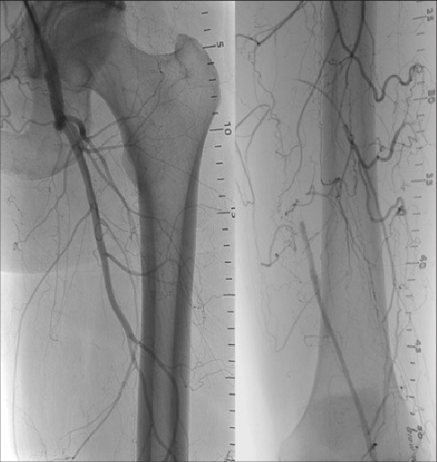
What’s next??
A FOCUS ON TASC D

Slide 25
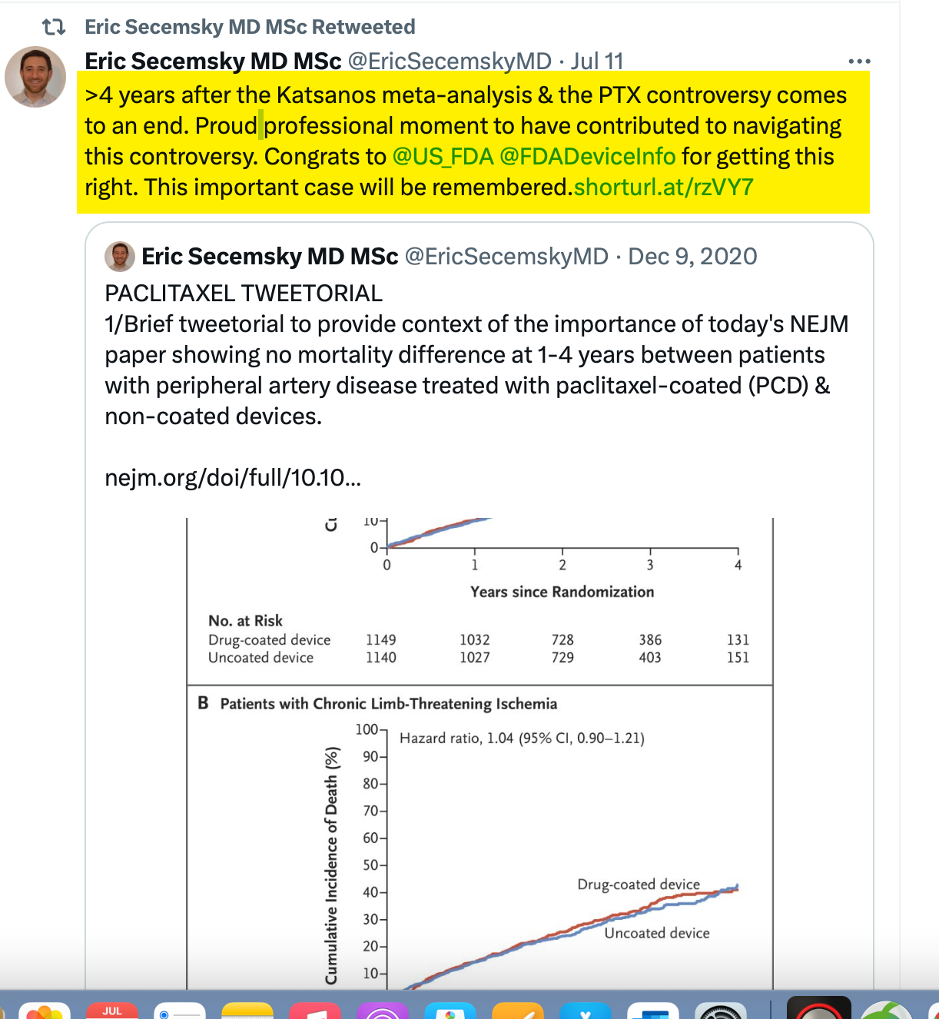
A quick discussion on the latest news of the day
What are you hearing, what do we do with this?

