Slide 1
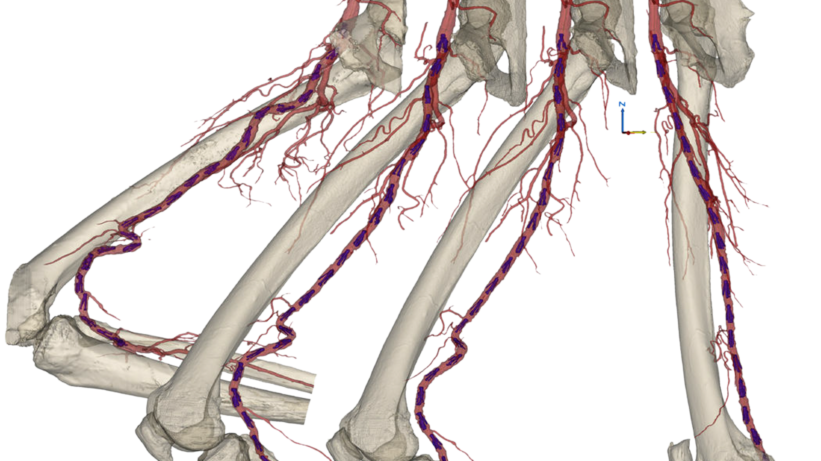
Challenges of treating the Distal SFA and Proximal Popliteal Segment

Slide 2
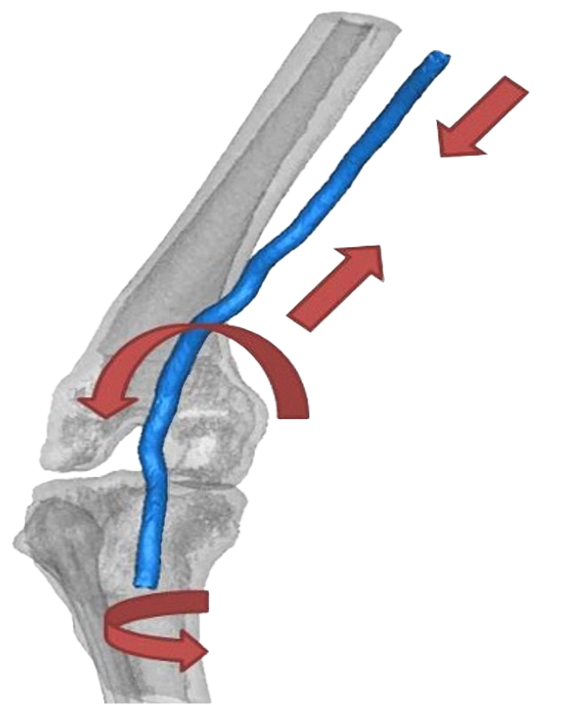
Treatment Challenges in Distal SFA and Proximal Popliteal
Compression
Forces impacting interventional strategy
Compression
Elongation
Torsion
Bending
Bending
Torsion
PAM 301 Version 1.0
Notes:
Reminder of the forces that are uniquely challenging in the distal sfa and proximal popliteal. The goal is to gain agreement that these forces make interventional strategies more complex in this area of the fempop segment

Slide 3
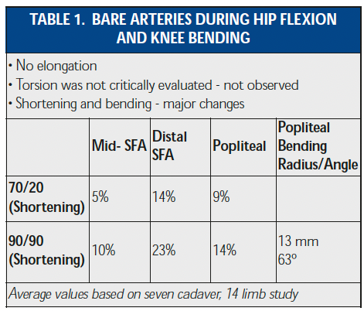
Impact of Movement on Vessel Compression
Cadaver study examining native artery shortening under flexion
Distal SFA and proximal PA demonstrated the most significant impact under flexion
  9-14% compression while in walking position
  14-23% compression during seated position
1. Smouse H, Nikanorov A, LaFlash D (2005) Endovasc Today 4:60–66
Notes:
Goal is to quantify that actual impact of those forces on this segment from a cadaver study done by Smouse et al. Reinforcing that the majority of the compression actually occurs in the distal sfa and the popliteal artery above the knee

Slide 4
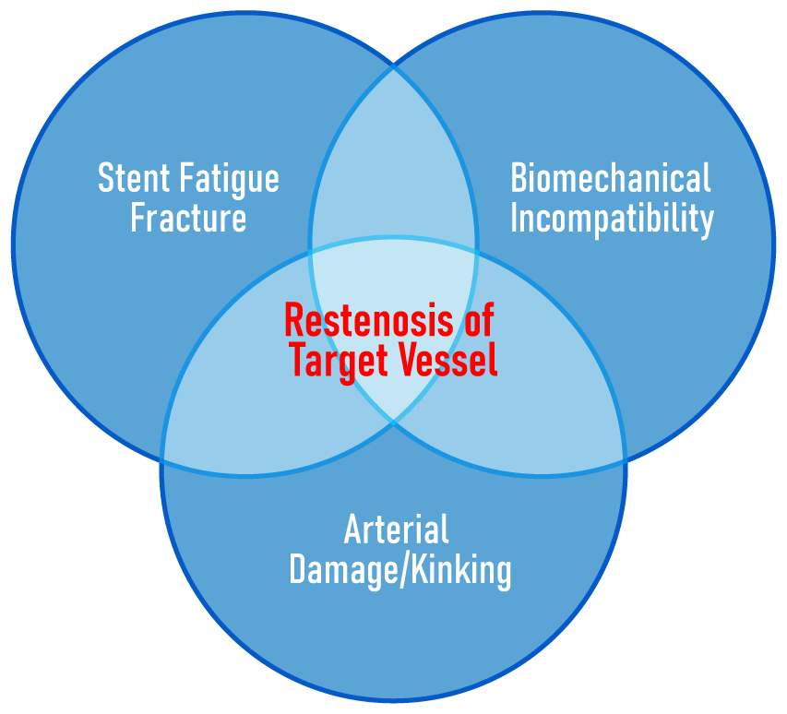

Biomechanical Incompatibility of Traditional Stent Designs
Prior to Treatment
Post Treatment – Straight Stent
1. Tamashiro et al, 2011 (J Invasive Cardiol. 2011 Oct;23(10):431-3.)
Notes:
Goal is to show the impact of those forces on traditional slotted tube designs. In a native artery, knee flexion leads to compression that creates to a kink in the distal segment. Once a straight stent is implanted, that biomechanical incompatibility actually makes matters worse as depicted on the angio to the right. That incompatibility can lead to arterial kinking or damage, stent fatigue/fracture, perhaps both! All of that can potentially lead to restenosis of the stented segment or distal vessel.

Slide 5
How Well is The Distal SFA/Prox Pop Segment Represented in Contemporary Data?
Limited inclusion of lesions extending to the highly dynamic proximal popliteal
Limited follow up available on fracture rates beyond 1-yr
Data on file at Veryan Medical
Notes:
Goal is to show that this segment has not been well studied in the contemporary fem pop stent studies

Slide 6
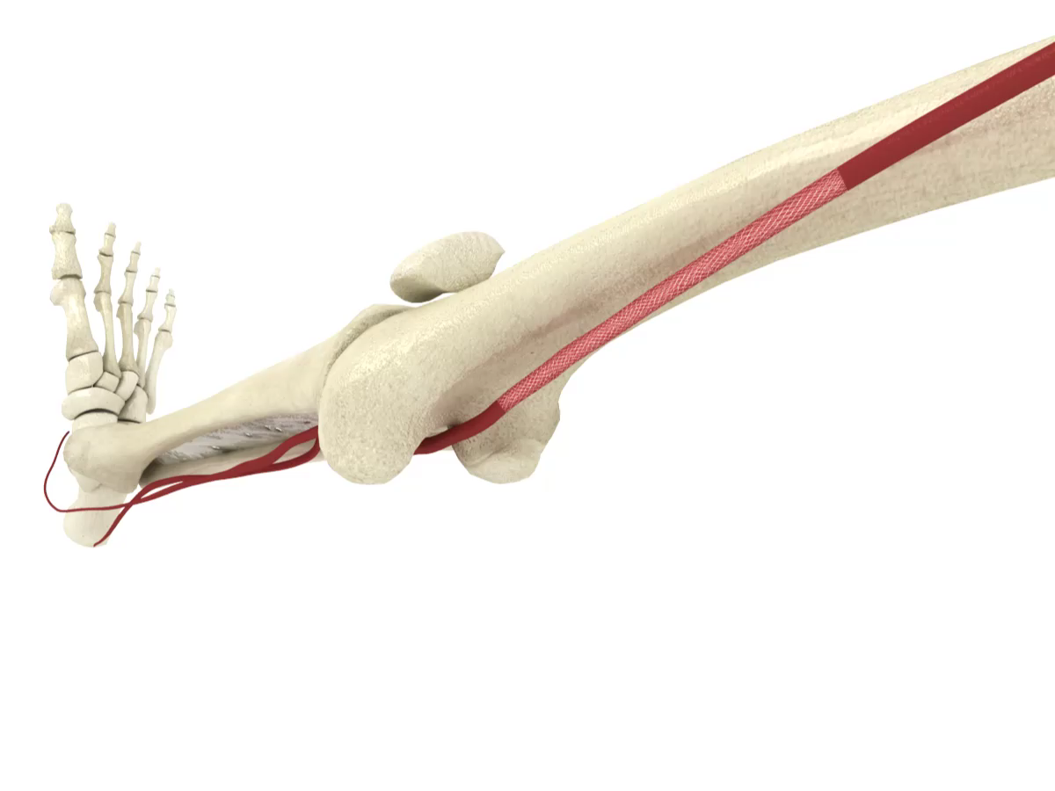
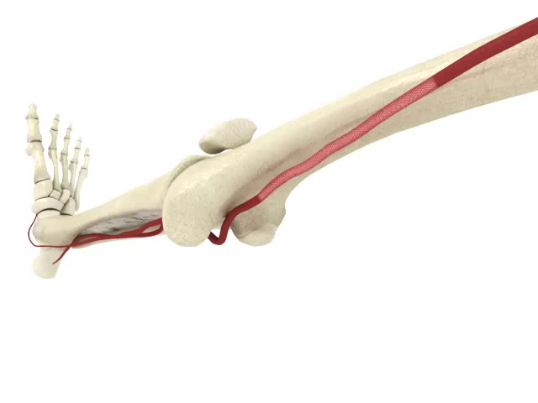
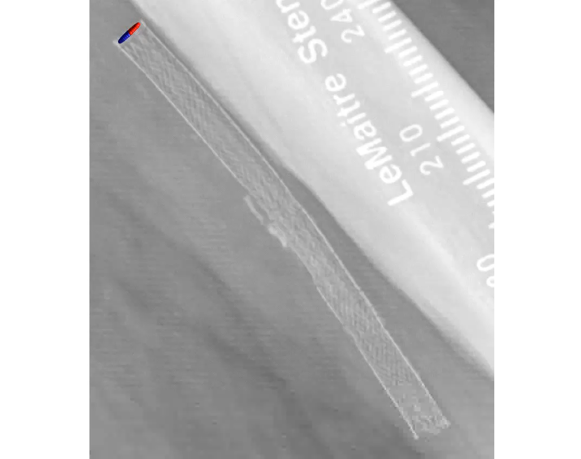
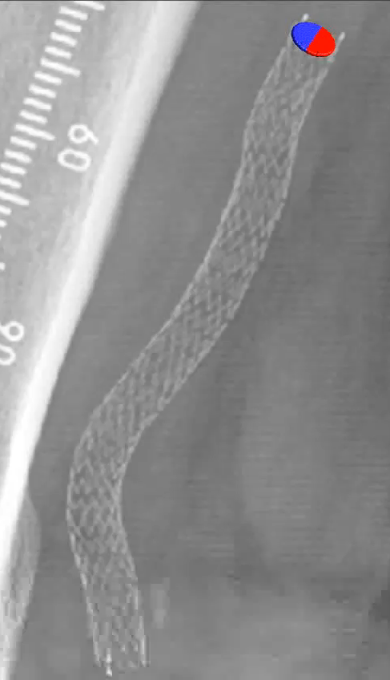
Design Intent:
Purpose-built for the Femoropopliteal Segment
BIOMIMETIC DESIGN¹
  Mimics natural movement of the femoropopliteal segment
  Aids in reducing localized trauma
  Helps reduce risk of stent
  fracture in dynamic artery
ELEVATED WALL SHEAR STRESS²
  Reduces restenosis by reducing thrombus formation and inflammation
  Reduces Smooth Muscle Cell proliferation
  Reduces neointimal hyperplasia
PAM 301 Version 1
The BioMimics 3D Vascular Stent System has FDA, PMDA and CE Mark approval.
CAUTION: Federal law restricts this device to sale by or on the order of a physician.
Data on file at Veryan Medical
Murphy EA, Cardiovascular Engineering and Technology 2012 ​
PAM 301 Version 1.0
Notes:
Goal: Should have already introduced the the MOA in the Intro to Veryan deck. As a result, here we will be focusing on the mimetic nature of the stent that makes it uniquely suited for the forces that are enacted on this segment

Slide 7

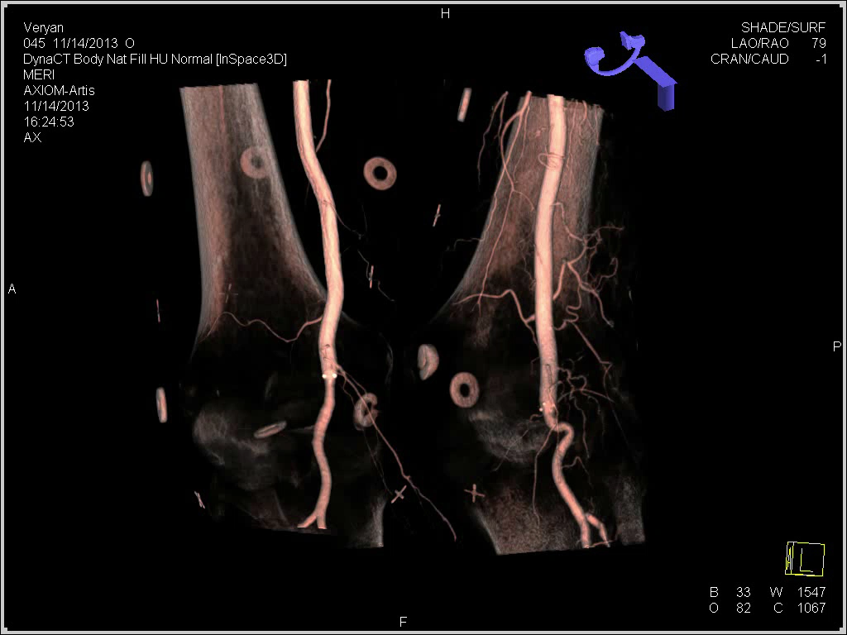
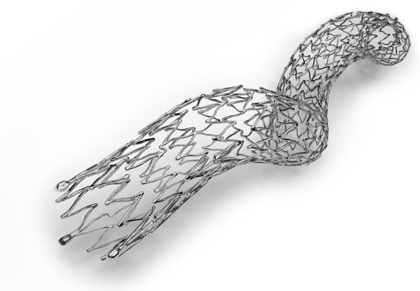
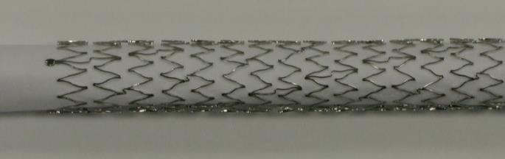
Improving the Biomechanics
Bent knee cadaver study
Straight Stent
Data on file at Veryan Medical
Notes:
Goal is to demonstrate the difference in biomechanical compatibility b/w BM3D and slotted tubes from our own cadaver study, which nicely illustrates the arterial kinking distal to the straight stent that occurs with knee flexion. BM3D doesn’t transmit those forces distal to the stent

Slide 8
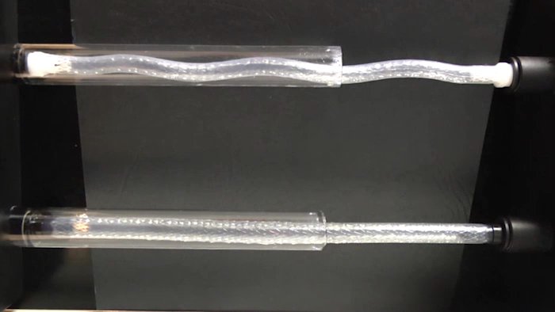
Managing Vessel Compression
BioMimics3D
Straight Stent
Real-world testing rig
Stents undergoing 10% compression
^{Data on file at Veryan Medical}
G. Ansel, presented at the Vascular Interventional Advances, Las Vegas, Nevada, 22-Oct-2009
Notes:
Goal, this model is intended to mimic the show the impact on stent designs as the stent exits the adductor canal into the popliteal fossa. That transition creates significant compression on each standard slotted tube design as you can see illustrated to the right. Regardless of whether it’s BMS or DES.

Slide 9
BioMimics 3D 3-Year Clinical Update
*
*
Increasing lesion complexity
Higher % of patients treated with distal disease
Comparable patency to DES platforms with low 3-year fracture rate
*Site reported
ITT population. KM FF Loss of Patency at 12 mos. PSVR >2.4
Data on file at Veryan Medical. Fracture data are site reported
Patency is defined as the composite of:
(1) freedom from more than 50% restenosis within the stented segment as observed by DUS or Angiography within the visit window and
(2) freedom from CDTLR prior to the indicated time point.
Notes:
Goal: By comparison the MIMICS clinical program has an extensive amount of experience with patients in the distal segment demonstrating durable outcomes.

Slide 10
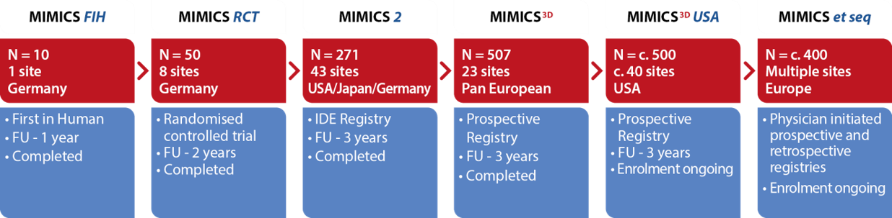

The MIMICS Clinical Program
1750+ patients
Notes:
Goal: Focus on MIMICS3D study, a real world 500+ patient study with 3 year follow up

Slide 11
MIMICS-3D European Registry Results
Freedom from Clinically-Driven TLR at 3 Years
Key baseline and procedural data
100
90
80
70
60
50
40
30
20
10
0
Mean lesion length | 125.9mm +/-91mm
% CTO | 57%
% Mod/Severe Ca++ | 38%
% CLI | 24%
3-yr Primary Patency* | 71.4%
FREEDOM FROM CDTLR (%)
1 year
90%
2-years
82%
3-years
78%
0 | 90 | 180 | 270 | 360 | 450 | 540 | 630 | 720 | 810 | 900 | 990 | 1080 | 1170
TIME IN DAYS
*ITT population. KM FF Loss of Patency at 36 mos. PSVR >2.4
Patency is defined as the composite of:
(1) freedom from more than 50% restenosis within the stented segment as observed by DUS or angiography and
(2) freedom from clinically-driven target lesion revascularization (TLR)
. Data on file at Veryan Medical
Notes:
Goal: Reinforce the OVERALL results that were JUST presented at ISET. Highlight overall challenging lesion characteristics and impressive FF Loss of Patency and FF from CDTLR through 3 year follow up

Slide 12
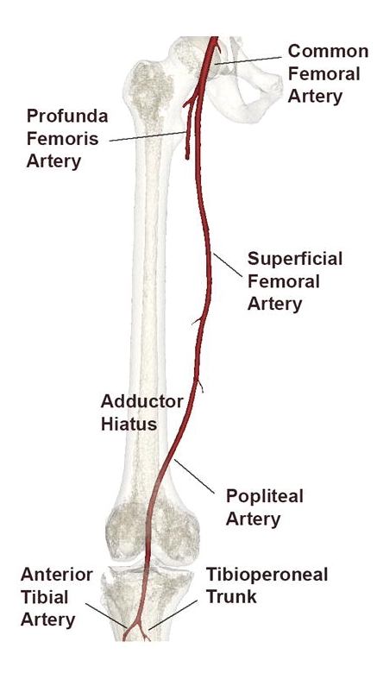
Design Intent – Subgroup Analysis
As part of the 3-year follow up, a separate analysis was conducted to determine:
  Lesion location and morphology
  Primary patency
  Freedom from clinically-driven TLR
  Freedom from stent fracture
P1
P2
P3
Anterior Tibial
Data on file at Veryan Medical
Notes:
Goal: Given the prevalence of distal lesions, wanted to do a subgroup analysis to determine if there was a difference in 3 year outcomes with patients treated is the distal segment compared to those treated in the proximal segment.

Slide 13
Patient Demographics and Medical History
 |  | Distal SFA – Proximal Pop | Proximal – Mid SFA | P-value
Age (years) | Mean±SD (n) | 71.5 ± 9.6 (177) | 68.5 ± 9.4 (105) | 0.0100
Gender: Male | n/N (%) | 107 / 177 (60.5%) | 74 / 105 (70.5%) | 0.0964
BMI | Mean±SD (n) | 26.7 ± 4.4 (175) | 27.0 ± 4.7 (105) | 0.6868
CVA or TIA | n/N (%) | 15 / 177 (8.5%) | 8 / 105 (7.6%) | 1.0000
Hypertension | n/N (%) | 147 / 177 (83.1%) | 92 / 105 (87.6%) | 0.3918
Hypercholesterolemia / dyslipidemia | n/N (%) | 108 / 177 (61.0%) | 69 / 105 (65.7%) | 0.4474
MI, CABG, PCI or coronary artery disease | n/N (%) | 61 / 177 (34.5%) | 35 / 105 (33.3%) | 0.8969
Premature atherosclerotic disease | n/N (%) | 21 / 177 (11.9%) | 14 / 105 (13.3%) | 0.7127
Bleeding diathesis or coagulopathy | n/N (%) | 3 / 177 (1.7%) | 0 / 105 (0.0%) | 0.2964
Smoking | n/N (%) | 106 / 177 (59.9%) | 68 / 105 (64.8%) | 0.4486
Diabetes mellitus | n/N (%) | 55 / 177 (31.1%) | 47 / 105 (44.8%) | 0.0290
Renal insufficiency | n/N (%) | 13 / 177 (7.3%) | 13 / 105 (12.4%) | 0.2011
Dialysis | n/N (%) | 3 / 177 (1.7%) | 2 / 105 (1.9%) | 1.0000
Non-healing wound on the target limb | n/N (%) | 24 / 177 (13.6%) | 15 / 105 (14.3%) | 0.8602
NOTE: P-value from Fisher's Exact test for categorical variables and from Student's t-test (means) or Wilcoxon Rank-Sum test (medians) for continuous variables.
Data on file with Veryan Medical
Notes:
Goal: Highlight the extensive # of patients, prevalence of occlusions and significant ca+ in the distal cohort

Slide 14
Baseline Lesion Characteristics
 |  | Distal SFA – Prox Popliteal | Proximal – Mid SFA | P-value
Number of Subjects | N | 177 | 105
Number of Lesions | N | 178 | 105
Max Reference Vessel Diameter (mm) | Mean±SD (n) | 5.3 ± 0.7 (178) | 5.4 ± 0.8 (105) | 0.4692
 | [min,max] | [4.0, 7.0] | [4.0, 7.0]
Target Lesion Type
De novo | n/N (%) | 163 / 178 (91.6%) | 91 / 105 (86.7%) | 0.2243
Restenotic | n/N (%) | 15 / 178 (8.4%) | 14 / 105 (13.3%) | 0.2243
Occlusions | n/N (%) | 88 / 178 (49.4%) | 40 / 105 (38.1%) | 0.0833
Lesion Length (mm) | Mean±SD (n) | 79.8 ± 46.8 (178) | 102.2 ± 76.6 (105) | 0.0541
 | [min,max] | [10.0, 300.0] | [10.0, 450.0]
Calcification
Grade 0 | n/N (%) | 34 / 177 (19.2%) | 17 / 104 (16.3%) | 0.6316
Grade 1 | n/N (%) | 45 / 177 (25.4%) | 29 / 104 (27.9%) | 0.6754
Grade 2 | n/N (%) | 53 / 177 (29.9%) | 29 / 104 (27.9%) | 0.7862
Grade 3 | n/N (%) | 24 / 177 (13.6%) | 16 / 104 (15.4%) | 0.7247
Grade 4 | n/N (%) | 21 / 177 (11.9%) | 13 / 104 (12.5%) | 0.8524
NOTE: P-value from Fisher's Exact test for categorical variables and from Student's t-test (means) or Wilcoxon Rank-Sum test (medians) for continuous variables.
Data on file with Veryan Medical
Data on file with Veryan Medical
ITT population.
KM FF Loss of Patency at 36 mos. PSVR >2.4
Patency is defined as the composite of: 1) freedom from more than 50% restenosis within the stented segment as observed by DUS or Angiography within the visit window and ; (2) freedom from CDTLR prior to the indicated time point.
Notes:
Goal: Highlight the extensive # of patients, prevalence of occlusions and significant ca+ in the distal cohort

Slide 15
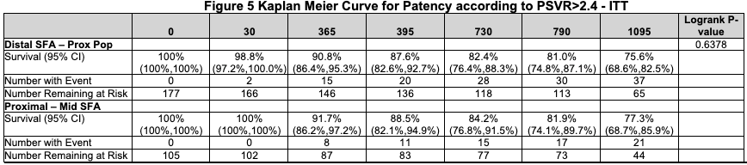
3-Year Primary Patency
Lesion Location
No statistical difference in Primary Patency, regardless of lesion location
----- Proximal-Mid SFA = 77.3%
Distal SFA-Prox PA= 75.6%
Data on file at Veryan Medical
Notes:
Goal: Highlight that at each interval and at 3 years, there is no difference in Primary Patency between these two cohorts, with an impressive 75.6% Primary Patency at 3 year follow up

Slide 16
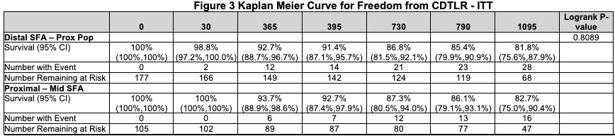
3-Year Freedom From CDTLR
Lesion Location
No statistical difference in need for reintervention, regardless of lesion location
----- Proximal-Mid SFA = 82.7%
Distal SFA-Prox PA= 81.8%
Data on file at Veryan Medical
Notes:
Goals: Highlight that at each interval and through 3 years there is no difference in outcomes b/w these cohorts with an impressive 81.8% FF CDTLR at 3 years

Slide 17
CONCLUSIONS
Real world, prospective 500 patient registry with more complex patients and lesions demonstrating:
  71.4% Freedom from Loss of Patency at 3 Years
  78% Freedom from CDTLR at 3 Years
  Comparable outcomes to DES despite more challenging lesions
Subgroup analysis performed to determine differences in outcomes based on lesion location
  35% of patients treated had lesions within distal SFA, extending to proximal P2
  3 year outcomes demonstrate:
    No difference in Primary Patency between the cohorts
    No difference in CDLTR between the cohorts
    Low <1.0% stent fracture rate through 3 year follow up in distal cohort
Data on file at Veryan Medical
Notes:
Goal: Reinforce overall results in challenging lesions. Focus on subgroup analysis. High % of patients in this distal segment, no difference in outcomes at 3year with impressive patency and CDTLR and only 1% fracture rate through 3 years in this highly dynamic segment.

Slide 18
Design Intent:
Purpose-built for the Femoropopliteal Segment
BIOMIMETIC DESIGN¹
  Mimics natural movement of the femoropopliteal segment
  Aids in reducing localized trauma
  Helps reduce risk of stent
  fracture in dynamic artery
ELEVATED WALL SHEAR STRESS²
  Reduces restenosis by reducing thrombus formation and inflammation
  Reduces Smooth Muscle Cell proliferation
  Reduces neointimal hyperplasia
Data on file at Veryan Medical
Murphy EA, Cardiovascular Engineering and Technology 2012 ​
Notes:
Goal: Use this slide to reinforce the two unique MOAs that should help address where BM3D is uniquely suited to help their patients. Close for understanding, agreement and next steps.

