Slide 1
VERYAN MEDICAL BUSINESS TRANSFORMATION
Leveraging Research and Development to enhance Therapeutic Offerings

Slide 2
STRONG EARLY MARKET ADOPTION
Limited Market Release in 2021 with 15 Sales Territories
Rapidly grew market share against 8 large strategics despite being outnumbered 45:1 in avg territory
6% Market Share exiting 2022
Unique clinical/economic value proposition earned contracts in Top 10 US IDNs

Slide 3
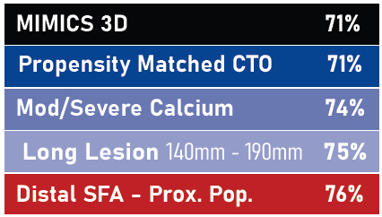
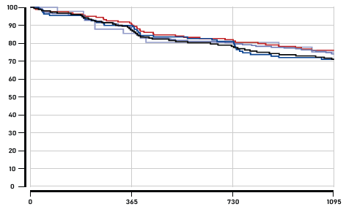
IMPACT OF DESIGN ON OUTCOMES
MIMICS3D 3Y PRIMARY PATENCY
Commercial Focus on segments where stent design and clinical data demonstrated improved outcomes
  Distal SFA/Prox Popliteal
  Mod/Severe Calcium
  Long segment lesions
  CTOs

Slide 4



VERYAN BUSINESS TRANSFORMATION
Otsuka Medical Devices comprised of three distinct business units
Near term focused effort to commercialize RDN through Recor Medical
Leverage Veryan IP and R&D capabilities to expand endovascular offering
Expand Therapeutic Device offerings in:
  Arterial Intervention
  Venous Intervention
  Neuro/Peripheral Thrombectomy
Reduce US footprint to service current physician partners and IDN agreements

Slide 5
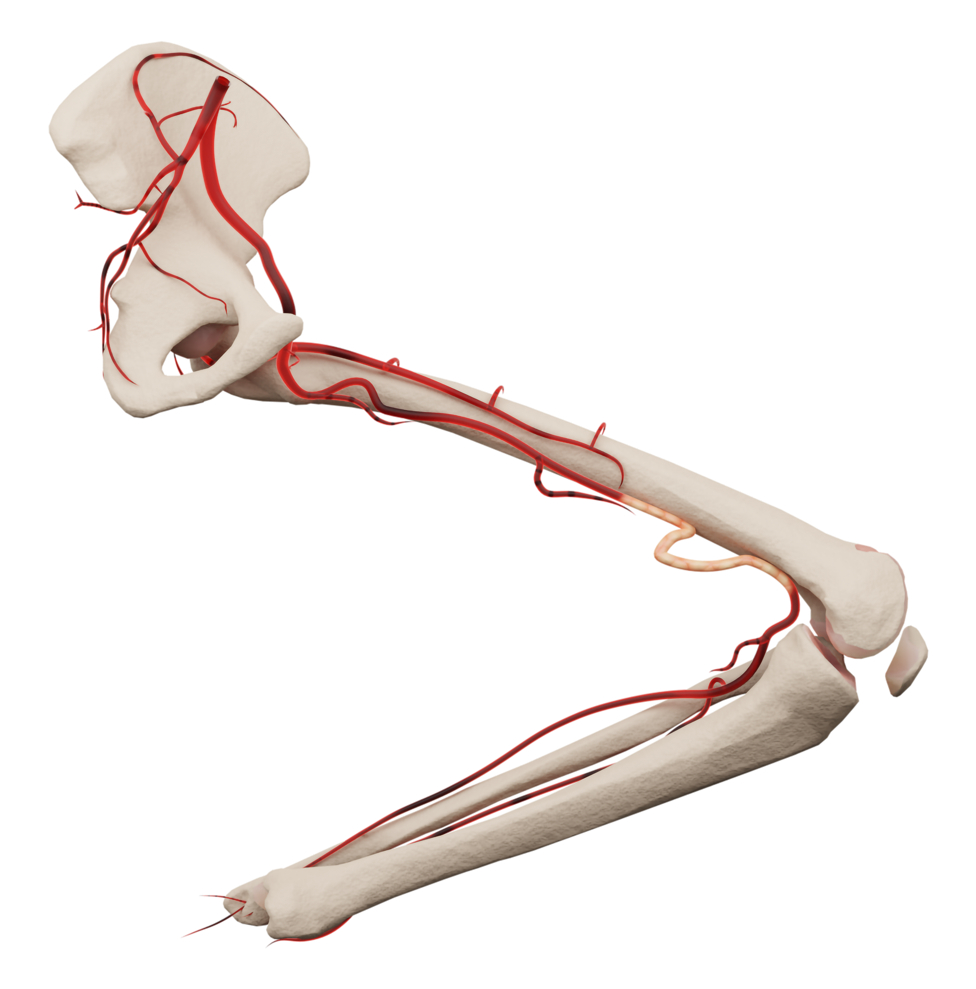
ARTERIAL R&D PIPELINE
P3 INDICATION EXPANSION
NEXT GENERATION DES / DRUG DELIVERY
Clinical Program to expand BioMimics3D indication into the P3 segment
PROVEN DESIGN in highly dynamic space
DURABLE OUTCOMES through 3Y in DSFA/P2, the most dynamic segment
UNMET NEED Only one stent indicated
Delivering drug/device combination therapy leveraging expertise of both organizations
CTZ DES creating the first “Next Gen” DES platform that focuses on drug delivery AND stent design
CTZ DCB expanding therapeutic options above and below the knee
NEXT GEN DRUG DELIVERY addressing the challenge for both DES and DCB

Slide 6
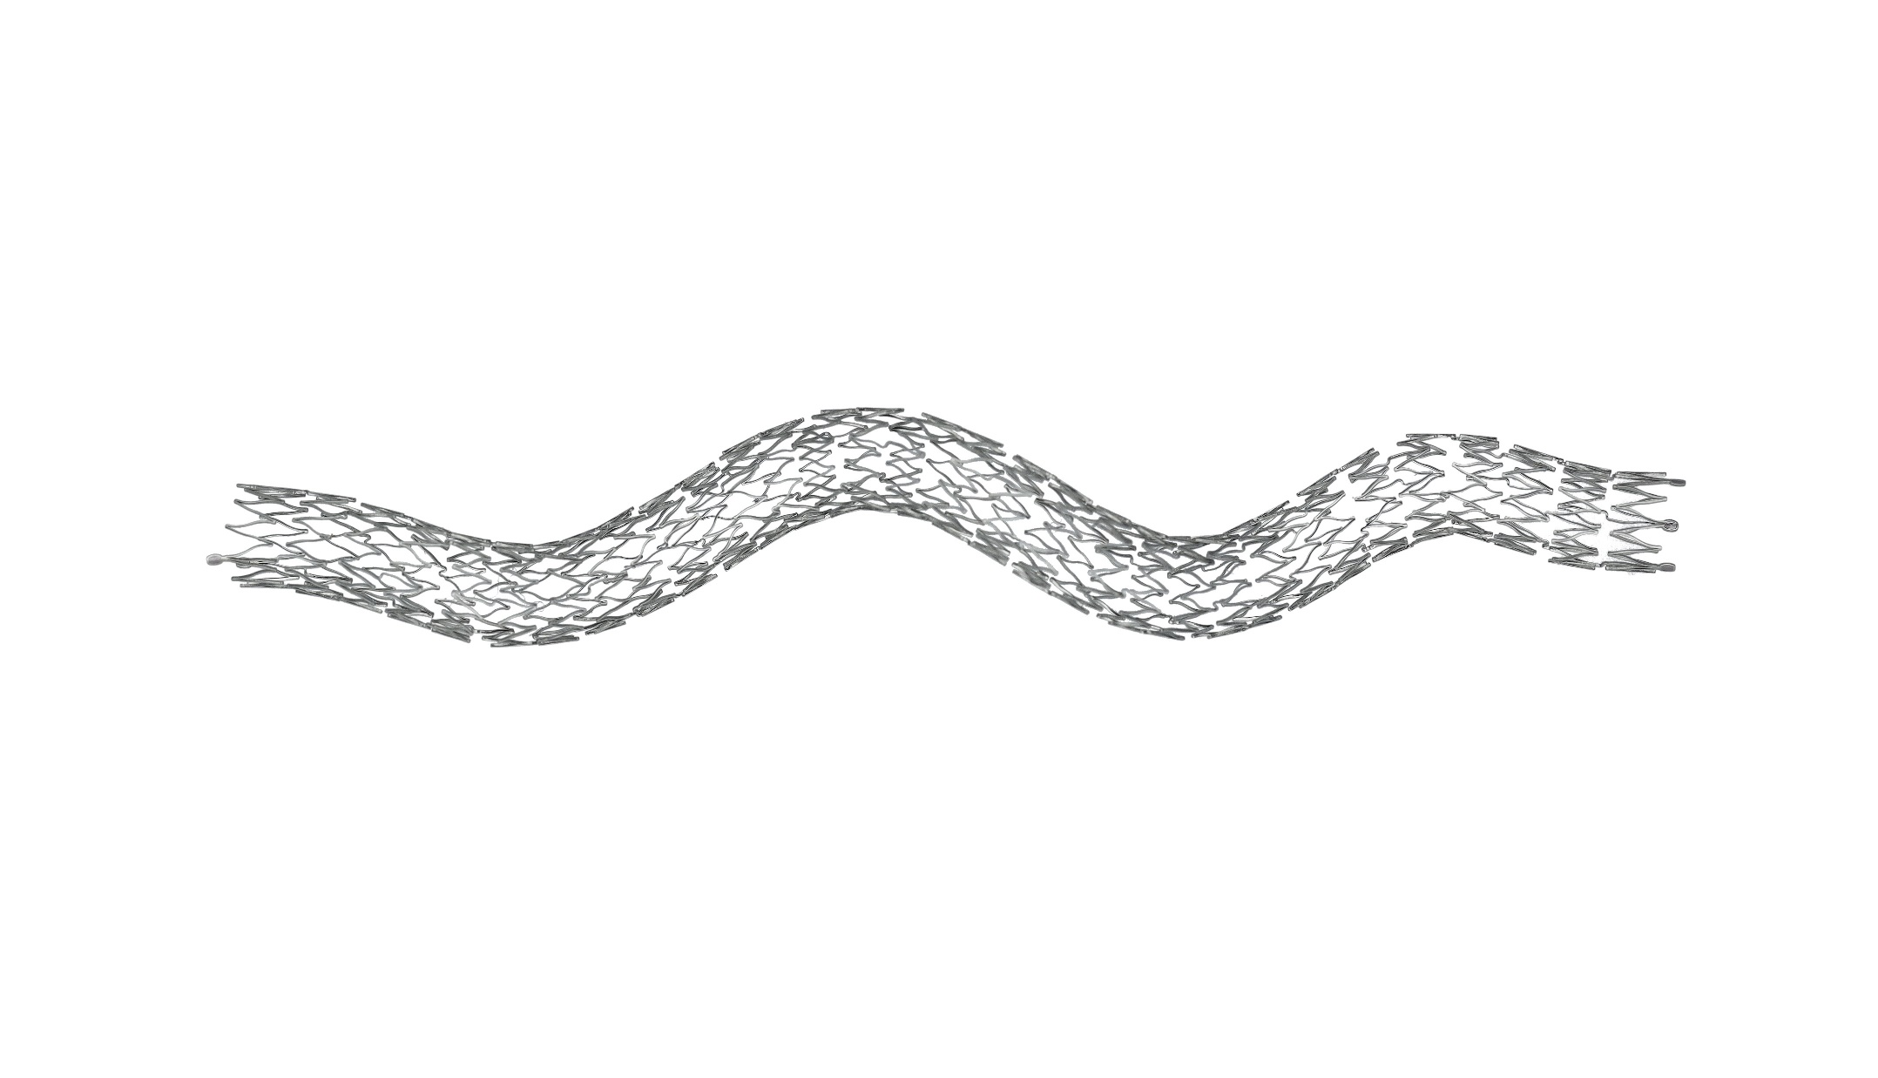
VENOUS R&D PIPELINE
NON-THROMBOTIC ILIAC VEIN LESIONS
POST THROMBOTIC SYNDROME
Leveraging core technology to improve patient outcomes
ANTI MIGRATION design feature to address challenges in current venous platforms
OPTIMIZED blend of radial force and flexibility to address variability of venous anatomy
SIMPLIFIED sizing and delivery system
Drug/device combination therapy leveraging expertise of both organizations
LEVERAGING PROVEN STENT DESIGN in effort to address restenotic cascade
COMBINATION DRUG/DEVICE THERAPY to address reduced patency rates associated with PTS patient population

Slide 7
NPD TIMELINE – 4 Priority Projects
2023
2024
2025
2026
P3 INDICATION
Bench
Pre Sub
ENROLLMENT
F/U
VENOUS NIVLS
FIM
Sub
ENROLLMENT
F/U
VENOUS PTS
FIM
Sub
ENROLLMENT
F/U
CTZ DES
FIM
Sub
ENROLLMENT
F/U

Slide 8
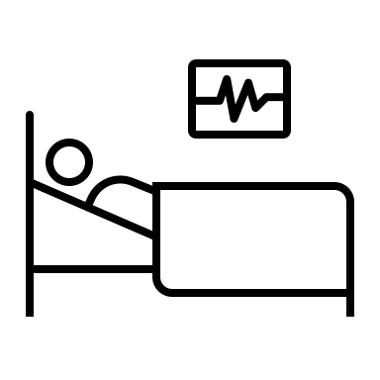


SUMMARY AND EXPECTATIONS
VERYAN MEDICAL
Continued engagement from Regional and National KOLs
Engagement on future clinical initiatives and Peer to Peer events
Unmet Patient Needs
PHYSICIAN PARTNERS
Commercial support in pts where you’ve already recognized clinical value
Feedback on R&D Projects and Clinical Campaigns as we advance the Veryan endovascular mission
Value
Innovative

Slide 10
New Device Introduction Requirements
Unmet Patient Needs
Value
Innovative

Slide 11
Challenges of treating COMPLEX Fem Pop disease in real-world practice
Long segment disease
Frequently present with CTO
Presence of Ca²⁺
Dynamic forces in the distal SFA

Slide 12
Adjunctive Stenting in Real World Studies
% of enrolled patients
REAL WORLD STUDIES SUGGEST 20-40% OF PATIENTS REQUIRE STENTING
Thieme M, et al. J Am Coll Cardiol Intv. 2017 Aug, 10 (16) 1682–1690
Mustapha J, et al. J Endovasc Ther. 2019 Apr;26(2):143-154
Ansel GM, et al. J Endovasc Ther. 2018 Dec;25(6):673-682
SHOCKWAVE: Intravascular Lithotripsy for Peripheral Artery Calcification: Interim Analysis of 752 Patients From the Disrupt PAD III Observational Study Ehrin Armstrong, MD VIVA 2021
Notes:
Thieme M, et al. J Am Coll Cardiol Intv. 2017 Aug, 10 (16) 1682–1690
Mustapha J, et al. J Endovasc Ther. 2019 Apr;26(2):143-154
Ansel GM, et al. J Endovasc Ther. 2018 Dec;25(6):673-682
SHOCKWAVE: Intravascular Lithotripsy for Peripheral Artery Calcification: Interim Analysis of 752 Patients From the Disrupt PAD III Observational Study Ehrin Armstrong, MD VIVA 2021

Slide 13
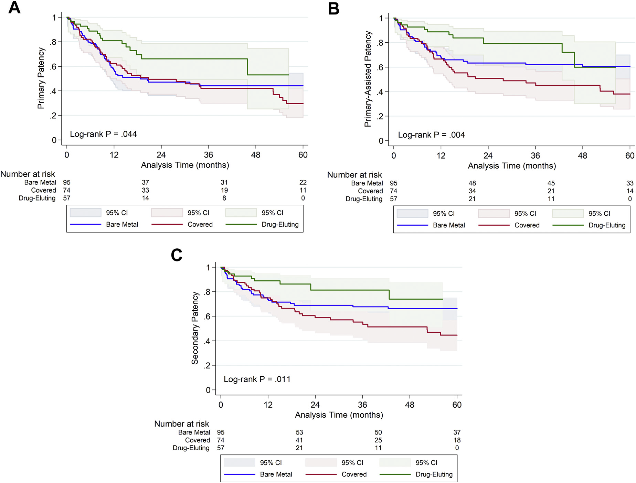
Comparison of stents in COMPLEX lesions
226 patients analyzed to determine the impact of lesion severity on outcomes
Retrospective analysis on TASC C/D lesions
Compared performance of traditional BMS vs DES vs CS
4 Year PP between 42-53% across all platforms
“In the adjusted model, there was NO STATISTICAL ASSOCIATION between stent type and patency”
1. Zamani N, et al. J Ann Vasc Surg. 2021 Feb; 71:298-307
Notes:
https://www.annalsofvascularsurgery.com/article/S0890-5096(20)30807-4/fulltext
Outcomes after Endovascular Stent
Placement for Long-Segment Superficial Femoral Artery Lesions
Nader Zamani,¹ Sherene E. Sharath,¹ Rocky C. Browder,¹ Neal R. Barshes,¹
Jonathan D. Braun,¹ Joseph L. Mills Sr,² Panos Kougias,¹ and Houssam K. Younes,¹ Houston,
Texas
The unadjusted KaplaneMeier estimates
for primary patency at 12, 24, and 48 months were 57%, 47%, and 44% for the BMS cohort; 62%,
49%, and 42% for CS; and 81%, 66%, and 53% for DES, respectively (P ¼ In the

Slide 14
Summary of Unmet Needs w/ Stents
The complexity of real-world patients aren’t often well represented in studies
According to data, this patient population more frequently requires a stent to complete the intervention…
However, traditional stents haven’t performed well in complex disease.
DES have shown benefit, but demonstrate comparable results in more challenging lesions in long term follow up

Slide 15
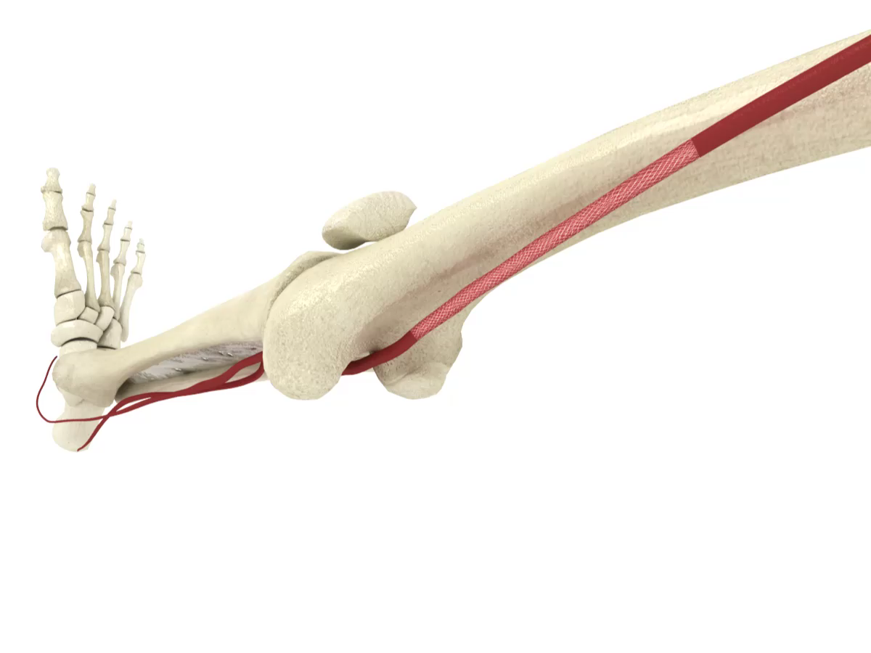
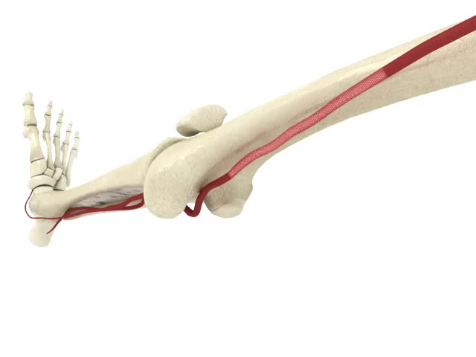
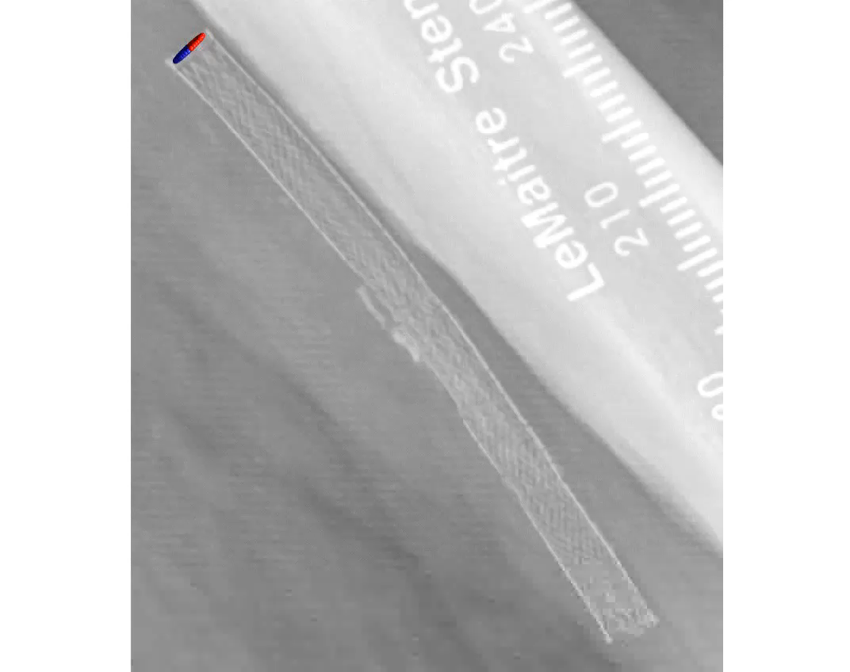
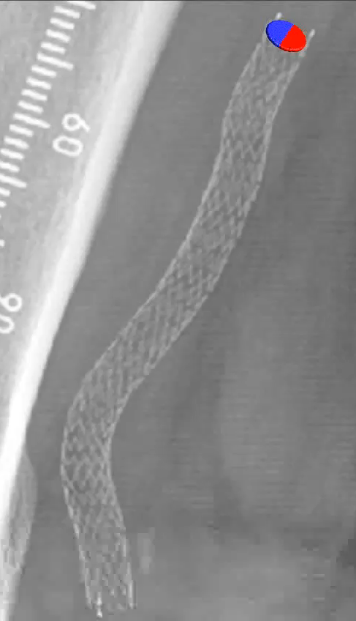
Design Intent:
Purpose-built for the Femoropopliteal Segment
BIOMIMETIC DESIGN¹
  Mimics natural movement of the femoropopliteal segment
  Aids in reducing localized trauma
  Helps reduce risk of stent
  fracture in dynamic artery
ELEVATED WALL SHEAR STRESS²
  Reduces restenosis by reducing thrombus formation and inflammation
  Reduces Smooth Muscle Cell proliferation
  Reduces neointimal hyperplasia
Data on file at Veryan Medical
Murphy EA, Cardiovascular Engineering and Technology 2012 ​
PAM 301 Version 1.0

Slide 16
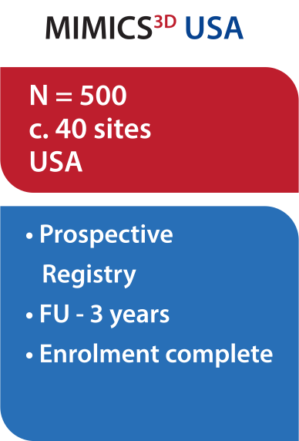

The MIMICS Clinical Program
IDE
Real World
1750+ patients
Data on file at Veryan Medical

Slide 17
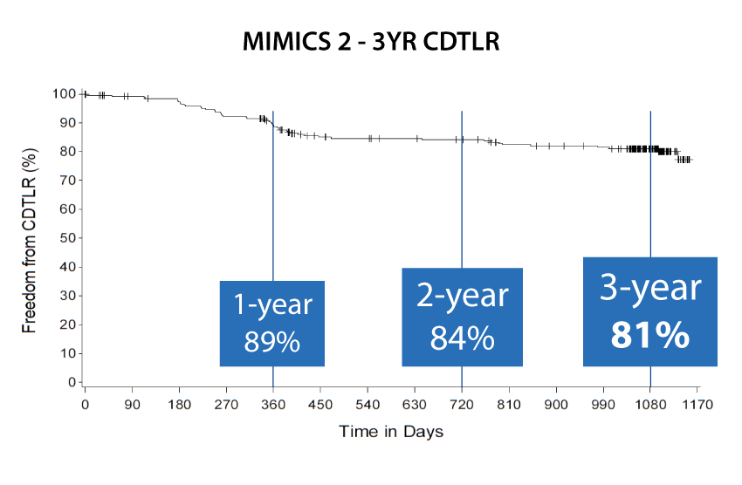
MIMICS-2
The MIMICS-2 study validated the outcomes of the randomized study (MIMICS RCT), by providing clinical proof in a larger, more challenging cohort.
3YR Stent Fracture
0%
Core Lab Review
*Core Lab adjudicated, clinically-driven TLR with objective evidence
Subjects are censored at their last known follow-up, or at time of study exit (withdrawal or lost to follow-up) or death
1. Data on file at Veryan Medical: MIMICS-2 CSR

Slide 18
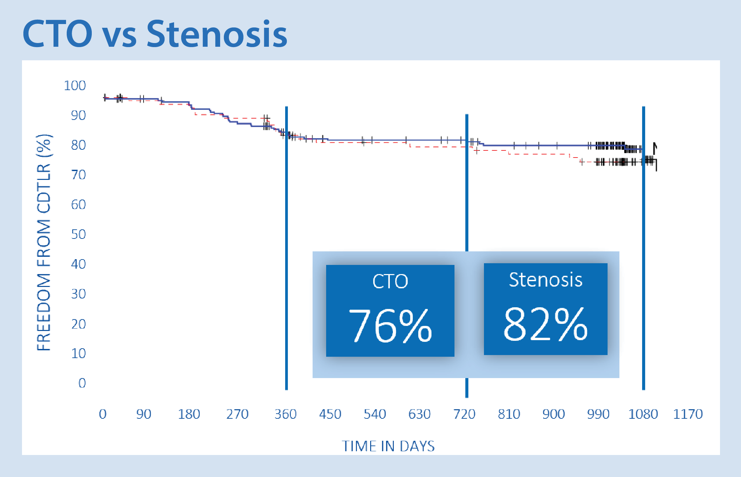

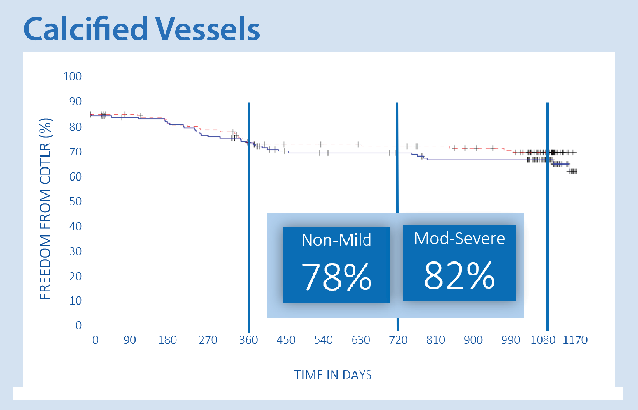
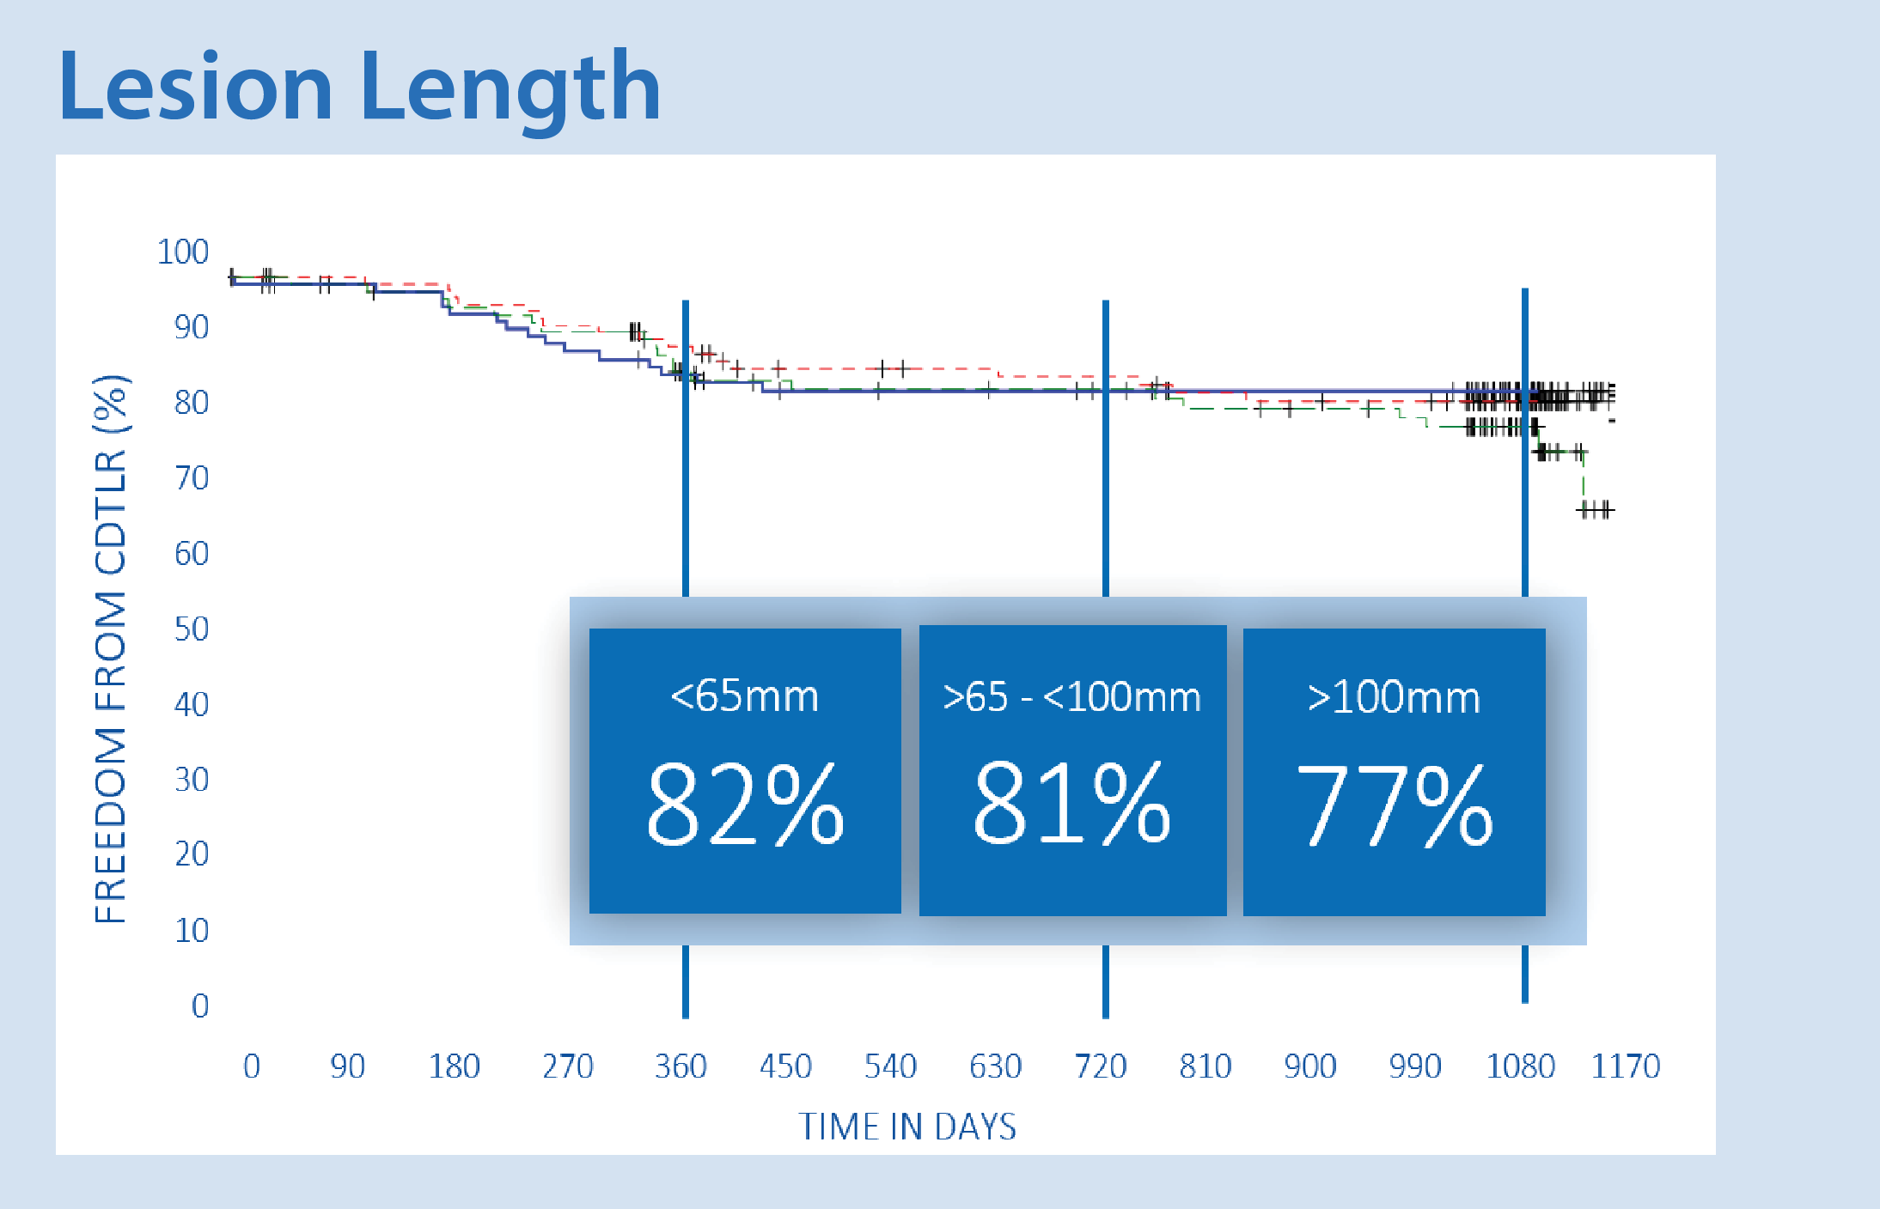
MIMICS-2
*CEC adjudicated, clinically-driven TLR
Subjects are censored at their last DUS follow-up, or at time of study exit (withdrawal or lost to follow-up) or death. Subjects who are patent at DUS follow-up are censored at the end of the follow-up window
Data on file at Veryan Medical

Slide 19
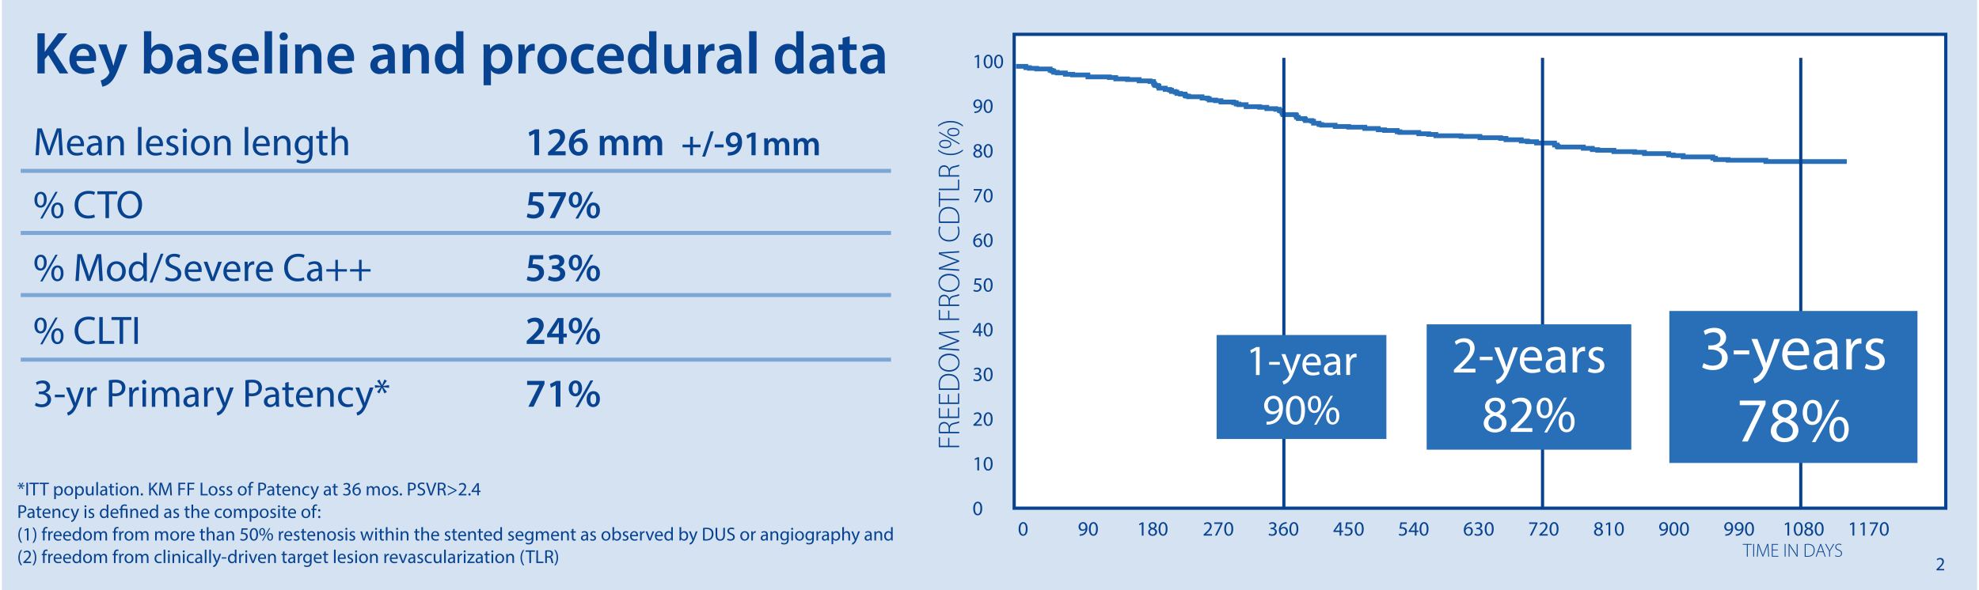
MIMICS^{3D}
MIMICS-3D data contribute real-world experience to the evolving database supporting the therapeutic value of swirling flow in the BioMimics 3D® stent.
0.4%
Fracture rate at three years (investigation confirmed)
Data on file at Veryan Medical

Slide 20

MIMICS Clinical Program
Enrolling progressively longer and more complex lesions
Mean ± SD (mm) | MIMICS-RCT | MIMICS-2 | MIMICS^{3D}
Lesion Length | 66 ± 29 | 81 ± 38 | 126 ± 91
Stented Segment Length | 99 ± 30 | 112 ± 36 | 131 ± 80
CTO | 44% | 30% | 57%
Mod/Severe Ca++ | 52% | 46% | 53%
CLTI | 6% | 6% | 24%
Core lab reported data for MIMICS and MIMICS-2, site-reported for MIMICS-3D
Data on file at Veryan Medical

Slide 21
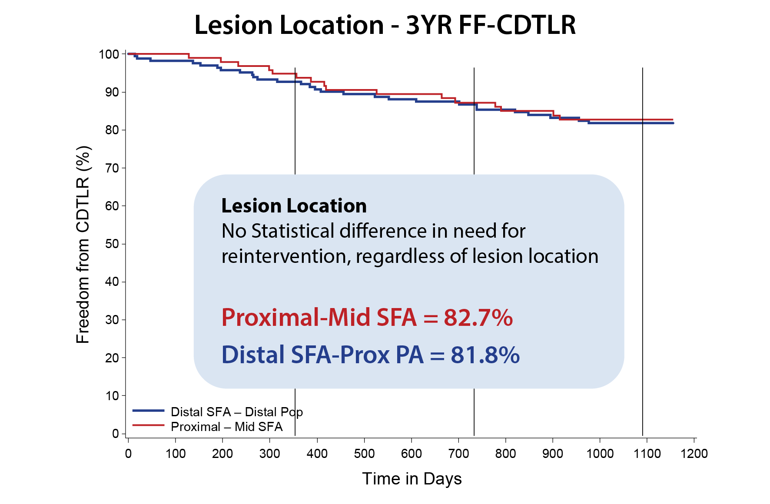
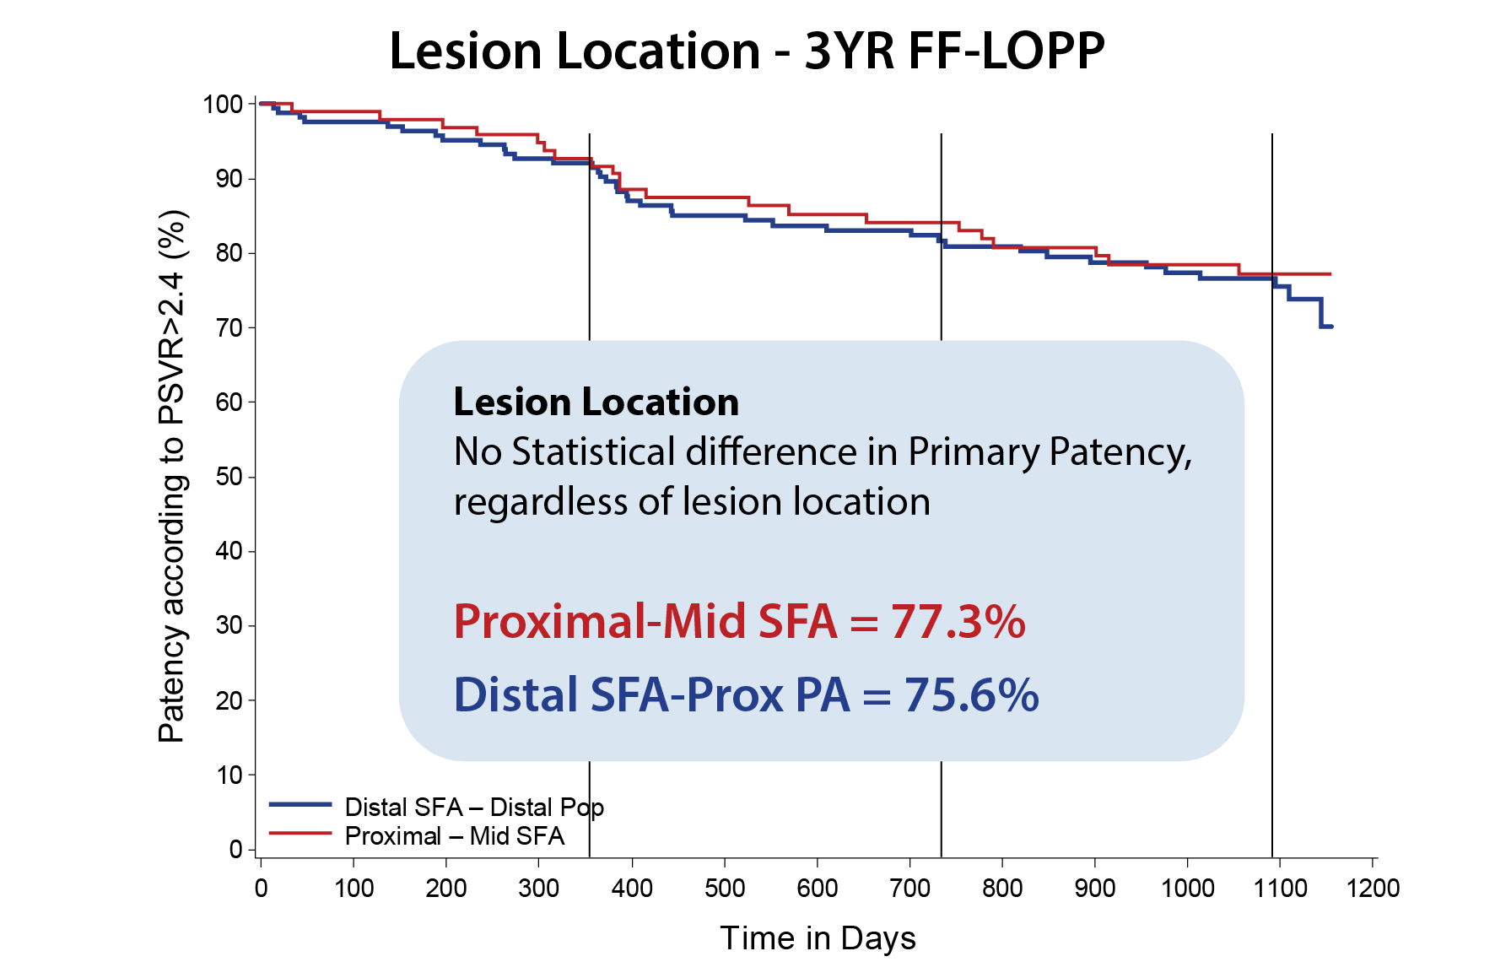
MIMICS^{3D}
<1%
Stent Fracture Rate
Three-year outcomes by lesion location
Distal Cohort:
Lesion Demographics
49.4%
Of lesions were
CTOs
55.4%
Of lesions had moderate to severe calcification
7.98 cm
Avg. lesion length
In distal cohort
No statistical difference,
regardless of lesion location
Data on file at Veryan Medical

Slide 22
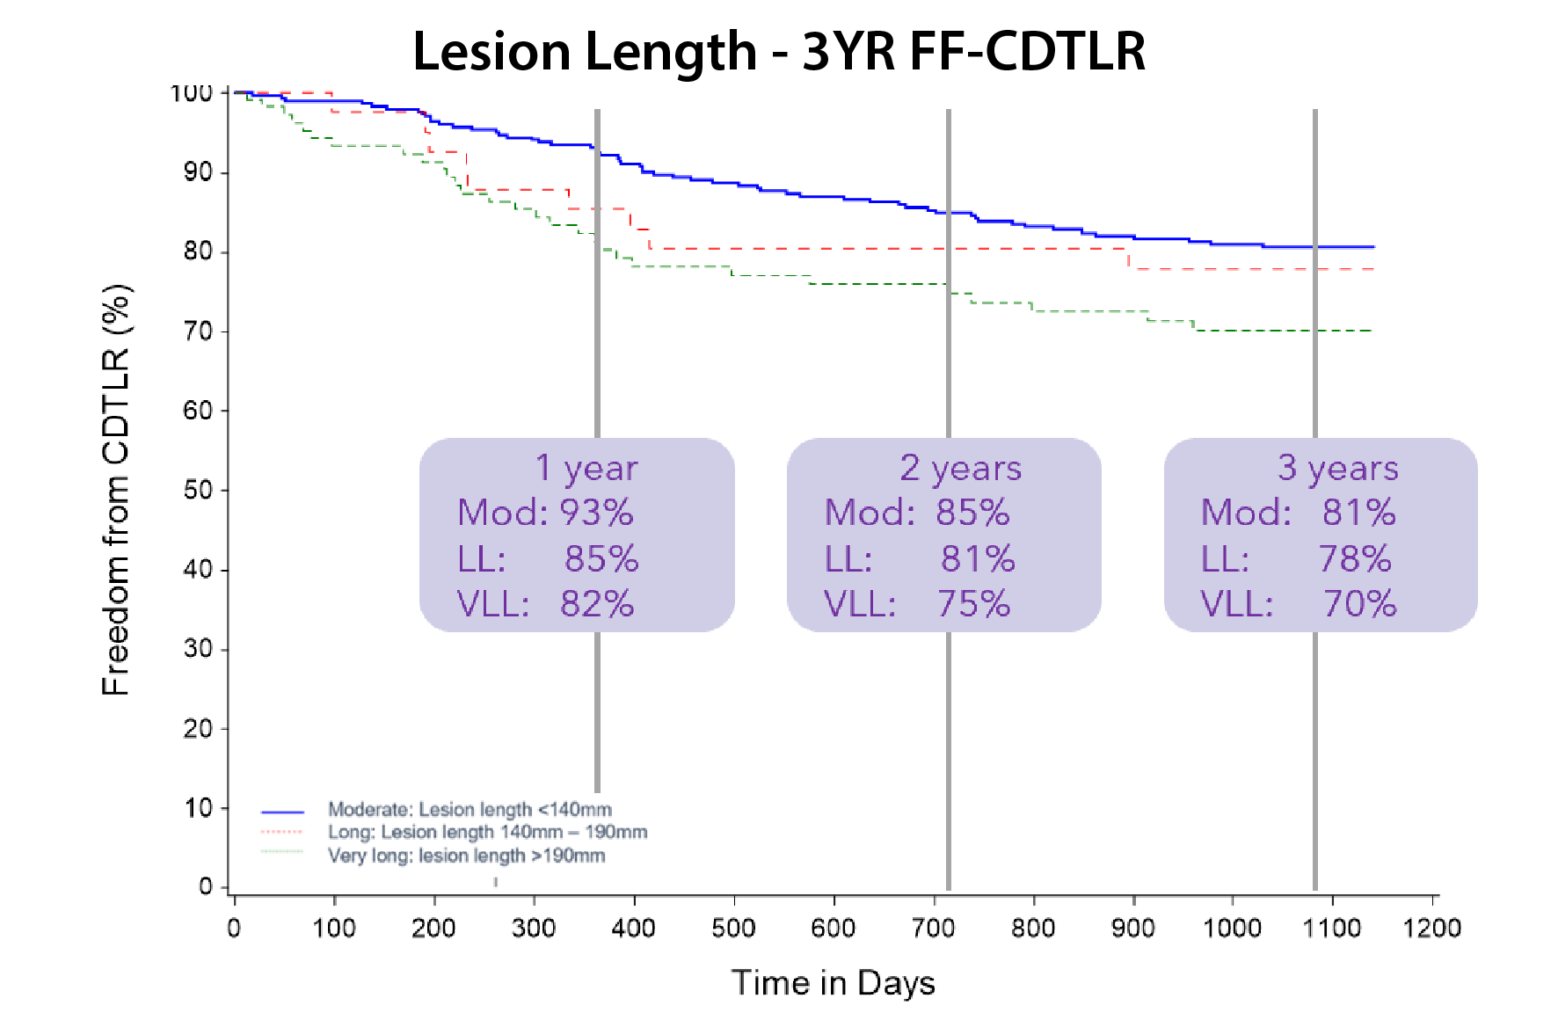
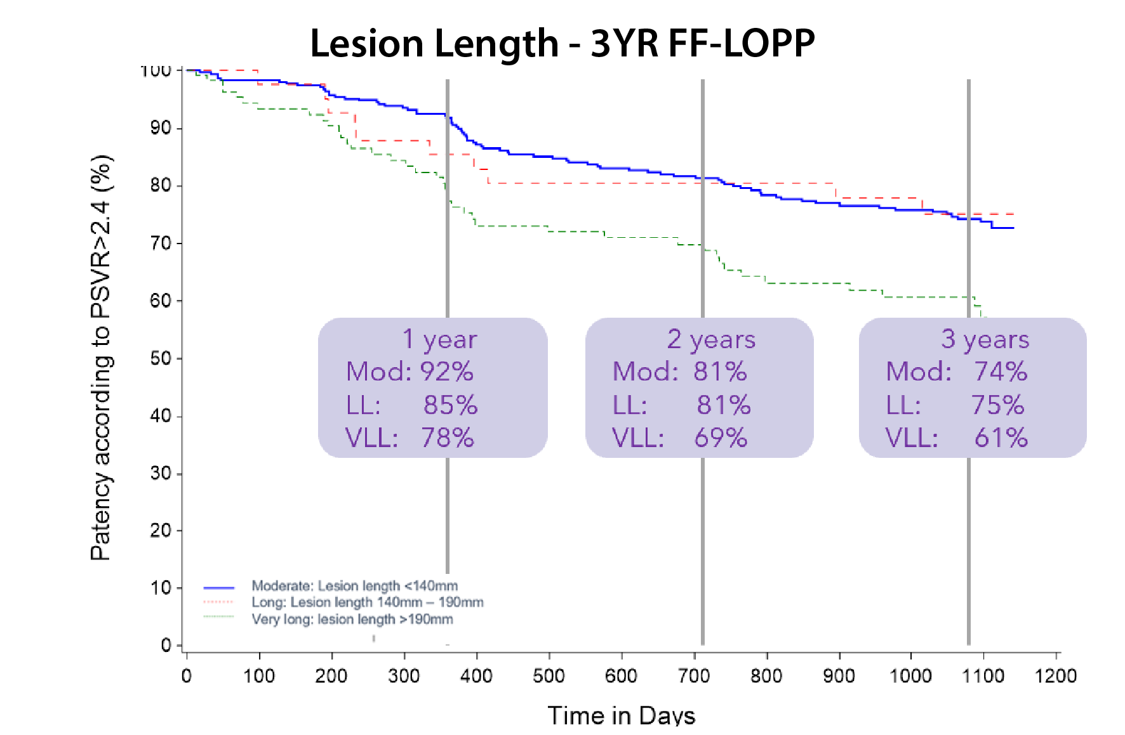
<1%
All three groups
Stent Fracture Rate
MIMICS^{3D}
Three-year outcomes by lesion length
Lesion Demographics
Occlusions
Moderate Lesions 45%
Long Lesions 58%
Very Long Lesions 92%
Lesion Length (mm)
Moderate Lesions 72
Long Lesions 160
Very Long Lesions 269
Severe Calcification
Moderate Lesions 26%
Long Lesions 25%
Very Long Lesions 38%
No statistical difference between Mod and LL groups
Data on file at Veryan Medical

Slide 23
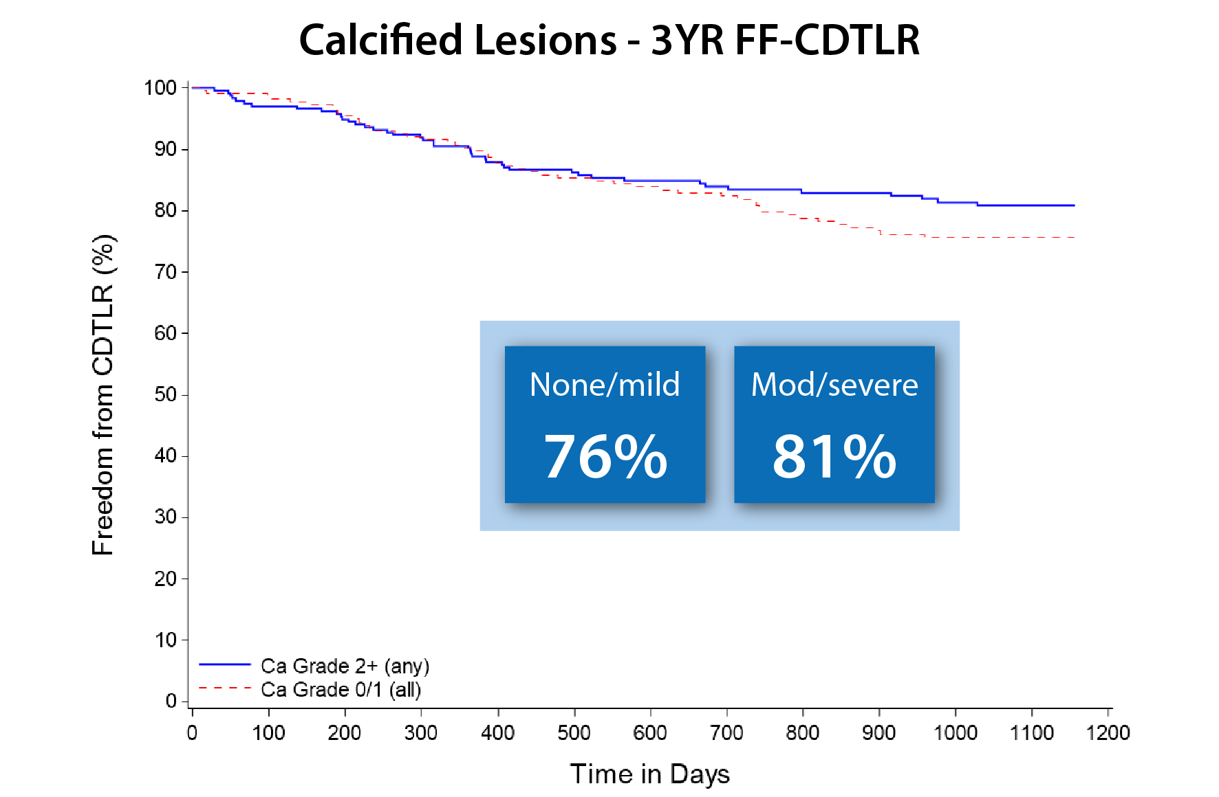
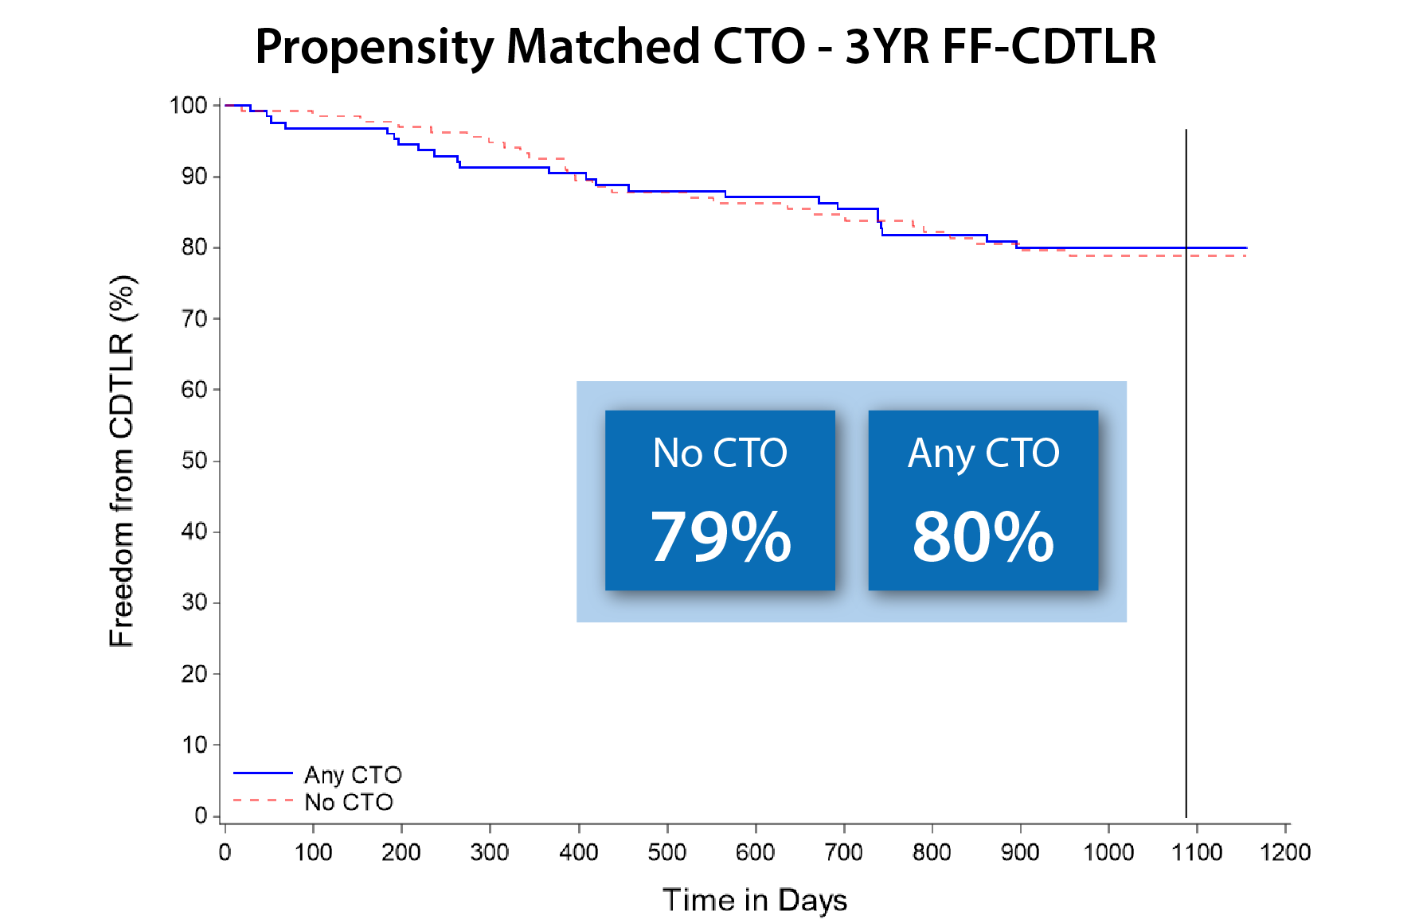
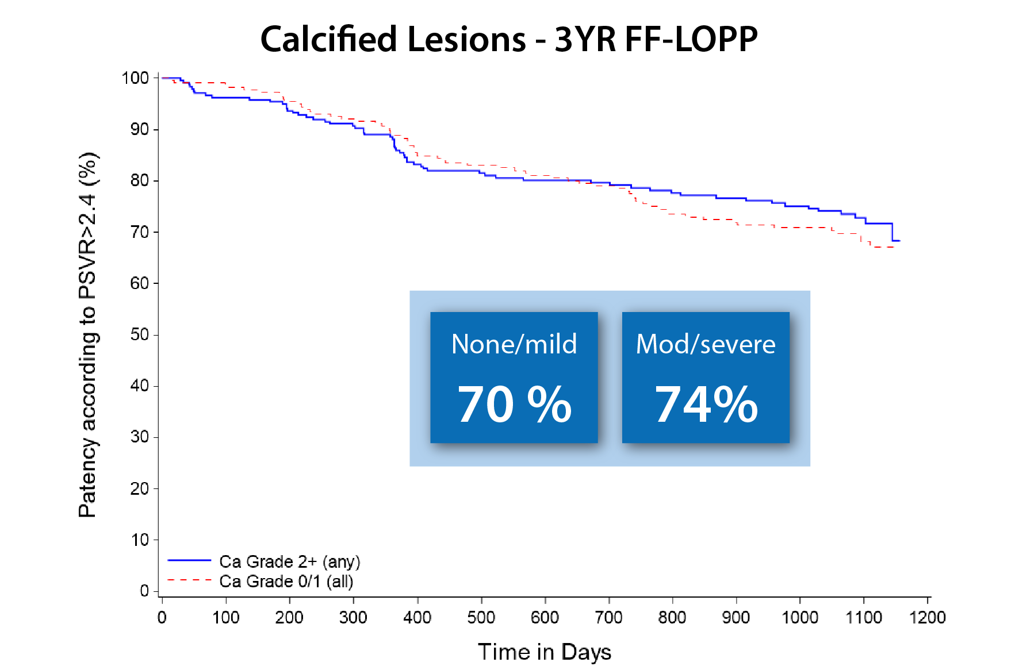
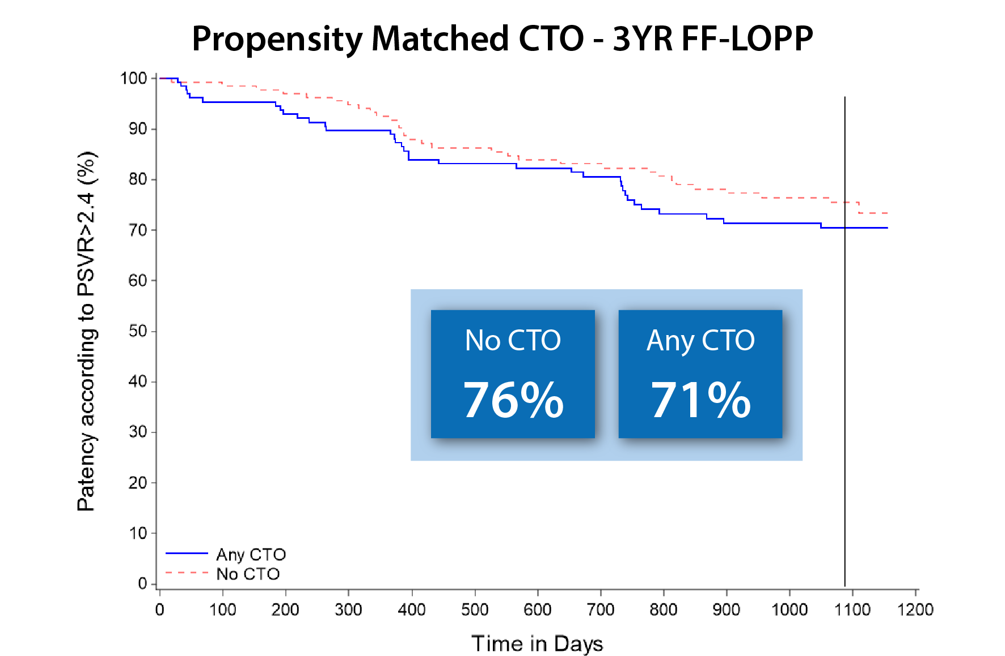
MIMICS^{3D}
Three-year outcomes by lesion morphology
Data on file at Veryan Medical

Slide 24
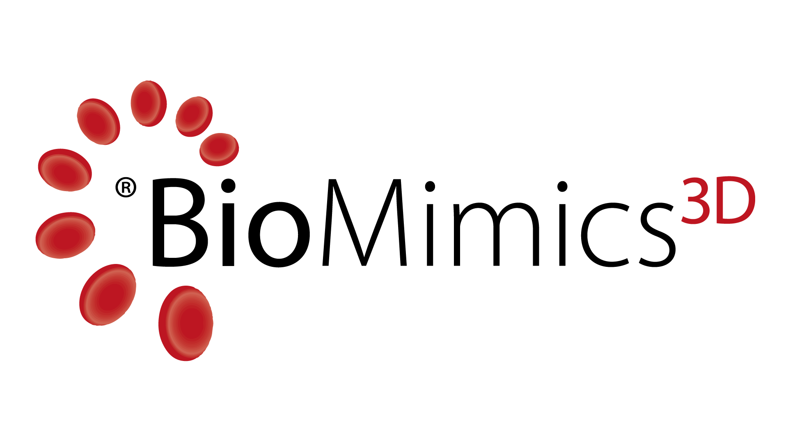
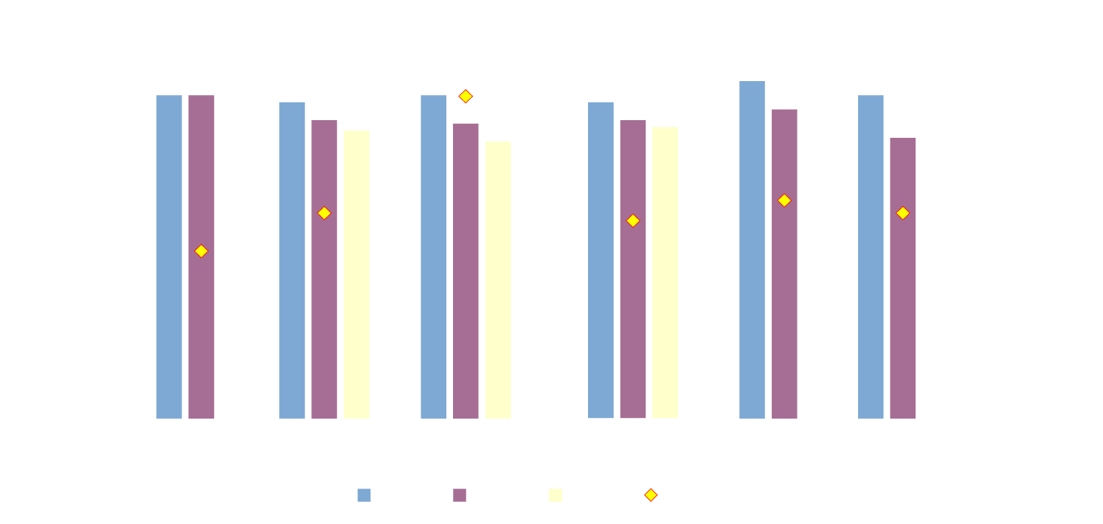
BioMimics 3D Industry Comparison
BioMimics 3D has performed consistently across the MIMICS program with longer more complex lesions
Data on file at Veryan Medical

Slide 25

Summary
In 3 clinical studies, of increasing complexity, BioMimics 3D continues to show durable results on par with what is seen with DES or Supera
Regardless of lesion location, length, or morphology, BioMimics 3D demonstrates consistent, durable results through 3 Year F/U
BioMimics 3D offers a simple, durable and cost-effective platform to address patients with complex femoropopliteal disease
Unmet Patient Needs
Value
Innovative

Slide 26

A/V THROMBECTOMY PIPELINE
XXX
XXXX
Commercial support in pts where you’ve already recognized clinical value
Feedback on R&D Projects and Clinical Campaigns

