Slide 1
MANAGEMENT OF CHALLENGING LESIONS: IS THERE A ROLE FOR NEXT GENERATION MIMETIC STENT TECHNOLOGY?
John Rundback MD
(on behalf of Thomas Zeller, Masoto Nakamura, Michael Lichtenberg and all investigators of MIMICS-RCT, MIMICS-2 and MIMICS-3D)

Slide 2
Disclosure
Speaker name:
John Rundbeck MD
I have the following potential conflicts of interest to report:
Consulting
Employment in industry
Stockholder of a healthcare company
Owner of a healthcare company
Other(s)
X I do not have any potential conflict of interest

Slide 3
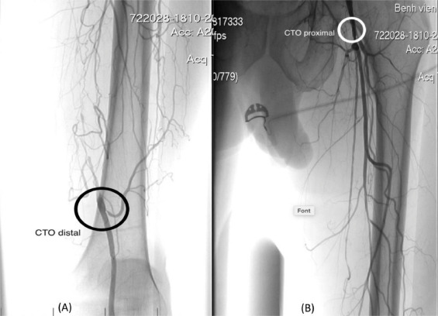
CHALLENGES IN TREATMENT OF
COMPLEX LESIONS & PATIENTS
In practice, treatment of complex lesions is all too common
Further, 3.8M patients with CLTI in US alone⁶⁻⁹
Numerous interventional/surgical options
  No consensus/little data to support a particular approach
Unfortunately, there is a paucity of clinical evidence in patients with complex lesions. ¹⁻⁵
1. Giannopoulos S, et al. Cardiovasc Revasc Med. 2021;22:52-65. 2. Creeden T, Ann Vasc Surg. 2024. 3. Wittig T, et al. JACC Cardiovasc Interv. 2024;17(9):1134-44. 4. Bosiers M, et al.. J Endovasc Ther. 2020;27(2):287-95. 5. Gostev AA, et al, J Endovasc Ther. 2023:15266028231170125. 6.Vosgin-Dinclaux V, et al, Cardiovasc Revasc Med. 2024. 7. Conte MS, et al, Eur J Vasc Endovasc Surg. 2019;58(1s):S1-S109.e33. 8. Nehler MR, et al, J Vasc Surg. 2014;60(3):686-95.e2. 9. Aday AW, et al, Circ Res. 2021;128(12):1818-32.
Notes:
Nguyen Viet Lam, Phan Anh Khoa, Nguyen Ngoc Son, Tran Duc Anh, Ho Anh Binh,
Endovascular treatment for chronic total occlusion of superficial femoral artery: Is retrograde approach from popliteal artery effective and safe?,
Radiology Case Reports,
Volume 15, Issue 11,
2020,
Pages 2116-2119,
ISSN 1930-0433,
https://doi.org/10.1016/j.radcr.2020.08.029.

Slide 4
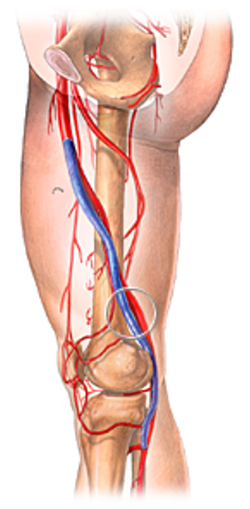
Surgical Femoropopliteal Bypass
Trans-Atlantic Inter-Society Consensus II recommendations suggest bypass for the treatment of complex fem-pop lesions
Potential for improved mid-term patency compared to endovascular approach
  72% vs 62% at 1 year¹
Significantly higher 30-day morbidity (37%) noted in surgical bypass²
  8.2% infection rate noted in meta-analysis of surgical fem pop outcomes
Patient preference for endovascular
1. George A. Antoniou et al, JVS,Volume 57, Issue 1,2013
2. Shah, T, et al. J CRIT LIMB ISCHEM 2022;2(4):E122-E130

Slide 5
Endovascular First Approach
Leave nothing behind (PTA/DCB):
  Numerous endovascular strategies available to avoid stents due to concerns over long
    Need for adjunctive stenting remains high, up to 68% of cases in recent meta-analysis¹
Stenting/Stent-supported angioplasty:
  BMS 1◦ patency rates as low as 64% @1y, 41% @3y in complex lesions¹
  DES offer some promise, but very limited data in complex lesions to date
    73% primary patency @1y
New therapies
  Percutaneous transmural arterial bypass (PTAB) and LimFlow may offer promise, but still early in adoption
1. S. Giannopoulos et al.Cardiovascular Revascularization Medicine 22 (2021) 52–65

Slide 6
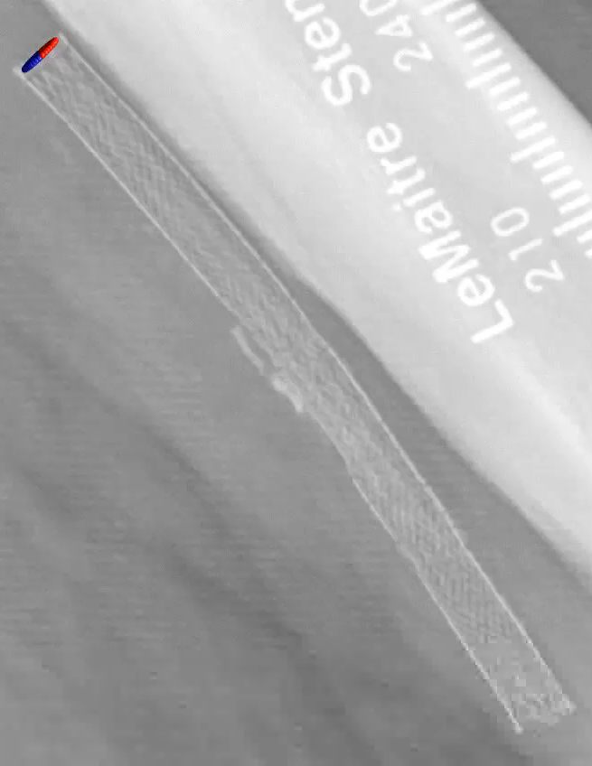
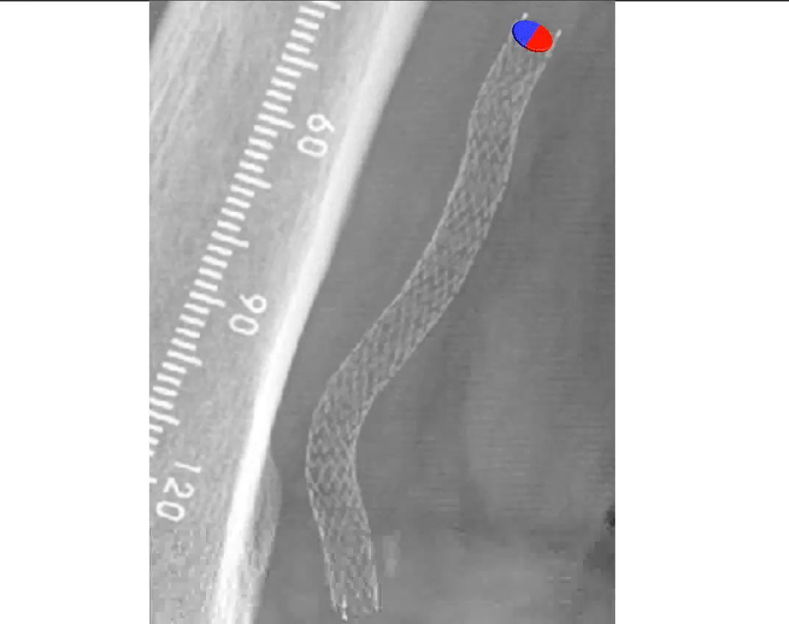
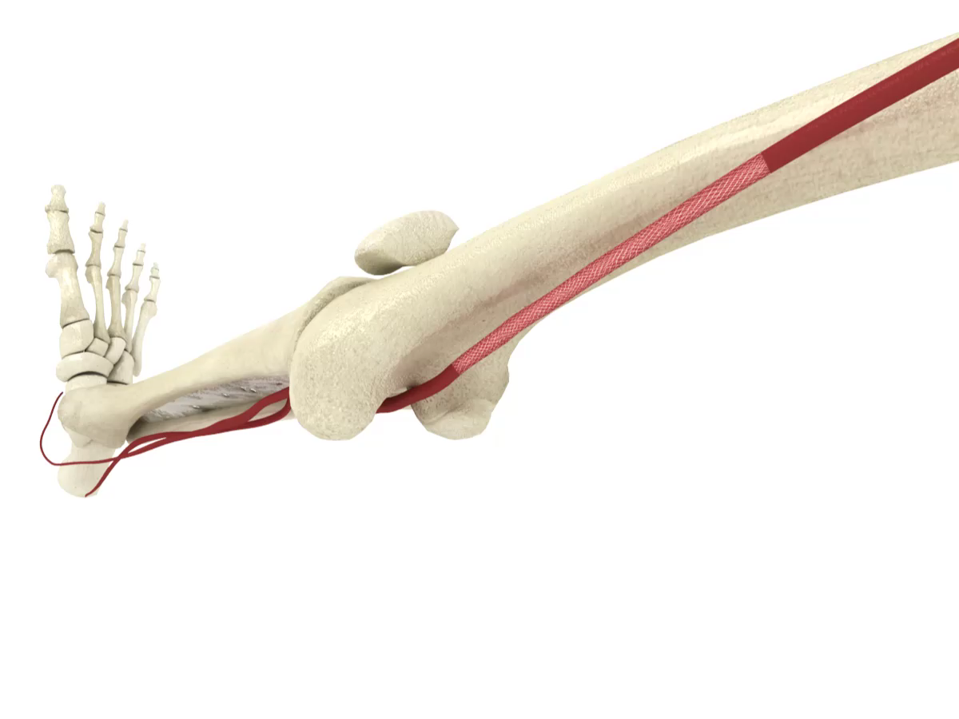
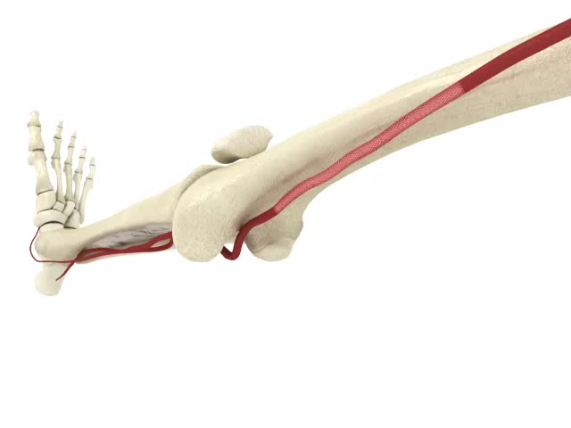
BioMimics 3D: Designed Specifically for the Femoropopliteal Segment
Straight stent BioMimics 3D
Straight laminar flow
Swirling laminar flow
BioMimetic Design¹
Elevated Wall Shear Stress²
  Mimics natural movement of the femoropopliteal segment
  Aids in reducing localized trauma
  Helps reduce risk of stent fracture in dynamic artery
  Reduces restenosis by reducing thrombus formation and inflammation
  Reduces Smooth Muscle Cell proliferation
  Reduces neointimal hyperplasia
PAM 353 Version 1.0
The BioMimics 3D Vascular Stent System has FDA, PMDA and CE Mark approval.
CAUTION: Federal law restricts this device to sale by or on the order of a physician
Data on file at Veryan Medical
Murphy EA, Cardiovascular Engineering and Technology 2012

Slide 7
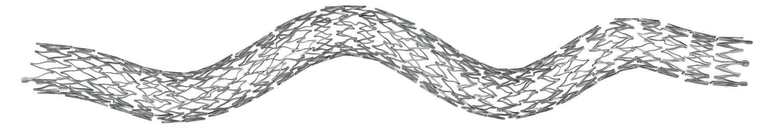
STUDY INTENT: BioMimics 3D® In Complex Lesions
Review outcomes from a large pooled meta-analysis of a next generation mimetic stent in complex lesions/patients:
  CLTI
  Lesion Length
  Calcification
  CTO

Slide 8
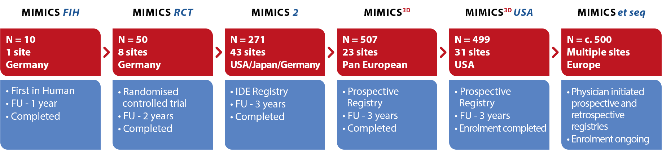

MIMICS Clinical Program
Subgroup Analysis of Clinical Results at 2 years
1750+ patients
Data on file at Veryan Medical

Slide 9
Pooled Meta-Analysis of 3 MIMICS Studies
828 patients treated with the BioMimics 3D stent were enrolled across the three trials and the data were pooled in the meta-analysis as follows:
50 from the MIMICS-RCT study
271 from the MIMICS-2 IDE study
507 from the MIMICS 3 registry
Pooled sub-group totals
CLTI | IC | CTO | No CTO | PACSS 3,4 | PACSS 0-2 | TASC C/D | TASC A/B
138 patients | 685 patients | 390 patients | 438 patients | 204 patients | 622 patients | 172 patients | 656 patients
1, Data on file at Veryan Medical
2. Rammos C et al. Eur J Vasc Endovasc Surg. March 2024

Slide 10
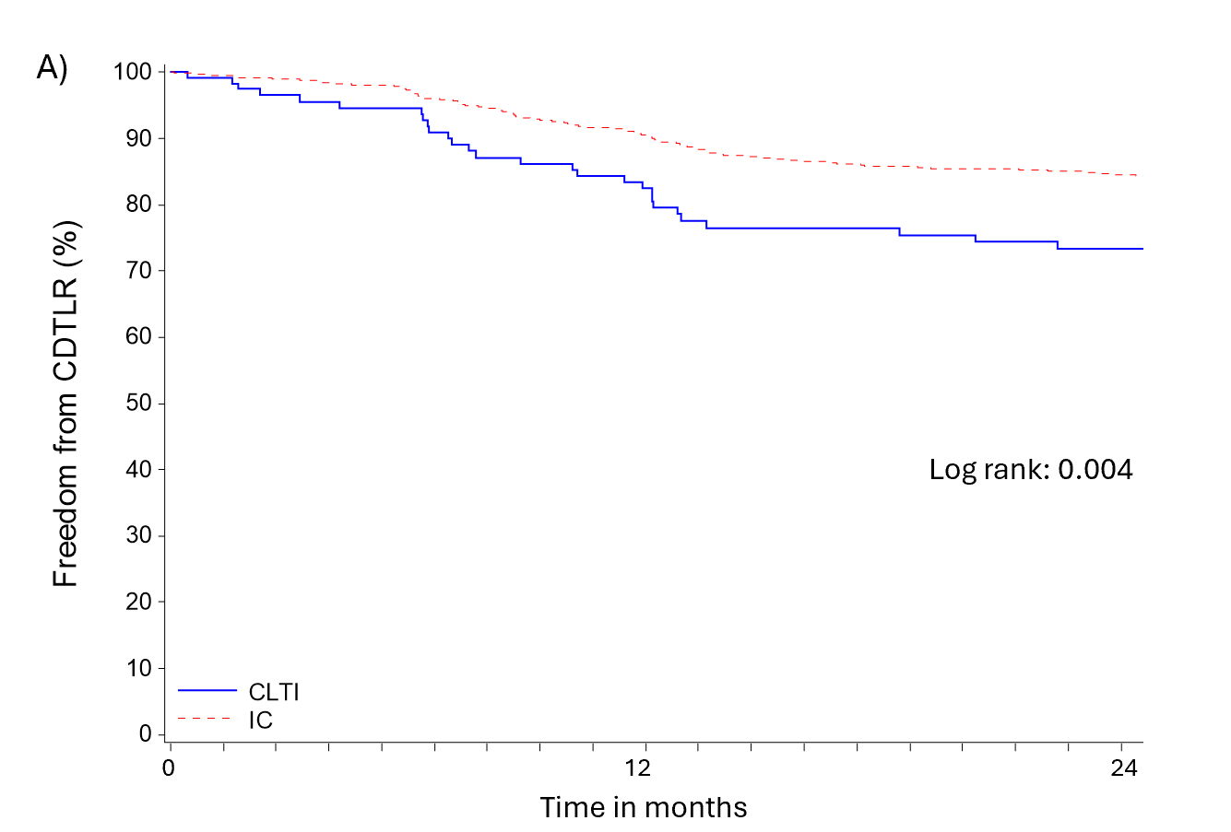
2 YR Freedom From CDTLR (fCDTLR) CLTI vs IC
PT/LESION CHARACTERISTICS
 | CLTI N=138 | IC N=685 | p-value
Age (yrs) | 71.5±10.6 | 69.0±9.7 | 0.007
Male | 84 (60.9) | 458 (66.9) | 0.201
CLTI | 138 (100) | 0 (0.0) | NA
Lesion length (mm) | 120.8±84.3 | 108.3±75.3 | 0.150
Occlusion | 86 (60.6) | 306 (44.2) | 0.0004
IC 84%
CLTI 73%
While the lower fCDTLR in pts with CLTI is expected,
the outcomes are still competitive through 2 years
1. Data on file at Veryan Medical
2. Rammos C et al. Eur J Vasc Endovasc Surg. March 2024

Slide 11
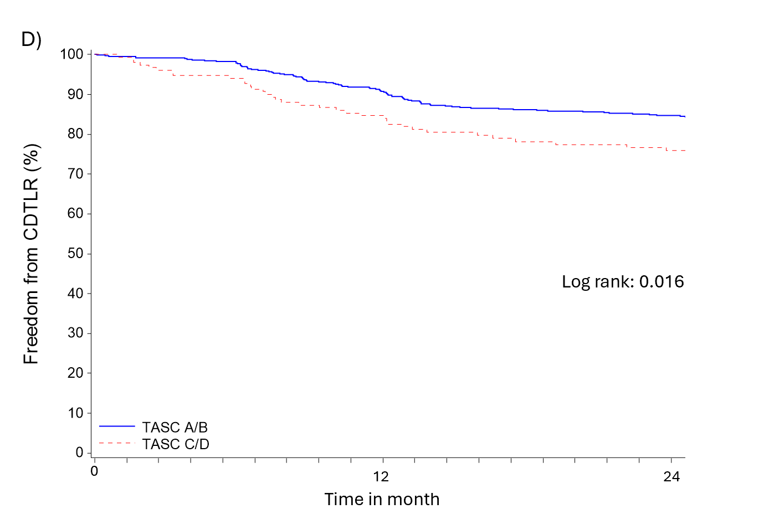
2 YR fCDTLR TASC C/D vs TASC A/B
PT/LESION CHARACTERISTICS
 | TASC C/D N=172 | TASC A/B N=656 | p-value
Age (yrs) | 69.8±10.2 | 69.3±9.8 | 0.581
Male | 113 (65.7) | 432 (65.9) | 1.000
CLTI | 43 (25.1) | 95 (14.5) | 0.002
Lesion length (mm) | 210±100 | 83.3±37.0 | <.0001
Occlusion | 136 (76.0) | 259 (39.2) | <.0001
TASC A/B 85%
TASC C/D 76%
Despite much more challenging lesion characteristics (LENGTH),
BioMimics 3D demonstrates very durable results through 2 years
1. Data on file at Veryan Medical
2. Rammos C et al. Eur J Vasc Endovasc Surg. March 2024

Slide 12
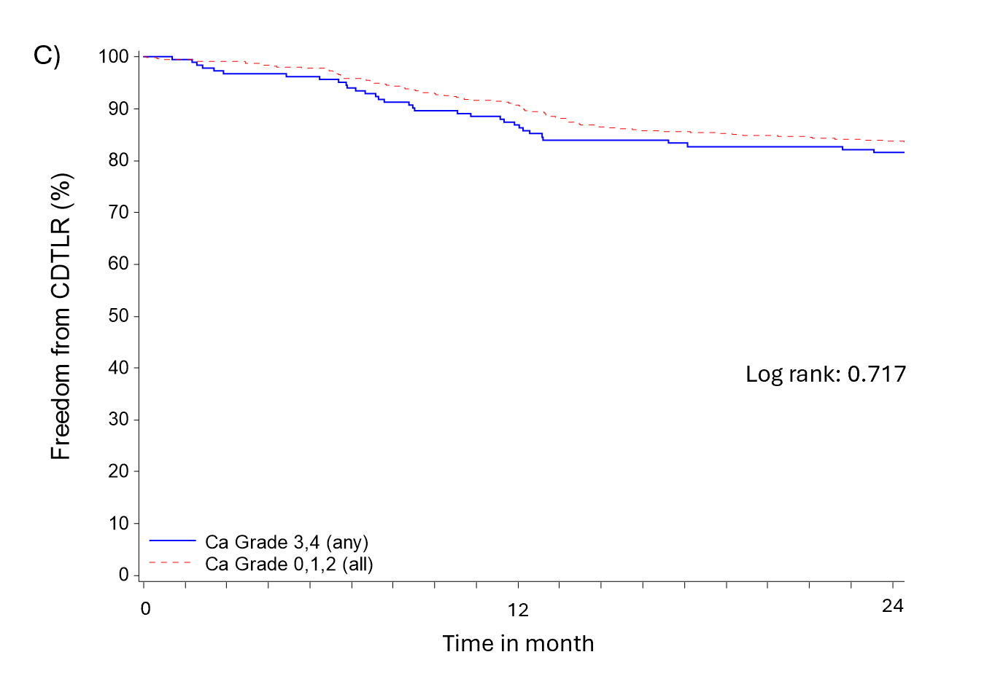
2 YR fCDTLR PACSS 3 & 4 vs PACSS 0 - 2
PT/LESION CHARACTERISTICS
 | PACSS 3,4 N=204 | PACSS 0-2 N=622 | p-value
Age (yrs) | 71.4±9.9 | 68.7±9.8 | 0.0007
Male | 155 (76.0) | 389 (62.5) | 0.0005
CLTI | 43 (21.4) | 94 (15.1) | 0.049
Lesion length (mm) | 129.1±84.7 | 104.2±73.0 | <.0001
Occlusion | 104 (49.8) | 290 (46.2) | 0.380
PACSS 0/2 84%
PACCS 3/4 82%
No statistically significant difference in CD-TLR between PACSS 3, 4 and PACSS 0 - 2
1. Data on file at Veryan Medical
2. Rammos C et al. Eur J Vasc Endovasc Surg. March 2024

Slide 13
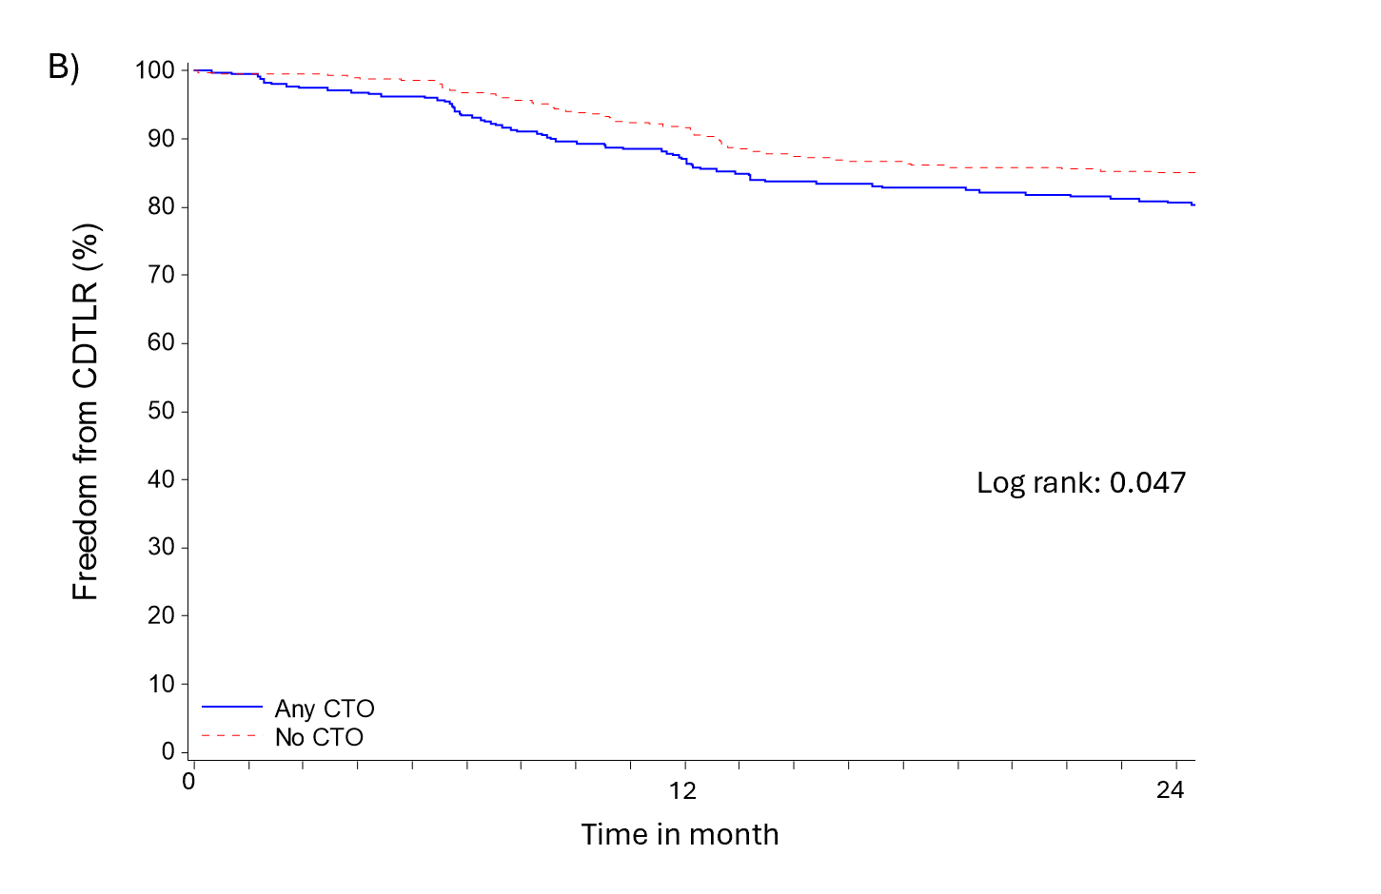
2 YR fCDTLR CTO vs NO CTO
PT/LESION CHARACTERISTICS
 | CTO N=390 | No CTO N=438 | p-value
Age (yrs) | 68.2±10.1 | 70.5±9.5 | 0.0008
Male | 255 (65.4) | 290 (66.2) | 0.826
CLTI | 83 (21.3) | 55 (12.6) | 0.001
Lesion length (mm) | 140.7±91.6 | 83.2±45.7 | <.0001
Occlusion | 395 (99.5)* | 0 (0.0) | <.0001
NO CTO 85%
CTO 81%
While the lower fCDTLR in patients with CTO is expected,
the outcomes are still durable through 2 years
1. Data on file at Veryan Medical
2. Rammos C et al. Eur J Vasc Endovasc Surg. March 2024

Slide 14
Stent Fracture Resistance
Only 4 stent fractures in 828 patients reported
  3 confirmed by clinical events committee.¹
While calcification is a predictor for stent fractures,² there were zero reported stent fractures for stents placed in PACSS 3,4 lesions.
Despite TASC C/D lesions being associated with a high risk of stent fractures,³ the 24-month stent fracture rate in TASC C/D lesions was only 1.2%.
1. Data on file at Veryan Medical
2. Ichihashi S, et al. J Endovasc Ther. 2019;26(5):613-20.
3. Davaine JM, et al. Eur J Vasc Endovasc Surg. 2013;46(2):201-12.

Slide 15
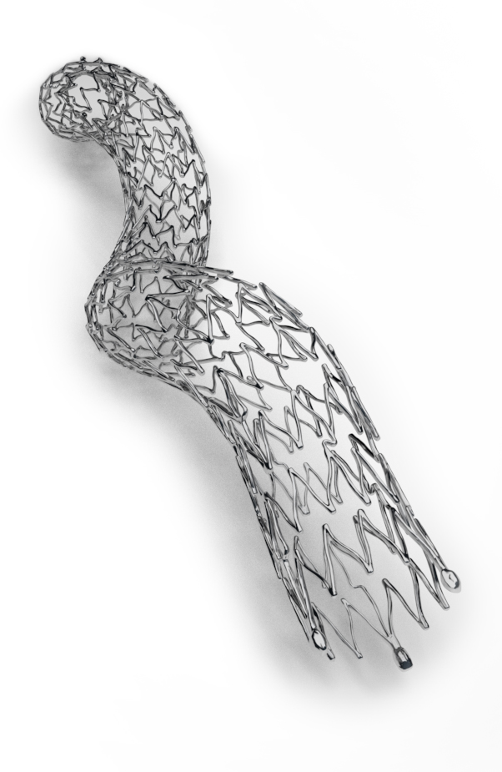
Conclusions
The pooled analysis demonstrated durable results @2y across all subgroups, despite those subgroups typically being associated with poorer clinical outcomes.
In multiple sub-group analyses, BioMimics 3D continues to demonstrate compelling outcomes regardless of:
  Lesion severity, morphology, & length
Data on file at Veryan Medical

